Slide 1


DIFFERENTIATED MODELS OF CARE (DMOC)
ADHERENCE CLUB ESTABLISHMENT MODULE
SOP 5.2 Adherence Club
NATIONAL DEPARTMENT OF HEALTH
CARE AND TREATMENT DIRECTORATE

Slide 2
Training Outline: Adherence Club Establishment
Module 1:
Adherence Clubs Definition & Guiding Principles
Module 2:
Adherence Club Procedures and Facilitation
Module 1: Adherence Clubs Definition & Guiding Principles
Introduction
Background and Context
    Progress Towards 95-95-95
    Impact of non-adherence
    Reasons for non-adherence and addressing them
Adherence Club Definition and Description
Guiding Principles, Dos & Don’ts of Adherence Clubs
Benefits of Adherence Clubs
Eligibility to be Enrolled in the Club
Assessment and Enrolment
Information for potential adherence club patients
Types of Adherence Clubs
Module 2: Adherence Club Procedures and Facilitation
Roles and Responsibilities for Adherence Clubs
RPCs Algorithm – Focus on Adherence Clubs
Adherence Club Procedures & Annual Visit Schedule
Detailed Guidance: Before, During, After
Tracing and recall of AC patients
Re-engagement and/or Deactivation from Clubs
Module 3:
Monitoring and Evaluation
Module 3: Monitoring and Evaluation
  Documentation in the Adherence Club Register
  Documentation in ART Clinical Stationery
  Capturing for Adherence Clubs in TIER.Net
  Capturing for Adherence Clubs in SyNCH
  Adherence Club Monthly Reporting

Slide 3

Introductions
Registrations
Welcome & Introductions
Ground Rules
Course expectations
Discuss training logistics and agenda
Pre-test Assessment
Purpose of the training

Slide 4

Background and Context to Adherence Clubs Establishment

Slide 5
Background
Adherence to treatment for HIV, TB and NCDs is a key priority in healthcare
  to manage chronic conditions
  to prevent further disability
  improve health outcomes and quality of life for patients
Longer and healthier life for all
SA has over 12 million people being treated for chronic diseases and/or living with HIV:
  Diabetes, hypertension and cerebrovascular disease now all surpass HIV and TB as causes of death
SA: largest number of PLHIV in the world,
largest ART programme in the world.
Only 76% of PLHIV are on ART.
Lifestyle factors, lack of awareness, undiagnosed and uncontrolled conditions
Eligible for Adherence Clubs and other RPCs

Slide 6
Context – Progress Towards 95-95-95
Oct 2025
95-80-97
  South Africa is at 96-80-97* for all PLHIV
RPCs eligibility
  3.6 million patients are eligible for Repeat Prescription Collection Strategies (RPCs).
    59% of those on ART
    45% of all PLHIV
3,633,434
95-80-97
  South Africa is at 86-77-91* for children.
RPCs eligibility
  46,508 children are eligible for RPCs.
    50% of those on ART
    33% of all CLHIV
46,508
    * 95-95-95 October 2025. Dec 2025 CTG Extension Engagement

Slide 7


The Challenge of Non-Adherence
Non-adherence to treatment can
- accelerate disease progression
- cause treatment failures
- increase resource utilization.
FACILITY
Patient-related barriers to adherence
Health system-related barriers to adherence
Low health literacy
Emotional factors: depression, anxiety, shame
Cognitive factors: forgetfulness, confusion, dementia
Treatment fatigue, side effects
Behavioural factors, e.g., missing appointments
Socio-economic factors e.g., transport, work
Lack of support, including social support
HIV-related stigma
Inadequate provision of health education
Lack of appropriate healthcare provider skills
Organisation barriers (waiting time, distance, lack of integration, inflexible clinic hours, etc.)
Education sessions,
Adherence Planning,
Counselling
Peer support,
Support Groups
Patient tracing
Integrated Model for co-infected patients
Repeat Prescription Collection strategies,
Multi-Month Dispensing
“Minimum package of interventions” to support linkage, adherence and retention includes:
Adapted from Adherence Guidelines for HIV, TB and NCDs, February 2016

Slide 8
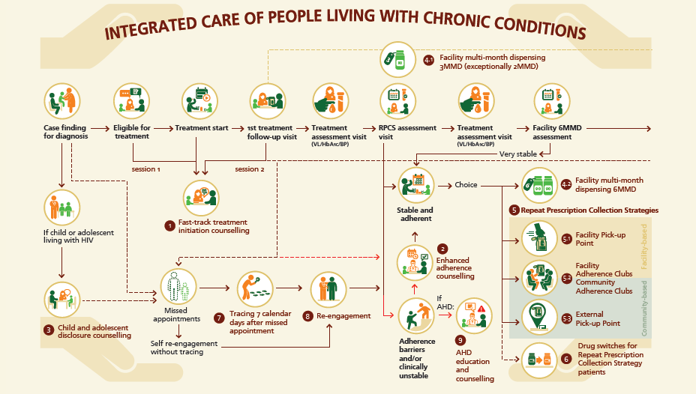
A Differentiated Approach to Keeping Patients in Care
DMOC SOP September 2025 p19

Slide 9
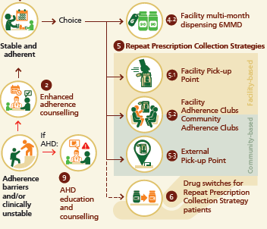




A Differentiated Approach to Keeping Patients in Care
Differentiated Models of Care (DMOC):
A differentiated approach to care that aims to strengthen linkage, adherence and retention, using a patient-centred approach throughout the treatment cascade.
Choices for Clinically Stable Patients:
Clinically stable patients require less intensive service delivery with a lower frequency of clinical contact and longer treatment supply.
Facility multi-month dispensing 6MMD: (SOP 4.2)
A longer treatment supply covers the full period between clinical contacts; 6 months dispensed when prescribed. Only for very stable patients.
Stable and Adherent
Repeat Prescription Collection Strategies (RPCs) (SOP 5)
Treatment collection outside of clinical contacts at one-stop pick-up points or support groups at or outside a health facility.
REPEAT PRESCRIPTION
COLLECTION STRATEGIES
(RPCs)
SOP 5
Adherence Club (SOP 5.2)
A Repeat Prescription Collection option for stable patients who value continued psychosocial support and group engagement.
Facility
Pick-up Point
External Pick-up Point
Adherence Club
DMOC SOP September 2025

Slide 10




DIFFERENTIATED MODELS OF CARE (DMOC)
Clinically unstable | Not yet stable | Stable | Very stable ***
Symptomatic, acute/sick < 6 months old Pregnant AHD | New on ART OI on treatment 6 months to 5 years old Newly re-engaged Postnatal <12 months Elevated VL | 1 x VL<50 copies/ml 1 x HbA1c ≤8% 2 x BP <140/90 mmHg | 12 months on ART 2 x VLs <50 copies/ml 2 x HbA1c ≤8% 2 x BP <140/90 mmHg
More intensive service delivery | Standard service delivery | Less-intensive service delivery
Monthly** clinical reviews and script | 3-monthly* clinical reviews + + 3 month script (3MMS*) | 6-monthly clinical review + 6-month script (6MMS)
Facility monthly** dispensing | Facility 3MMD* | RPCs: External Pick-up Point: (EX-PUP) Facility Pick-up Point (FAC-PUP), Adherence Club (AC) 3MMD (or 2+4MMD) | Facility 6MMD***
DMOC SOP September 2025 p10
* 2-monthly if on TB Rx, new on ART at month 1 visit, at delivery (see 2025 VTP guidelines tables) or necessary to align with required follow-up clinical management in 2 months time.
** Monthly can be adjusted: for pregnant women to integrate into BANC Plus visits; for AHD clients 2-weekly or monthly applies in the first 3 months; thereafter, adjust as clinically indicated for AHD and symptomatic/sick clients (can extend to 2- or 3-monthly; do not increase frequency unless clinically required).
*** Limited to ART TLD regimen only until national medicine stock availability is confirmed for other ART regimens and hypertension and diabetic treatment.
10

Slide 11
Adherence Clubs: History
National Adherence Guideline (AGL) for HIV, TB & NCDs was introduced in July 2016 to address linkage to care, adherence to treatment and retention in care challenges.
2007
Pilot project
Commenced in Western Cape
2011
Western Cape roll-out
Adopted in policy and established in Western Cape
2016
National roll-out
included in differentiated models of ART delivery by NDoH
2020
Discontinuation during COVID-19 pandemic
Most were discontinued with some used as pick-up points
2024
Resolution to revive adherence clubs.
2025
A need for guidance
for the re-establishment of adherence clubs in general and the establishment for sub populations

Slide 12
MODULE 1: ADHERENCE CLUBS (AC)
& THEIR GUIDING PRINCIPLES

Slide 13
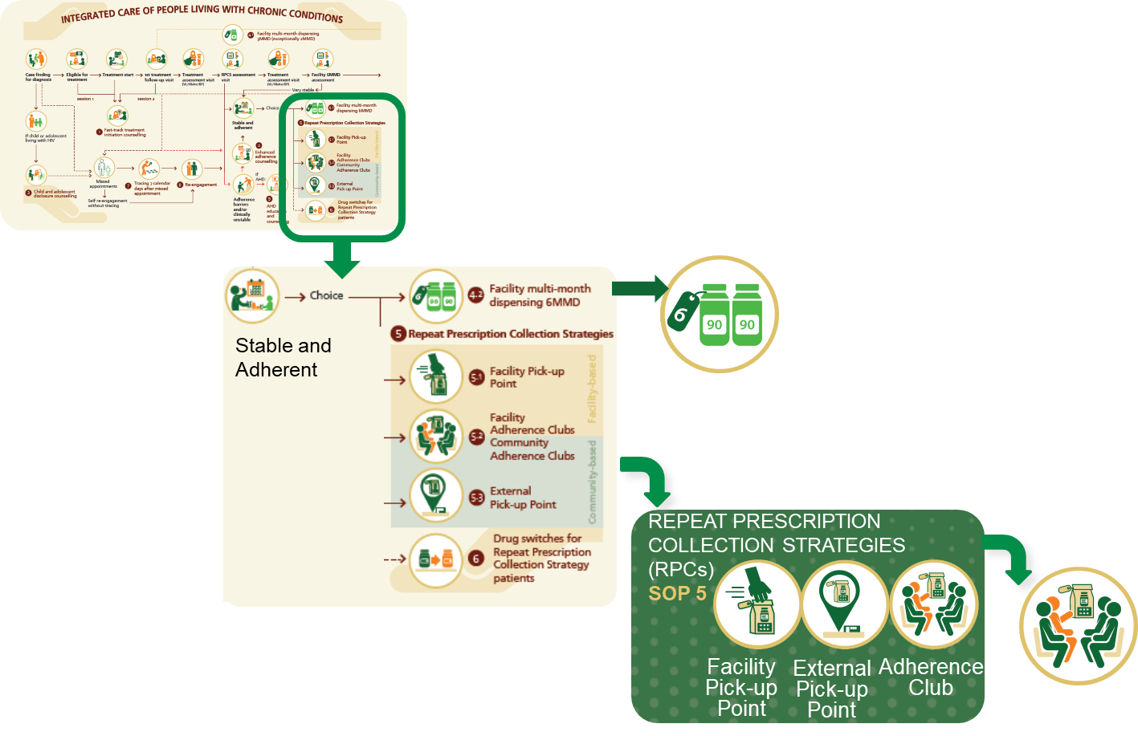
Module 1: Contents
Adherence Club Definition and Guiding Principles
Adherence Club Definition and Description
Guiding Principles, Dos & Don’ts of Adherence Clubs
Benefits of Adherence Clubs
Eligibility be Enrolled in the Club
Assessment and Enrolment
Information for Potential Adherence Club Patients
Types of Adherence Clubs

Slide 14

Module 1: Learning Objectives
To define an adherence club and distinguish it from other RPCs models.
What?
Who?
Where?
To understand club size, composition, membership criteria, and guiding principles and enrolment process.
Why?
When?
How?
To discuss the types of clubs, their benefits and the information to be given to potential club members during enrolment.

Slide 15
Adherence Clubs Definition

Slide 16
Group Activity: Description of an Adherence Club
Describe what you know about clubs from your past.
What are the common things that bring people together in a club?

Slide 17
Adherence Clubs - Description
What?
Adherence Clubs (ACs) are an
intervention wherein patients
who are stable on chronic
treatment meet as a group.
Who?
AC members are from the same
geographical area. May sometimes
be a specific sub-population of patients: e.g. Adolescents, Men, Postnatal women.
Adherence Clubs
Why?
ACs are aimed at
providing a RPCs for stable
patients who value continued psychosocial support and group engagement.
When?
Clubs are scheduled
3-monthly.
Where?
How?
The AC can be held in a facility or in the community.
The treatment for an AC can
be pre-dispensed by the facility pharmacy
or by a CDU or by CCMDD.
DMOC SOP September 2025 page 79

Slide 18
Group Activity: Choosing an Adherence Club
There are four tables in the room, each representing an adherence club.
Please can you all voluntarily join a group at any of the tables.
Explain why you went to the specific table.

Slide 19
Guiding Principles of Adherence Clubs

Slide 20
Guiding Principles for RPCs for Stable Patients
Assess, offer, enrol and document
  Offer eligible patients a choice of the 3 different RPCs if available.
  Assess patients for RPCs enrolment at Month 4 (first visit after VL/HbA1c are taken).
  Document the RPCs enrolment/deactivation in the patient’s clinical stationery.
  Capture in TIER.Net & SyNCH.
Investigations
  Conduct routine investigations only at the comprehensive clinical consultation at RPCs M6 visit:
    Not at the rescripting visit at RPCs M12
  Include annual TB-NAAT with VL assessment.
  Do not require the RPCs patient to return for result review before a new RPCs script is submitted.
  Recall RPCs patients with abnormal assessment results immediately on receipt of the abnormal result.
Prescription and Dispensing
  Clinicians will see the patient and prescribe twice annually. (A province may choose to have the brief check-up by a clinician at M12 be at the clinician discretion, within prescription requirements).
  Prescribe all chronic, preventive and ART medication on one script with the same supply and location.
  Maximum 2 drug collections from a+ RPCs script; 1st from the facility, 2nd from the RPCs location.
  (Preferably script 2x3MMD)
  Treatment supply can be pre-dispensed by CCMDD or a CDU or the facility pharmacy.
DMOC SOP September 2025 pages 66, 67, 84

Slide 21
Guiding Principles for RPCs for Stable Patients (cont.)
Contraceptives
  Explain to women how each contraceptive method impacts required return visits’ frequency and location (facility or community).
  Long-acting reversible contraception (no alignment concerns);
  Oral contraception &new self-injectable prescribe 6 months (can dispense 6M or 3M (facility) +3M (RPCs)
  Short-acting IM injectable contraception align with 6-monthly visits (preferred FAC-PUP or Facility AC)
Unwell RPCs patient
  Patients feeling unwell should see a clinician at any time, and not wait for the scheduled appointment date
Presence of TB symptoms
  Positive TB symptom screen in a RPCs the clinician will rescript for RPCs. TB-NAAT for all presumptive.
Positive TB diagnosis, facility has a reliable results management and recall system recall the patient
Positive TB diagnosis, facility does not have a reliable results management and/or recall system advise patient with TB symptoms to return to the facility within 5-7 days for a review of their TB results.
  No TB diagnosis, normal assessment result patient will continue in RPCs.
  TB diagnosis return patient to regular clinician-managed care
  Consider 2-monthly supply of ART and TB treatment during the continuation phase.
  Re-assess for RPCs enrolment when TB treatment is completed.
DMOC SOP September 2025 pages 66-67

Slide 22

Guiding Principles for Adherence Clubs
Health facilities can establish both Facility-based and Community-based adherence clubs.
  Clubs are scheduled every 3 months
  Aim for 10 or more members in Community ACs and rural ACs, 25-30 members in Facility ACs
  Participation can be built up over a few months.
  Prepare / check Patient Medicine Parcels (PMPs) at least a day before
Facility-based Adherence Club
Community-based Adherence Club
Patients are not required to attend registry.
No patient folder collection needed.
Vital signs should not be taken.
Clinician visit not needed for each treatment supply.
Do not add members to the facility headcount.
AC can be in any community venue
Adherence clubs can start at the facility and later move to a community-based venue.
DMOC SOP September 2025 pages 79, 82

Slide 23

Dos and Don’ts of Adherence Clubs
DOs (Good Practice)
DON’Ts (What to avoid)
Enrol only clinically confirmed eligible, stable patients..
Prepare Patient Medicine Parcels (PMPs) at least a day before AC meetings.
PMPs can be prepared by facility pharmacy, CDU or by CCMDD SP.
(CCMDD SP only option for adherence clubs >10 patients)
Protect confidentiality – choose safe, private, stigma-free meeting spaces.
Discuss the need for members to uphold confidentiality.
Encourage peer support through shared experiences and coping strategies
Link ACs to the health information systems.
(pharmacy, SyNCH, TIER.Net, DHIS).
Adapt clubs to meet the needs of special groups.
(youth, families, postnatal, men, key population groups, over 50s, etc.)
Provide regular feedback and ensure members know their next steps.
Don’t enrol unstable patients who need frequent clinical reviews.
Don’t require routine vital signs or clinical consultations at every club meeting.
Don’t skip data reporting - capture all clubs in the AC register and TIER.Net.
Don’t add adherence club clients to facility headcount register.
Avoid open or stigmatizing venues to protect confidentiality.

Slide 24
Benefits of Adherence Clubs

Slide 25

Group Activity: Discuss Benefits of an Adherence Club
Discuss the benefits of adherence clubs.
Compare the benefits of an adherence club in a rural setting vs an adherence club in the urban setting?

Slide 26
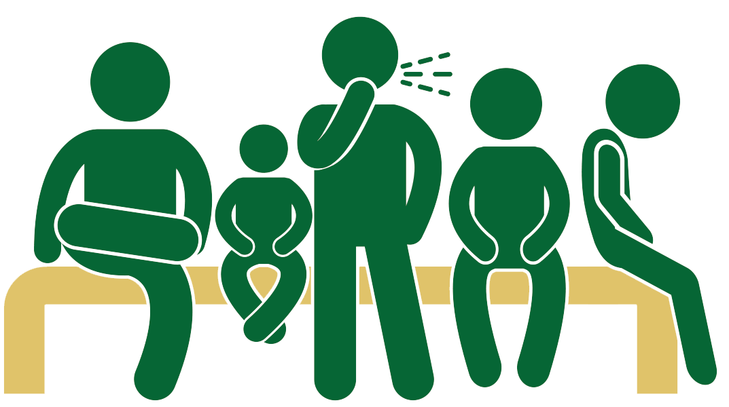
Benefits of Adherence Clubs
Patient benefits
Health system benefits
Improved adherence, retention, viral suppression
Better patient adherence reduces tracing time
Group consultations speed up access to care
Improved outcomes means less time managing disease progression
Convenient local or facility medicine pick-up
Decongested facilities ease staff burden
No transport costs if nearby. Reduced time off
Community network for tracking absentees
Improves capacity for new patients
Psychosocial support, shared experiences, reduced stigma
Improves capacity for unstable patients

Slide 27
Adherence Clubs: Eligibility and Enrolment

Slide 28
Group Activity: Eligibility for an Adherence Club?
Identify which clients may be eligible for adherence clubs.
Who determines that a client is eligible for a club?
How is a client’s eligibility determined?

Slide 29
Eligibility for Enrolment into Adherence Clubs
The criteria are the same across Repeat Prescription Collection Strategies
For Adults
For Post-Partum Women
Above 18 years
Not pregnant or postnatal within 12 months of delivery
Most recent assessment results normal:
  HIV: most recent viral load (VL) in past 12 months < 50 copies/ml
  Diabetes: most recent HbA1c taken in past 12 months ≤ 8%
  Hypertension: 2 consecutive BP < 140/90
Clinically stable: no current TB, other opportunistic infection, malnutrition, chronic condition requiring clinical review more regularly than 6 monthly.
Clinician confirms the patient’s eligibility for RPCs.
Patient voluntarily opts for the RPCs option.
Patient identification or asylum-seeking number.
Enrol mothers into preferred RPCs (or 6MMD if eligible) at the Month 12 EPI visit.
  She needs 6-monthly viral load tests until she stops breastfeeding.
Pregnant women are not eligible for RPCs. Integrate ART and care into BANC plus visits.
Integrate maternal ART with infant EPI visits, providing care through MNCWH services until 6 weeks post-breastfeeding.
For Children & Adolescents (5-18 years old)
Age 5-18 years old and other criteria as for adults
No regimen or dosage changes in last 3 months.
Caregivers counselled on disclosure process if age-appropriate disclosure not yet achieved.
Patient (>12 years / caregiver if patient < 12 years) voluntarily opts for the RPCs option.
DMOC SOP September 2025 pages 65 - 66

Slide 30
Group Activity: Recruiting for an Adherence Club?
Brainstorm. What proportion of your clients at your facility are clinically stable on chronic medication?
How many clubs do you have at your facility?
What recruitment strategy has worked for you?
What challenges have you encountered in setting up clubs at your facility and how did you mitigate them?

Slide 31
Assessment & Enrolment into Adherence Clubs
Registration Visit
Enrolment Visit RPCs M0
Months on ART 4
Months on ART 4-6
RPCs eligibility assessment
Explain & offer RPCs options.
Patient chooses AC
All patients enrolled into a particular AC attend the facility together for the first AC meeting.
1st AC meeting at facility
Record present AC members
Script AC members (6 MMS) + indicate supply length
Provides/updates patient appointment card with next AC meeting date/location/time
Provide detailed information about AC
Complete RPCs registration form
Record in clinical stationary: AC
1st AC meeting date KNOWN:
  Script treatment supply until 1st AC date
1st AC meeting date NOT KNOWN:
  Script 2/3 months treatment supply
Patient collects from pharmacy
Provide/update patient appointment card with 1st AC meeting date at facility.
.
AC facilitator calls with date & time.
There may be days to months lapsed between RPCS registration and the 1st AC date whilst members are determined.
Patient collects treatment supply from pharmacy
DMOC SOP September 2025 pages 84, 144, 145

Slide 32
Information for Potential Adherence Club Clients

Slide 33


Information for Potential Adherence Club Patients
Undetectable = Untransmittable
An undetectable viral load means zero risk of sexual HIV transmission.
You are UNDETECTABLE if your Viral load is ≤ 50 copies/ml
An UNDETECTABLE viral load is certain if you comply and adhere to your ART
You are UNTRANSMITTABLE when an undetectable viral load prevents the sexual transmission of HIV.
You are UNTRANSMITTABLE to sexual partners if you use ART as prevention.
Always celebrate the client achieving a VL < 50 copies/mL
“An undetectable viral load qualifies you for easier treatment collection.”
U=U is based on strong scientific evidence from multiple studies over decades of research.
Undetectable = Untransmittable U=U Messaging Toolkit p 10
Notes:
Scientific evidence:
HPTN 052: HIV Prevention Trials Network. 1763 sero-discordant couples – partners followed for 8509 person-years.
>> No linked infections were observed when HIV-1 infection was stably suppressed by ART in the index participant.
PARTNER 1 (888 heterosexual and gap couples with 439 couple-years) and PARTNER 2 (gay couples). Over 76,000 instances of condomless anal sex):
>> The risk of HIV transmission from an HIV-positive person on suppressive antiretroviral therapy (ART) to their partner through condomless sex is zero,
Opposites Attract: 343 gay male sero-discordant couples with ~17,000 acts of condomless anal sex. HIV+ male had VL < 200 copies/mL
>> Zero cases of transmission in MSM couples during 232 couple-years of follow up when condomless anal intercourse was reported.

Slide 34

Information for Potential Adherence Club Patients (cont.)
Adherence Club Format
Composition and Venue of Clubs
Duration: 45 minutes to 1.5 hours.
Facilitator: supports group engagement, shares information about diseases, treatment and RPCs.
Group members: share experiences and challenges of living with a chronic condition and taking lifelong treatment.
10-30 patients per club (> 10 in rural settings, community ACs, >25 urban facility ACs)
Timing as agreed by members
Venue as agreed by members
(They can start at the facility and later move to a community-based venue)
Attendance
Patients receive a card with scheduled collection and return dates..
Adherence club attendance on the scheduled date is important.
If member cannot attend, a nominated buddy may collect their treatment. (Not twice in a row, not a clinical consultation visit)
If unable to attend or send someone, the patient has 28 days to collect treatment from the facility.
Clinical Assessment
Members need two clinician visits annually:
  comprehensive clinical consultation, scripting, investigations
  prescription renewal and brief checkup.
34
DMOC SOP September 2025 pages 82 - 83

Slide 35

Information for Potential Adherence Club Patients (cont.)
Women on Contraceptives
Medication
Long-acting reversible contraception è
no impact on facility visits or AC location.
Oral or self-injectable è receive a 6-month supply or 3-month + refill at the AC.
Short-acting IM è patient needs 2-4 additional facility visits per year.
  Depo-Provera: 2 additional visits
  NET-EN: 4 additional visits
(may prefer facility-based AC or FAC-PUP)
6-month repeat prescription.
Multiple months’ treatment supply is received at each group meeting.
?
Return to Regular Care
Patients will leave the club and return to regular facility care if they:
need more frequent care
are more than 28 days late for an AC appointment.
have a VL of 1000 copies/ml or higher
were diagnosed with TB, opportunistic infections, malnutrition, or uncontrolled/new mental or chronic health conditions
become pregnant. She must inform the Club Facilitator and return to the facility for integrated antenatal care.
Advise patients that returning to regular care ensures more frequent monitoring until they have stabilised.
In case of health problems
Patients must visit the facility immediately rather than waiting tor the scheduled date.
Leaving the Club
You can choose to leave the Adherence Club if you:
prefer a pick-up point and still have VL<50
qualify for 6MMD: 12 months on ART, 2 VLs < 50
Discuss with clinician at the comprehensive clinical consultation
DMOC SOP September 2025 pages 82 - 84

Slide 36
Types of Adherence Clubs

Slide 37

Types of Adherence Clubs
Adherence Clubs can be general or tailored to specific populations.
A club can meet at any suitable, convenient location (facility or community).
General Adherence Clubs
Men’s Clubs
For stable adult clients on ART and other chronic medications.
Mixed age and gender groups.
Include health literacy for all adult clubs
Address stigma
Add member-suggested activities like sports, gym, fitness activities.
Socializing via game nights, braais, TV, or gym sessions.
By request:
practical skill sharing, e.g. car maintenance or digital literacy.
Cover prostate, sexual, nutritional, mental health and other health topics (and stigma in seeking help)
Key Population Clubs (specific to each sub population)
Clubs tailored for specific groups like sex workers, MSM, or transgender persons.
Provide safe, stigma-free spaces
Include targeted health literacy e.g. STIs, GBV and resources available.

Slide 38

Types of Adherence Clubs (cont.)
Family/Household Clubs
Youth/Adolescent Clubs
For families or household members
Simplifies logistics (one meeting, one pick-up point).
Encourages family-based support for adherence.
For adolescents and young adults LHIV.
Tailored to age-specific needs, peer bonding, and youth-friendly services.
Include interactive health education and psychosocial support, mental assessment.
Over 50s Clubs
For PLHIV 50 years and older
Mandatory clinical assessments at rescripting visits.
Basic chronic illness screening within AC.
g
Maternal Clubs
For eligible women LHIV > 12 months post-birth.
Focus on aspects critical to the care and literacy of mothers of toddlers:
  Integrated counselling and management for mothers.
  6-monthly VL assessment if breastfeeding
  Toddler testing, immunization and development .

Slide 39
Key Population Adherence Clubs
Stigma-free Environment
Provide safe, stigma-free spaces.
Facilitator should be sensitization-trained.
Client-specific support
Targeted health literacy
e.g. STIs, GBV, dealing with stigma, resources available.
Clinical consultations: include member-appropriate aspects.
Immediately refer GBV survivors for first-line support within 72 hours; including HIV-PEP
Use 6MMD to incentivize continued undetectable viral loads.
Member Choice and Peer Support
Tailor for specific populations where possible
- such as sex workers, MSM, transgender persons, PWID.
Assign a peer to run specialized clubs, where possible
Allow members to self-select the club they join.
Encourage members act as "expert peers" to inspire unstable PLHIV in their network.

Slide 40

Family Adherence Clubs
Benefits
Same date and medication collection for child and caregiver so more convenient.
Quick, easy ART access so children have less time off school.
Child disclosure is strengthened through shared peer experiences.
Provides a community network for tracing patients not attending their family club.
Continued access to clinical care and support through proper referral.
Family adherence support
Improves retention in care and virological outcomes, especially for the children
  NB! Only 33% of CLHIV (50% of those on ART) have undetectable VLs and are eligible for RPCs*.
Caregiver eligibility
Age criteria for each club
A caregiver not on ART must be a primary caregiver for the child.
Age of the child to align with the following age criteria of each club
Alternative if families or resources are limited
Age-specific for child disclosure support
Clinician to assess disclosure status at enrolment as
no disclosure (none), partial disclosure (PD) or full disclosure (FD)
5 to <7 years
7 to <10 years
10 to 15 years
5 to <10 years
10 to <15 years
    * 95-95-95 October 2025. Dec 2025 CTG Extension Engagement

Slide 41
Family Adherence Clubs (cont.)
Resources
Where possible have two facilitators
(allows concurrent sessions for caregivers and children.)
Meeting Space
2 separate spaces are recommended;
  i) caregivers to discuss child disclosure; ii) children to engage in fun activities.
Comprehensive clinical reviews and rescripting must be at or near the facility
  children < 35 kg can be weighed, dosed correctly, have ART packs adjusted if needed.
Options within the facility:
  Support group room
  Outside courtyard or NPO structure on facility grounds (ideal space for children)
  General waiting area if family club meets after-hours
Family Clubs have 2 additional requirements at clinical visits
Children < 35 kg: weight check every 6 months to assess the need for dosage changes.
Pharmacy must be on standby to repack PMPs if dosages change.
Consolidated Guidelines for the Prevention and Management of HIV. Pages 170-171
Notes:
Based on overlaying the Paediatric Dosing Chart in the National Consolidated Guidelines for the Prevention and Management of HIV with Age Weight charts:
1. Children will change doses 3-5 times between the age of 5 when they become eligible for RPCs options and when they achieve the weight where no more dose changes are needed )
(3 times for those on the higher weight age percentile, 4 for the average and 5 for those in the lower weight age percentile.)
2. Minimum lapse between dose changes approximates 12 months. Thus, it should be adequate to check weight 6 monthly for children - at comprehensive clinical consultation and at rescripting. No need to check in ACs.
3. Only those in the lowest weight age percentile will still have a dosage change after 12 years old after they can join A&Y ACs.
4. Note the last dosage change for DTG is at 30kgs but the last dosage change for LPV/r is at 35 kgs.

Slide 42
Youth/Adolescent Clubs
Eligibility
Most recent assessment results normal:
  HIV: most recent viral load (VL) in past 12 months < 50 copies/ml
  Diabetes: most recent HbA1c taken in past 12 months ≤ 8%
  Hypertension: 2 consecutive BP < 140/90
Clinically stable with no current TB or other opportunistic infection/ condition requiring clinical review more regularly than once every 6 months.
Clinician confirms the patient’s eligibility for RPCs option.
Patient voluntarily opts for the RPCs option.
Grouping by Age
If the clinic has large numbers of HIV positive adolescents and youth,
form 3 age-dependent groups:
  adolescents 12 – <16 years
  adolescents 16 – <20 years
  youth 20 – 24 years
If numbers of HIV positive adolescents and youth are not enough for 3 groups,
then 2 groups can be formed:
  adolescents 12 – <16 years
  youth 16– 24 years
PLUS:
12 – 24 years
HIV status disclosed to and understood
Mature enough to be taking own treatment
Age-appropriate learning

Slide 43
Youth/Adolescent Clubs (cont.)
Club Frequency
  Every 3 months
  Can vote to have an additional meeting
Meeting Spaces
  The clinic
  Another safe space
  (e.g. school, church, community hall)
Club Activities
  Prescribed activities:
  PMP collection, annual clinical consultation and 6-monthly scripting, TB screening.
  Advised additional (age-appropriate) activities and discussions:
  Screening: STIs, mental health screening.
  Contraceptives (including provision);
  Disclosure. Testing and prevention for partners.
  Nutrition, psychosocial well-being.
  Myths/findings in social media about HIV, other conditions.
  Awareness of GBV, preventive measures and coping.
  Other appropriate topics requested in advance.
Easier transition to adult HIV care

Slide 44

Youth/Adolescent Clubs: Mental Health Screen
Assess members’ appearance / behaviour
Clean, looking after him or herself
Looks worried or sad?
Seems agitated? Or unusually slow?
Seems suspicious, nervous or hostile?
Noticeable weight changes?
Assess members’ thoughts
Ask 1-on1. Avoid sensitive discussions in front of the group.
Having negative thoughts?
Having strange thoughts?
Any unusual fears? (such as being followed, spied on)
Any strange experiences or special abilities?
(such as hearing voices/seeing visions other people cannot hear or see)
Assess members’ mood.
Feelings over the last week?
Feeling mostly normal, sad, happy, or worried?
Feelings today?
Feelings about the future?
Assess substance abuse. Ask:
Assess members’ cognition
Offer of referrals should be made
1-on-1.
Serious problems due to drugs or alcohol?
More than 5 drinks in one session?
Use of illegal drugs or misused prescription drugs?
Thinking seems slow?
Speech seems too slow? Too rapid?
Ability to concentrate?
Does memory seem impaired?
44
DMOC SOP September 2025 pages 134 - 136

Slide 45

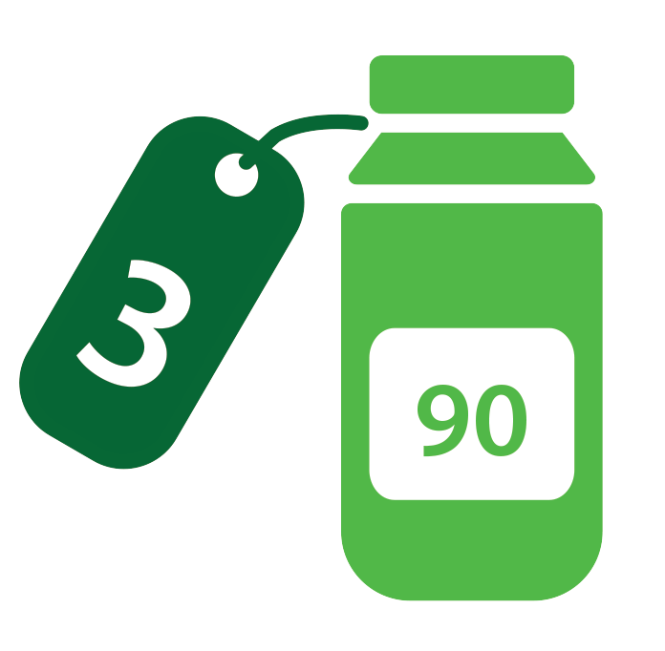
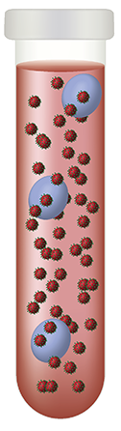
Maternal Clubs
g
Eligibility
The postpartum period is high risk for poor adherence.
Mothers LHIV at least 12 months postpartum
Meeting all eligibility criteria for RPCs
Health Literacy & Peer Support
Screenings, Health Check
Early Childhood Development
Medication Distribution
Integrated Clinical Care
  Maternal adherence
  Vertical transmission prevention
  Gradual stopping of breastfeeding
  Age-appropriate feeding advice
  TB screening
  Mental health screening
  STI screening
  ECD from 1 year
  Observation / health education on ECD milestones
  3-month PMPs
  Maternal VL monitoring 6-monthly if breastfeeding.
  TPT, CTMX if indicated
  Holistic clinical checkup
  Contraception
  Toddler HIV testing
  Toddler immunisation completion
45
National Consolidated Guidelines for the Management of HIV and Prevention of Vertical Transmission 2025 page133,134, 144, 147,152
Notes:
Longitudinal adherence to maternal antiretroviral therapy and infant Nevirapine prophylaxis from 6 weeks to 18 months postpartum amongst a cohort of mothers and infants in South Africa. Larsen et al. BMC Infect Dis. 2019.
Cumulative adherence to maternal ART (2811 MIPs) from 6 weeks until 18 months was 63.4%. (85% until 14 weeks postpartum)
(Studies report adherence rates in SA of adults LHIV ranging between 77% and 91.8%.)

Slide 46

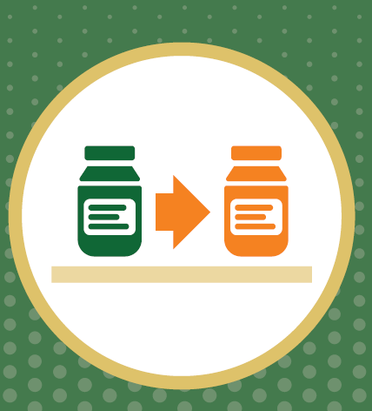
Graduation from Postnatal Clubs (support groups) to Maternal Adherence Clubs (a RPCs option)
g
Postnatal Clubs
Maternal Adherence Clubs
Stable mothers 12 months post birth
Mother-Infant Pairs; until 12 - 18months
Women eligible for RPCs
>12 months post birth
Stable mothers in postnatal clubs can graduate to maternal adherence clubs
  if they meet all the eligibility criteria for RPCs.
Toddlers return to clinic standard of care.
Health Literacy & Support
Screenings & Health Checks
Early Childhood Development
Health Literacy & support,
ECD discussion
Screenings, health checks
change to align to toddlers
Medication Distribution
  Integrated Clinical Care
change to align with RPCs principles
Medication distribution
Adapted from Postnatal Clubs Toolkit, MSF. P7 DMOC SOP p 65

Slide 47
Over-50s Clubs
Key Priorities
Comprehensive approach to clinical assessment
  High prevalence of chronic conditions
  Comprehensive clinical assessment at rescripting visits highly recommended.
  Health information aimed at early detection of chronic conditions.
  Screening for cognitive impairment and frailty
  Chronic pain management options
  Review of polypharmacy and medicines optimisation
  Blood pressure (BP) monitoring
  Lipid profile monitoring
  Blood glucose monitoring
  Monitoring bone and joint health
Tailored health information on:
  Symptoms of common illnesses to look out for
  Chronic condition monitoring and management
  Bone health
  Nutrition to manage weight and heart health
  Physical activity to maintain multi-system health.
  Mental stimulation
  Menopause / andropause
  Sleep quality
  Impact of smoking and alcohol
Notes:
Top 10 Common Chronic Conditions for 50+
High Blood Pressure (>75% of older adults)
High Cholesterol (>50% of older adults)
Arthritis (60%)
Diabetes (15%)
Heart Disease (>25%)
Cancer
Obesity (>45%)
Osteoporosis (>33% women, 20% men)
Stroke
Chronic Obstructive Pulmonary Disease (COPD) (10-20%)

Slide 48
Module 2: Adherence Club Procedures and Facilitation

Slide 49
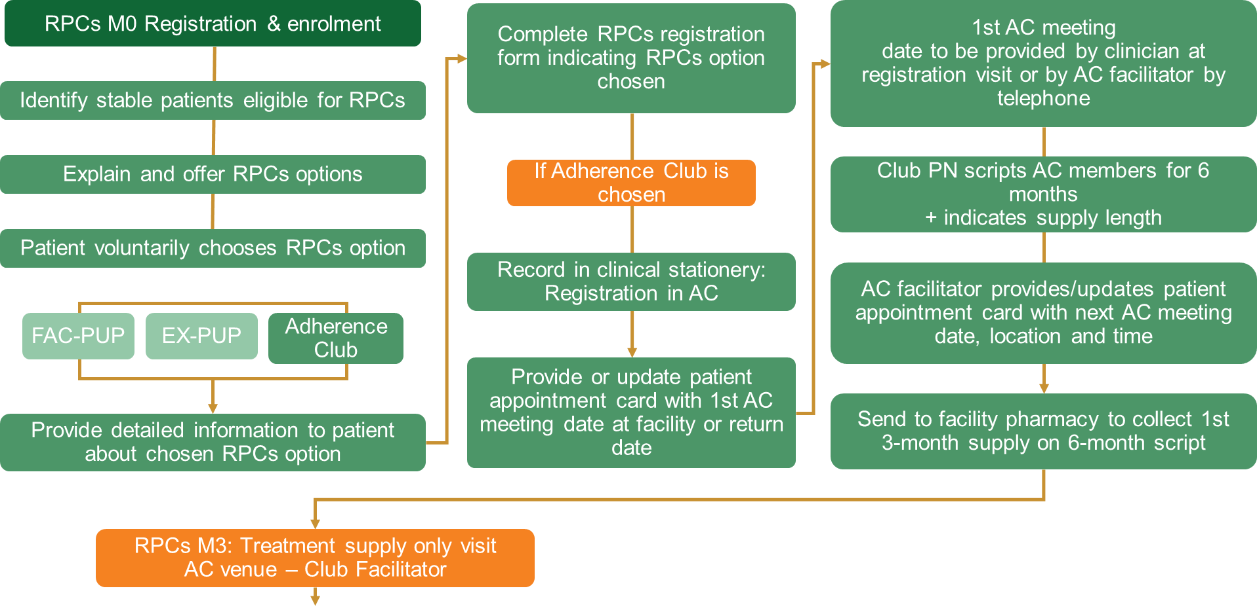
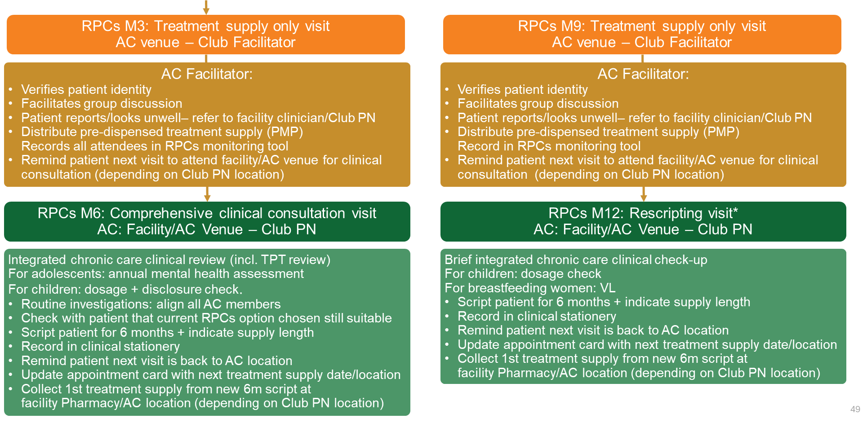
Module 2: Contents
Adherence Club Procedures and Facilitation
Roles and Responsibilities for Adherence Clubs
RPCs Algorithm – Focus on Adherence Clubs
Adherence Club Procedures & Annual Visit Schedule
Detailed Guidance: Before, During, After
Tracing and Recall of AC patients
Re-engagement and/or Deactivation from Clubs

Slide 50
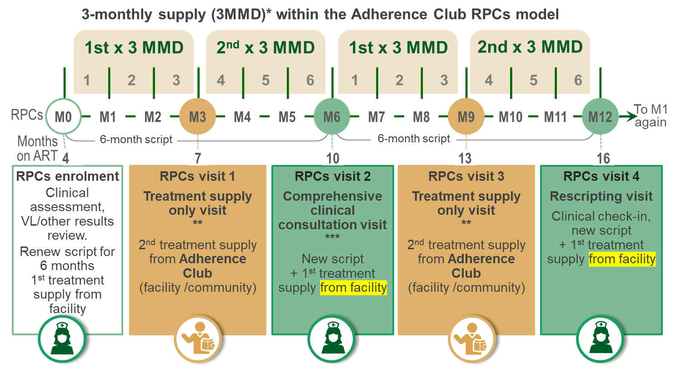



Module 2: Learning Objectives
To understand the roles and responsibilities before, during and after adherence clubs.
To understand steps and requirements to conduct and facilitate adherence club sessions over the year.
To define the processes to be followed should members require more frequent clinical care due to absence, abnormal results, ill-health or pregnancy.

Slide 51
Adherence Clubs: Roles & Responsibilities

Slide 52
Group Activity: Responsibilities for an Adherence Club?
Brainstorm the skills and qualities required for a Club facilitator.

Slide 53
Roles and Responsibilities for Adherence Clubs
Club Manager
Responsible for successful adherence club implementation Duties include:
Ensure the DMOC SOP is carried out
AC recruitment
Schedule AC visit dates
Provide Facilitators with treatment literacy materials
Ensure review and management of assessment results; and recall of patients with abnormal results
Ensure AC enrolment, deregistration, attendance is captured
Ensures proper monitoring, reporting and club evaluation
Club Facilitator
Runs adherence clubs in coordination with the Club Manager.
Running the adherence club sessions.
Duties include:
Facilitate group discussion and engagement
Collect and distribute pre-dispensed medication
Check member wellness, refer unwell patients to Club PN
Register attendance in RPCs monitoring tool;
Follow up patients who miss sessions
Only the Facilitator is always present at each club session.
Club PN
Responsible for oversight of AC on the day of the club.
Needs not be present at non-clinical club sessions but is available at the facility before, during and after the session.
Duties include:
See symptomatic patients referred
Conduct clinical consultations/routine investigations
Provide prescriptions for AC members
Review and sign off the AC registers
Pharmacist/
Pharmacy Assistant
Pre-dispenses treatment for adherence clubs.
Administrative Clerk/
Data Capturer
Captures patients’ AC enrolment, attendance, deactivation or deregistration
DMOC SOP September 2025 page 80

Slide 54
Adherence Clubs: Procedure & Annual Visit Schedule

Slide 55
Adherence Clubs Algorithm
Slide covered earlier
Registration Visit
Enrolment Visit RPCs M0
Months on ART 4
Months on ART 4-6
RPCs eligibility assessment
Explain & offer RPCs options.
Patient chooses AC
All patients enrolled into a particular AC attend the facility together for the first AC meeting.
1st AC meeting at facility
Record present AC members
Provides/updates patient appointment card with next AC meeting date/location/time
Provide detailed information about AC
Complete RPCs registration form
Record in clinical stationery: AC
Script AC members (6 MMS) + indicate supply length
1st AC meeting date KNOWN:
  Script treatment supply until 1st AC date
1st AC meeting date NOT KNOWN:
  Script 2 to 3 months treatment supply
Patient collects 3 months’ treatment from pharmacy
Provide/update patient appointment card with 1st AC meeting date at facility.
.
AC facilitator calls with date & time.
Patient collects treatment supply from pharmacy
DMOC SOP September 2025 pages 84, 144, 145

Slide 56
RPCs Algorithm: Focus on Adherence Clubs
FROM
1st TREATMENT SUPPLY ONLY VISIT
RPCs M3: Treatment supply only visit
AC venue – Club Facilitator
RPCs M6: Comprehensive clinical consultation
AC: Facility/AC Venue * – Club PN
Verifies patient identity
Facilitates group discussion
Patient reports/looks unwell: refer to facility clinician/Club PN
Records all attendees in RPCs monitoring tool
Remind patient next visit to attend facility/AC venue for clinical consultation (depending on Club PN location)
Adherence Club Meeting
Integrated chronic care clinical review (incl. TPT review)
For adolescents: annual mental health assessment
For children: dosage + disclosure check.
Routine investigations: align all AC members
Verify RPC suitability
Script patient for 6 months + indicate supply length
Record in clinical stationery
Remind patient next visit is back to AC location
Update appointment card
Distribute PMP - 2nd treatment supply from 6-month script
* Clinical consultations are individual and held before or after club meetings. If the nurse cannot attend the venue, they occur at the facility.
Patient collects 1st treatment supply from new script
(pharmacy or AC)
DMOC SOP September 2025 pages 146, 84

Slide 57
RPCs Algorithm: Focus on Adherence Clubs
(cont.)
RPCs M9: Treatment supply only visit
AC venue – Club Facilitator
RPCs M12: Rescripting visit*
AC: Facility/AC Venue – Club PN
Verifies patient identity
Facilitates group discussion
Patient reports/looks unwell: refer to facility clinician/Club PN
Records all attendees in RPCs monitoring tool
Remind patient next visit to attend facility/AC venue for clinical consultation (depending on Club PN location)
Adherence Club Meeting
Brief integrated chronic care clinical check-up
For children: dosage check
For breastfeeding women: VL
Script patient for 6 months + indicate supply length
Record in clinical stationery
Remind patient next visit is back to AC location
Update appointment card
Collect 1st treatment supply from new script
(pharmacy or AC)
Distribute PMP - 2nd treatment supply from 6-month script
* Rescripting visits should ideally be held before or after club meetings. If the nurse cannot attend the venue, they occur at the facility.
Patient collects 1st treatment supply from new script
(pharmacy or AC)
DMOC SOP September 2025 pages 146, 84

Slide 58
Adherence Club Procedure & Annual Visits Schedule
3-monthly supply (3MMD)* within the Adherence Club RPCs model
** At the Adherence Club
Conduct adherence check
Check if patient unwell or wants to see a clinician – refer if yes to either
Facilitate group discussion
Issue PMPs
Record patient visit in RPCs monitoring tool
1st 3 MMD
2nd 3 MMD
1st 3 MMD
2nd MMD
1 | 2 | 3 | 4 | 5 | 6 | 1 |  | 3 | 4 | 5 | 6
RPCs
M0
M1
M2
M3
M4
M5
M6
M7
M8
M9
M10
M11
M12
To M1 again
Months on ART
6-month script
6-month script
*** At the clinical consultation
Record in clinical stationery:
RPCs M6 – Comprehensive clinical consultation visit
Integrated chronic care clinical review
(incl. FP + TPT review)
Routine investigations as per HIV, hypertension or diabetes guidelines
Treatment script + first supply
For children add:
Weight and dosage check at M6 and M12 with possible adjustment
Disclosure process review and check-in with caregiver
For adolescents add:
Mental health assessment
Brief integrated chronic care clinical check-up at M12
Clinician can carry out clinical consultation at adherence club venue
4
7
10
13
16
RPCs enrolment
Clinical assessment, VL/other results review.
Renew script for 6 months
1st treatment supply from facility
RPCs visit 1
Treatment supply only visit
**
2nd treatment supply from Adherence Club location
(facility /community)
RPCs visit 2
Comprehensive clinical consultation visit ***
New script
+ 1st treatment supply from facility
RPCs visit 3
Treatment supply only visit
**
2nd treatment supply from Adherence Club location
(facility /community)
RPCs visit 4
Rescripting visit
Clinical check-in, new script
+ 1st treatment supply from facility
* Where a facility is experiencing drug shortages, the treatment supply only visits to the RPCs location can be changed to RPCs M2 & RPCs M8.
This will support a first supply of 2 months (2MMD) from the facility and a second supply of 4 months (4MMD) from RPCs. Every effort should be made not to provide a shorter supply from the facility/RPCs to ensure maximum 2 patient visits per 6-month script.
DMOC SOP September 2025 pages 142, 85

Slide 59
Adherence Clubs Annual Visit Schedules
Months* in RPCs (Months on ART) | Location AC visit | Activities
RPCs M-1 (M3 on ART) | Facility (not an adherence club visit) | Registration visit RPCs eligibility assessment + offer RPCs options + complete RPCs registration form + script and align treatment supply to cover until first adherence club visit date + collect treatment supply at facility pharmacy
RPCs M0 (M4 on ART) | Facility (meet as a group for the first time) | Enrolment visit ª Enrolment in RPCs monitoring tool + record adherence club enrolment in clinical stationery + 6MMS+ 3MMD** pick-up from facility pharmacy
RPCs M3** (M7 on ART) | Adherence club venue | Repeat collection 3MMD** pick-up
RPCs M6 (M10 on ART) | Facility/ Adherence Club venue ^{e} | Comprehensive clinical consultation visit. Integrated chronic care clinical review (incl. FP+TPT review) + investigations + Check RPCs option chosen still suitable ^{b} + 6MMS ^{c} + record in clinical stationery + 3MMD ** pick-up
RPCs M9** (M13 on ART) | Adherence club | Repeat collection 3MMD** pick-up
RPCs M12 (M16 on ART) | Facility/Adherence Club venue ^{e} | Rescripting visit ^{d} Brief integrated chronic care clinical check-up + 6MMS + record in clinical stationery + 3MMD ** pick-up
* A month refers to a dispensing cycle (whether 28 or 30 days in length)
** RPCs treatment supply only visits can be 2 months after the clinician scripting date at M2 and M8 if the facility was experiencing drug shortages at date of scripting. The clinician can then specify 1x2MMD (first dispense from the facility at RPCs M0/M6/M12) and 1x4MMD (second dispense from RPCs location at RPCs M2/M8/M14).
VL/HbA1c should not be done again at the enrolment visit.
If patient chooses to change RPCs option: Clinician to complete registration form indicating change and record change in clinical stationery for capturing
After RPCs enrolment, patients should be rescripted at their 6-monthly clinical review dates. Patient should not be required to return for result review prior to rescripting. The minority of RPCs enrolled patients receiving an abnormal result should be recalled to the facility.
To see clinician at clinician discretion
Clinician can carry out clinical consultation at adherence club meeting venue
DMOC SOP September 2025 p84

Slide 60
Adherence Clubs: Detailed Guidance – Before, During, After

Slide 61
Preparation for the Club Session
Standard Visits
Preparation for the club
At the club visit
After the club visit
During the grace period
End of the grace period
Preparation can begin earlier but must be finalised the day before the club:
  Prepare the club register – Date of club visit. Visit type.
  Type of visit
    Follow preparation guidelines for blood draws or clinical visits.
    If the previous clinical visit lacks a weight tick in the register, pull the patient's folder.
    If a clinical visit was missed, mark register “to be seen by clinician before PMP”.
  Recruited patients
    Draw folders for recruited patients
    Capture prescription
  Patient Medication Parcels (PMPs)
    Pharmacy to check PMPs for completeness
    Add missing medications from facility pharmacy
Patient files are only drawn for clinical and scripting visits.

Slide 62
At the Club Session
Standard Visits
Preparation for the club
At the club visit
After the club visit
During the grace period
End of the grace period
Ensure the PMP pick-ups can begin on time.
For each individual patient
  Review and action any highlighted patient items
  For a new patient, label the next open register line (or fill manually), add the club ID, and record their contact details and "NEW" by the first visit..
  Record the club ID number after the club number on the appointment card
  Record weight or “B” for buddy in the weight block.
  Screen for TB/other issues, register findings, refer to the nurse if needed, record RTC (refer to clinician).
  (TB symptoms: cough, fever, night sweat, and unintended weight loss)
  Record next date and type of visit on the appointment card.
  Give the patient their PMP. Patient to check contents at the club and report any issues immediately.

Slide 63



Activities in Adherence Clubs
The Club Facilitator shall:
Verify patient identity with approved ID; nominated PMP collectors must also produce the patient's ID. .
Lead a group discussion, including using relevant treatment literacy materials provided by the Club Manager.
Foster peer-led interventions and mentorship to empower members and improve adherence.
Issue Patient Medicine Parcel
Have patient or nominated buddy sign for the PMP
Check current treatment progress and screen for TB.
Refer to the Club PN if the patient is unwell or unstable.
Register the patient visit in the RPCs monitoring tool.
Refer to the Integrated TB/HIV data management SOP RPCs annexure.

Slide 64
End of the Club Session
Standard Visits
Preparation for the club
At the club visit
After the club visit
During the grace period
End of the grace period
After clinical and rescripting sessions (every 6 months):
Facilitator actions:
    Provide pre-drawn folders and the register for all enrolled patients to Club Nurse.
    Reports to nurse how many patients have not attended the session’
    Match non-attendance to remaining PMPs.
    Immediate recall or non-attending patients if possible.
    Nurse actions
    Complete clinical details of enrolled patients in the register.
    Record enrolment date in the folder next to the recruitment information and sign the entry.
    Unclaimed PMPs:
    Facilitator returns the unclaimed PMPs to the facility.
    Uncollected PMPs are stored by Clubs Managers in designated rooms or in the pharmacy during the grace period

Slide 65
During the 28-day grace period
Standard Visits
Preparation for the club
At the club visit
After the club visit
During the grace period
End of the grace period
Store remaining PMPs for the 28-day grace period in a secure, approved location known to staff and patients.
Remind patients to attend their sessions and to report to the designated venue on time.
If a blood or clinical visit is missed, a clinician must see the patient.
Register each session and record the attendance date.
Patients collect PMPs from the pharmacy or a pre-arranged location.
Once all club patients are marked as attended, hand the register to the nurse to close and the clerk to capture.

Slide 66
After the 28-day grace period
Standard Visits
Preparation for the club
At the club visit
After the club visit
During the grace period
End of the grace period
Close the club register by Day 28 (or earlier if all PMPs collected).
    Mark "DNA" for patients who didn't collect PMPs within 7 days.
    Ensure all last-visit entries have a weight and screening record, or “B”, or outcome.
    Discuss any gaps in recording with the facilitator.
    Initial bottom of each last visit column upon completion.
    Sign/Date front summary page to verify check.
    Check/Follow scripting procedures if due.
  Register to be given to the clerk/data capturer for capturing and returned to area where registers are stored.
  Remaining PMPs to be returned to the pharmacy.
Facilitator must follow up with patients who missed the grace period.
Refer patients arriving after the grace period to the Clubs Manager
  Club Manager returns the patient to mainstream care for increased support.

Slide 67
After the 28-day grace period
Standard Visits
Preparation for the club
At the club visit
After the club visit
During the grace period
End of the grace period
Data cleaning
Check paper register for services that need to be captured to correctly set up the batch capture screen.
Recruited patients:
    Select club-start from the ART services menu:
      Those enrolled at this visit: mark as "club-start“, assign a club ID number (paper register line number).
      Those recruited before the last club visit that were not enrolled: remove from the list (go into the individual patient record and remove the recruited status).
Current patients:
    Capture correct regimen given for those patients who received a regimen
    Capture “no regimen given” for patients with DNA in the weight box; capture the outcome as BTC - DNA
Once the register is captured, the data capturer should date, write name and sign the front page.
Return the register to appropriate register storage space.
Capturing will take place within a week of receipt..

Slide 68
Group Activity: Our great BUDDIES
When can a client not send a buddy to the club meeting?
What information CAN and CANNOT be shared with the buddies of club clients?

Slide 69
Tracing and Recall of Adherence Club Patients

Slide 70
Tracing and Recall: Criteria and Prioritisation
Criteria and Prioritisation order for Tracing and Recall:
Attempt to trace all patients with missed appointments or abnormal results.
Prioritize tracing and recall for these patients:
  Advanced HIV Disease patients starting/restarting treatment (last 6 months)
  Patients with abnormal results, e.g.
    HIV: Serum CrAg+, PCR+ or viral load >50 copies/ml
    Diabetes: HbA1c >8%
    TB: positive TB-NAAT, Culture
  Patients with overdue tests/assessments
  Patients failing to return for appointments/medication within 7 days.
DMOC SOP September 2025 pages 99-100

Slide 71
Tracing and Recall: Guiding Principles
Guiding Principles of Tracing and Recall:
Trace patients via consented methods (SMS, WhatsApp, phone call, and/or home visits)
  Home visits (if agreed to) require a prior phone call.
Incorporate these activities to trace and recall patients:
  Inform patients about tracing and recall processes.
  Obtain consent for tracing and document preferred contact methods.
  Update contact details at each visit.
  Maintain strict patient confidentiality at all times.
  Identify missed appointments or abnormal results using TIER.Net (HIV/TB) or chronic registers.
Check missed appointments via patient records/tools before calling.
Begin patient tracing 7 calendar days after a missed appointment or failure to return following an abnormal result recall.
Actively refer to facility within 7 days of successful tracing.,
Document all patient tracing attempts in file and register.
DMOC SOP September 2025 page 100

Slide 72
Tracing and Recall of Adherence Club Patients
AC Patient does not collect treatment within 7 days
OR
AC Patient has abnormal results
If an Adherence Club member
  fails to collect treatment within 7 days of schedule OR
  received abnormal test results:
Patients receive SMS/call reminders to collect medicine.
Failed contacts are added to the facility tracing list.
  Patients returning to an Adherence Club or facility within 28 days of their missed appointment may continue in their Adherence Club.
  If more than 28 days late, refer to re-engagement process.
SMS or reminder call successful
No
Trace patient
Yes
Patient returns to the facility
Missed appointment ≤ 28 days, AND identifies as well and not on TB Rx
Missed appointment > 28 days, OR identifies as unwell/ on TB Rx
Specific to Adherence Club Patients
Adherence Club members arriving within 28 days of their appointment are reviewed by the Clubs Manager and sent to the pharmacy for treatment, if appropriate.
Clubs Manager ensures prompt re-engagement after missed visits.
Can continue in Adherence Club
Re-engagement Needed
DMOC SOP September 2025 pages 69, 85. Algorithm adapted from page 69

Slide 73
Re-Engagement and Deactivation of Adherence Club Patients

Slide 74
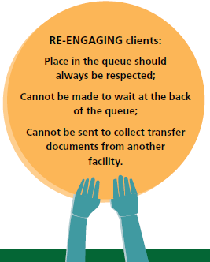






Key Principles of Re-Engagement
RE-ENGAGING clients:
The first return visit
experience is critical
Not all late clients are re-engaging
Re-engaging client needs vary.
1
2
3
Respect their place in queue
Do not send to the back of the queue;
Do not send to collect transfer documents from another facility.
Welcoming, supportive and empathetic
Only a person who is more than 28 days late for a scheduled appointment or self-identifies as unwell or on TB treatment
Easier access to treatment
Clear facility visit flow focused on a positive client experience
Psychosocial support
No punitive actions!
Clinical management
Re-engagement in care job aid, 2025 Slides 3, 6

Slide 75
Re-Engagement of Adherence Club Patients
Patient returns to the facility
Definition of a
re-engaging client
Missed appointment ≤ 28 days, AND well and not on TB Rx
Missed appointment
> 28 days
Clinically unwell / diagnosed TB AND missed appointment of any duration
RE-ENGAGEMENT PROCEDURE
OR
A
If the patient returns to the facility 29-90 days late and is clinically well: restart treatment, assess for RPCs and offer if eligible, OR offer 3-month drug refill & resume routine follow-up.
Re-engagement
Can continue in Adherence Club
Perform re-engagement clinical assessment + decide if EAC could assist =‘
B
If the patient returns to the facility > 90 days late and is well:
  restart treatment and provide 3-month refill,
  check CD4 and assess for TPT (including TB-NAAT)
  recall if CD4 < 200 to offer AHD package.
  re-assess in 3 months
Presents clinically well
Presents clinically unwell/ abnormal result/ TB co-infected
C
Missed appointment 29-90d
Missed appointment >-90d
Follow HIV/NCD/TB guidelines
If the patient returns unwell (including mental health), on TB treatment or >28 days late, a clinician will see the patient to:
  do a re-engagement assessment, including TB-NAAT
  follow the appropriate clinical guideline (including A-E elevated VL assessment).
  restart treatment and take a CD4 count for HIV patients.
  decide follow-up clinical review frequency as clinically indicated; and align drug refill length (do not require a patient to return for clinical review unless clinically necessary).
  Transition to RPCs if stable at 3-month reassessment. .
Continue treatment Assess, offer, enrol in RPCs if eligible
Same day restart chronic treatment
Drug refill 1-3 months to cover until next appointment
3-month drug refill
Recall if CD4 < 200 to provide AHD package
If CD4 < 200:
provide AHD package
Assessment
as per routine schedule
Assessment
3 months after re-engagement
DMOC SOPs September 2025, pages 108, 148-149
Re-Engagement in Care Job Aid 2025, page 11
ART Clinical Guidelines 2024 Job Aid

Slide 76
Group Activity: Deactivation from an Adherence Club?
Client on ART for 2 years, viral load 250 copies/ml, and has missed club appointment for 35 days.
Is this client eligible, should they be deactivated, or should they continue in the club?
Discuss answers in plenary.

Slide 77

Deactivation from an Adherence Club
Criteria for Deactivation
Advice to Client
Client missed treatment collection by >28 days.
Client assessed as clinically unstable requiring more frequent clinical management (e.g. TB or other opportunistic infection).
Abnormal lab results:
  For HIV: VL ≥ 1000 copies/mL
  (unless clinician confirms persistent viraemia)
  For Diabetes: HbA1c > 8%
  For Hypertension: BP > 140/90 mmHg
Client is pregnant. Refer to integrated MNCWH services.
They are returning to regular care for more frequent clinical care until stable.
They will discontinue club attendance during regular care.
They can rejoin the club or other RPCs option after one normal result and meeting other RPCs criteria.
If the patient chooses to leave the club, a different option will be discussed with the clinician and started at the next clinical consultation
A client may also choose to leave the Adherence Club to:
return to regular care
switch to a pickup point
access 6MMD if eligible
The reason for the client being deactivated from CCMDD must be documented in the notes section of the patient folder by the clinician.
NB! Deactivation is a temporary removal. The client can be re-enrolled.
Deregistration is a permanent removal due to client’s death / a duplicated profile.
DMOC SOPs September 2025, pages 68-69

Slide 78
MODULE 3: ADHERENCE CLUB (AC)
MONITORING AND EVALUATION

Slide 79
Module 3: Contents
Adherence Club Monitoring and Evaluation
Documentation in the Adherence Club Register
Documentation in ART Clinical Stationery
Capturing for Adherence Clubs in TIER.Net
Capturing for Adherence Clubs in SyNCH
Reporting for Repeat Prescription Collection Strategies

Slide 80
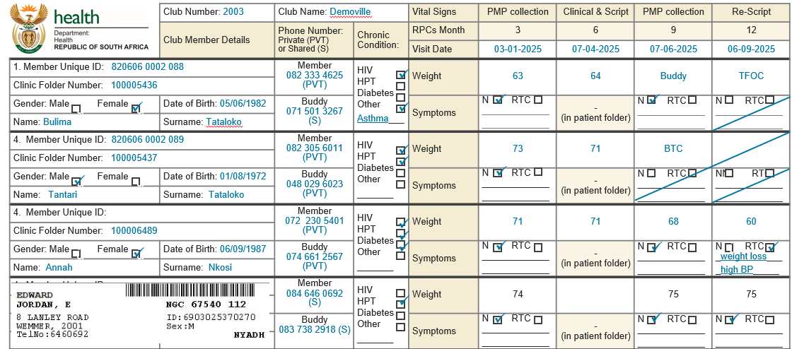
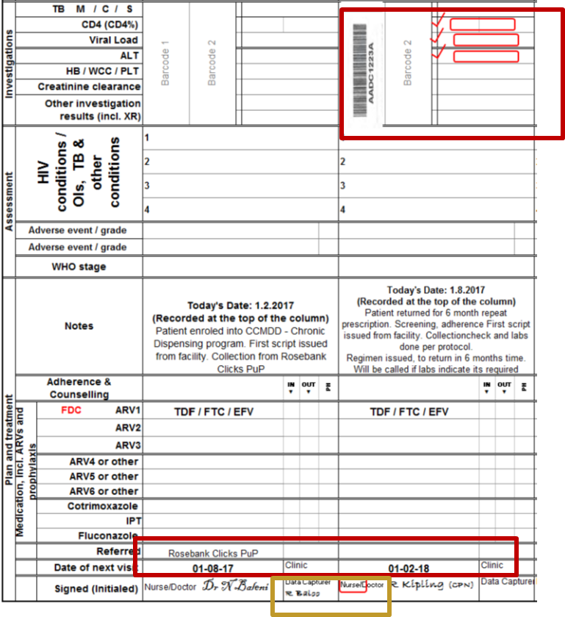


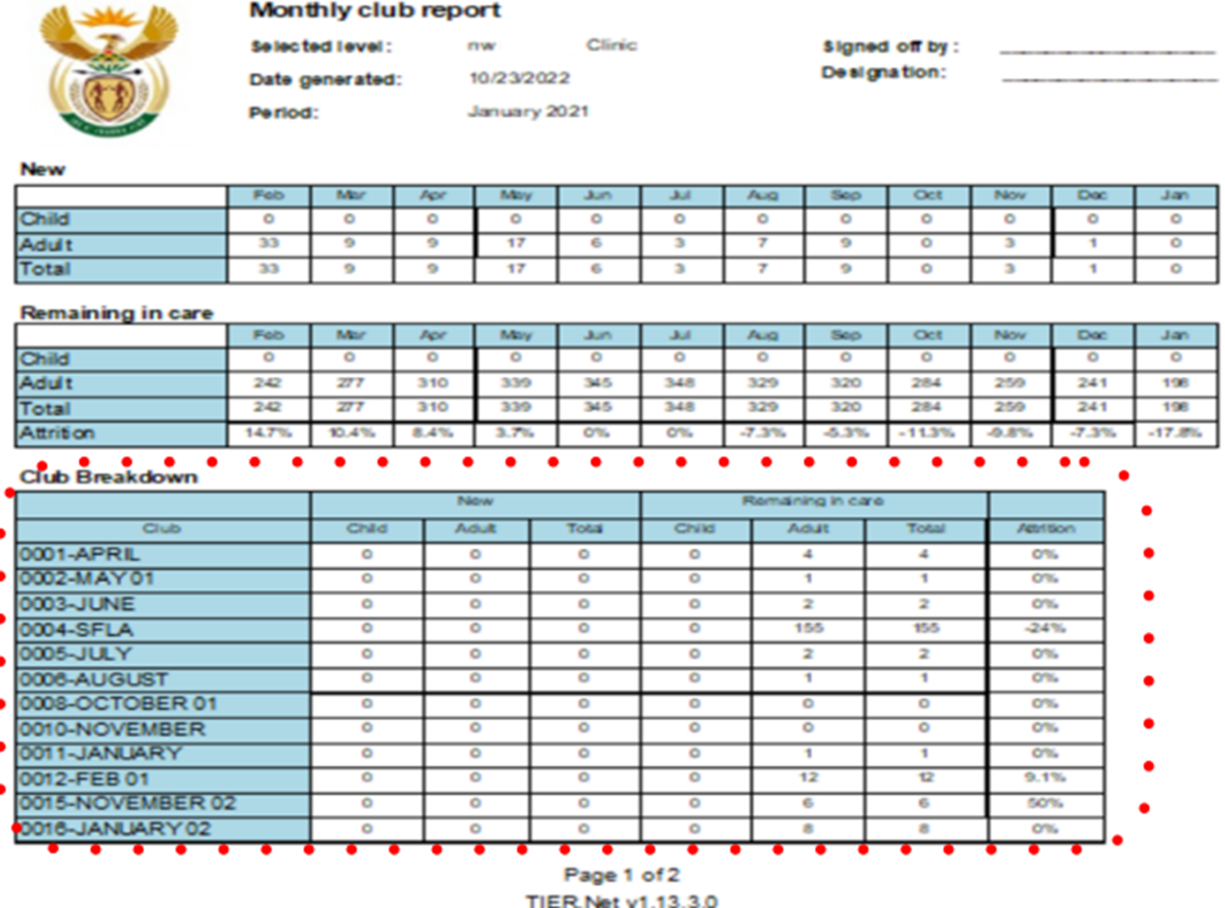
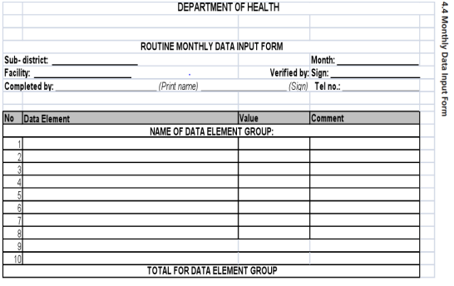
Module 3: Learning Objectives
To understand the documentation in clinical stationery and in Adherence Club registers and the data flow for adherence clubs.
To understand the registration and deactivation of adherence clubs and the individual patients in SynCH and TIER.Net
To understand the generation and use of monthly summary sheets to monitor client attendance, medication pick-up and identify potential adherence issues

Slide 81
Documentation in the Adherence Club Register

Slide 82
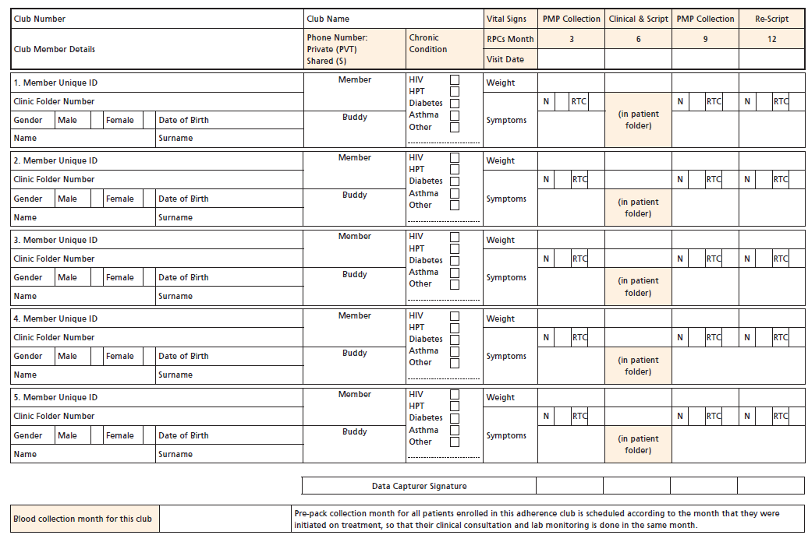
Adherence Club Register

Slide 83

Adherence Club Register Example
 | Club Number: 2003 | Club Name: Demoville |  | Vital Signs | PMP collection | Clinical & Script | PMP collection | Re-Script
 | Club Member Details | Phone Number: Private (PVT) or Shared (S) | Chronic Condition: | RPCs Month | 3 | 6 | 9 | 12
 |  |  |  | Visit Date | 03-01-2025 | 07-04-2025 | 07-06-2025 | 06-09-2025
1. Member Unique ID: 820606 0002 088 |  | Member 082 333 4625 (PVT) | HIV HPT Diabetes Other Asthma___ | Weight | 63 | 64 | Buddy | TFOC
Clinic Folder Number: 100005436
Gender: Male Female | Date of Birth: 05/06/1982 | Buddy 071 501 3267 (S) |  | Symptoms | N RTC _____________ _____________ | - (in patient folder) | N RTC _____________ _____________ | N RTC _____________ _____________
Name: Bulima | Surname: Tataloko
4. Member Unique ID: 820606 0002 089 |  | Member 082 305 6011 (PVT) | HIV HPT Diabetes Other _______ | Weight | 73 | 71 | BTC
Clinic Folder Number: 100005437
Gender: Male Female | Date of Birth: 01/08/1972 | Buddy 048 029 6023 (PVT) |  | Symptoms | N RTC _____________ _____________ | - (in patient folder) | N RTC _____________ _____________ | NN RTC _____________ _____________
Name: Tantari | Surname: Tataloko
4. Member Unique ID: |  | Member 072 230 5401 (PVT) | HIV HPT Diabetes Other _______ | Weight | 71 | 71 | 68 | 60
Clinic Folder Number: 100006489
Gender: Male Female | Date of Birth: 06/09/1987 | Buddy 074 661 2567 (PVT) |  | Symptoms | N RTC _____________ _____________ | - (in patient folder) | N RTC _____________ _____________ | N RTC _weight loss___ _high BP_____
Name: Annah | Surname: Nkosi
4. Member Unique ID: |  | Member 084 646 0692 (S) | HIV HPT Diabetes Other _______ | Weight | 74 |  | 75 | 75
Clinic Folder Number:
Gender: Male Female | Date of Birth: | Buddy 083 738 2918 (S) |  | Symptoms | N RTC _____________ _____________ | - (in patient folder) | N RTC _____________ _____________ | N RTC _____________ _____________
Name: | Surname:
ü
ü
ü
ü
ü
ü
ü
ü
ü
ü
ü
ü
ü
ü
ü
ü
ü
ü
ü
ü
ü
ü
ü
ü
ü
ü
ü
ü
ü
Blood collection month for this club: | April | Pre-pack collection month for all patients enrolled in this adherence club is scheduled according to the month that they were initiated on treatment, so that their clinical consultation and lab monitoring is done in the same month.

Slide 84
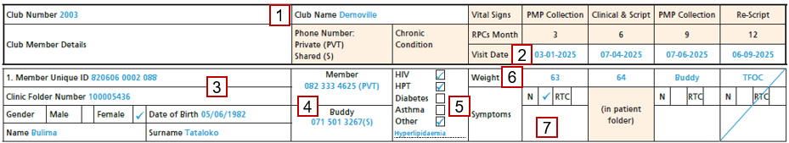
Adherence Club Register Instructions
Facilitator
Write the name and number of the Adherence Club. MUST correspond to TIER.Net & SyNCH.
Fill columns 1 & 2 with client ID, folder number, gender, DOB, and name.
In the 3rd column, note member/ buddy phone number.
Mark “PVT” (private) or “S” (shared).
In the 4th column, tick the relevant chronic condition(s)
Tick "other" and specify if not listed.
Record the client’s weight in the "Weight" row, or write "Buddy" if someone else collects the medication.
In the row “Symptoms”, tick
  “N” (normal) or
  “RTC” for abnormal symptoms, and Referred to Clinician.
List any abnormal symptoms.
  Skip this for clinical consultation months (6, 18, 30, etc.), as data is recorded in the client’s folder. Facilitators still screen symptoms during rescripting months (12, 24, etc.)
Record in the "Visit Date“ row current and next club session dates

Slide 85
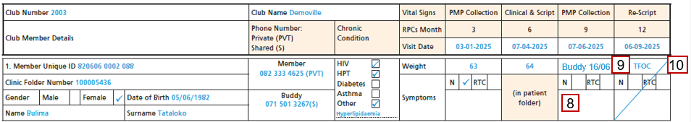
Adherence Club Register Instructions (cont.)
Facilitator
If the client is absent, leave weight/symptom fields blank; if no buddy is present, contact the client.
If client/buddy arrives within 28 days, register normally and note the PMP collection date.
Recorded Outcome | Outcome Event
DNA | Did Not Attend: Did not collect PMP at club session or present at clinic within 28 days.
BTC | Back to Clinic: Re-entering facility care from club.
TFOC | Transfer out to different club: Patient transferred to another club within facility. (Record future club number.)
TFO | Transfer Out: Patient is leaving the facility to attend a different clinic.
RIAC | Remaining In AC: Patient is remaining in AC.
RIP | Rest In Peace: Patient has died.
If neither client nor buddy arrives within 28 days, or once the patient's outcome is known, record the outcome in the weight row.

Slide 86
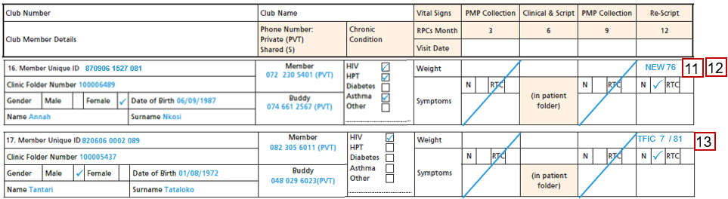
Adherence Club Register Instructions (cont.)
Facilitator
For new club members who join the club after session 1, place the patient sticker in column 1 or record all patient information as above.
Cross out all sessions prior to their first session and write “NEW” and their weight and symptoms for the first session they attend.
If a patient returns after exiting, record them as a new patient and start a new row.
Do not use the original row.
For patients transferred in from another club write “TFIC” and the prior club number.

Slide 87
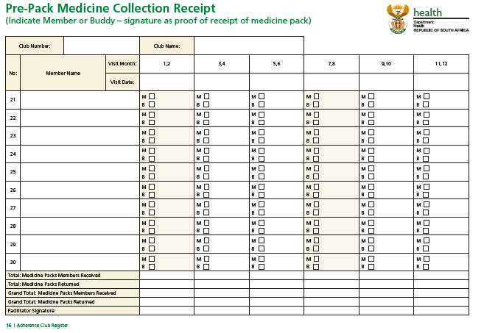

Pre-Pack Medicines Collection Receipt
Write club dates in the “Visit Date” row
M3
M6
M9
M12
Tick if medication was collected by Member or by Buddy.
Fill in members’ names in this column.
After the session, tally total PMPs received by members and returned.
Annah Nkosi
Align rows with enrolment register numbers.
Facilitator ensures signing during AC.
Nurse or Pharmacist during grace period
Facilitator
Members/buddies must sign for their pre-pack medication.
Nurse
Pharmacist

Slide 88
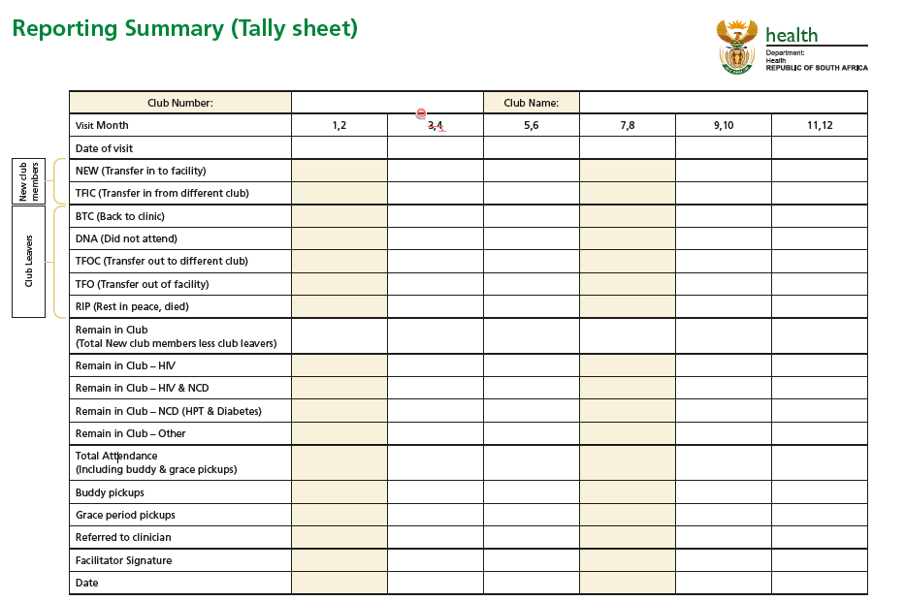
Reporting Summary (Tally Sheet)
Within 29 working days of the Club session, complete and sign the register's final tally sheet. Submit to the Club Manager.
Club Facilitator
M3
M6
M9
M12
Club Manager checks and signs the register's final tally sheet. Submit it to the data clerk.
Club Manager
After data capturing, the clerk signs the page 3 of the register and each sheet under the column for that visit.
Data Capturer
The facilitator verifies the data capturer sign-off and collects the register for the next session
Facilitator

Slide 89
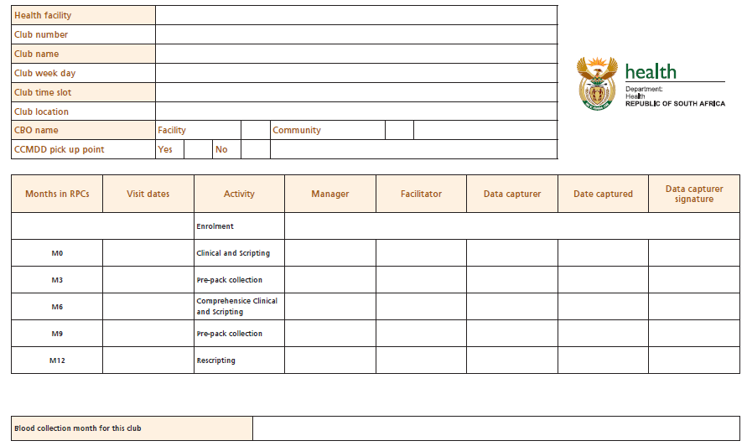
Adherence Club Sign-off Sheet page 3
At the AC formation:
The upper part of the sheet is completed by the Club Facilitator.
The blood collection month is filled in by the Club Nurse.
Club Facilitator
After the grace period or register close off for each session, each of the following persons will sign off the lower table:
Club Facilitator: when register is closed.
Club manager: after register is closed
Data Capturer: when the data is captured.
Club Facilitator
Club Manager
Club Facilitator
Data Capturer
Data Capturer
Data Capturer
Club Nurse

Slide 90
Documentation in ART Clinical Stationery

Slide 91
Documentation in ART Clinical Stationery
Record date of clinical visit.
Documentation in notes section by clinician
Indicate patient issued 1/12 repeated 6 times.
1
12
X 6
Indicate patient enrolled in DMoC in ‘referred’ field.
If Adherence Club, stipulate name of AC and date of DMoC enrolment.
Record next clinical visit date in ‘next visit date’ field.
The next clinical visit is 6 months from current visit.
1234RosslynCommunityAC 5.8.2016

Slide 92
Documentation of Follow-up Consultation
Barcode next to investigations indicate -clinician requested laboratory tests.
However, results yet to be recorded into clinical stationery.
Documentation by clinician in clinical stationery
Consultation recorded.
Next visit date captured & Folder flows to data clerk after consultation.
Data clerk/Data Capturer to receive folder
Data captured.
Data clerk initials bottom of clinical chart.
Patient folder is returned for filing.

Slide 93
Deactivation from Adherence Club - Documentation
Documentation by clinician in clinical stationery
If a patient is deactivated from RPCs (due to pregnancy, illness, missed pick-up or choice), the reason must be documented in their folder.
Today’s Date 1.07.2017
Facilitator confirmed that patient has not collected PMP in more than 30 days.
Patient agreed to come on 01.08.2017. Deregistered from Adherence Club.
Data clerk/Data Capturer to receive folder
Data captured.
Reason for deactivated is captured in notes section of TIER.Net.
Data clerk initials bottom of clinical chart.
Patient folder is returned for filing.

Slide 94
Deactivation from Adherence Club Documentation (cont.)
1
2
Double click on the last month in which a visit was recorded.
In this example it is August 2017.
Click Edit
Select Delete All in the treatment visit screen.
Data clerk/Data Capturer to Amend TIER.Net
4
3
In this image the forward captured months have been removed.
The November visit has been captured as a single month script issued.
But - this deletes too many visits.
Replace the visits with regimen collection until the missed appointment.
In the working example it is October 2017. In this example you would change “Months ART Prescribed” to 3 Month.
Click Save.
5
Per clinical record next appointment date is 22.12.2017.
The notes section has been updated to reflect the deactivation from RPCs. NB! The reason can be clinical, missed appointment or by choice.
Future visits will be captured as monthly visits, per normal practice.
If the patient is re-enrolled in the CCMDD program the SOP would be followed as from the start.
Deactivation is a temporary removal from the program. The patient can be re-enrolled.
Deregistration is a permanent removal from the program due to demise or a duplicated profile.

Slide 95
Capturing for Adherence Club in TIER.Net

Slide 96
TIER.Net Adherence Club Set-up

Slide 97
Adherence Club Set-up on TIER.Net
Set up an Adherence Club
Ensure that the box "Show Adherence clinic field on HIV data screen" is ticked from the options window for capturing adherence-club information.
The following steps can be completed by the user:
Click Setup >> Adherence Clubs.
Click on New.
Tool >> Options
The Adherence Club details window will open.
The Adherence Club name number (4-digit number) automatically updates as you add a new adherence club/chronic club.

Slide 98

Adherence Club Set-up on TIER.Net (cont.)
After the 4-digit number in the Name box, type the adherence clinic name of choice.
Select the Type of adherence clinic: - Pre-ART club patients only
  ART club patients only
  Mixed is a club type which consists of both pre-ART and ART patients
Select the VL due month.
Enter the Date In the Created Date box.
(The date defaults to today's date.)
Click Save
Close the Adherence Clubs window.
The adherence club is now created.

Slide 99
Capture of RPCs Patients in TIER.Net

Slide 100
Capture of RPCs Patients in TIER.Net
Data clerk/Data Capturer to receive folder
In (ART) patient treatment tab –DMOC check-box must be checked
In notes section -that patient has been enrolled in a particular DMOC (AC) captured
Capture current visit (visit date and treatment regimen) and 5 months additional script (total, 6 months)
Capture next appointment date
Save and close

Slide 101
Capture of RPCs Patients in TIER.Net (cont.)
Capture current visit date
Data clerk/Data Capturer
Capture 6-month repeat
1
12
X 6
Record in notes section of TIER.Net.
Stipulate AC name
(if facility has multiple)
1234RosslynCommunityAC 5.8.2016
Capture ‘next visit date’ field.

Slide 102
Capture of RPCs Patients in TIER.Net (cont.)
In patient treatment tab
On DMOC drop down list. Select FAC-Pup/Ext-Pup or adherence club
Data clerk/Data Capturer
In “months ART prescribed” field – select 6 months
In “next clinical appointment date” field – insert next appointment date
Select Adherence Club at the bottom according to clinical notes

Slide 103
Capture of RPCs Patients in TIER.Net (cont.)
Data clerk/Data Capturer
1
2
3
4
5
6
Visit – 1 Feb 2017 captured
Next clinical appointment date recorded as August
Patient enrolled in RPCs.
Collecting meds at 1234RosslynCommunityAC
Under ‘months ART prescribed’ field – 6 months selected
Treatment notes section capture name of Adherence Club. E.g. 1234 RosslynCommunityAC

Slide 104
Bulk Capturing of Multiple Adherence Clubs in TIER.Net

Slide 105
Bulk Capturing of Adherence Clubs in TIER.Net
A
In TIER.NET, go to tools >> Bulk Adherence Club Visit Capturing to open the Adherence Club Multi Visit Capture window.
Select the name of the adherence club (ensure this matches the adherence club register).
Select the date of visit as recorded in the register.
Select the date of the next visit as recorded in the register.
Select the type of visit as recorded in the register.
Select “generate” to go to the next section to add adherence club client details.
Search for clients using name, surname, or folder number, and add the clients for the visit on the chosen day.
Select the visit option:
  ATTENDED (if client attended).
  LATE (if client was late or attended at a later date).
  DNA (client did not attend).
B
Select the outcome or type of visit for the next visit for the client:
  TFOC - Transfer out of Club
  BTF - Back to facility
  TFO - Transferred out to another facility
  RIP - The client has died
If TFOC was selected, select the club within the facility that the patient transferred to.
If TFO was selected, select the facility that the patient transferred to.
Select or confirm the date by clicking on the blank cell below Date (Optional).
Check the Viral Load Requested checkbox, if a viral load was requested (Optional).
Repeat this process for all clients reported in the register.
Remove clients by selecting the client record and clicking remove patient.
Once complete, click save visits.
A pop-up will appear informing you that the visits
were generated successfully.

Slide 106
Bulk Capturing of Adherence Clubs in TIER.Net
1
2
If your facility has many clubs and club patients, you can capture visits in bulk, one adherence club/chronic club at a time.
Click on Tools >> Bulk Adherence Club Visit Capturing.
The Adherence Club Multi Visit Capture window will open.
Data clerk/Data Capturer
5
4
Select one of the following from the This Visit drop-down list:
Attended - the patient attended this visit
Late - the patient was late for this visit and did attend on another date after the specified date.
DNA - the patient did not attend the visit.
Search for, and add, the patient for the visit on the chosen day.
Double-click on the patient record that appears in the grid, to add them to the visit list
3
To add patients to the list select Add Patients. The patient Lookup window will appear.

Slide 107
Bulk Capturing of Adherence Clubs in TIER.Net (cont.)
6
Select the outcome or type of visit for the next visit for the patient:
TFOC - Transfer out of Club
BTF - Back to facility
TFO - Transferred out to another facility
RIP - The patient has died.
Data clerk/Data Capturer
7
8
If you select TFOC or TFO, you must select a destination.
Click on the blank cell below Destination.
  TFOC was selected, select the club within the facility that the patient transferred to.
  If TFO was selected, select the facility that the patient transferred to.
Select or confirm the date by clicking on the blank cell below Date
Check the Viral Load Requested checkbox, if a viral load was requested.
9
Repeat this process until you have added all your patients.
Patients may be removed from the list by selecting the patient record and clicking on Remove Patient
After you have added all your patients, click on Save Visits at the bottom of the Adherence club Multi Visit Capture window.
10
A pop-up will appear confirming the visits were generated successfully.
Click OK to close the Adherence club Multi Visit Capture window.

Slide 108
Capturing for Adherence Club in SyNCH

Slide 109
Adding and Deactivating an Adherence Club in SyNCH
109

Slide 110
Capturing an Adherence Club in SyNCH
Register the Adherence club in the system.
In SyNCH, capture all designated adherence clubs using the AC/OP administration tool.
Adherence club clients who receive prepacked PMP through CCMDD need to be registered in SyNCH.
When a client is being enrolled or has their prescription renewed, navigate to the PuP Selection Tab within SyNCH.
Select the modality and choose the correct DMOC modality for the client from the available options.
Select Adherence Club (AC) from the list, which will appear after an AC has been registered in the system.

Slide 111
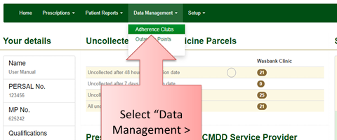
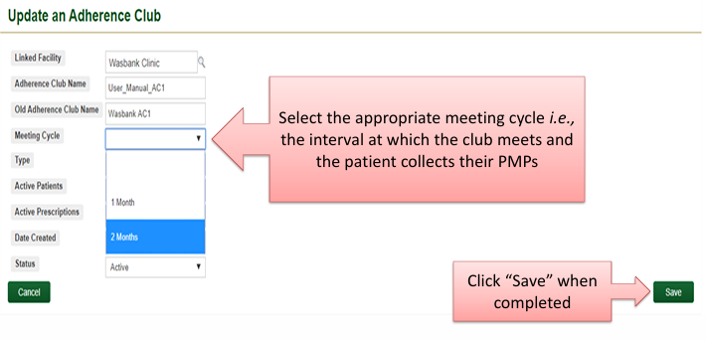
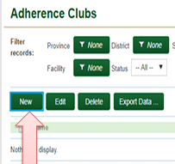
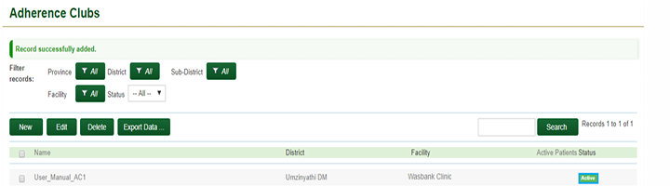
SyNCH: Adding a New Adherence Club
Linked facility is auto-populated.
Enter the unique adherence club name using the prescribed format according to the relevant SOP.
Enter the old adherence club name (prior to new SOP adoption) if applicable.
1
3
Select
“Data Management > Adherence Clubs”
Select the appropriate meeting cycle i.e., the interval at which the club meets and the patient collects their PMPs
4
Click “Save” when completed
5
2
The newly added AC will appear on AC list with an “Active” status
Click on “New”
to add an AC”
6

Slide 112
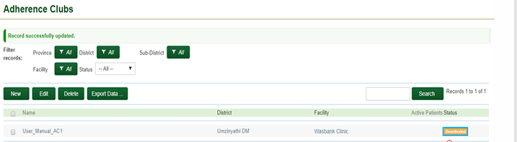
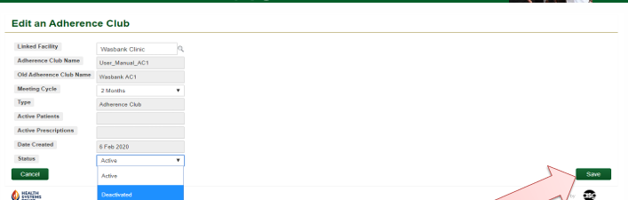
SyNCH: Deactivating an Existing Adherence Club
The status of the AC will change to “Deactivated”
4
1
Click on the selection button next to the correct Adherence Club or click on the Adherence Club name
Then click “Edit”
2
Under the “Status” Field select “Deactivated”
3
Then click “Save”

Slide 113
Creating a New Prescription in SyNCH
113

Slide 114
SyNCH – Creating a New Patient Prescription
Select “Prescriptions” > “Manage Prescriptions”
1
Click “New” to create a patient profile
Search if a patient profile exists on SyNCH
2
OR
2
3
Click on “Create New Prescription” button

Slide 115
SyNCH – Creating a New Patient Prescription (cont.)
4
Patient must provide
verbal consent - select “Yes”
To prevent “double counting” of patients and track how many patients have converted from “paper based” to SyNCH
Select “No” if this is patient’s first enrolment
select “Yes” if patient was previously enrolled on the CCMDD programme on paper prescription)
5

Slide 116
SyNCH – New Patient Details Tab
Date of birth is auto-populated if SA ID is entered (MUST be captured manually if Passport/asylum seeker no. provided)
Passport/Asylum number is compulsory if no SA ID available
7
8
Type in 1st line of address, type “Enter”, then capture 2nd line of address
9
Compulsory fields denoted with an (*)
6

Slide 117
SyNCH – Existing Patients
Details of patient’s last visit including last health facility visit (provided the health facility uses SyNCH)
10
“Use Patient Record” option will NOT auto- populate the previous prescription
“Use Patient Record & Prescription” option will auto-populate the previous prescription provided that the patient is seen in the same province.
11a
11b

Slide 118
SyNCH – Next of Kin / Nominated Collector
Details of patient’s next-of-kin are non-compulsory but should be captured if available
12
The fields for a nominated collector can be partially completed. However, the patient must provide all details to the health facility before the proxy can collect any PMPs.
13

Slide 119
SyNCH – RPCs Selection Tab
14
Select AC if patient chooses to collect PMP from AC.
Note: These options will only be visible if the AC have been captured on SyNCH using the AC/OP administration tool.

Slide 120
SyNCH – Adherence Club Selection
All data appearing in these pop-up boxes reflects data captured on the AC/OP administration tool
15
16
Click on the selection button next to the correct AC
Then Click “Select”

Slide 121
SyNCH – Adherence Club Selection
The Adherence Club will appear here
17
The next scheduled adherence club date must be entered on the calendar provided.
19
Note: Meeting dates ≤ 21 days or ≥56 days from the profile/prescription submission date cannot be selected.
20
18
Once the AC is selected using the pop up box…
The next AC meeting date (collection date) will determine subsequent collection dates.
21

Slide 122
SyNCH Prescription Tab

Slide 123
SyNCH – Prescription Tab
Enter patient’s clinic file number
1
4
5
Click on “Add selected dosage” to add the medicine regimen to the
Prescription.
Select the appropriate dose for the medicine from the drop-down list
Select the Condition (Indication) from the drop down list. Only conditions approved for CCMDD will appear here
Repeat process to add more medicines to the prescription.
2
6
Select the medicine
associated with the
condition from the drop-down list. Only
medicines approved for dispensing by CCMDD will appear here
3

Slide 124
SyNCH – Prescription Tab
Select “Consulting Room” if medicine is issued from consulting room.
7
8
If medicine is not
issued from consulting
room, select “Not
Dispensed”
9
Repeat this for each medicine on the script
If all medicines are issued from the consulting room, the prescriber can click on the “First Issue: Mark all” button
10

Slide 125
Patient Deactivation or Deregistration in SyNCH

Slide 126
SyNCH – Patient Deactivation or Deregistration
For either deactivation or deregistration > Select the Deactivate/Deregister tab.
1
2
3
4
3
2
To Deactivate: Click on “Patient Deactivation” tab
From the dropdown box the reason for patient deactivation must be selected, then click on “Deactivate Patient”. Comments can be provided.
OR
To Deregister: Click on “Patient Deregistration” tab “Patient Deregistration” tab
Reason for patient deregistration must be selected.
Then click on Deregister Patient.
Deactivation is a temporary removal from the program. The patient can be re-enrolled.
Deregistration is a permanent removal from the program due to demise or a duplicated profile.

Slide 127
Reporting on Differentiated Models of Care

Slide 128
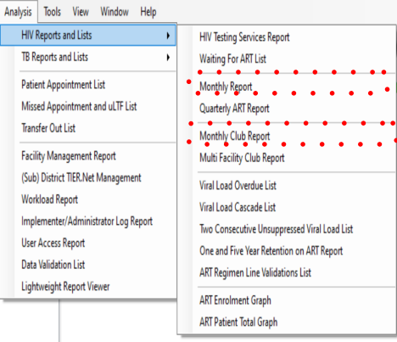
HIV Reports and Line Lists
Reports with Data on Repeat Prescription Collection Strategies.
Note, Patient enrolment on RPCs is also included in some of the line lists:
VL Overdue;
Patient Appointment;
Missed Appointment
uLTF lists

Slide 129
Reporting on RPCs Enrolment in HIV Monthly Report
Differentiated Models of Care (DMOC) Total patients enrolled in Repeat Prescription Collection Strategies (RPCs)
Adherence Clubs | Fac-PUP | Ex-PUP | Total | % of patients on ART enrolled in RPCs
1
Total patients enrolled in Adherence Clubs
2
3
Total patients enrolled in RPCs
Proportion of patients enrolled in RPCs out of total TROA

Slide 130
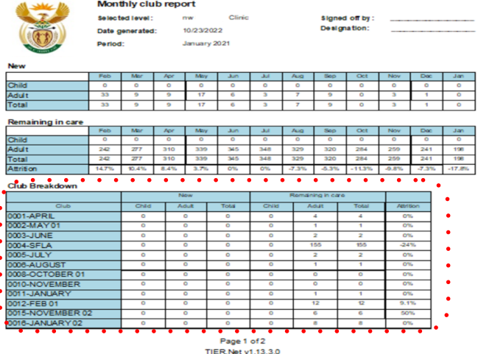
Monthly Club Report
New patients (enrolled this month) in RPCs
1
Total patients remaining in care
2
Breakdown of the number of patients enrolled in clubs and RIC per club
3

Slide 131
NIDS Definition of Adherence Clubs
Data element name | Patients on ART enrolled in repeat prescription collection strategies of Adherence clubs
Bulleted Definition | All patients receiving ART repeat prescription through adherence clubs collection strategy
Extended Definition | Stable patients should be decanted to a differentiated model of Care (Facility, external and adherence club) and have a clinic appointment at least once every 6 months for clinical review and to review if the patient still meets the stable criteria. A Stable patient meets the following eligibility criteria: VL<50copies/ml HbA1C<8%, 2 consecutive BP<140/90
Use and Context | ART stable patients who have been decanted to Differentiated model of care (adherence clubs). The extent to which adherence club model of care have been scaled up and reporting on this indicator will support efforts to expand the offer of this model.
Inclusions | INCLUDE: all ART stable patients decanted to adherence club for collection of Repeat prescription for ART. Include: ART stable patients also receiving chronic treatment for Hypertension, Diabetes Mellitus, & TB treatment.
Exclusions | EXCLUDE: Chronic patients without ART
Collected by | Clinicians
Collection points | ART offering facilities & hospital

Slide 132
Process for Data Elements Collection & Reporting
Enrolment of patients into DMoC/CCMDD patients
Data clerk receives folder
Record in notes sections of TIER.Net the DMOC option
Captures current visit date
Captures next visit data
Generation of the Monthly ART report from TIER.Net
Generates the Monthly ART report from TIER.Net.
Prints the report
Zoom the report into Differentiated Models of Care (DMOC): Total patients enrolled in (RPCs) for data.
Generate the monthly data input (MDI) form
Transcribe DMoC total patients enrolled in RPCs into the monthly data input (MDI) form.
Submits hard copy report to the FM
Verify, approve, and submit MDI to (sub)district.
File MDI & Monthly ART report.
Transcription of data elements from monthly ART report into DHIS
In webDHIS find data entry in Apps
Select data set NIDS 20XX (monthly), then the period reporting
Filter for HIV
Transcribe data elements from Monthly ART report into the variables on the tool
Enter complete
Sub-district capturing of data from MDI data form in webDHIS.
Obtain validated data input forms from the facility manager Day 3 of each month
Conduct a rapid data quality assessment of data on the data input forms – must be 100% complete and with no gaps or outliers without comments.
Capture monthly data into the webDHIS
Subdistrict level collation, QA and corrections, submission to district.
Check for missing data, add comment and mark record for follow up.
Follow up on incorrect monthly data and do edits once the source documents have been corrected
Validate and submit to district.
File records and store safely in a facility with controlled access

Slide 133
Thank You

Slide 134
Acknowledgements
The Adherence Club Establishment Module (SOP 5.2) is the result of a collective effort involving extensive consultation, research, and writing. It incorporates the latest information from the National Department of Health, the World Health Organization (WHO), and other reputable institutions.
The collaboration and support of the Provincial Departments of Health, District Health teams, healthcare facilities, BroadReach Health Development and other partner organisations, and technical experts have been instrumental in bringing this valuable resource to completion. The National Department of Health extends its sincere appreciation to all contributors and acknowledges the support and resources provided by partner organisations throughout this process.
Centers for Disease Control (CDC) and BroadReach Health Development (Pty)Ltd.
Dr. Musa Manganye, Director HIV/AIDS Treatment Care and Support, National Department of Health
Ms. Lufuno Malala, Programme Manager: Care & Treatment, DMOC, Cluster: HIV/AIDS & STIs National Department of Health
Published by the National Department of Health,
Dr. AB Xuma Building, 1112 Voortrekker Rd, Pretoria Townlands 351-Jr, Pretoria, 0187
© 2025 Department of Health
Requests to reprint this publication should be addressed to the:
Director, Care and Support Directorate, National Department of Health
Private Bag X 828
Pretoria 0001
South Africa
Email: Musa.Manganye@health.gov.za
Telephone: +27 (0)12 395 9216/9393
This publication was supported by Grant Number: CDC-RFA-GH21-2126.NU2G. Its contents are solely the responsibility of the National Department of Health of South Africa and do not necessarily represent the official views of the Implementing Agency.

