Slide 1
Training and Orientation

Slide 2
Outline
Introduction
Re-engagement principles
Who is a re-engaging client?
What to do for returning routine care clients?
What to do for re-engaging clients?
Reception staff
Clinicians
Counselling – clinicians/counsellors
Pharmacy staff
Facility implementation plan

Slide 3
Introduction
1.

Slide 4
Why to focus on re-engaging patients now?
Critical to provide a positive patient experience when a person returns to care to increase likelihood of sustained retention and viral suppression
As South Africa aims to reach its 95-95-95 targets and achieve its 1.1. million campaign, there are MORE people who have previously been on ART than people who have never been on ART
Increasingly important to focus on people previously on ART
People need to be encouraged back into care and retained long term:
To reduce morbidity and mortality (improve people living with HIV’s health outcomes)
To reduce transmission (reduce new infections)

Slide 5
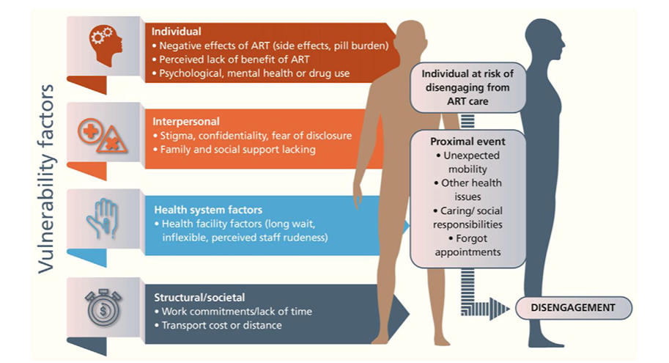
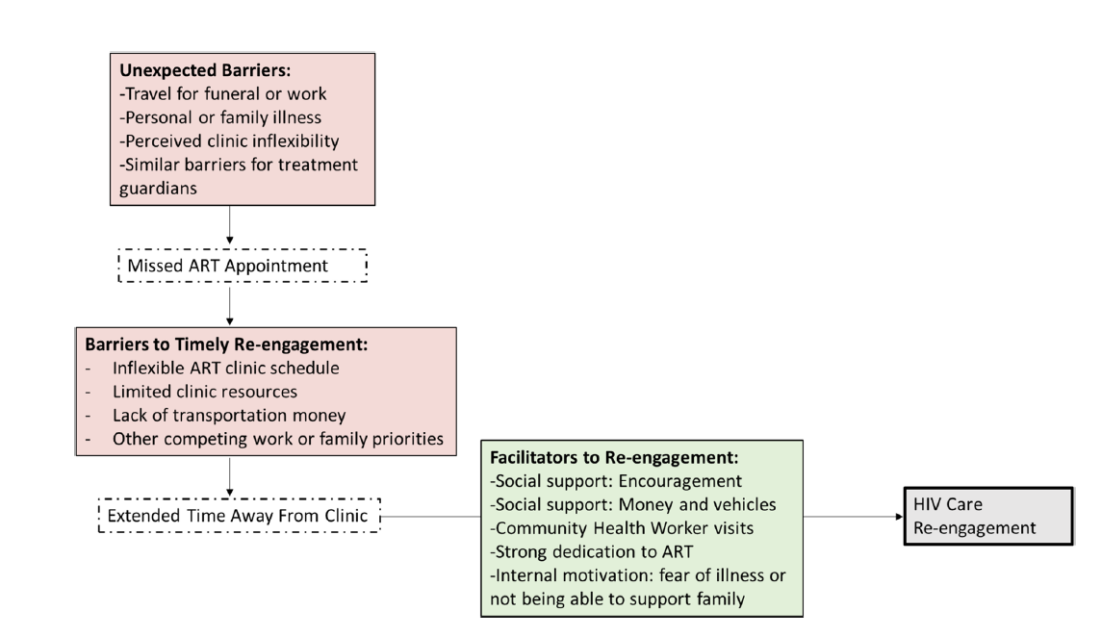
REASON FOR RE-ENGAGMENT
Reasons for
disengagement
Burke et al 2024
2. Barriers to
timely
re-engagement
= reasons for
prolonged
disengagement
Chamberlain et al 2022

Slide 6
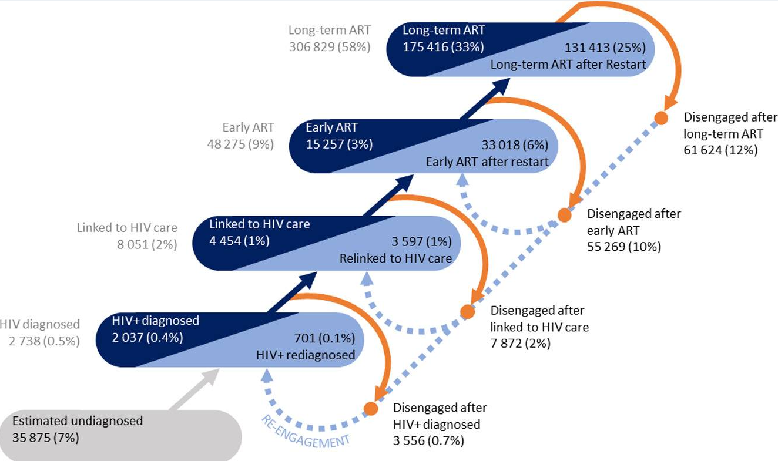
WESTERN CAPE DISENGAGEMENT DATA
Euvrard et al 2024

Slide 7
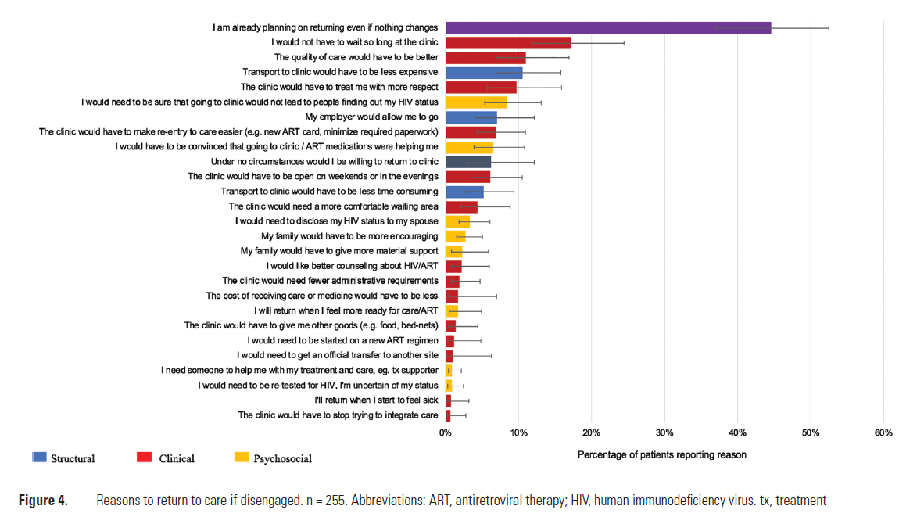
FACILITATING RE-ENGagEMENT
How to use stated barriers to facilitate re-engagement:
Reduce time in clinic
Increase quality of care
Provide respectful care
Make re-entry easier and quicker
Sikazwe et al et al 2021

Slide 8
Prolonged disengagement
Tracing
Hospitalization
Morbidity/mortality
Transmission
Tracing
Hospitalization
Morbidity/mortality
Transmission
Easy quick durable returns

Slide 9
How to support easy quick durable returns
Personal motivation to re-engage
Remove
Barriers
Add
Facilitators
Prioritize respectful care for people returning and those observing others returning
Re-engagement completed on day of return
Increase appointment schedule flexibility: When missing a visit & at return
Reduce waiting time at clinic when return
Don’t intensify appointment schedule after return unless clinically necessary
Enable “silent” transfers

Slide 10
Revised ART guidelines central to the re-engagement approach
Updated clinical and service delivery guidance at the same time
Coordinated national technical working group
Developed a revised re-engagement algorithm
Aim 1: Implement optimized ART regimens
Clinical updates
Aim 2: Create an enabling environment to support (re)engagement in care and adherence
Person-centred service delivery updates
The first time clinical and service delivery guidelines were revised together to ensure coordinated approach to of both components of HIV care
Notes:
The 2023 ART guideline revision considered critical to improving retention and viral suppression, taking an integrated approach that recognised that clinical management includes person-centred service delivery.
Clinical and the service delivery components were considered throughout the ART guideline, towards improving the 2nd and 3rd 95 targets.

Slide 11
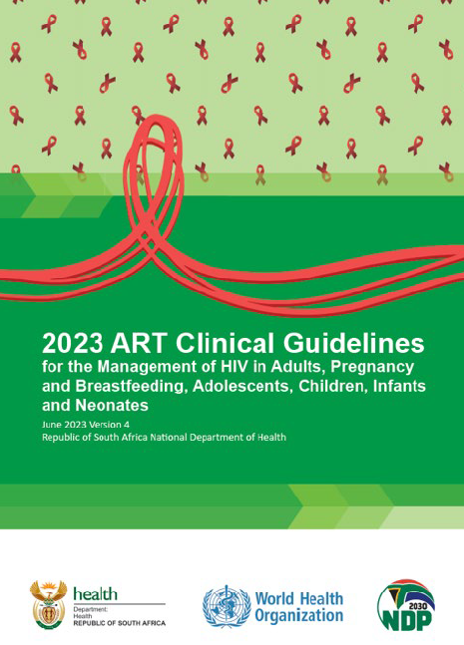
Guiding principles:
Acknowledge it is normal to miss appointments
DO NOT require the patient to provide transfer documents, provide transfer-in and ART same day
Adherence counselling not appropriate for all returning clients
Differentiate the follow-up plan on re-engagement depending on client needs and preferences
Increasing the intensity of service provision may NOT be supportive, restrict to when clinically necessary.
Expedited access to 3MMD and repeat prescription collection strategies (RPCs/DMOC)
New streamlined re-engagement algorithm in ART guidelines supported by revised SOP which set out guiding principles and narrative explanation
June 2023

Slide 12
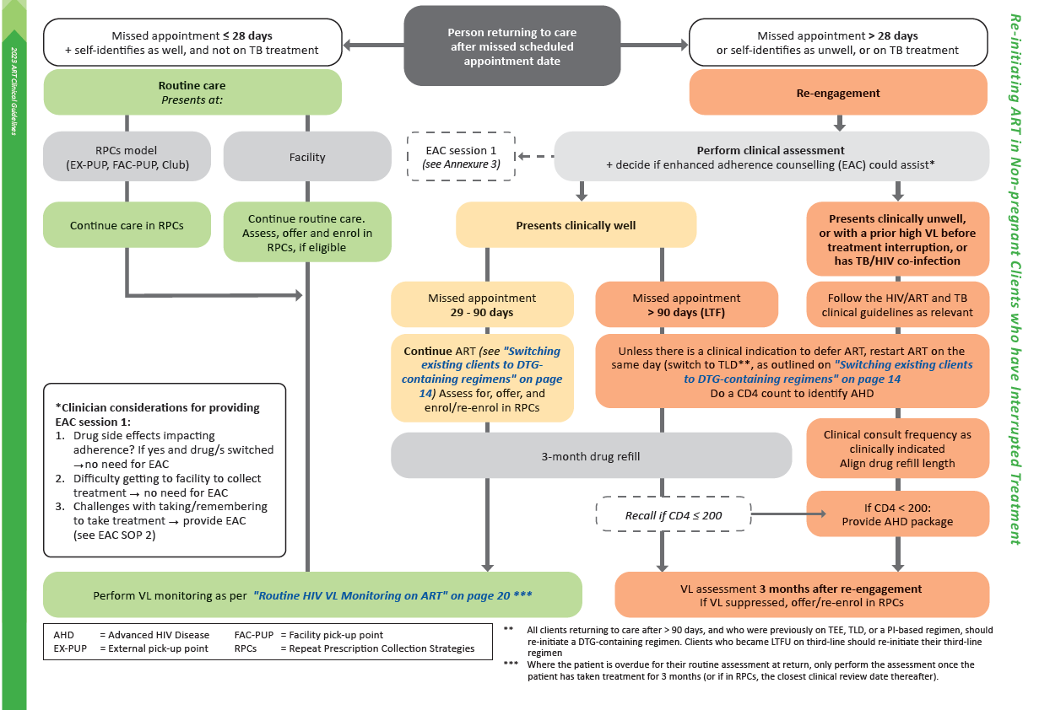
Streamlined approach to re-engagement
ART guidelines Pg 12

Slide 13
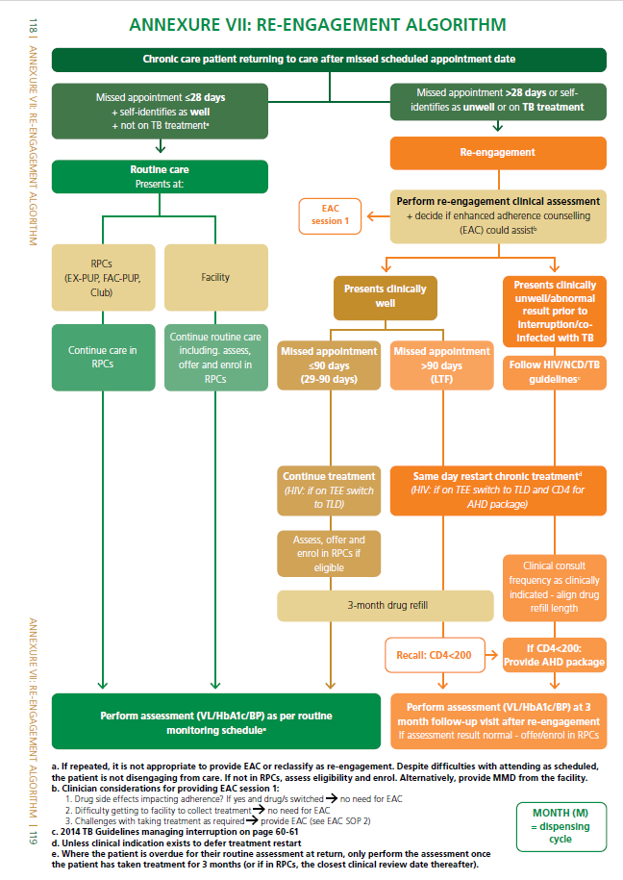
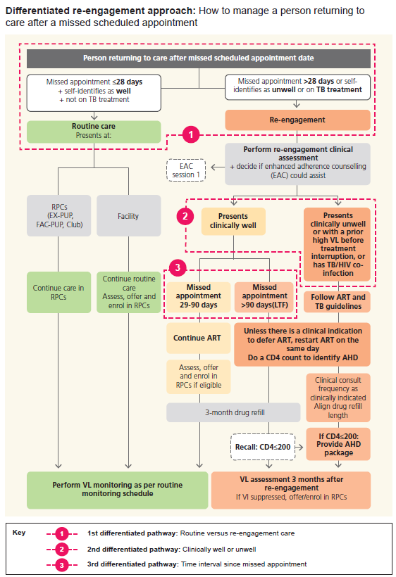
How Many algorithms are there?
AGL portrait version
DMOC SOP 8 version

Slide 14
Re-engagement principles
2.

Slide 15
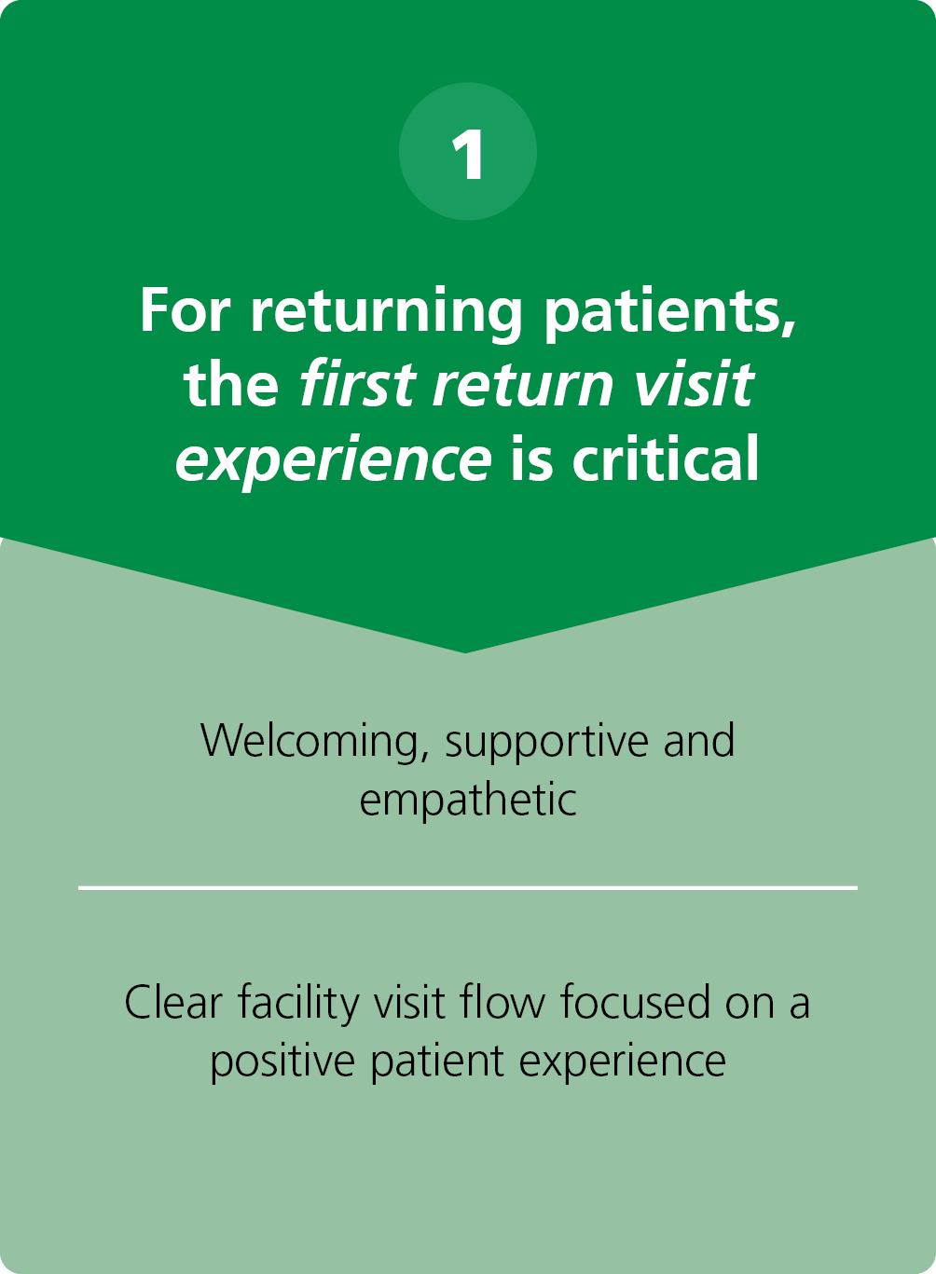
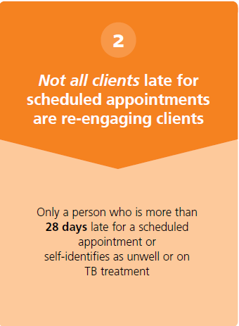
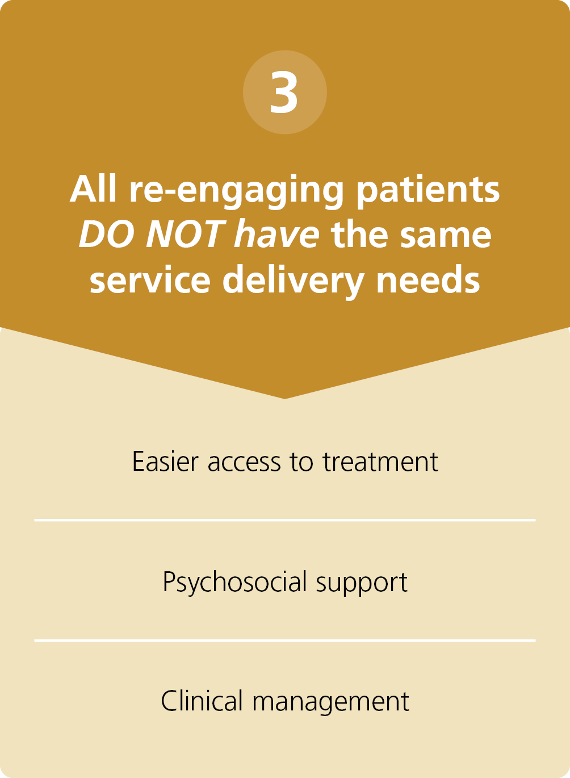
RE-ENGAGEMENT THREE KEY PRINCIPLES

Slide 16
DIFFERENTIATE RE-ENGAGMENT APPROACH CONSIDERATIONS
Clinical Factors
Ensure a returning person who needs a clinical assessment gets one
Aim to reduce unnecessary burden for client + healthcare system
Practical and simple to implement
Duration since missed appointment

Slide 17
Who is a re-engaging patient?
3.

Slide 18
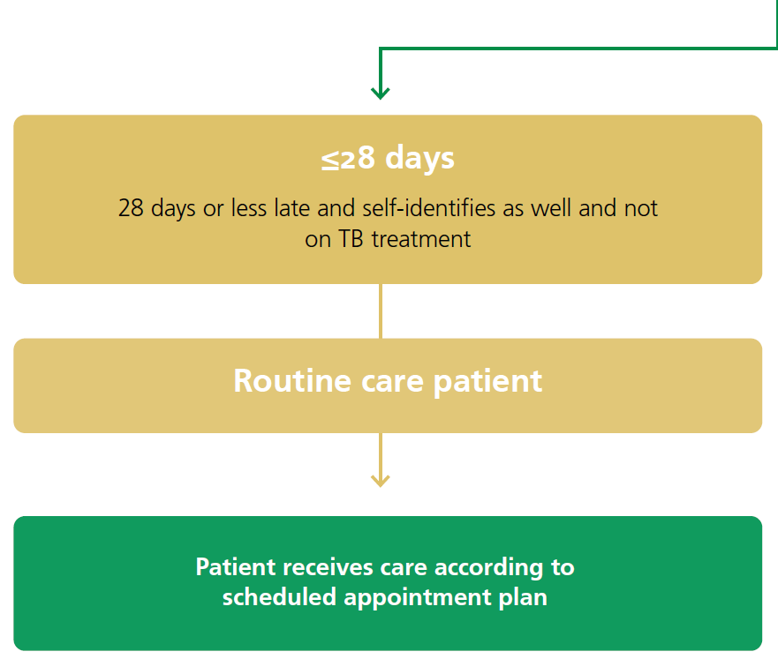
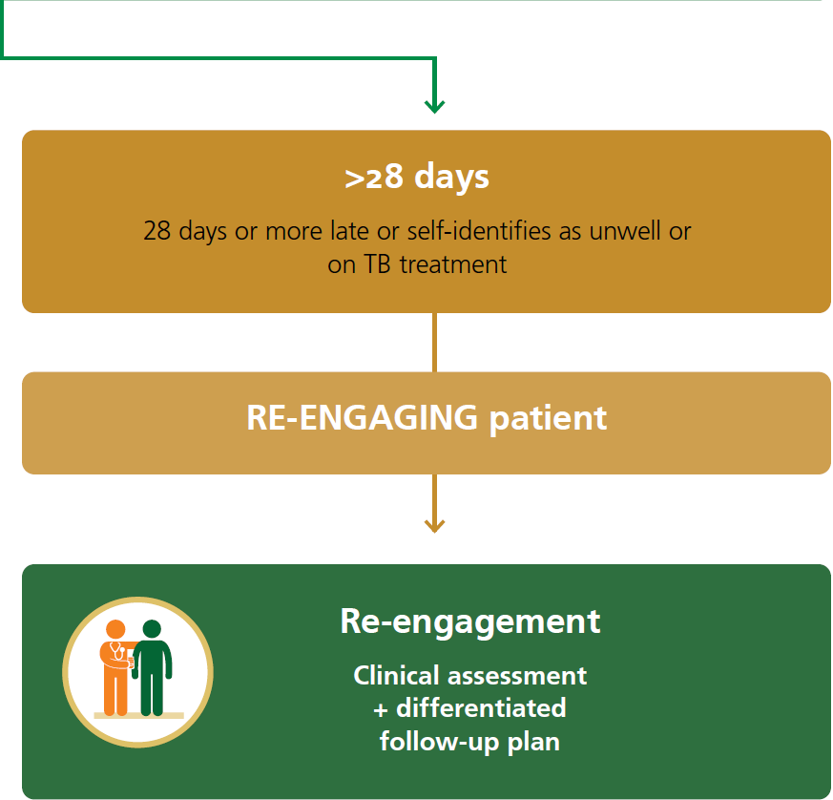
Who is a re-engaging CLIENT?
WHY?
Support appointment flexibility rather than disengagement in era of DTG
Reduce unnecessary burden/administration complexity on clients and health system

Slide 19
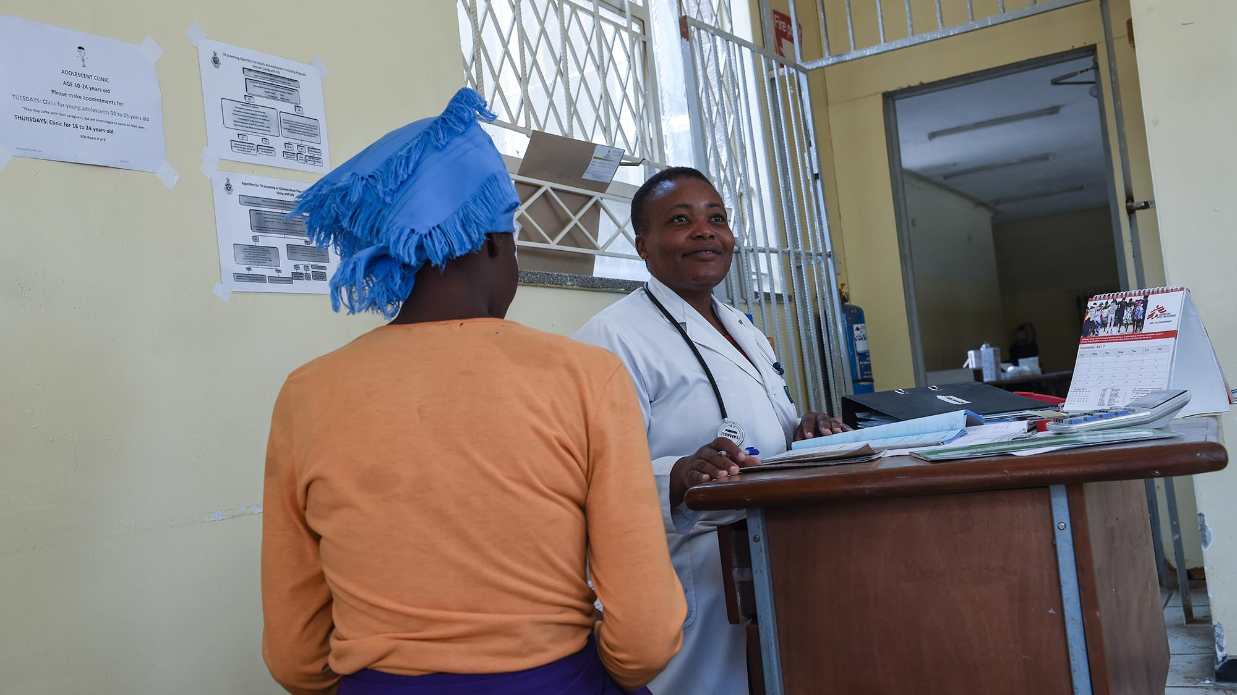
What to do for a returning routine CLIENT?
4.

Slide 20
What to do for returning routine CLIENTS?

Slide 21
What to do for returning routine CLIENTS?

Slide 22
What to do for a re-engaging patient?
5.

Slide 23
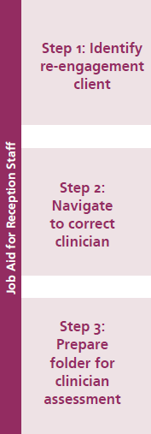
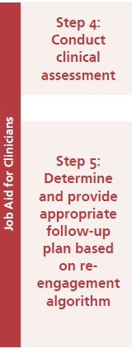
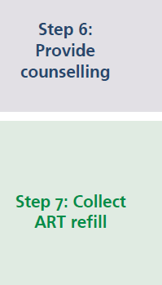
What to do for re-ENGAGING CLIENTS?

Slide 25
STEP 1: IDENTIFY IF CLIENT IS RE-ENGaGING?

Slide 26
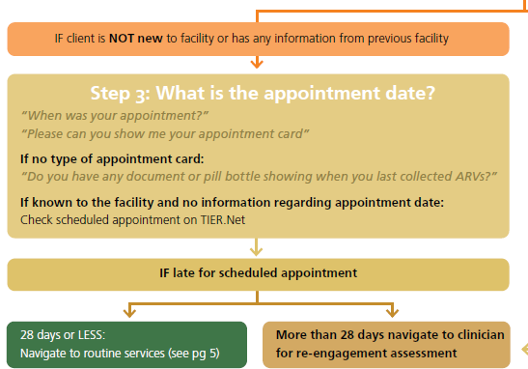
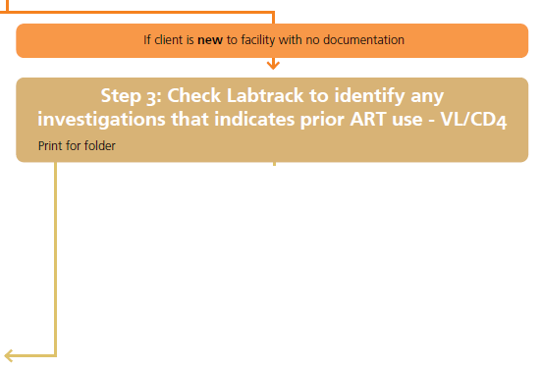
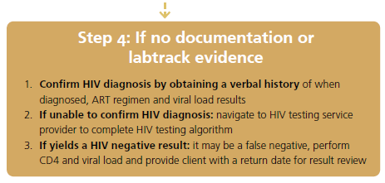
1. DECIDE IF CLIENT IS RE-ENGAGING?

Slide 27
STEP 1: IDENTIFY IF CLIENT IS RE-ENGaGING?

Slide 28
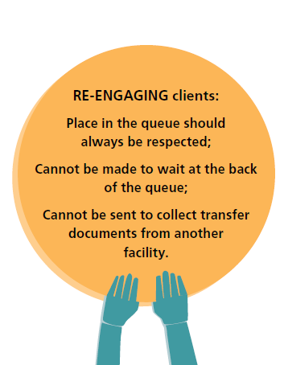
STEP 2 and 3: NAVIGATE TO CLINICIAN WITH LAB RESULTS

Slide 29
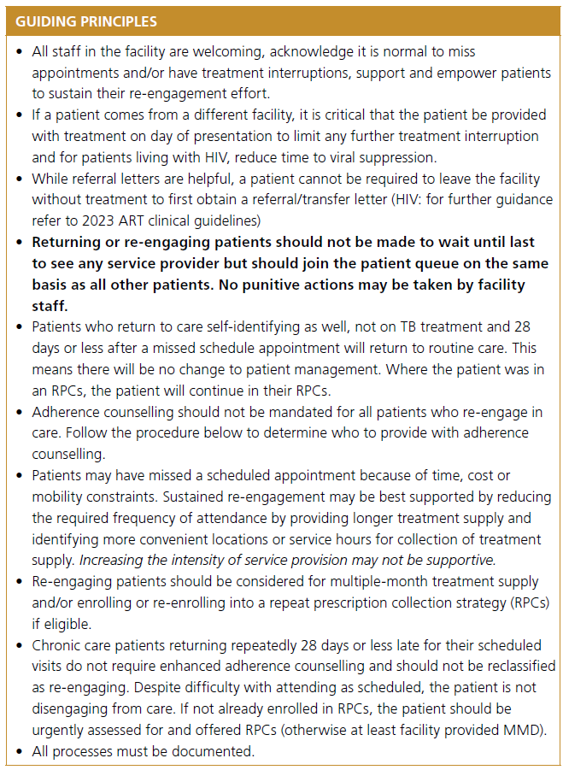

Slide 31
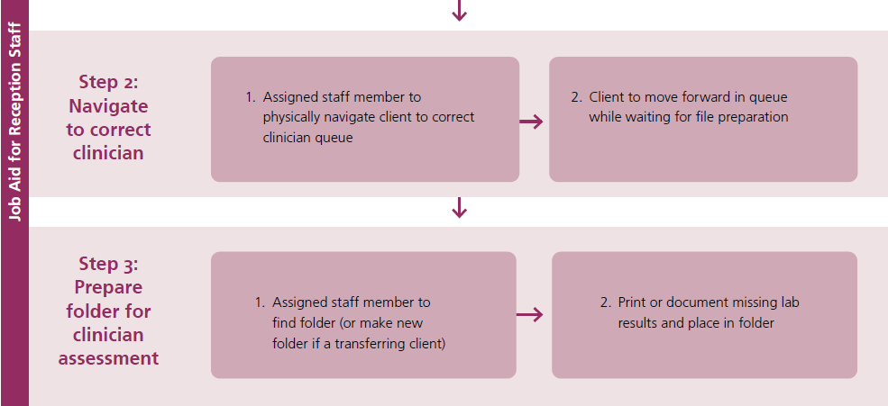
STEP 4: CONDUCT CLINICAL ASSESSMENT

Slide 32
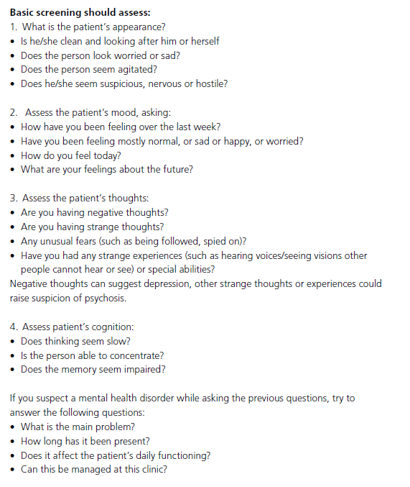
Re-engaging CLIENT clinical assessment
Mental Health Screen →
Annex 4 AGL
Annex 2 DMOC SOPs

Slide 33
STEP 4: CONDUCT CLINICAL ASSESSMENT

Slide 34
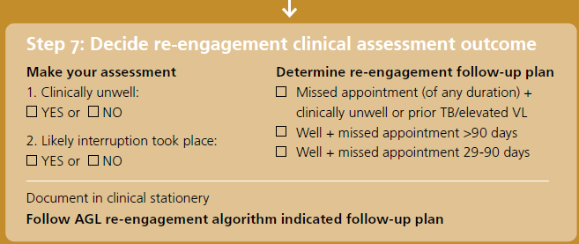
Re-engaging CLIENT clinical assessment

Slide 35
Differentiated follow-up based on each CLIENT’s CLINICAL NEEDS AND TIME SINCE MISSED APPOINTMENT
3 differentiated
follow-up plans :
Re-engagement algorithm follow-up plans

Slide 36
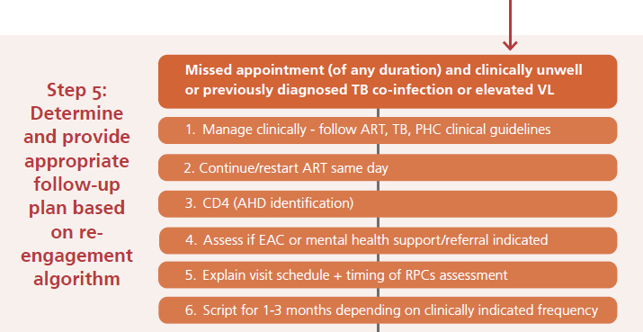
What to do for re-engaging CLIENTS:
Missed appointment (of any duration) and clinically unwell or previously diagnosed with TB co-infection or elevated VL

Slide 37
Re-engagement visit PROCEDURE:

Slide 38
Follow-up visit schedule

Slide 39
What to do for re-engaging CLIENTS:
Clinically well + missed appointment by > 90 days (LTF)

Slide 40
Re-engagement visit PROCEDURE:

Slide 41
Follow-up visit schedule

Slide 42
What to do for re-engaging CLIENTS:
Clinically well + missed appointment for 28-90 days

Slide 43
Re-engagement visit PROCEDURE:

Slide 44
Follow-up visit schedule

Slide 45
IN SUMMARY

Slide 47
STEP 6: WHAT COUNSELLING TO PROVIDE AND TO WHO?

Slide 48
Enhanced adherence counselling (eac) session 1

Slide 49
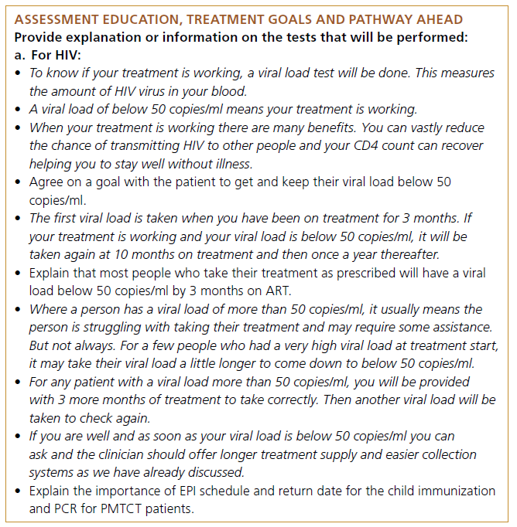
Fast track initiation counselling (ftic) VL EDUCATION

Slide 50
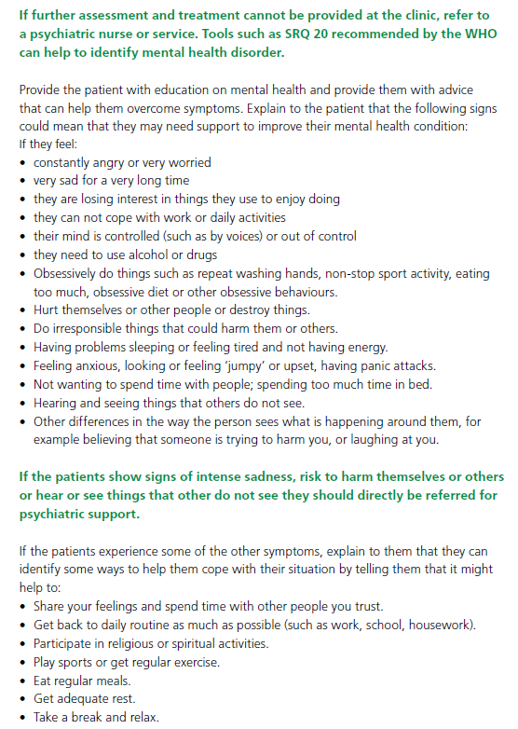
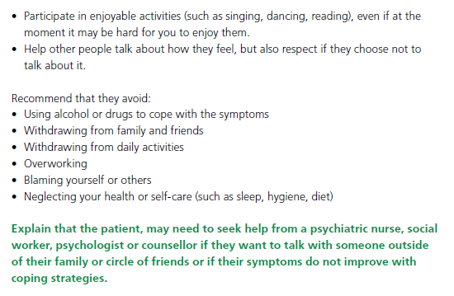
MENTAL HEALTH SCREEN + SUPPORT
Annex 4 AGL/Annex II DMOC SOPs
Mental health support
Mental health referral
Mental health referral

Slide 51
Pharmacy staff
What to do for a re-engaging patient?

Slide 52
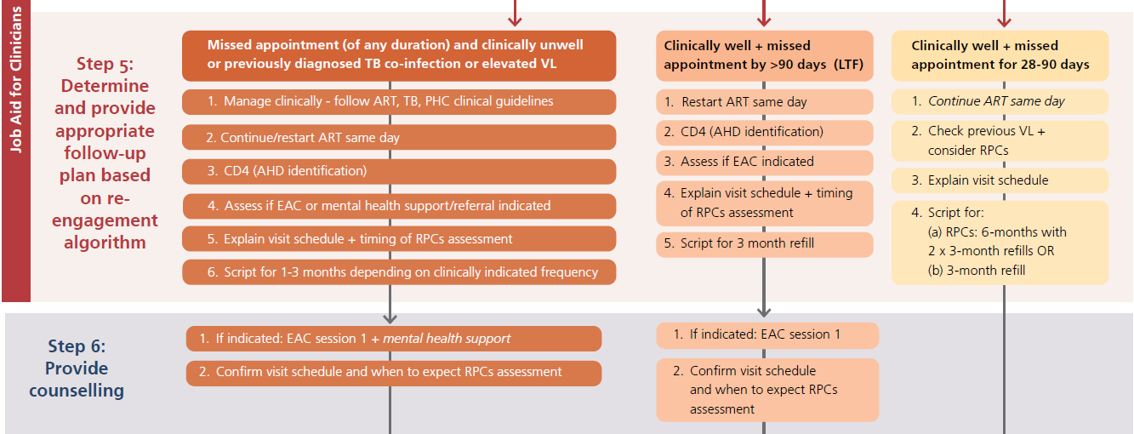
STEP 7: WHAT IS PHARMACY TEAM’S RESPONSIBILITIES?

Slide 53
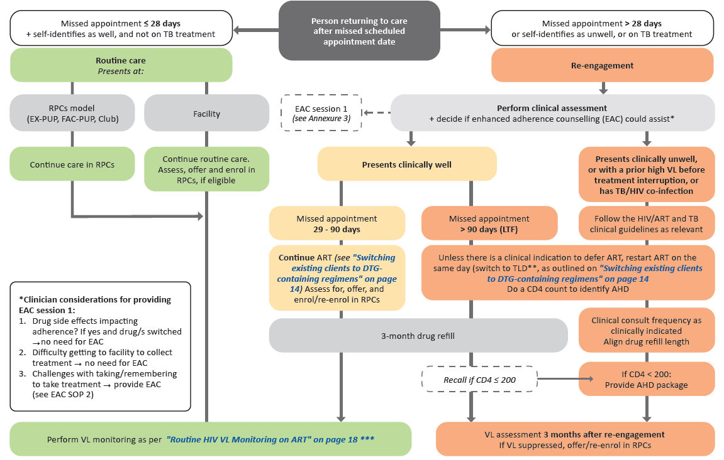
IN SUMMARY
Re-engaging need clinical assessment
1. Routine client – needs less-intensive DSD
2. Clinically unstable need clinical management, check AHD, clinician discretion visit schedule, VL in 3 months time
3. Clinically well,
Short interruption, need less-intensive DSD or 3MMD
3. Clinically well,
Longer interruption, check for AHD and 3MMD until next VL

Slide 54
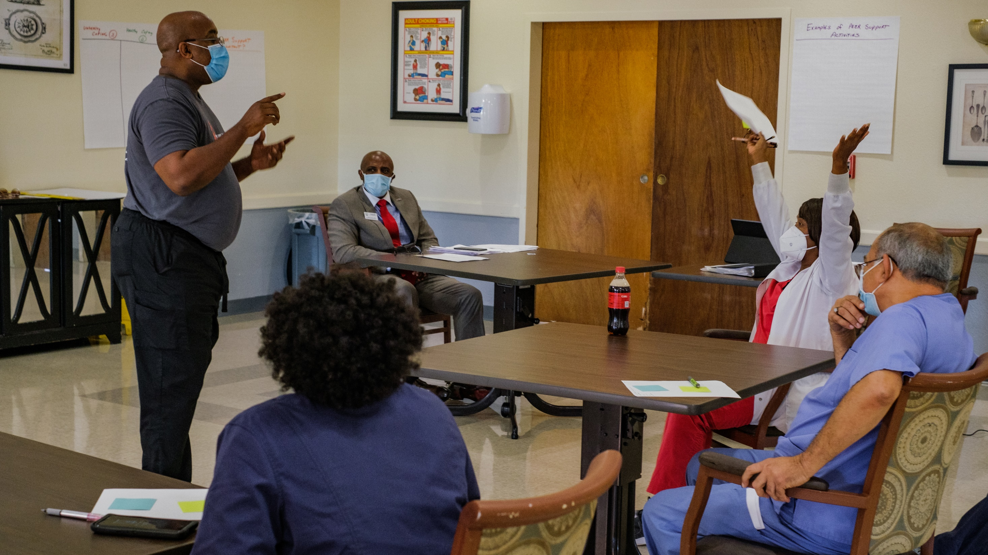
Facility implementation plan
6.

Slide 55
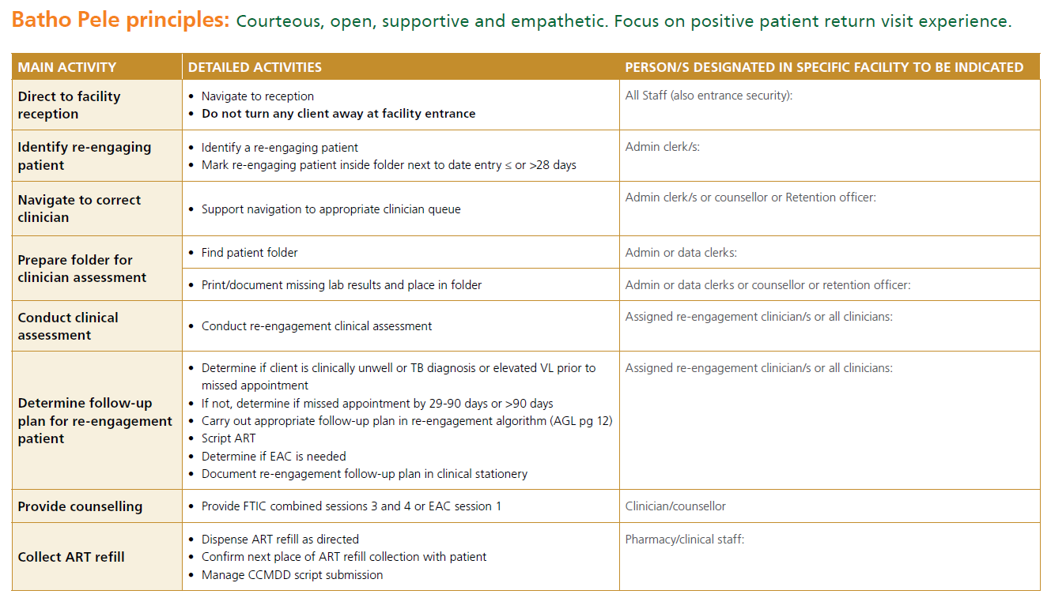
Assign role players in facility

