Slide 1
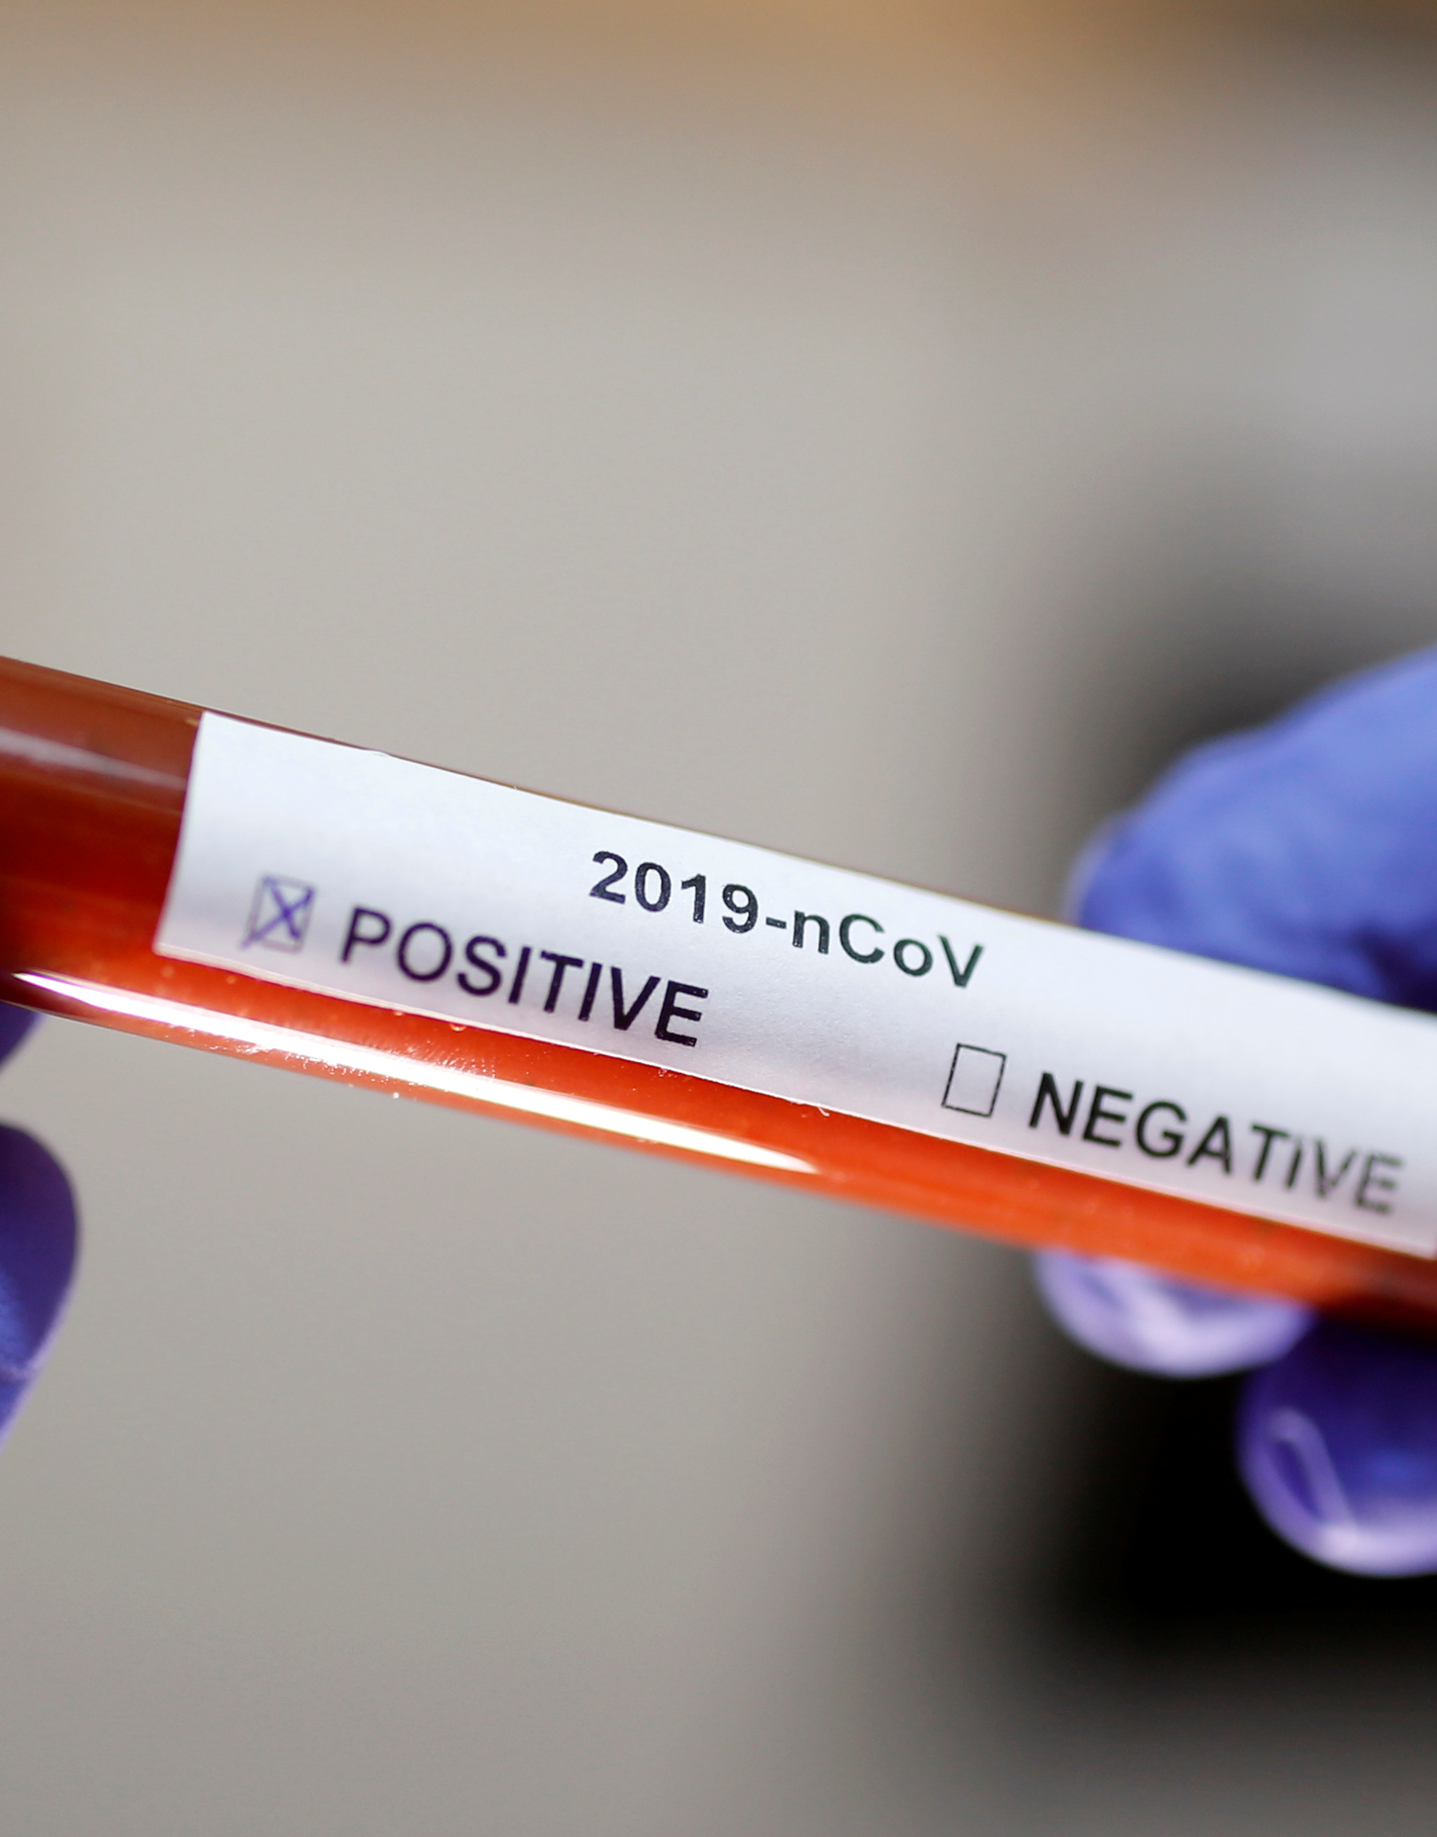
Management of suspected COVID-19
HCW to use N95 respirator and cover eyes – especially when taking a specimen or performing an aerosol generating procedure)
Use the screening questionnaire
If screening is positive, give the patient a medical/surgical mask
Direct the patient to a separate area, preferably isolation room if available
Educate the patient on how the cover the nose and mouth while coughing or sneezing (flexed elbow may be used)
Educate the patient on hand hygiene
Early initiation of supportive therapy may be required
Limit patient’s movements in the facility

Slide 2
Laboratory Diagnosis
Polymer Chain Reaction (PCR method)
GeneXpert will be used in near future
Antibody-based tests not recommended for COVID-19 diagnosis
Point of care antigen tests not recommended
Samples to be sent are: upper respiratory tract samples (nasopharyngeal and oropharyngeal swabs in universal transport medium) or lower respiratory tract samples if possible (sputum, tracheal aspirates, bronchoalveolar lavage fluid). Saliva may be used when directive is in place
Notes:
Antibody tests not yet defined and should not be used at this point in time.

Slide 3
Repeat testing
Repeat testing may produce false negative results due to factors such as poor sampling technique, suboptimal specimen storage (e.g. unavailability of viral/universal transport medium, or specimen not stored at cold temperatures), the site the sample is obtained from, and the time point at which the swab is taken (viral loads are usually highest early on in the disease course).
Test may be done if there is strong suspicion in consultation with ID specialist
Keep in mind differential diagnosis
No role for repeat confirmatory test- one single positive is enough

Slide 4
Differential diagnosis include
Influenza
Both conventional and atypical bacterial pneumonias
CD 4 count < 200 cells/mm3
Pneumocystis jiiroveci pneumonia (PJP)
Malaria (in patients with history of travel)
Non-infectious cases of dyspnoea and/or fever should be considered, such as pulmonary emboli, myocardial infarction, and heart failure

Slide 5
Appropriate tests for patients with severe disease who require admission
HIV test (if status unknown)
Full blood count + differential count
Blood culture
Nasopharyngeal and/or oropharyngeal swabs for detection of viral and atypical pathogens
Chest radiography
Sputum for MCS and Mycobacterium tuberculosis detection (GeneXpert MTB/RIF Ultra)
Urine for lipoarabinomannan (LAM) if HIV positive
Beta-D-glucan and expectorated sputum/tracheal aspirate for PJP if HIV+ and clinically suspicious of PJP (Do not induce sputum though)

Slide 6
For patients with mild disease who do not require admission
Limited workup depending on the specific presentation
HIV test
Sputum GeneXpert MTB/RIF Ultra if patient is HIV positive and is coughing
If HIV negative, TB test may be done if the individual is a close contact of a TB patient

Slide 7
Specimen collection for SARS-CoV-2 testing
Collect appropriate samples
Lower respiratory tract samples are preferred because the lower respiratory tract is the primary site of infection
Take combined nasopharyngeal and oropharyngeal swabs in ambulatory patients and sputum (if produced) and/or tracheal aspirate or bronchoalveolar lavage in patients with more severe respiratory disease
Use universal/viral transport medium for swabs, if available; sterile container for sputum and aspirates

Slide 8
How to collect nasopharyngeal and oropharyngeal swabs
Oropharyngeal swab
Nasopharyngeal swab

Slide 9
Step 1: Equipment and materials
Complete specimen submission form and person under investigation (PUI) form and contact line list found here
Nasopharyngeal (NP) and oropharyngeal (OP) flocked swabs
Tube containing universal transport medium (UTM), if UTM unavailable may use gel or send dry in sterile tube
Tongue depressor
Gloves, N95 respiratory (or surgical mask if unavailable) and eye protection
Tissue for the patient to use after sample collection
Biohazard bag for disposal of non-sharp materials
Cooler box and cooled ice packs
Ziploc plastic specimen bag

Slide 10
Step 2: Record keeping
Complete
Complete the specimen submission form and person under investigation (PUI) form and contact line list
Place
Place specimen submission and PUI form into a Ziploc bag
Label
Label the tube of universal transport media (UTM) with the patient’s name and date of birth and sample type

Slide 11
Step 3: Collection of nasopharyngeal swab (NPS)
Don gloves, respirator or mask, and eye protection.
Open a sterile flocked swab at the plastic shaft.
Ask the patient to tilt his/her head back. Estimate the distance from the patient’s nose to the ear.
Gently insert swab into the nostril and back (not upwards) to the nasopharynx until a slight resistance is met.
Rotate swab 2-3 times and hold in place for 2-3 seconds.
If resistance is met before fully inserted, remove and try the other nostril.
Slowly withdraw the swab and put it into the specimen container.
Break plastic shaft at the break point line and close the tube.

Slide 12
Step 4: Collection of oropharyngeal swab (OPS)
Wearing gloves, respirator or mask, and eye protection, and holding the UTM with the nasopharyngeal swab in, open a second flocked swab for OPS collection.
Ask the patient to tilt their head back and mouth open.
Hold the tongue down with a tongue depressor.
Have the patient say “aahh” to elevate the uvula.
Swab each tonsil first, then the posterior pharynx in a figure-8 movement.
Avoid swabbing the soft palate or the tongue with the swab tip as this can induce the gag reflex.
Place the swab into the same UTM tube with the NPS already in and break off the shaft at the break point.
Tightly close the tube.
Place the closed tube with two swabs in the Ziploc bag.
Remove gloves, respiratory or mask, and eye protection and wash hands thoroughly.

Slide 13
Step 5: Transport of specimens
Ensure the cooler box and ice packs stay at 2-8°C.
Transport to NHLS or private laboratory on the day of specimen collection.
Contact NHLS laboratories as below for shipping instructions or contact private laboratories directly.
If shipping to NICD (for reference testing), mark:
“Suspected COVID-19, NHLS/NICD, Centre for Respiratory Diseases and Meningitis (CRDM), Lower North Wing, SAVP building 1 Modderfontein Rd, Sandringham, Johannesburg, 2131”
NHLS laboratories use usual overnight regional courier service; private labs will ship via existing systems.

Slide 14
Step 6: NHLS laboratory contact details
Eastern Cape Province:
Dora Nginza Virology Lab Dr Howard Newman 0413956152
Free State Province:
Universitas Virology 051 405 3162 After hours ask for virologist on call 051 405 3033
Gauteng Province:
Charlotte Maxeke Laboratory 082 329 2914
Tshwane Virology Laboratory Prof Sim Mayaphi 012 319 2351
DGM Virology Laboratory Dr Temitayo Famoroti 012 521 4398
KwaZulu Natal Province:
Inkosi Albert Luthuli Academic Hospital Virology Dr Khanyisile Msomi 031 240 2791/4
Northern Cape Province:
Universitas Virology 051 405 3162 After hours ask for virologist on call 051 405 3033
Western Cape Province:
Tygerberg Virology 021 938 4330/4934
Groote Schuur Hospital Virology 021 404 4129/3091

Slide 15
Empiric treatment of other pathogens
Depending on the clinical syndrome that is appropriate
Conventional community-acquired pneumonia see SA community-acquired pneumonia guidelines
Atypical pneumonia (see above guidelines)
Notes:
Refer to NEMLC Standard Treatment Guidelines. These guidelines may be downloaded on your phones from Google Play.

Slide 16
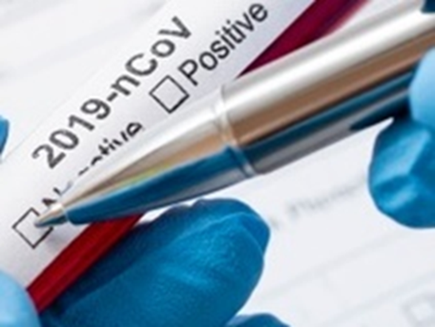
Managing Patients at Home while Awaiting Lab Results
Suspected cases who are medically well, or who are assessed as having only mild disease, may be managed at home while awaiting test results.
Criteria for mild disease:
SpO2 equal or >95%
Respiratory rate <25
Heart rate <120
Temperature 36–39°C
Mental status normal

Slide 17
Advice for Patients Self-Isolating at Home
Sleep in own room and use own bathroom (if possible)
Use surgical mask, maintain at least 1m distance from other members
Wash hands with soap or alcohol-based solution
Practice cough etiquette (elbow crease)
Frequently clean hard surfaces and objects at patient’s disposal
Use own dishes, cups, spoons, forks etc.
Patient should know who to call if condition worsens

