Slide 1
GUIDELINES FOR SYMPTOM MONITORING AND MANAGEMENT OF ESSENTIAL WORKERS FOR COVID-19
(Version 1 - April 2020)
Notes:
This course will evolve as we get more information about COVID-19. There shall therefore be version 2, version 3 depending on the available evidence.

Slide 2
Outline
Background
Recommended procedure
Possible scenarios
Defining essential services
Conclusion

Slide 3
Background
This presentation is aligned with the provisional guidelines compiled by the Occupational Health and Safety Committee COVID-19 Response
The content of this presentation is applicable to all essential services workers covered by regulation GN R.398 of Government Gazette 43148 under section 3 of the Disaster Management Act, 1957 (Act 57 of 2002) as amended on 25th March 2020
Essential services are defined in Annexure B (available on request)

Slide 4
Aims
The aim of this guidelines is to enable:
Early and timeous identification and diagnosis of workers at risk of COVID-19 infection
Early referral for appropriate treatment, care and timeous return to work of affected workers
The protection of other unaffected workers, consumers, visitors and clients of these groups of workers

Slide 5
Recommended Procedure (1)
Employees should be screened for COVID-19 related symptoms and report such symptoms to a designated person and/or occupational health practitioner prior to entry into the workplace or work area for a decision to be made as to the staff member’s continued attendance at work.
At the start of a shift and prior to ending the shift, designated persons and/or occupational health practitioner must check with employees whether they have experienced sudden onset of any of the following symptoms: cough, sore throat, shortness of breath or fever/chills (or ≥ 38°C measured temperature if this is available at the worksite), in the past 24 hours as outlined in the symptom monitoring sheet.
Notes:
Antibody tests not yet defined and should not be used at this point in time.

Slide 6
Recommended Procedure (2)
Should an employee report any of the symptoms mentioned in the previous slide, s/he should immediately be provided with a surgical mask and referred to the designated staff at the workplace so that arrangements can be made for COVID-19 testing at the closest testing centre.
Should an employee report any additional symptoms as outlined in the symptom monitoring sheet, s/he should be provided with a surgical mask and referred to the occupational health clinic, family practitioner or primary care clinic for further clinical evaluation and requirement for COVID-19 testing if indicated.
Notes:
Antibody tests not yet defined and should not be used at this point in time.

Slide 7
Recommended Procedure (3)
On receiving their results the employee and/or health professional supporting the employee should notify their workplace so that the employee is managed accordingly. The workplace should proactively take steps to obtain this information to avoid any delays in reporting.
The employee should be managed according to either scenario 1 or 2 in the algorithm below.
A positive COVID-19 test in an employee will require all potential contacts in the workplace to be assessed using scenarios 3 or 4 in the algorithm outlined below.
Notes:
Antibody tests not yet defined and should not be used at this point in time.

Slide 8
RECOMMENDED PROCEDURE (4)
Recommended Procedure (4)
All employees on returning to work after isolation or quarantine period, should follow general work restrictions that include:
undergo medical evaluation to confirm that they are fit to work
wearing of surgical mask or N95 respirator always while at work for a period of 21 days from the initial test
implement social distancing measures as appropriate
adherence to hand hygiene, respiratory hygiene, and cough etiquette
continued self-monitoring for symptoms, and seek medical re-evaluation if respiratory symptoms recur or worsen

Slide 9
Screening Register: Day 1 - 7

Slide 10
Screening Register: Day 8 - 14

Slide 11
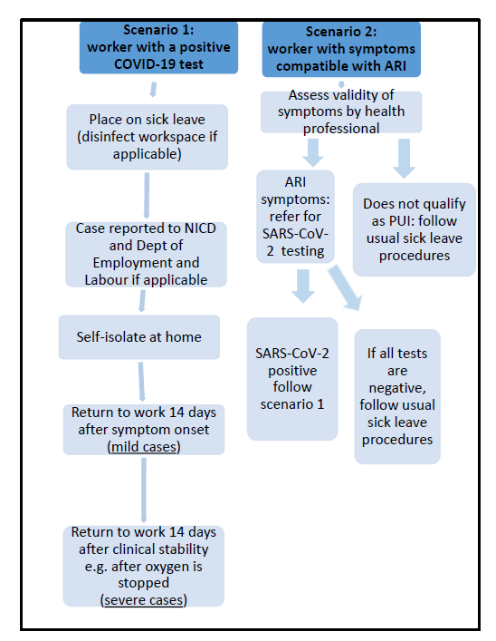
Scenario 1 and 2

Slide 12
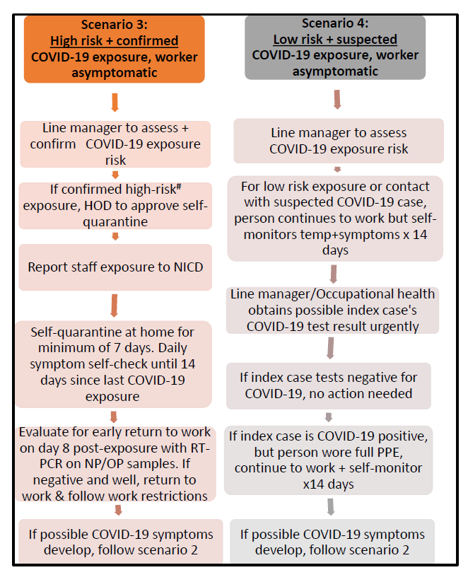
Scenario 3 and 4

Slide 13
Scenario 1: worker with a confirmed positive COVID-19 test
To remain consistent with the advice in the NDOH clinical management of COVID-19 disease Guideline3, scenario 1 (COVID-19 confirmed in a worker), will require self-isolation of staff member for 14 days after symptom onset (mild cases) and 14 days after clinical stability (severe cases). Should an early return to work policy be needed in future owing to severe workforce shortages, the US CDC criteria may be re-considered.
Scenario 2: worker with current flu-like symptoms
Consider latest NICD and international criteria (US CDC): any staff in with direct COVID-19 contact who develops an acute respiratory infection (e.g. cough, shortness of breath, sore throat) with or without fever (≥38°C) or history of fever (e.g. night sweats, chills) is a suspected COVID-19 case. Complete NICD PUI form2 and select appropriate essential worker tick box PLUS notify to NICD. Perform SARS-C0V-2 RT-PCR testing.
Scenario 3: High risk, confirmed COVID-19 exposure, asymptomatic
High risk exposure: close contact within 1 metre of a COVID-19 confirmed case for >15 minutes without PPE (no face cover/eye cover) or with failure of PPE and/or direct contact with respiratory secretions of confirmed COVID-19 case (clinical or laboratory). Line manager to assess and confirm COVID-19 exposure risk (if uncertain, refer to WHO tool for assessing exposure risk).
Scenario 4: Low risk, suspected COVID-19 exposure, asymptomatic
Low risk exposure: >1 metre away from a COVID-19 confirmed case for <15 minutes OR within 1 meter but wearing PPE (face cover, eye cover). Also consider lower risk if COVID case was wearing a surgical mask (source control).
Line manager to assess and confirm COVID-19 exposure risk (if uncertain, refer to WHO tool for assessing exposure risk.
Notes:
Scenario 2:” For staff, with a negative RT-PCR test, but high-risk COVID-19 exposure and COVID-19 compatible symptoms, discuss with occupational health/infectious diseases regarding the need for further testing and/or self-quarantine. If an alternate diagnosis is made (e.g. influenza), the criteria for return to work should be based on that diagnosis and duration of infectivity for other respiratory infections.
Scenario 3: (if uncertain, refer to WHO tool for assessing exposure risk).5 Notify exposure to NICD. Staff member to perform daily symptom self-check and complete symptom monitoring form until 14 days since last COVID-19 exposure. If asymptomatic through day 7, consider for return to work, following a negative RT-PCR on day 8
Scenario 4: 5
For low-risk exposures to a confirmed COVID-19 positive case, worker can continue to work with self-monitoring (twice daily temperature and daily symptom check) for 14 days after last COVID-19 exposure. (use symptom monitoring form below)

Slide 14
Conclusion
Refer to “Categorisation of Essential Good and Services During Lockdown – Regulation 11A
Early identification, early diagnosis and early referral for appropriate treatment are essential to protect health care workforce that is unaffected.
Occupational health practitioners and health care managers need to ensure that the provisions of these guidelines are adhered to in the interest of our health care workers.

