Slide 1



Lead Exposure and Lead Poisoning Training
Date: 26 October 2021
Virtual Webinar

Slide 2

Theme:
Learning the risks, raising awareness and promote action to prevent lead poisoning in South Africa

Slide 3


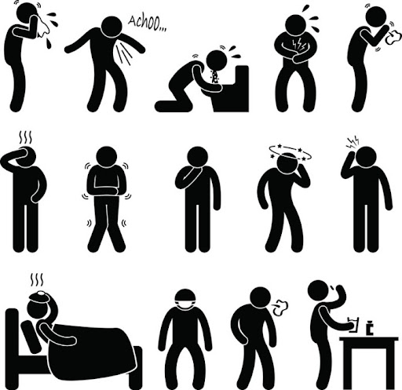

Slide 4


Slide 5
The aim of International Lead Poisoning Prevention Week is to draw attention to the health impacts of lead exposure, highlight efforts by countries and partners to prevent childhood lead exposure, and accelerate efforts to phase out the use of lead in paint.

Slide 6
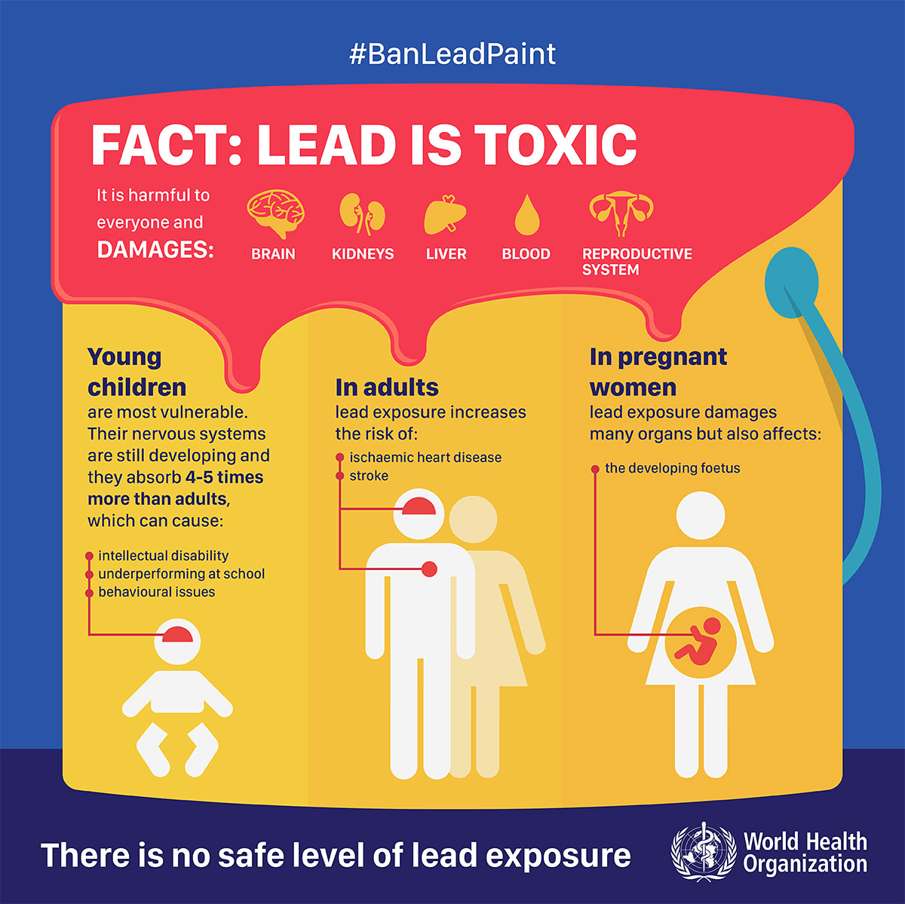

Slide 7





Slide 8


Don’t cast your own bullets
Don’t keep bullets or airgun pellets in your mouth
Don’t eat, drink, smoke or chew gum at a shooting range
Wash your face, hands and arms very well with soap and water, and dry with a clean paper towel (or use wet wipes) after handling guns or bullets

Slide 9
Change and bag the clothing you use while shooting (including your shoes) before leaving a shooting range
Wash the clothing you used while visiting the range or shooting, separately
Wear gloves when cleaning guns

Slide 10


Slide 11
Shooting range

Slide 12
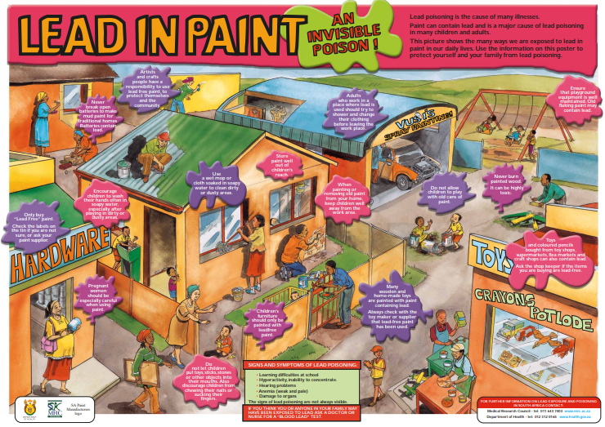

Slide 13
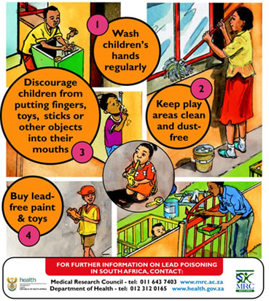
Prevent Lead Poisoning in Children
Follow these four important steps to protect children from lead poisoning

Slide 14
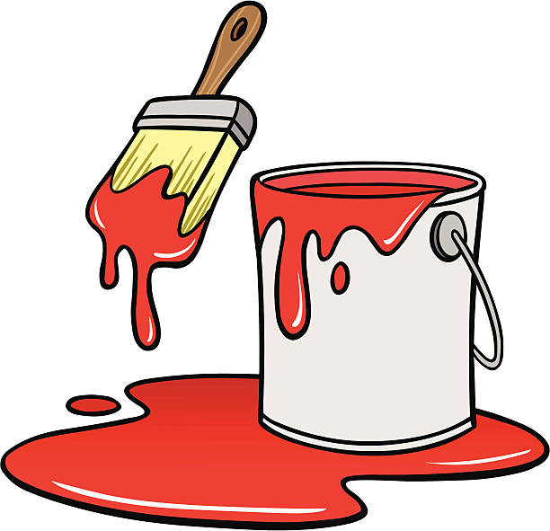
Lead poisoning from lead in paint is preventable and there are cost-effective, technically feasible alternatives to lead in paint.

Slide 15

Young children are particularly vulnerable because they have higher exposures than adults and because lead affects the developing brain, potentially resulting in reduced intellectual ability.

Slide 17
Potential sources of lead in fishing communities

Slide 18


Lead is a poisonous substance
Lead is especially harmful to the health of children
Melting lead to make fishing sinkers is very dangerous

Slide 19
Artisanal Pots
Highly elevated emissions of aluminium
Presence of arsenic and lead
Pot makers have elevated blood lead levels relative to other community members

Slide 20
Lead Poisoning among Male Juveniles Due to Illegal Mining

Slide 21
Lead Poisoning among Male Juveniles Due to Illegal Mining

Slide 22
