Slide 1
District Planning and Monitoring Framework v23
(adapted after inputs from all Provincial DoH at the workshop on 5th and 6th July 2017, and further inputs received from LP, KZN, NC and MPU)
August 2017

Slide 2
Our Business – “Healthcare”
Our Vision is:
Ensure a long and healthy life for all South Africans!
What do we need to Plan and Measure?
Better access to high quality preventive, promotive, curative, rehabilitative and palliative care services through a organized network of interlinked service delivery points across the district health system, inclusive of referral hospitals (Regional, Tertiary and Central Hospitals)
Life Expectancy
Mortality
Morbidity

Slide 3
Planning for impact (The Impact Calculator)
High proportion of people receiving heath care
… delivered at high quality every time.
Access to care
Quality of the care
Coverage x Effectiveness = Impact
What we do (interventions, actions)
to change the outcomes
What we measure
our actions against
Planning, Implementing, Monitoring (frequent), and Evaluation functions
Source: Adapted from Tanahashi, 1978

Slide 4
Key Messages
Planning, Financing, Implementing, Monitoring and Responding are one (Single) objective
Integration of Planning with Service Delivery (business of health care)
Integration of Planning with Programme and Administrative line functions
Integration of Programme Implementation with Service Delivery Platform
Timely Response and Action Planning are life blood of effective health system
Health Systems Effectiveness is attained through high level coverage of key clinical and public health interventions delivered at high quality, all the time.

Slide 5

Background
The NDHSC, NHISSA, NSPC received presentations with these recommendations.
The Tech NHC received and approved recommendations from National Strategic Planning Committee (NSPC) for Strengthening District Planning and Monitoring on 11 Aug 2016.
A follow up workshop was held with Provincial DoH with Districts on 27 and 28 Sep to advance the discussions, and develop solutions.
A workshop report containing key discussions and recommendations was circulated

Slide 6
Aim of Strengthening District Planning and Monitoring
Transform District Health Plans into a unified and integrated action plan that responds to both…
  programmatic priories (clinical governance, clinical protocols, standard treatment guidelines, etc.) and
  health system priorities (Ideal Clinic - HR, Infrastructure, finance, Information, etc.)
…in order to improve efficiency and achieve better quality of care resulting in improved health outcomes.

Slide 7
District Planning Technical Working Group (established April 2016)
Core Group – National DOH | Oversight and Support from National DoH – Deputy DGs
Mr Gaurang Tanna - Policy co-ordination and Integrated Planning Cluster (Convener) | Dr Gail Andrews – Chief Operations Officer
Ms Roanda Pretorius - Policy co-ordination and Integrated Planning Cluster | Dr Yogan Pillay – DDG: TB, HIV and MNCH
Mr Ramphelane Morewane – District and Development Cluster | Ms Jeanette Hunter – DDG: Primary Health Care and Environmental Health Services
Mr Bennett Asia – District and Development Cluster | Provincial DoH
Mr Hadley Nevhutalu – Provincial Financial Management Support Unit | Dr Singilizwe Moko – District Health Services, Eastern Cape DoH
Dr Andrew Crichton – Human Resources for Health | Dr Grace London – District Health Services, Free State DoH
Dr Shuaib Kauchali – Technical Advisor for MNCWH&N | Ms Karen Ching – Strategic Planning, Western Cape DoH
Dr Carol Marshall – National Co-coordinator of District Clinical Specialist Teams (DCSTs) | Ms Ester Snyman – Strategic Planning, KwaZulu-Natal DoH
Dr Lesley Bamford – Child Health Cluster | Mr John Molokwane – Strategic Planning, Limpopo DoH
Ms Romy Overmeyer – Technical Assistant Strategic Information
Dr Sanjana Bhardwaj and Dr Joey Cupido – UNICEF

Slide 8
Objectives of District Planning and Monitoring Reforms
DISTRICT STRATEGY | 1. Priority setting, decision making at District level unlock bottlenecks, deliver health outcomes (strategy / macro planning) 2. District targets aligned to Provincial APPs disaggregated to sub-districts/health facilities (top-down planning) | 3. Action plans at all levels (facility, sub-district and district- bottom up action/micro planning) linked to resources, budgets achieve targets: Implement, monitor | DISTRICT AND SUB-DISTRICT ACTION PLANS
 | Closer monitoring of performance - improve data quality (and Audit outcomes), inform macro and micro planning. Reporting and feedback mechanisms at local level (District and below), and between District and Province
MONITOR STRATEGY, TARGETS, (OUTCOME) AND ACTION PLANS (EFFORT) AT ALL LEVELS

Slide 9
WHAT?
Revised planning framework for District and Sub-District planning and monitoring for 2018/19 planning cycle, and 2017/18 monitoring cycle
District and Sub-District planning and monitoring templates and tools

Slide 10
Health Sector’s macro Planning Terrain (System)
Where are District Health Plans located?
Health System effectiveness - includes Quality Improvement and NHI
Sustainable Development Goals 2030
National Development Plan 2030
Medium Term Strategic Framework (MTSF) 2014-2019
MTSF
2019-2024
MTSF
2024-2029
Risk factors /
determinants (Research)
Maternal Health
Child Health
HIV & Aids NSP
BOD & COD
Annual National Health Plan
Provincial Long Term Plans for Health
National DoH Strategic Plan, Annual Performance Plans & Budgets
9x Provincial DoH Strategic Plan, Annual Performance Plans & Budgets
District Health Plans & Budgets
Provincial Operational Plans
District Health Expenditure Review
Provincial Growth & Development Plans
District Operational Plans (DOPs)
Integrated Development Plans of Municipalities
2015/16
2016/17
2017/18
2018/19
2019/20

Slide 11
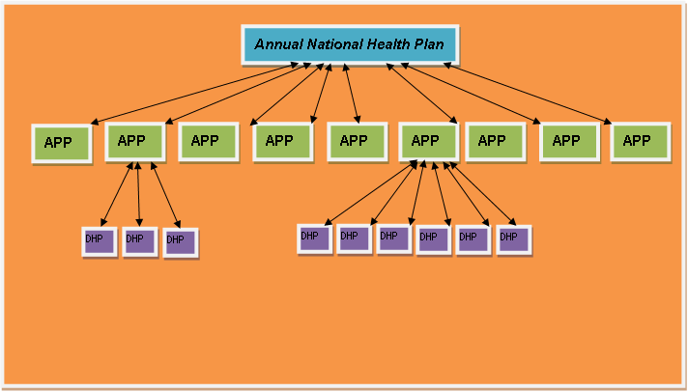
Medium Term Strategic Framework (MTSF) 2014-2019
NDOH
PROVINCIAL DOH
Referral Hospital
Plans
District Operational Plans
Linkage between Referral Hospital
Plans and Districts (Consolidated Mortality
Report – developed from Monthly M&M Meetings)
District Hospital
OPs
SD OPs
SD OPs
Section 33 of National Health Act, 61 of 2003 stipulates that:
“District and Metropolitan health manager must within the national budget cycle develop and present to the district health council in question the relevant member of the Executive Council a district health plan drawn up in accordance with national guidelines issued by the Director-General with due regard to national and provincial health policies…”

Slide 12
Challenges with the current approach
  Planning at micro-level is absolutely critical so that Districts implement appropriate actions to achieve desired outcomes.
  District planning to be anchored on numbers instead of just rates (and percentages).
  Current DHP guidelines not adequate to improve planning. The District Health Plans must not only provide targets but also provide strategies/activities that will be deployed by Districts to achieve the targets.
  Forge strong alignment between planning, budgeting, monitoring, and reporting - NOT just planning.
  Planning and M&E Forums already exist, in different shape, size and form at Provincial, District and sub-District levels. They need to be optimised. Develop ToRs need to outline how they will operate, and propose minimum stakeholders.
  Pervasive incentive to Compliance, however, experience tells us Compliance planning neither effective nor efficient.
  And many more….. (refer to 7.1 Strengthening District Planning and Monitoring that contains key discussions and Recommendations from the NSPC)

Slide 13
Intent of ‘new’ District Planning and Monitoring framework
Simplified and logical set of steps requiring District Management Team to collectively answer relevant questions that foster thinking (strategy, problem solving and learning), and encouragement through reflection.
Collective ownership: The revised planning and monitoring process requires District Offices, District Clinical Specialist Teams, and Referral Hospitals (Regional, Tertiary and Central) to collectively plan for reducing mortality and morbidity.
Onboard action planning and monitoring at District and lower levels with shorter cycles (at least monthly), tied to a response.
Strengthen coherence, and prevent duplicate planning for various health programmes (HIV, TB, Ideal Clinic, MNCH, NCDs, etc.) required from District staff.
A common logical framework that consolidates requirements of overlapping plans to free up time to make way for this integrated planning approach. District Health Plan becomes the Plan where all interventions come together.

Slide 14
Intent of ‘new’ District Planning and Monitoring framework (2)
Streamlined process to ensure top down and bottom up needs are accommodated within the planning cycle.
Make planning more comprehensive, yet easier by simplifying (and reduce) what must be ‘handed in’ to higher levels.
Emphasis on the process of planning, as opposed to just a plan, and a report.
Strengthen District and Provincial health planning (currently administrative in nature) with the patient pathways. (refer to Integrated Plan for reducing Maternal, Infant, and Child Mortality, and NHC directive to regionalize role of DCSTs).
This requires introduction to dual approach to planning to achieving better health outcomes.
  Proactive one of improving (or maintaining) effective coverage of interventions that are known to impact on causes of illness (morbidity), and death (mortality), and
  Reaction or response to undesired outcomes (which include avoidable deaths), and under achieved targets to learn and prevent recurrence, thus bringing down mortality.
Increase flexibility and make planning live. Ensure that its guides action, but, conversely also ensure that results from in year implementation guide plans.

Slide 15
Considering the business of healthcare
Our Business is ‘healthcare’. we plan to improve health of people and managing associated diseases. There are 3 variables we plans for:
  community/people/patients,
  Health status of the community (manage diseases)
  Service delivery platforms (manage health services and platform)
The life course approach considers people lives with different structural, social and cultural contexts throughout their lives,
The illness condition approach considers a programmatic perspective of rendering health services in response to certain conditions/illnesses
The life course and illness/condition approach can be combined to create a robust tool for understanding vulnerable groups that require prioritised interventions.

Slide 16
Planning for the health of people and managing diseases
Integration, coordinated planning and monitoring
 |  |  | Programmatic Approach
Life Course Approach |  | Estimated Population (Year xxxx) | Illness/ Condition |  |  |  | Target Population Aspiration
 |  |  | HIV | TB | Hypertension | ….etc.
Population Category | Pregnant Women
 | Age 0-4
 | Age 5-15
 | Female age 12-22
 | …..etc.
Disease Burden (Year: xxxx) |  |  |  |  |  |  | Health System Strengthening
Illness/ Condition Aspiration
Mortality
Morbidity
Example:
Maternal and Child Health (MCWH) Programme is intended to address all illnesses and conditions for pregnant women and children under the age of 5
Within MCWH there is a specific intervention for HIV-positive pregnant women – this addresses the intersection of the “Pregnant Women” horizontal population category above with the “HIV” illness/ condition vertical

Slide 17
Life Course and Illness Condition Matrix
Integration, coordinated planning and monitoring
Life Course Approach
Target population Aspiration
E.g. Reduce Maternal Mortality
Population Category
Pregnant Women
Age 0 - 4
Identify patterns of health and disease across population groups
Age 5 - 15
Female Age 12 - 22
etc…
Mortality
Biological, behavioural, psycho-social processes across the life span

Slide 18
Life Course and Illness Condition Matrix
Life Course Approach (reduce mortality)
 |  |  |  |  |  | Target Population Aspiration
Life Course Approach
Population Category | Pregnant Women
 | Age 0-4
 | Age 5-15
 | Female age 12-22
 | …..etc.
Mortality

Slide 19
Life Course and Illness Condition Matrix
Programmatic Approach (prevent illness and/or reduce severity of illness)
Programmatic Approach
Illness/Condition
HIV
TB
Hypertension
etc.
Morbidity
Disease Burden (Year: xxxx)
Illness/Condition Aspiration

Slide 20
Life Course and Illness Condition Matrix
Integration, coordinated planning and monitoring
 |  | Target population Aspiration
Illness/Condition Aspiration |  | Health System Strengthening
Improve compliance with National Core Standards;
Improve quality of District Hospitals;
Ensure quality primary health care services with functional clinics by developing all clinics into Ideal Clinics; and
Improve the acceptability, quality and safety of health services by increasing user and community feedback and involvement.

Slide 21
Logic Framework:
Planning and Monitoring for impact
Im-
pact
Outcome
Outputs
Activities
Inputs
What we wish to change.
The developmental results of achieving specific outcomes.
Results
(monitor and evaluate)
What we wish to achieve.
The medium term results (1-3 years) for specific beneficiaries that are the consequences of achieving specific outputs.
What we deliver
Occurs as a result of combining inputs and completing activities as outlined in the operational plan.
Delivery (Plan, Budget, Implement, monitor)
What we do:
Actions that use the inputs to produce the outputs.
What we use:
Human and Financial Resources to execute the activity.

Slide 22
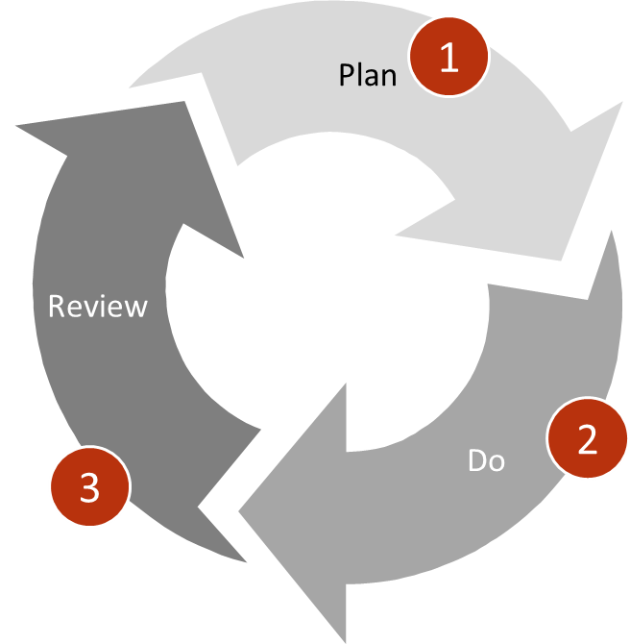
Plan-Implement-Monitor Process
(Plan-Do-Review)
1
PLAN FOR 2018/19 FINANCIAL YEAR
Define goals (outcome / impact).
Define public health interventions, quantify resources and expected change that interventions are to produce
identify Theory of Change indicators (Input, Process, Output, Outcome, Impact) and tools for monitoring change.
Identify actions (with role, and responsibilities).
Development of a costed District Health Plan (2018/19-2020/21), and Operational Plan (2018/19)
2
IMPLEMENT PLANS FOR 2017/18 FINANCIAL YEAR
Do what it takes to realise your targets – Implement District and Operational Plan for 2017/18 Financial Year
Communicate: Escalate and delegate where necessary
Oblige feedback
Manage resources (people & budget etc.)
3
MONITOR AND REVIEW PERFORMANCE MONTHLY FOR 2017/18 FINANCIAL YEAR
Monitor and review past performance: Health indicators
Track and adjust actions (Re-Prioritise where necessary) (input, and activity).
Adjust Ops plans (drop implemented actions, adjust others, and add any additional) in view of performance
Performance reporting and feedback
(Note: Monitoring is best done Monthly but Reporting to Provincial office could be Quarterly)

Slide 23

Planning for Impact
(District Health Plan)
Provincial Planning informing District Health Plan
Provincial Targets
Proposed District Targets
Country and Provincial Priorities
Resource Allocation
District Health Plan informing Provincial APP:
Key Interventions
District Targets
Impact/Outcomes
Outputs
Activities
Inputs
Diagnosis
Prioritize populations and public health interventions
2A. Coverage -
Where are we now?
3. Where will we play?
4. Public Health Interventions
How will we win?
5. Resource (HR and Budgets) allocation -
What do we need?
1. Goal Setting -
What is our aspiration?
2C. Why are we here?
4A. Clinical
4B. Community
2B. Quality -
Where are we now?
4C. Systems
Think Small
Think Big
Notes:
Complete animation

Slide 24
Planning for Impact (2)
(District Health Plan)
Indicator Cascade attached to each aspiration
(Target setting)
1. Goal Setting
What is our aspiration?
2. Diagnosis
Where are we now? Why are we here?
3. Where will we play?
4. Key Interventions
How will we win?
5. Resource (HR and Budgets) allocation
What do we need?
What outcome targets are we trying to achieve?
Examples:
Reduce maternal deaths
Increase PLHIV with suppressed viral loads
Increase TB Treatment success rate
Reduce premature mortality from NCDs through prevention and treatment
Reduce complaints and increase patient satisfaction
Improve staff satisfaction
Where are we now (Coverage)?
What was achieved?
Are we achieving our target?
Where are we now (Quality)?
How Ideal are the clinics, and compliant are the hospitals to the OHSC standards?
Patient Complaints and Patient satisfaction?
Staff satisfaction?
Why are we here?
Why are we not achieving? (Bottlenecks)
What is driving non-achievement (Root causes)
Which populations are we targeting?
Where are they?
Which services do we want to offer to them?
Where do we want to offer these services? (Household, PHC, DH, RH)
Are these services accessible? If No, re-think where you want to offer services
Are they accessible and acceptable?
Think big
List all options of interventions that could achieve priority
Prioritise interventions – choose cost effective, evidence-based and measurable
Categorise interventions:
Think Small
How much resources do we need?
Where do we source them?
How much do we have? How skilled are they?
Reprioritisation: Can we source funds within from other interventions?
Clinical
What clinical interventions do we need?
Community
What community interventions do we need?
Systems
What management processes and systems do we need?
Notes:
Complete animation

Slide 25
1. What is our aspiration?
Questions to answer: What outcome targets are we trying to achieve? What are our provincial targets? What are our proposed district targets? What are the country and provincial priorities? What are the unique peculiarities of our district? What resources are allocated to us?
Output A list of District aspirations, mapped to Provincial Goals. (use Provincial Goals as is if desired) For each aspiration, a list of Theory of change indicators, and annual targets for 3 years
Examples of Aspirations: Reduce xx (number) maternal deaths by xxxx/xx (financial year) Increase PLHIV with suppressed viral loads to xx (percent) by xxxx/xx (financial year) through the implementation of the 90-90-90 strategy Reduce premature mortality from NCDs through prevention and treatment by xx% by xxxx/xx (financial year) Reduce complaints and increase patient satisfaction to xx% by xxxx/xx (financial year) Improve staff satisfaction to xx (percent) by xxxx/xx (financial year) (aspirations are impact / outcome measurements)

Slide 26
Theory of Change Indicators
What is the theory of change (TOC)?
A methodology used for planning and evaluation that demonstrates or promotes social change
It outlines causal linkages
It assists us to pick the correct indicators for planning
Longer-term
Apex Indicator
Impact
Outcome
Output
Process (Activity)
Input
Short-term

Slide 27
What is our aspiration?
Aspiration (apex indicator) and its Theory of Change Indicators
Reduce xx (number) maternal deaths by xxxx/xx (financial year)
ToC Indicators
Increase PLHIV with suppressed viral loads to xx (percent) by xxxx/xx (financial year) through the implementation of the 90-90-90 strategy
ToC Indicators
Instituational maternal mortality ration (per 100k)
Proportion VLD - Adults (%)
Delivery in facility under 18 years rate (%)
Proportion VLD – Child (%)
Antenatal client initiated on ART rate (%)
Proportion VLS – Adult (%)
Mother postnatal visit within 6 days rate (%)
Proportion VLS – Child (%)
Proportion remaining in care – Adults (%)
Cervical screening coverage (%)
Proportion remaining in care – child (%)
Couple Year protection rate (%)
Clients remaining on ART rate – all (%)
HIV Test coverage (including antenatal care)
HIV Test positive client 15 years and older rate
Medical male circumcision rate (%)
Male condom distribution coverage (condoms)
Female condom distribution coverage (condoms)
Refer to Annexure C of guidelines for the list of proposed Theory of Change indicators for
major health outcomes
Notes:
Show how APEX cascade into different indicators (maternal care & HIV)

Slide 28
1. What is our aspiration?
District Health Plan Template:
Template 1
District Aspirations | Provincial Goals
Template 2 (targets)
District Aspirations | Indicator |  | Baseline | Target 2018/19 | Target 2019/20 | Target 2020/2021
 | Type | Name
 | Impact
 |  | Numerator
 |  | Denominator
 | Outcome
 |  | Numerator
 |  | Denominator
 | Output
 |  | Numerator
 |  | Denominator
Notes:
Change to district aspiration

Slide 29
2.A. Where are we now? – Coverage Indicators
Questions to answer: Where are we now? What was achieved? How much (and where) did we spend resources in the last financial year to achieve this?
Steps: Review past performance for each indicator in the theory of change for your District Goals and disaggregate per Sub-District. (For in facility mortality disaggregate by facility).
Source: DHIS, Tier.net, ETR.net
Consider district expenditure review of the previous financial year to understand how money was spent and identify allocative in-efficiencies. (TBD: a list of tracer financial measurements that Districts should use from DHERs for this step)
Source: DHER / BAS / PERSAL
Data Sources: DHIS Tier.net ETR.net District Health Expenditure Review (or BAS and PERSAL where it was not conducted).
Output Baselines for indicators for District and sub-Districts for all Theory of Change indicators

Slide 30
2A – Where are we now?
Output - Theory of Change (Coverage) Indicator Table
Notes:
Get larger

Slide 31
2.B Where are we now? - Quality
Questions to answer: Where are we now? What was achieved? How Ideal are the clinics? Patient Complaints and Patient satisfaction? Staff satisfaction?
Steps: Identify top 20 worst performing Ideal Clinic elements where facilities in the district fail.
Source: Ideal Clinic Realisation and Maintenance Software
Have there been events that should have been avoided (includes avoidable deaths)?
Source: Consolidated Death Report* from DCSTs
List the top 5 prevalent Patient Complaints, and the top 5 challenges identified through Patient Satisfaction Surveys.
Source: Patient complaints & Patient Satisfaction Surveys
Input Reports from Ideal Clinic Software (www.idealclinic.org.za) Consolidated Death Reports produced by DCST Aggregated results from Patient Satisfaction survey (or Patient Experience of Care survey)
Methods / Tools Ideal Clinic Software (www.idealclinic.org.za) Consolidated Death Reports (produced by DCSTs)
Output Baselines for Ideal clinic status, with a list of 10 worst performing Ideal Clinic elements List of modifiable factors to prevent mortality List 10 challenges identified and reported by Patients in PHC facilities and District Hospital (through the Patient survey and complaints systems).
*Consolidated Death Report includes:
a) numbers of death, b) causes of death, and c) interventions to address (system and facility)

Slide 32
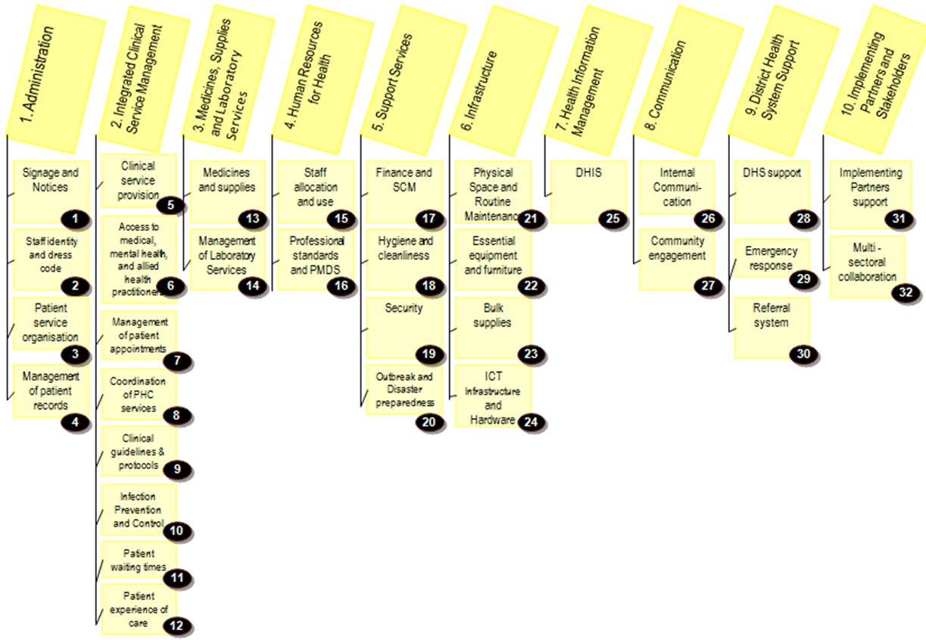
Tool & Template: Why are facilities not ideal?

Slide 33
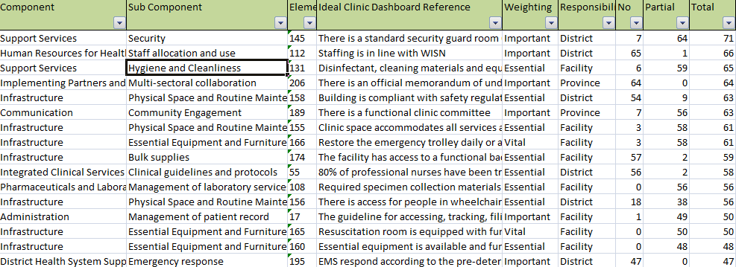
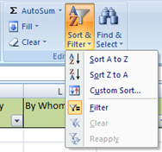
Tool & Template: ICRM software
4. Open the report, highlight the rows and columns with data in it.
5. Select from the menu bar the “Custom Sort” option.

Slide 34
2.C. Diagnosis – Why are we here?
Questions to answer: Why are we not achieving? (Bottlenecks) What is driving non-achievement (Root causes) Have there been events that should have been avoided?
Steps: List all challenges: list of factors that led to avoidable deaths identified by DCSTs challenges identified through the Expenditure review, 20 worst performing Ideal Clinic Elements, Common challenges picked up from the patient satisfaction survey analysis and patient complaints survey analysis)
Source: Consolidated Death Report, DHER, ICRM
Consolidate (ie. eliminate duplication) and Prioritise challenges, and thereafter link them to Aspirations (or specific indicator within the cascade - if essential).
Tool: Template
Identify root causes for each prioritised bottle neck and do root cause analysis. Possible tools:
Tools: Fishbone diagram, Five Whys, Problem Tree
Input: Baselines for Ideal clinic status, with a list of 10 worst performing Ideal Clinic elements List of modifiable factors to prevent mortality List 10 challenges identified and reported by Patients in PHC facilities and District Hospital (through the Patient survey and complaints systems).
Tools: Bottleneck analysis ICRM (clinics) National Core Standards (hospitals) Root Cause Analysis Fishbone diagram Five Whys Problem Tree (use any/combination of these)
Output List of bottlenecks and its root causes per goal

Slide 35
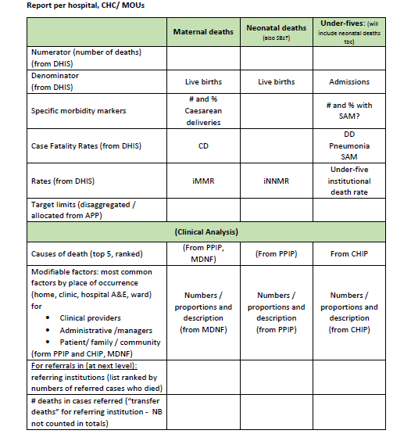
Tool/Template/Source for causes of mortality: Consolidated Death Report
Notes:
For BNA in mortality use CDR:
*CDR will contain:
-causes of death
-Numbers of death
-Interventions to address
(system vs facility)

Slide 36
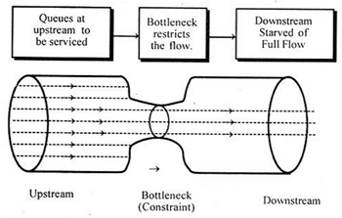
Tool: ICRM
(identifying bottlenecks for clinics)

Slide 37
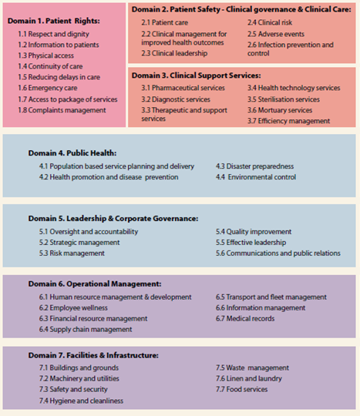
Tool: NCS
(identifying bottlenecks for hospitals)

Slide 38
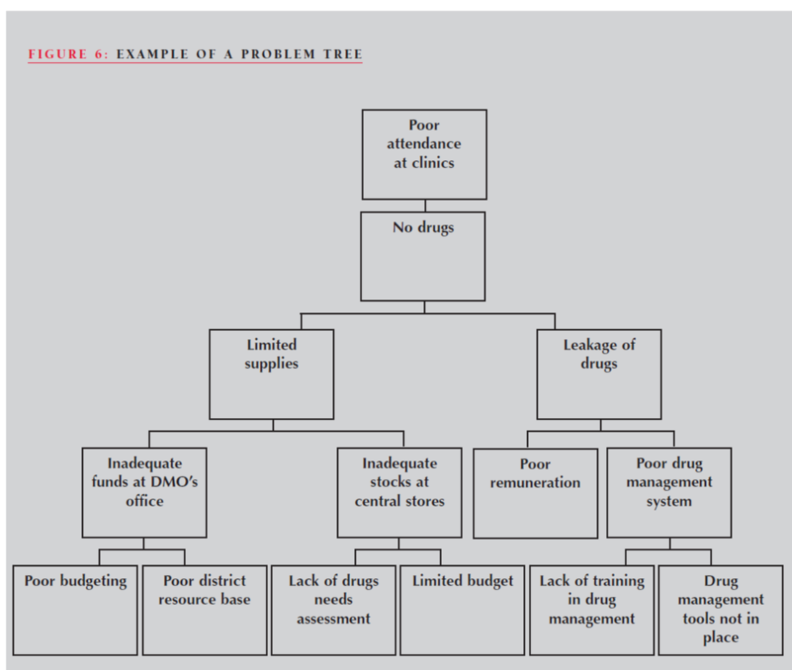
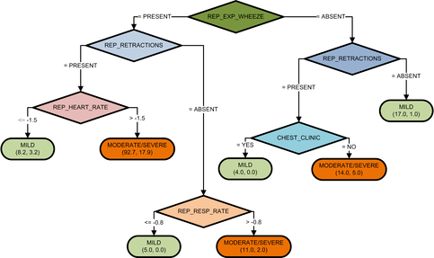
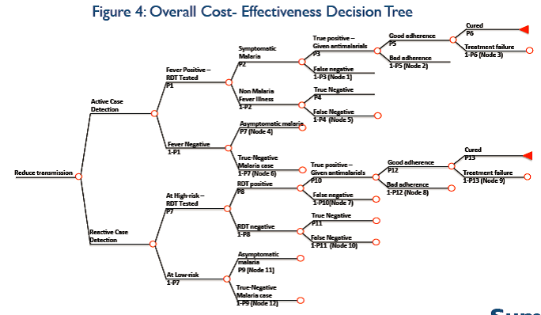
Why are we here? – Problem Trees
Problem tree Example 1
Problem tree Example 2
Problem tree Example 3

Slide 39
Why are we here? – The Five Whys Technique
The 5 Whys
5 Whys is an iterative interrogative technique used to explore the cause-and-effect relationships underlying a particular problem. The primary goal of the technique is to determine the root cause of a defect or problem by repeating the question "Why?" Each answer forms the basis of the next question. The method provides no hard and fast rules about what lines of questions to explore, or how long to continue the search for additional root causes. Thus, even when the method is closely followed, the outcome still depends upon the knowledge and persistence of the people involved.
Problem | Why 1 | Why 2 | Why 3 | Why 4 | Root Cause | Remedial action
Delays in conducting TB screening training workshops | No trainers available to conduct workshop | Staff are not interested in facilitating training | Issues around not having extra time to conduct training |  | Training seen as a low priority task in nurses’ KPIs | Assign training as a priority in nurses’ KPI
Low number of patients screened for TB | Nurses not adequately skilled in TB screening | Lack of training workshops | No trainers available | Staff are not interested in facilitating training | Training seen as a low priority task in nurses’ KPIs | Assign training as a priority in nurses’ KPI
Benefits of the 5 Whys:
1
Helps identify the root cause of a problem
2
Determine the relationship between different root causes of a problem
3
One of the simplest tools; easy to complete without statistical analysis

Slide 40
Why are we here? – The Five Whys Technique
Root Cause Analysis: The 5 Whys
WHY?
Challenge
WHY?
WHY?
WHY?
WHY?

Slide 41
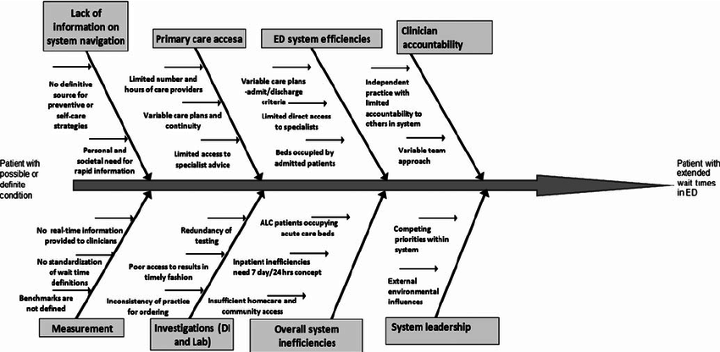
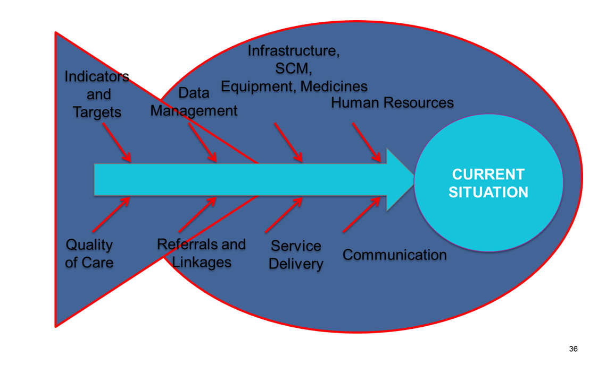
Why are we here? – Fishbone Diagram
Fishbone Diagram Example 1
Fishbone Diagram Example 2

Slide 42
Template: Why are we here?
Output Template
District Aspiration | Population |  | Geography |  | Public Health Intervention |  |  | Costing
 | Life Course Group | Specific Population ** | (Sub-district)** | Ward ** | Key Intervention | Root Cause** | Service Delivery Platform* | Amount | Funding Source
*WBOT, ISHP, PHC, DH, RH (drop-down)
** where applicable

Slide 43
3. Focus for impact - Where will we play?
Questions to answer: Which sub-districts should we focus on for impact? Which populations are we targeting? Where are they? Which services do we want to offer to them? Where do we want to offer these services? (WBOT, ISHP, PHC, DH, RH) Are these services accessible? If No, re-think where you want to offer services. Are they acceptable?
Steps: Identify specific population groups to be targeted (age groups, specific population groupings for specific illness conditions – use population prioritisation matrix) per aspiration Determine where these specific populations are located? (Sub-district indicator table) per aspiration Determine the health service(s) that will respond to the objective’ e.g. WBOTs; Mobiles; PHCs etc. per aspiration Determine if the selected health service will be offered as outreach or in facility. If in facility, are they (a) accessible to the identified specific population? (b) acceptable to the client? Use findings from Ideal Clinic Assessments Patient experience of Care survey result Patient Complaints
Input List of prioritised populations (from Population Prioritisation Matrix) Geographic prioritisation (from Sub-District Indicator Table) Service points (Source: DHIS) for each service being prioritised
Tools Population Prioritisation Matrix Sub-district indicator table
Output List of prioritised populations Geographic prioritisation Service Platform for each service being prioritised
Notes:
Identify non-performing sub-districts and investigate reasons for suboptimum performance
Add district health barometer screenshot

Slide 44
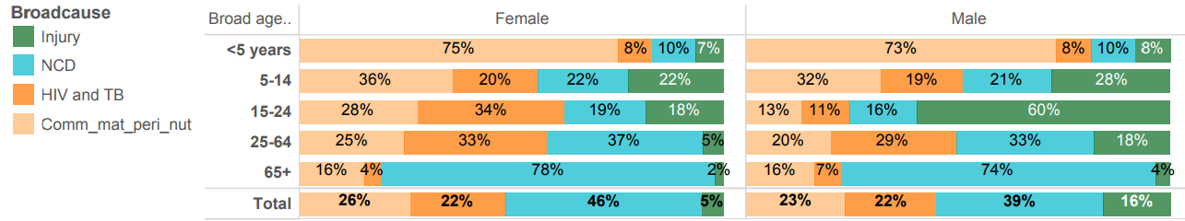
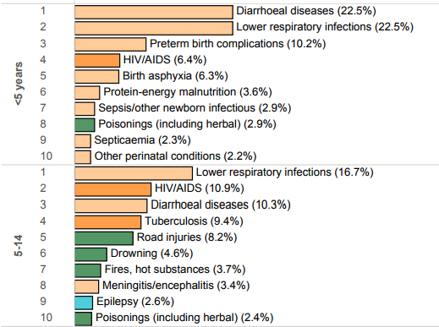
Tools: Where will we play?
District Health Barometer : 2015/16 and 2016/17
The District Health Barometer indicates the percentage of deaths by broad cause and leading causes for a five year period per district, together with a detailed breakdown of deaths & causes.

Slide 45
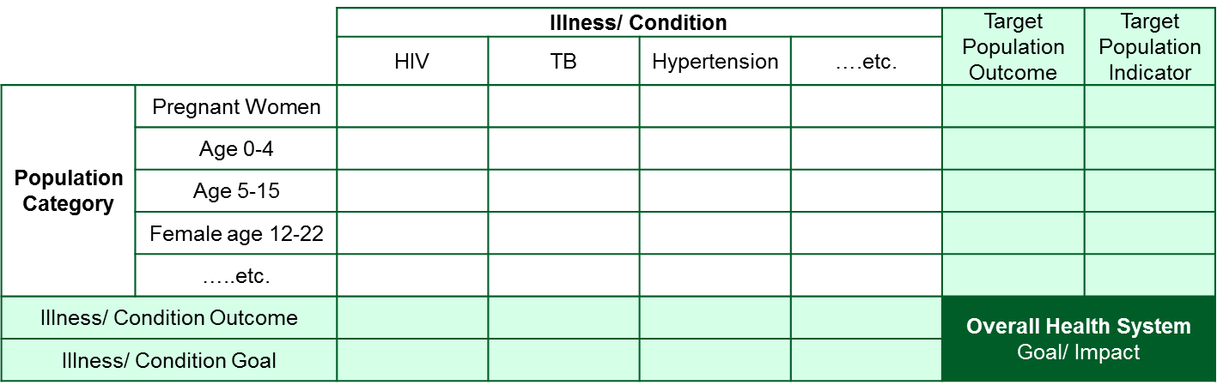
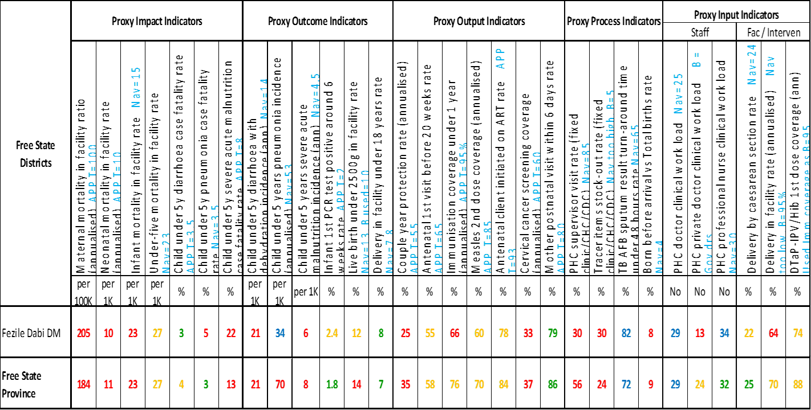
Tools: Where will we play?
Population Prioritisation Matrix
Sub-district indicator table

Slide 46
Population Prioritisation Matrix
(Life Course and Illness Condition)
Integration, coordinated planning and monitoring
 |  |  | Programmatic Approach
Life Course Approach |  | Estimated Population (Year xxxx) | Illness/ Condition |  |  |  | Target Population Aspiration
 |  |  | HIV | TB | Hypertension | ….etc.
Population Category | Pregnant Women |  |  |  |  |  | e.g. Reduce Maternal Mortality
 | Age 0-4
 | Age 5-15
 | Female age 12-22
 | …..etc.
Disease Burden (Year: xxxx) |  |  |  |  |  |  | Health System Strengthening
Illness/ Condition Aspiration |  |  | e.g. Reduce HIV incidence
Mortality
Morbidity
Example:
Maternal and Child Health (MCWH) Programme is intended to address all illnesses and conditions for pregnant women and children under the age of 5
Within MCWH there is a specific intervention for HIV-positive pregnant women – this addresses the intersection of the “Pregnant Women” horizontal population category above with the “HIV” illness/ condition vertical

Slide 47
Population Prioritisation Matrix
(Life Course and Illness Condition)
How would the matrix be generated?
It should be populated with the number of deaths associated with each population group for each condition
Colour-coding will based on the data populated and will give an indication of populations as well as conditions to be targeted
Districts should focus in terms of targeting specific population groups for a package of interventions which address the leading causes of mortality or morbidity in that group.
Districts can use existing reports to determine leading causes of death in different population groups
(Completed example on next slide)

Slide 48
Population Prioritisation Matrix
(Life Course and Illness Condition)
How would the matrix be used for mortality? (Example)
In trying to address Under 5 Mortality, we should focus on addressing HIV, Pneumonia, Acute Diarrhoea and Septicaemia (ie. those highlighted in red)
These causes should not be addressed in isolation of each other. A package of interventions, which reaches the target group 29 days to 1 year, would be most cost effective.

Slide 49
Population Prioritisation Matrix
(Life Course and Illness Condition)
How would the matrix be used for mortality? (Example)

Slide 50
4. Key Interventions – How will we win?
Think Big
Questions to answer: What clinical interventions do we need? What community interventions do we need? What management processes and systems do we need?
Steps: For each identified population and condition, identify intervention Develop all options of interventions that could achieve the desired aspirations Test whether intervention responds to bottleneck/root causes identified in 2C. Add intervention where interventions do not address all identified bottleneck/root causes Unpack the interventions into Clinical, Community and Systems interventions Identify duplicate interventions and eliminate/consolidate and Prioritize Interventions – choose cost effective, evidence-based and measurable Link each intervention to Goals link them to Goals (or specific indicator within the cascade - if essential) Re-prioritize interventions until identified and prioritised intervention is affordable
Output Key Interventions - linked back to (a) Aspirations (specific indicators that it will impact) , and (b) Challenges and root causes
Unpack the interventions into: Prioritise: Risk - Severity/danger: To the individual and the community – Is this a major contributor to health outcomes? Feasibility - Is the identified intervention technically feasible? Efficiency - Cost-effectiveness of the intervention: These criteria should answer the question whether the problem, if addressed, is worth the financial cost involved. Political acceptance - Even if a problem fulfils all of the above criteria, if it is not recognized as politically expedient by the central authority, (policy) it is very difficult to include it as a priority.
Clinical | What clinical interventions do we need?
Community | What community interventions do we need?
Systems | What management processes and systems do we need?

Slide 51
District Decision (Priority Setting) Matrix
 | District/Province Use Only
 | Decision Matrix
Intervention | Clinical Consequences (mortality/morbidity) | Rural Location (no alternative services) | Vulnerable Patient Group (poor or marginalised) | Feedback on Prioritisation Decision | District Priority
 | Very High | Very High | High |  | 1
 | High | Very High | Very High |  | 2
 | High | Medium | Low |  | 3
 | Medium | Very High | High |  | 4
 | Low | Medium | Medium |  | 5
 | Medium | Low | Medium |  | 6

Slide 52
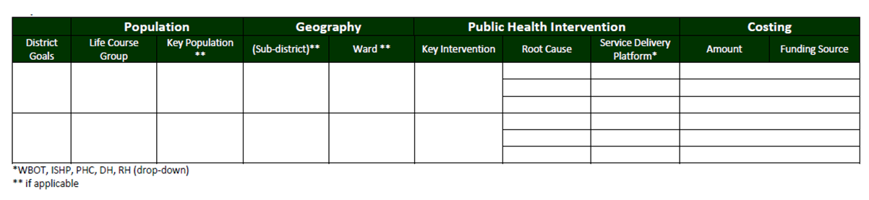
Template: Where will we play?
Output Template

Slide 53
Template: How will we win?
Describe and unpack shortlisted Public Health Interventions into three dimensions:
Public Health Intervention 1. | Description:
Clinical
Community
Systems
Public Health Intervention 2. | Description:
Clinical
Community
Systems

Slide 54
5. Resource (HR and budget) allocation -
What do we need?
Think Small
Output Headcount plans Procurement plans (goods and services) Financial Budgets Updated key interventions
Examples Other options for re-prioritisation: Addressing constraints by using community resources, modifying job responsibilities and tasks, shifting available resources from one activity to another an obtaining additional resources; Improving management and administration in line with identified interventions
Tools and Templates For the Compensation of Employees, use the recruitment prioritisation tool to prioritise vacant posts. Facilities will use the “Facility Template” to list vacant posts with their justification. Districts will use the “District Template” to rank priorities for posts according to the decision matrix.
Questions to answer: How much resources do we need? Where do we source them? How much do we have? How skilled are they? Reprioritisation: Can we source funds within from other interventions?
Description: The budget is broken down into 3 main components: Compensation of Employees Goods and Services Capital Budgets for Equipment and Infrastructure procurement and maintenance The budget must make provision for ongoing operational expenses such as: Salary of existing employees Operational goods and services (e.g. Drugs, utility bills, etc.) Maintenance of exiting equipment and infrastructure: The budget must further provide for the cost of interventions intended to close the performance gap. Here one must: Determine estimated costs per intervention Disaggregate costs per sub-District where necessary

Slide 55
Recruitment Prioritisation Tool (Facility and District Template)
Objectives
Balance the need for cost containment with the constitutional obligation to progressively realise the right to have access to health care services.
Maintain critical frontline health services during a time of crisis
Protect the most vulnerable patients who have no access to alternative health services
Protect hard-won progress and prevent the collapse of facilities
Facility
Facilities will list their recruitment needs in order of priority, using the “Facility Template” of the prioritization tool template .
District
Districts will review the lists submitted by their facilities using the “District Template” with the decision-making matrix. After ensuring continued service delivery, equity and access have been protected in the best possible manner, they will then consolidate the individual lists into a single District List of priority recruitment, based on greatest need.
Province
Province and district representatives will meet to review the District Lists and, using the decision-making matrix, consolidate these into a single Provincial List of priority recruitment, based on greatest need.
District & Facility
Start to advertise and recruit based on this pre-approved recruitment list.

Slide 56
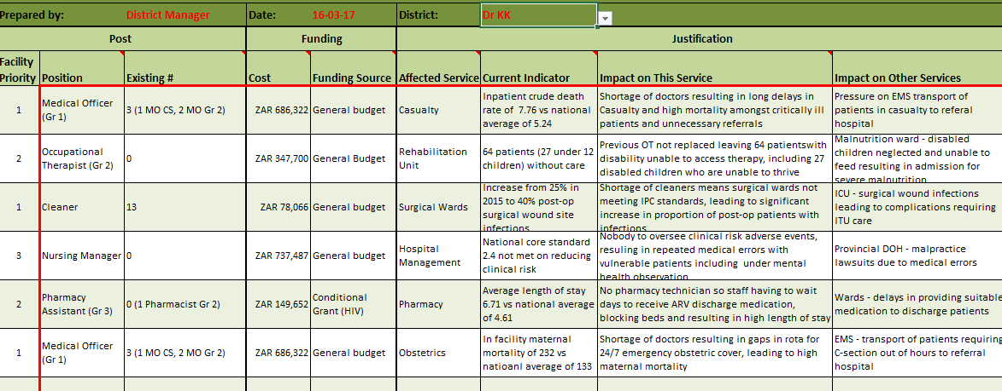
Facility Template
(List with vacant posts and justification from facilities to district)

Slide 57
District Template
(Decision Matrix to rank each post to identify most critical posts)
District/Province Use
Decision Matrix
Clinical Consequences (mortality/morbidity) | Rural Location (no alternative services) | Vulnerable Patient Group (poor or marginalised) | Feedback on Prioritisation Decision | District Priority
Very High | Very High | High | Urgent to reduce high mortality in severely short staffed facility | 1
High | Very High | Very High | No alternative service for highly vulnerable group, could result in chronic disability | 2
High | Medium | Low | Recruitment would bring significant clinical benefit at low cost | 3
Medium | Very High | High | Poor outcomes for vulnerable patient plus risk of legal costs for province but alternative solution possible | 4
Low | Medium | Medium | Shortage of beds a problem at Facility B but Facility E 5km away usually has bed availability | 5
Medium | Low | Medium | Alternative emergency obstetrics unit nearby at facility D10 km away | 6

Slide 58
Monitoring

Slide 59
Better responsiveness : Monitoring & Flexibility in Plans
Planning is useful. However, blindly following plans is not at all useful.
Implementation plans at all levels must adjust actions in response to actual performance to ensure that targets are achieved over time.

Slide 60
Monitoring and evaluation
What is M&E, and Why do it?
It is an integral part of the plan-do-review cycle. It is the process that helps improve performance and achieve tangible results, and it’s goal is to improve current and future management of outputs.
Monitoring :
To learn from experiences to improve practices and activities in the future; To check progress against plans; To have accountability of the resources used and the results obtained; To take informed decisions on the future of the initiative.
Monitoring allows results to be documented and used as a basis to steer decision-making and learning processes. The data acquired through monitoring is used for evaluation.
Evaluation:
It is an objective analysis or interpretation of the collected data in terms of: Relevance Effectiveness Efficiency Impact Sustainability.
Evaluation involves delving deeper into the relationships between the results of the activities/programmes to inform strategic decisions to improve the programme in the future

Slide 61
Logic Framework:
Planning and Monitoring for impact
Im-
pact
Outcome
Outputs
Activities
Inputs
What we wish to change.
The developmental results of achieving specific outcomes.
Results
(monitor and evaluate)
What we wish to achieve.
The medium term results (1-3 years) for specific beneficiaries that are the consequences of achieving specific outputs.
What we deliver
Occurs as a result of combining inputs and completing activities as outlined in the operational plan.
Delivery (Plan, Budget, Implement, monitor)
What we do:
Actions that use the inputs to produce the outputs.
What we use:
Human and Financial Resources to execute the activity.

Slide 62
Results based monitoring and evaluation
What is RBME?
The Result-Based M&E (RBME) system has its focus on the results obtained and obtaining evidence for decision making rather than just on the inputs used or the activities conducted.
Planned Work
What are hoping to achieve
Inputs
Activities
Outputs
Outcomes
Impact
Resources consumed by the activities to produce the desired output.
What we use to execute the activity.
Actions that use the inputs to produce the outputs.
What do we do.
Occurs as a result of combining inputs and completing activities as outlined in the operational plan.
What we deliver.
The medium term results for specific beneficiaries that are the consequences of achieving specific outputs.
What we wish to achieve.
The developmental results of achieving specific outcomes.
What we wish to change.
Delivery
Results

Slide 63
The role of M&E in the RBME framework
Monitoring and Evaluation informs the impact
PROBLEM
Resources used in an intervention e.g. Money, staff, materials
Services that the intervention provides to accomplish its objectives e.g. Outreach materials, distribution, testing, etc.
Direct products or deliverables of the intervention e.g. Number of patients tested, material distributed, etc.
Immediate results of the intervention such as changes in knowledge, attitude, skills
Long term results that occur over time. May entail results of combined interventions not just one such as reduction in disease prevalence.
INPUT
IMPLEMENTATION
Activities Output
OUTCOMES
IMPACT

Slide 64
District Responsive Planning (monthly track performance, and quarterly performance review, report and feedback)
Inform District Responsive Planning
Quarterly progress report to feed into Provincial Quarterly Performance Reviews
  What is/is not working?
  What went wrong with referred patients? (Consolidated Death Report)
  What are we going to change?
  What did we / others complete and if not, why not?
  Has it yielded the expected results?
  Are we on track to achieve our targets?
  Monitor implementation of actions by selves and others
Identify additional actions needed to improve performance
Implementation
Track your indicators (performance)
Track your original actions
Enable implementation
Adjust actions in light of results
  Ensure Sub-districts and District Hospitals are clear on what needs to be done
  Solve bottlenecks to ensure effectiveness
Know your targets or target limits
  What was achieved / not achieved?
  What did we fail to prevent?
  What are we trying to achieve?
  What do we want to prevent?
Inputs
Output/
Outcome/
Impact
Indicators
Input/ Activities

Slide 65
District Responsive Planning (monthly track performance, and quarterly performance review, report and feedback)
Evidence based decision making becomes a requirement for the new framework. It requires use of information and data already collected by the Districts to guide actions, and monitor performance.
The monitoring process requires Districts to (a) assess whether plans were implemented, (b) assess whether actions resulted in impact (negatively or positively), (c) adjust actions in light of results.

Slide 66
Monitoring for results
Monitoring
After selecting targets and completing the performance-based framework, we are now ready to use the information to monitor for results. Managers can use a variety of tools to manage inputs, including budgets, quarterly reviews, and project plans.
What should management do:
What are the practical steps for effective monitoring and reporting?
1 Gather
information
2 Conduct status
update meetings
3 Capture
meeting minutes
4 Compile
feedback reports
Gather data and/or feedback reports.
Check data source
Update the activity progress in the operational tool.
Prepare for the status update meetings:
  list actions taken since previous meeting
  list actions planned until the next meeting.
  Meet with the key stakeholders involved
  Review the activity progress ‘
  Discuss actions taken since previous meeting
  Discuss actions to take before next meeting
  Update/agree on remedial actions to take before next meeting
Write-up the meeting minutes and share will all the stakeholders that attended
Compile feedback reports as necessary.
For the meeting minutes compile feedback reports as necessary (monthly, quarterly, mid-year, annually)
Update actual progress in operational planning tool.

Slide 67
Compare with target
(e.g. Test 100 patients for TB)
Frequency
Questions: On or off target? What is going on?
Action
Daily / Monthly
Compare with the target
Is the number of patients tested on target? Why is the number of patients tested not on target?
Is the ‘actual’ number of nurses administering the tests on target
Why do we have a deviation from target?
Is the number of tests administered in line with the allocated capacity ? Why is the ‘actual’ output not in line with the allocated capacity (e.g. nb. of nurses working on testing during the same as the previous quarter)
Has the management testing plan been disseminated. If not why?
When you have a deviation from the target you organize an adhoc problem solving session (with the relevant team members/managers) in order to find the root cause.
Once that you have the root cause, you define solutions and you create an action plan to get the KPI back on target.
Follow-up. Check if the implemented actions have the expected effect on the Indicator.
Quarterly
Compare with target and analyze trend
Is the testing within target? Why not? What is going on?
Is the number of tests administered on target?
Is the number of new patients as expected. Why not?
Where do we need to focus on the long term ?
Was the resource allocation optimal?
What is the trend? Is there a systematic pattern?

Slide 68
Review and Monitoring for Impact on Health Outcomes
 | District | PHC Facilities (with their Supervisors) | Hospitals
Review actions in the light of results | District Management Team (DMT) Meeting | Monthly PHC Meeting (per sub-District) | Monthly Hospital Clinical meeting (PPIP/ChPIP/DHIS)
Implement and track actions | Identify and Implement actions needed for change, and support health facilities to enable implementation of their plans | Implement actions needed for change. Respond to modifiable factors that led to deaths in Hospitals | Identify and address Modifiable factors, and feedback those relevant to DMT for their response
Analysis to Identify actions | Diagnosis and challenges (escalate to Provincial office where necessary) | Identify challenges and where necessary Escalate challenges | PPIP/CHPIP review/analysis & capture
Track actions and monitor performance | Track performance (actions and indicators) | Track performance (actions and indicators) | Track numbers and causes of deaths (24 hour death report) and mortality dashboard
Know Your Targets | Targets for HIV, TB, MNCWH, NCD Indicators | Targets for HIV, TB, MNCWH, NCD Indicators | Targets for Death Reduction (max limit for deaths)

Slide 69
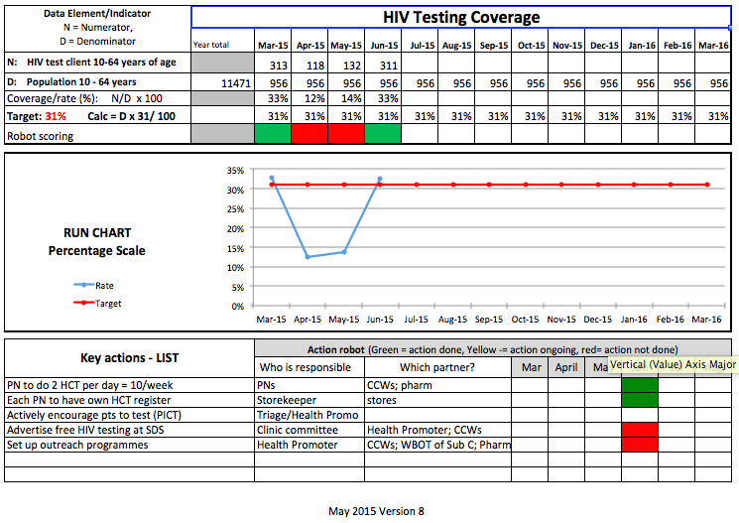
If the action is green (i.e. was done), and the performance indicator shows an upward trend, then you have the right action.
*from UNICEF - supported “3-feet” projct report

Slide 70
WHEN?
Define the planning and monitoring process timelines for 2018/19 cycle

Slide 71





Planning and Budgeting
Budgets
Q2
Q3
Q4
NDoH review Prov. Targets to calculate NDoH targets (1 Oct – 15 Oct)
30 Nov, 2017
8. 2nd Draft APP
31 Jul, 2017
7 Feb 2018
1st draft of MTEF Budget
12. Final Provincial Targets by 7 Feb 2018
31 Jul, 2017
12 Dec, 2017
13. Final Provincial APP
Provincial Level
31 Oct, 2017
9. Workshops with District Management Teams to agree on final targets from outputs from step 5 and 7 (Starts 12 Dec to end Jan 2018
1. Provincial Target Setting
2nd draft of MTEF Budget
8 Mar, 2018
4a. Submit 1st Draft APP to NDoH (end Aug)
31 Oct, 2017
31 Jan, 2018
4b. Updated 1st draft APP to NDoH with Targets end Sept 2017
7. Workshops with National DoH during month of Oct 2017
Final MTEF Budget
31 Aug, 2017
Jul
Aug
Sep
Oct
Nov
Dec
Jan 2018
Feb
Mar
2017
26 Jan, 2018
31 Jul, 2017
29 Sep, 2017
9-10. Final Target setting and intervention workshops supported by Provincial DoH
30 Mar, 2018
Budget
DHER and First Draft Budgets for forthcoming FY
14. Final DHP with OP plan completed
2nd draft of MTEF Budget
21 Sept 2017
31 Oct, 2017
3. Draft DHP with situational analysis and Draft Targets
6.a. Submit Draft 2nd DHP with Key-priorities and intervention Plan (Refine Stages 1-5); and
6.b. Draft District OP Plan by 31 Oct 2017
31 Jan, 2018
District Level
2. District Strategic Workshops: (Stages 1,2,3) based on Provincial Targets
Final Budget
4 Aug 2017
29 Jan, 2018
11. Final Draft DHP
10 Oct. 2017
5. District Workshops (Stages 4; 5 (10 Oct – 31 Oct 2017)

Slide 72
Budgeting and Planning (2)
1. Provincial DoH with District Managers discuss Provincial Targets (Guided by Q1 Performance); Discuss high level interventions (strategies to attain targets); (during August 2017)
2. Workshops in Districts to start Planning discussions for next FY: Complete Goal Setting; and Diagnosis (refer to Steps 1, 2A, 2B, and 2C, 3 from the planning framework defined above) (commence during Aug 2017 to 21 Sept 2017)
3. Districts complete their first Draft DHP (with situational analysis and draft targets) by 21 Sept 2017.
4a. Provincial DoH submit 1st Draft APP end August 2017 (as required by PFMA)
4b. Provincial DoH submit updated 1st Draft APP with proposed Provincial targets by end Sept 2017.
5. District level workshops to determine key priorities and Interventions to achieve Targets (Stages 4,5) proposed by Provincial Head Office Starts 10 October – 31 October 2017. (Refine targets if necessary).
6. 6a. Submit Draft 2nd DHP with key priorities and intervention plan with targets submitted to Provincial Head Office by 31 October 2017. 6b. Commence to draft District Operational Plan for 2018/19
7. National DoH will conduct workshops with Provincial DoHs to review proposed Provincial Targets (Month of October)
8. Provincial DoH to produce its 2nd Draft APP with near final targets, and key interventions sourced from DHPs and submit by end November 2017 as required by PFMA.
9-10. Provincial DoHs and Districts conduct workshops from beginning Dec 2017 to end Jan 2018 to finalize Provincial Targets and interventions based on outputs from workshops conducted at steps 5 and 7.
11. Districts finalize DHP compiled with refined targets and interventions, and submit to Province and NDoH (end Jan 2018)
12. Provincial DoH submit Final Provincial Targets (guided by DHPs and final budgets) to National DoH by 7 February 2018.
13. Provincial DoH table Final Provincial APP according to legislature (around 8 Mar 2017)
14. Final DHP and District Operational Plan completed by end Mar 2018, and signed copies sent to Director-General.

Slide 73



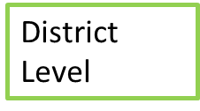


Monitoring
Q1 2018/19
Q2 2017/18
Q3 2017/18
Q4 2017/18
17 Jul, 2017
B. Q1 Performance Review Session (by Mid July) and Strategies and Remedial Actions finalized
F. Q3 Quarterly Performance Review Session and Strategies and Remedial Actions finalized
H. Q4 Quarterly Performance Review Session and Strategies and Remedial Actions finalized
12 Jan, 2018
Provincial Level
18 Apr, 2018
J. Annual Performance Review of previous FY
31 May,2018
D. Q2 Performance Review Session (by Mid Oct) and Strategies and Remedial Actions finalized
16 Oct, 2017
Apr
May
Jun
Jul
Aug
Sep
Oct
Nov
Dec
Jan 2018
Feb
Mar
2018
2017
2018
28 Apr, 2018
Today
3 Oct, 2017
12 Jan, 2018
I. Annual Performance Review of previous FY
C. Q2 Performance Review Session (begin Oct)
E. Q3 Quarterly Performance Review Session (begin Jan)
7 Apr, 2018
7 Jul, 2017
G. Q4 Quarterly Performance Review Session (begin April)
A. Q1 Performance Review Session (begin Jul)
Monitoring Q4 by 5th of Apr 2018
Monitoring Q1 by 5th of Jul 2017
Monitoring Q2 by 5th of Oct 2017
Monitoring Q3 by 5th of Jan 2018

Slide 74
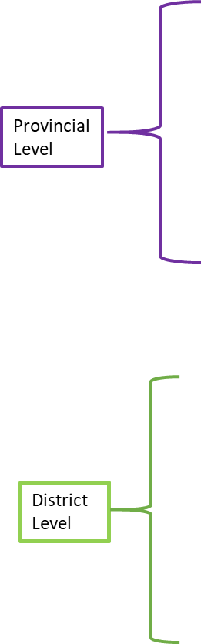

Monthly Monitoring/Reporting/Feedback Cycle
QPR:
Draft Q4 Prelim Report and Draft Q3 Validated Report submitted to NDOH and OTP by 11th
11 Apr, 2017
DHIS Monthly: DHIS: Data Submitted to NDoH by 11th for period ending Mar
DHIS Monthly: DHIS: Data Submitted to NDoH by 11th for period ending Feb
11 May, 2017
11 Apr, 2017
QPR: Final Q4 Validated Report submitted to NDoH and OTP by 19th
QPR: Final Q4 Prelim Report and Draft Q3 Validated Report submitted to NDoH and OTP by 19th
19 May, 2017
QPR:
Draft Q4 Validated Report submitted to NDOH and OTP by 11th
Annual Report produced previous FY
19 Apr, 2017
11 May, 2017
31 May, 2017
2017
1
2
April
3
1
May
2
3
2017
15 Apr, 2017
DHIS: District Data Submitted to Provincial Head Office by 15th for period ending April
4th Quarterly Report (Jan Feb Mar)
15 May, 2017
12 May, 2017
15 Apr, 2017
DHIS: District Data Submitted to Provincial Head Office by 15th for period ending March
Feedback report: Compile report to Sub District on Data Quality, and Performance for period ending April
12 Apr, 2017
Feedback report: Compile report to Sub District on Data Quality, and Performance for period ending Mar
DHIS: Sub-District Data Submitted to District Head Office by 10th for period ending March
DHIS: Sub-District Data Submitted to District Head Office by 10th for period ending April
Sub-District Level
10 Apr, 2017
Feedback report: Compile report to Facilities on Data Quality, and Performance for period ending April
7 May, 2017
7 Apr, 2017
15 May, 2017
Feedback report: Compile report to Facilities on Data Quality, and Performance for period ending Mar
5 May, 2017
Draft Annual Performance Report to Provincial DoH
DHIS: Facility data Submitted to Sub-District by 5th for period ending Apr
5 Apr, 2017
DHIS: Facility data Submitted to Sub-District by 5th for period ending March

Slide 75
WHO?
support mechanisms - Provincial Co-ordination and Support to Districts
governance /management forums - District and Sub-District Planning Monitoring and Response Forums

Slide 76
Provincial Co-ordination and Support to Districts
Head: District Health Services
  co-ordinate all the activities targeted at Districts by virtue of their role of providing leadership to all the districts.
  work with District Managers to develop plans and support implementation that take care of the national and provincial priorities and their localized challenges
  facilitate alignment of performance Agreements of District Managers with their District Health Plans (and by implication review performance of District Managers based on performance of the Districts)
  streamline communication between Provincial Head Office and District Managers,
  support Districts during their quarterly performance reviews, and unlock bottlenecks at Provincial Head Office

Slide 77
Provincial Co-ordination and Support to Districts
Head: Planning and M&E
  develop processes and procedures to facilitate Quarterly Performance Reviews and Strategic Planning sessions at Provincial and District levels.
  provide all the technical support (use of indicators, indicator definitions, targets setting) to management regarding planning and M&E at both Provincial and District levels.
  development of planning tools, indicators, target setting and alignment between the District Health Plans and Annual Performance Plans.
  Work with Head of District Health services in establishing a process to facilitate negotiation of District targets between Provincial programme managers and District Managers to ensure that District targets (in District Health Plans) are aligned to Provincial Targets (in Provincial Annual Performance Plans

Slide 78
District Planning Monitoring and Response Forum
Meets at least monthly (and reports quarterly to Province)
Includes all sub-districts, district hospitals as well as referral hospital representatives OR data

Slide 79
Functions: District Planning Monitoring and Response Forum
Present and discuss National / Provincial / District Priorities of the forthcoming year as well as performance of the District.
  Present results from the District Health Expenditure Review, and Budgets of the forthcoming year, and respond to all relevant procurement needs.
  Present and agree on any programmatic needs for the next financial year
Present reports and agree on remedial interventions /actions for
  latest self-assessment Ideal Clinic Dashboard at the District level
  Inspection reports from Office of Health Standards Compliance
  Data quality reports (data validation and completeness reports)
Review and discuss District performance for priority health programmes and other initiatives
  Discuss challenges experienced by clinics, propose interventions, and obtain commitment from District managers to address challenges identified by “diagnosis”.
  Discuss the report on death audits and determine or track corrective actions
  Recommendations from DCSTs on clinical governance and quality, and improvement measures taken in past quarter (and consolidated death report)
Notes:
I adapted /summarized this and added some words

Slide 80
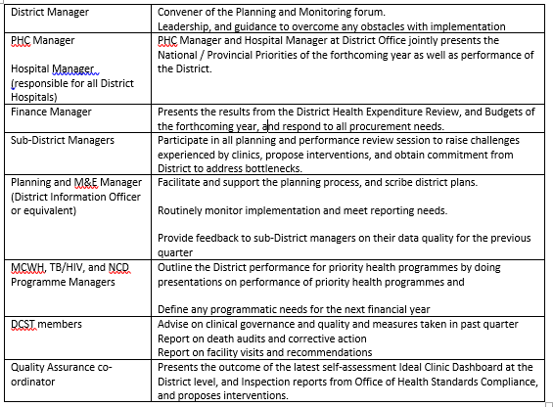
Head of EMS, District Pharmacist, and HR Managers are requested to be added

Slide 81
SUB-District Planning Monitoring and Response Forum
Meets at least monthly
Includes district hospitals

Slide 82
Functions: Sub-District Planning Monitoring and Response Forum
Discuss and present budget (of the forthcoming month) and expenditure (for the past month) of the sub-District
Present and discuss run charts for PHC facilities and District hospital if relevant.
Discuss status of implementation of actions and whether implementation resulted in improvement, using a standardised report.
Present and discuss data quality reports (data validation and completeness reports), and develop remedial actions to improve data quality.
Present the outcome of the latest self-assessment Ideal Clinic Dashboard and formal OHSC inspections, and propose interventions.
Review and adjust actions

Slide 83
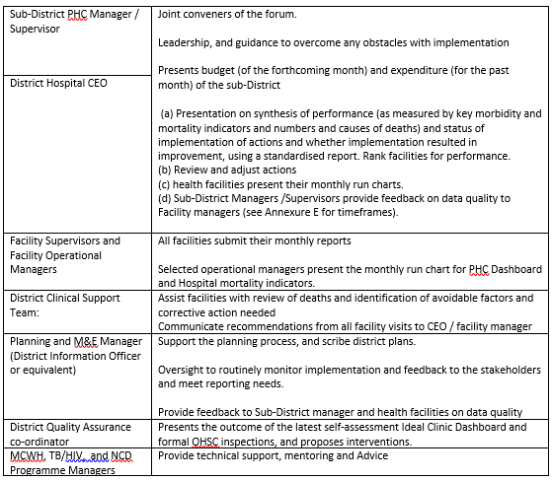
Sub-District Planning Monitoring and Response Unit

Slide 84
Recommendations on Roles and Responsibilities
Provincial DOH to adapt/tailor TechNHC approved forums and support mechanisms (as outlined in the foregoing slides) in line with their institutional arrangements. These include:
  Provincial Co-ordination and Support mechanisms to Districts
  District and Sub-District Planning Monitoring and Response Forums
All Provincial DoH to identify appropriate and carefully selected external stakeholders to bring about legitimacy into planning. Provincial DoH are requested to indicate their preferences. This could be guided by Social Determinants of Health principles.
National DoH to receive Terms of Reference to adapted above (functions, composition and roles of various forums including external stakeholders).
Provincial DoH to use above to support and facilitate the District planning process, that integrates with the Provincial head office planning process.

Slide 85
Conclusion and Next Steps
All districts are required to produce a District Health Plan that complies with national guidelines for District Health Plans, issued by the Director-General of National DoH in terms of Section 33 of National Health Act, 61 of 2003.
The National and Provincial DoH has spent the past several months to address the weaknesses in District Planning through above approach that:
  (a) strives to make district planning more effective (comprehensive), and efficient (one comprehensive District Health Plan and Operational Plan),
  (b) Strengthens linkages between District, Provincial and National planning,
  (c) promotes critical thinking, where production of the plan is secondary,
  (d) emphasizes outcome based planning by requiring District management, District Clinical Specialist teams, and Referral Hospitals to collectively take decisions and implement actions.
The National DoH would like to acknowledge inputs on the draft framework received from KwaZulu Natal, Limpopo, Northern Cape, Mpumalanga.
We would like to request that Provincial DoHs provide the following by 4 Sep 2017:
  Name (and contact details) of the senior manager that will be coordinating (or championing) the implementation of the District planning and monitoring framework in all Districts for the next planning cycle.
  Propose two dates (between 18 Sep 2017 and 6 Oct 2017), where a team from National DoH can provide an overview of the new District Planning Framework and engage Provincial and District management on its implementation.
  Approved Terms of Reference (with functions and composition) of the District Planning and Monitoring forum (one for each District). (guided by the framework but tailored to your local institutional arrangements).
  Learning Districts: We wish to request Provincial DoH to nominate of two learning Districts. (NDoH will select one District per province to provide support and learn from the implementation of the framework to improve it for the next cycle).

Slide 86
Contact Details
All queries on these guidelines may be directed to the National Department of Health on email DHP@health.gov.za.
The District Management Teams may also submit their final draft District Health Plans for 2018/19-2020/21 (due end January 2018) with a cover letter signed by District Manager or Provincial Head of Department, addressed to Director-General on email address: DHP@health.gov.za
Ms MP Matsoso
Director-General: Health
Tel: 012 395 9150
Mr Gaurang Tanna
Cluster: Policy co-ordination and Integrated Planning
National Department of Health
Tel: 012 395 8408
Email: Gaurang.Tanna@health.gov.za
Mr Bennett Asia
Cluster: District Health Services
National Department of Health
Tel: 012 395 8760
Email: Bennett.Asia@health.gov.za

