Slide 1
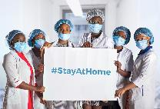
COVID-19 Infection Prevention and Control Guidelines for South Africa
(Version 2 – May 2020)

Slide 2
COVID-19 Infection Prevention and Control Guidelines for South Africa
These are interim guidelines which are subject to change as the situation with COVID-19 develops in South Africa. The guidelines will be updated regularly based on WHO recommendations.
Summary May 2020

Slide 3
Outline
Education and Training Core Components:
Goals of COVID-19 Guidelines for SA
Epidemiology
Routes of Transmission and Signs and Symptoms
Roles and Responsibilities of Health Care Workers (HCW)
General Infection Prevention and Control (IPC) Precautions
Laboratory Processes
Patient Management, Transport and Placement
Visitor Management
Environmental Controls
Management of Human Remains
Monitoring and Evaluation

Slide 4
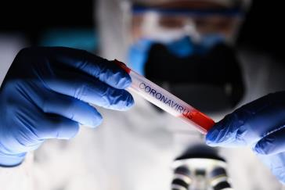
COVID-19 Infection: Background
Current evidence suggests that the virus that causes COVID-19 is transmitted between people through close contact and droplets.
People most at risk of acquiring the disease are those who are in contact with or care for patients with COVID-19.
This inevitably places health care workers (HCW) at high risk of infection.
Understanding how HCW exposure to COVID-19 virus translates into risk of infection, it is critical to adhere to prevention and control recommendations.
This will mitigate HCW exposure.
Eventually many facilities will be receiving positive COVID-19 patients who will require care.

Slide 5
COVID-19 Infection: Introduction
The World Health Organization (WHO) declared COVID-19 a global pandemic on 11th March 2020.
The first case diagnosed in South Africa was on the 3rd March 2020. South Africa has a unique challenge of a large vulnerable immune compromised (due to high burden of TB and HIV) population living in overcrowded conditions.
This refresher training is aligned to the IPC Guideline and provides guidance towards the reduction and prevention of transmission in both patients and staff at community and health care facility level.

Slide 6
Goals of COVID-19 IPC Guidelines for South Africa
Flatten the curve of COVID-19 infection and
reduce the risk of transmission from microorganisms
Reduction and prevention of transmission in both patients and staff
Combating healthcare-associated infections
Health system strengthening and patient safety
Improve quality of life
Reduce impact of outbreaks of highly transmissible diseases

Slide 7
Flatten the Curve: Video
Play video
Notes:
What is the curve? The “curve” refers to the projected number of people who will contract COVID-19 over a period of time.
A steep curve means an over-burdened health system. The curve takes on different shapes, depending on the virus’s infection rate. It could be a steep curve, in which the virus spreads aggressively. In this case, counts keep doubling at a consistent rate & the total number of cases skyrocket to peak within a few weeks. Infection curves with a steep rise also have a steep fall. After the virus infects pretty much everyone who can be infected, case numbers begin to drop quickly too. The faster the infection curve rises, the quicker health care system will get overloaded beyond its capacity to treat people. That’s why the Minister of Health Dr Zweli Mkhize has said we must heed precautionary measures to #flattenthecurve.
Why we want to flatten the curve A flatter curve assumes the same number of people ultimately get infected, but over a longer period of time. A slower infection rate means a less stressed health care system.
How can you help flatten the curve?
Stay at home. That means no visitors or visiting, playdates, movies, meals at restaurants or even coffee with friends.
Pray at home.
Only go out if its absolutely necessary.
Take all precautions while at home & while outside for any important work.
Be a responsible citizen by following instructions & advice, & educate others about measures in place to contain the spread of the virus.
Spread facts, not fear.
https://www.youtube.com/watch?v=d914EnpU4Fo

Slide 8
Why this matters
Infection curves with a steep rise also have a steep fall. After the virus infects pretty much everyone who can be infected, case numbers begin to drop quickly too. The faster the infection curve rises, the quicker health care system will get overloaded beyond its capacity to treat people. We must heed precautionary measures to flatten the curve.
Dr Zweli Mkhize, Minister of Health

Slide 9
Training Objectives
Implement COVID-19 IPC training at national, provincial, district and health facility level including Emergency Medical Services (EMS)
Include COVID-19 IPC training in IPC programmes currently led by IPC-trained professionals
Train health workers on COVID-19 IPC
Enhance COVID-19 IPC measures towards improving patient safety and improve health outcomes
1
2
3
4

Slide 10
What we know about coronavirus and disease (COVID-19)
Coronaviruses are a group of viruses belonging to the family of Coronaviridae, which infect both animals and humans
Human coronaviruses can cause mild disease similar to common cold, while other cause more severe disease and examples are:
MERS (Middle East Respiratory Syndrome)
SARS (Severe Acute Respiratory Syndrome)
A new coronavirus that previously has not been identified in humans emerged in humans in Wuhan, China in December 2019

Slide 11
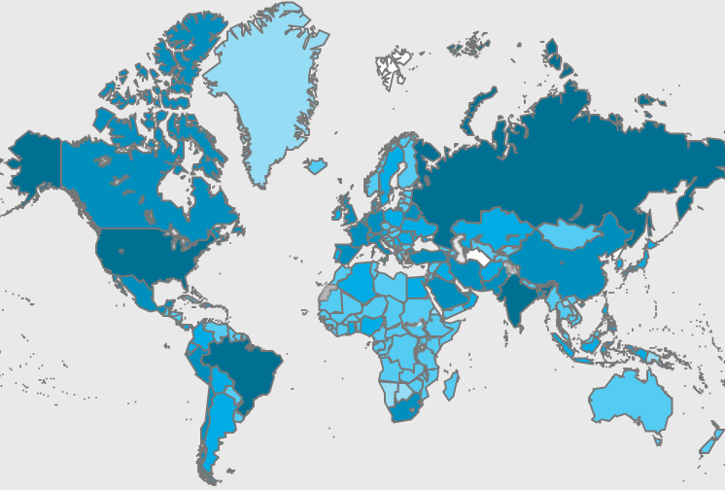
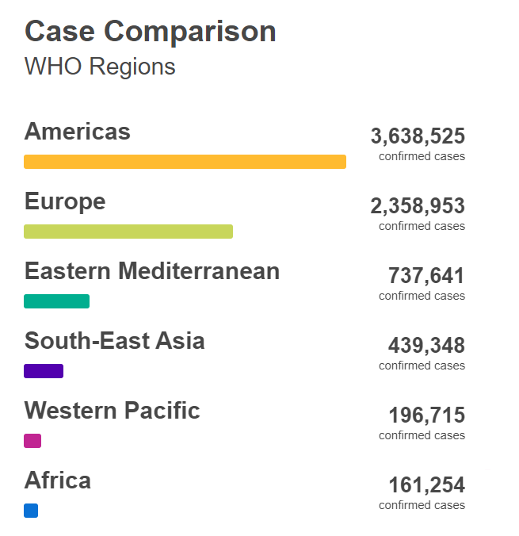
Epidemiology Global: WHO
Globally, as of 5 June 2020, there have been 7,533,177 confirmed cases of COVID-19, including 422,770 deaths, reported to WHO.
Source: World Health Organisation
Notes:
Source: https://who.sprinklr.com/
As of 28 April 2020
Check latest stats when presenting

Slide 12
Notes:
Source: https://sacoronavirus.co.za/category/press-releases-and-notices/
As of 8 April 2020
Check latest stats when presenting

Slide 13
COVID-19 can produce many symptoms that range in severity. Most people will experience mild symptoms, but some people may show no symptoms—while others may become dangerously ill.

Slide 14
Routes of Transmission
There are two known routes of transmission (WHO recommendations)
Via respiratory droplets produced via sneezing, coughing which is directly inhaled person to person.
Via respiratory droplets landing on environmental surfaces surrounding the infected person (also known as the patient zone and the health zone) which are then transferred by the contact route via contaminated hands to a person’s face and mucous membranes.
1
2

Slide 16
Routes of Transmission
The figure below illustrates the difference between the distance travelled between droplet and airborne after aerosol generation through coughing or sneezing.

Slide 18
Notes:
Except while examining patients.

Slide 19
Roles and Responsibilities of Health Care Workers (HCW)
HCWs have an ethical duty and a professional responsibility to act in the best interest of their patients, both as a group and as individuals.
Ensure Respect
Ensure Dignity
Ensure Compassion for all clients and patients
Reduce Stigma and discrimination
(WHO: 2020)

Slide 20
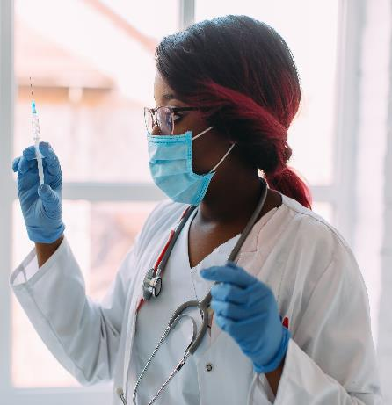
Roles and Responsibilities of all HCW
Avoid exposing others to health and safety risks
Participate in employer provided occupational safety and health training
Use provided protocols to assess, triage and treat patients
Treat patients with respect, compassion and dignity
Maintain patient privacy and confidentiality
Understand and adhere to the relevant policies and procedures
Self-monitor for signs of illness and self-isolate and report illness to managers, if it occurs

Slide 21
Health Care Worker Responsibilities
Responsibilities of HCW to all clients with suspected or confirmed COVID-19

Slide 22
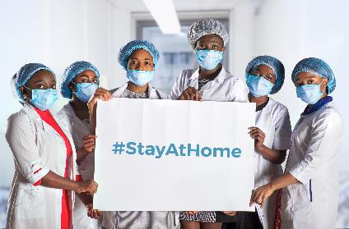
General IPC Precautions – All Staff
1
Frequent hand washing and use of alcohol-based hand rub (ABHR)
Correct cough etiquette and respiratory hygiene
Social distancing: Keep a distance of 1.5 to 2 m when in contact with other people except during patient’s examination or procedure
Do not touch your face unless your hands are clean
PPE is necessary at the workplace
2
3
Clinical, Security, Food Aids, Cleaning Staff, Nurses, and Doctors
4
5

Slide 23
General IPC Precautions – Laboratory and Clinical Staff
1
Take the correct required samples and send to the laboratory for processing
Ensure nasopharyngeal and other samples are processed and reported timeously
Implement effective management of patients (triage, isolation, treat promptly, discharge)
Follow IPC protocols meticulously
Use IPC equipment as indicated to avoid unnecessary wastage
2
3
4
5

Slide 24
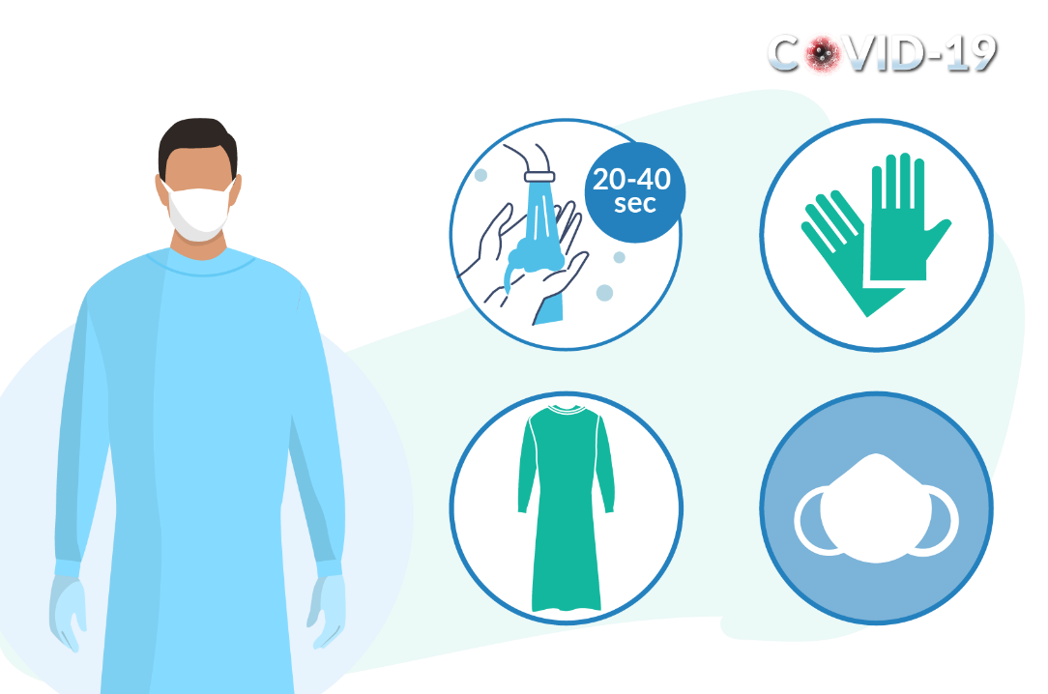
Transmission-based precautions - droplet and contact
Hand hygiene is the first and most essential aspect.
Healthcare worker PPE consists of gloves, gown (or apron), and a medical mask.
Safe waste management.
Use either disposable or dedicated equipment (e.g. stethoscopes, blood pressure cuffs and thermometers). If equipment needs to be shared among patients, clean and disinfect between each patient use.
Limit patient movement within the institution (e.g. where possible, use portable X-rays rather than sending the patient to the X-ray department), and ensure that patients wear medical masks when outside their rooms.

Slide 25
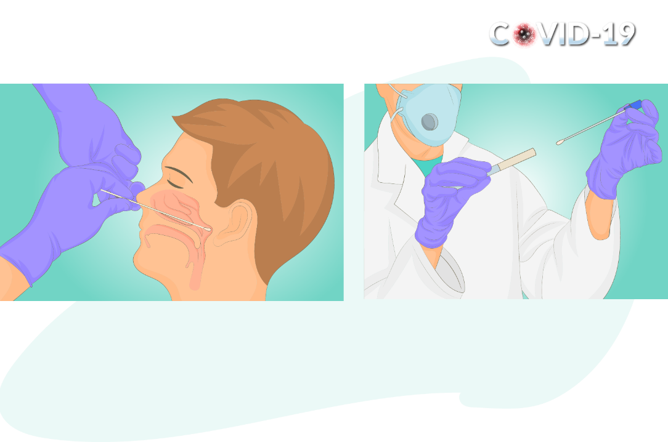
Aerosol-Generating Procedures
Aerosol precautions are required when performing aerosol-generating procedures. These include taking respiratory tract samples for SARS-CoV-2 testing (such as nasopharyngeal and oropharyngeal swabs), intubation, bronchoscopy, open suctioning of the respiratory tract, and cardiopulmonary resuscitation.
Aerosol precautions for healthcare workers:
Healthcare worker PPE consists of gloves, gown (or apron), a fit-tested particulate respirator (N95 respirator or equivalent), and eye protection (goggles or face shield).
Use an adequately ventilated single room when performing aerosol-generating procedures, with spacing between beds of at least 1-1.5 metres.

Slide 26
Key Elements of Standard Precautions
Standard precautions (SP) are aimed at reducing the risk of transmission. The key elements of SP precautions are:
Notes:
Effective hand hygiene (HH) is a critical component of SP and ensures patient and staff safety
Liquid soap for washing hands must be available at each basin.
• Clean running water should be available

Slide 27
COVID-19 Isolation Area Droplet and
Contact Precautions
Notes:
N95 respirator is necessary when handling a patient or performing aerosol-performing procedures. In the absence of N95 respirator, use a surgical mask.

Slide 28
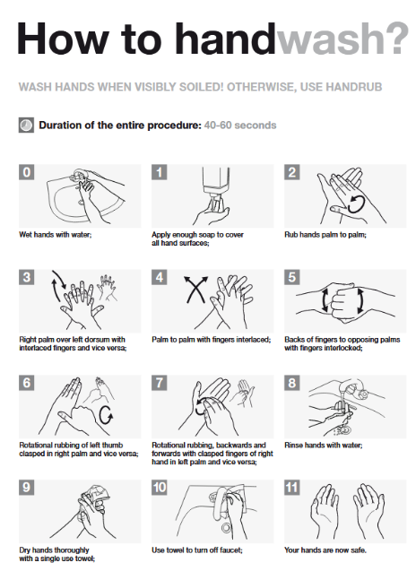
Hand Hygiene
Hands are most frequently in touch with patients, surfaces and parts of the health care worker’s body, such as the face, nose and mouth.
To remove microbes optimally, hands must be thoroughly and systematically washed paying special attention to the most contaminated areas, such as the fingers and thumbs.
Notes:
Source: https://www.who.int/gpsc/5may/Hand_Hygiene_When_and_How_Leaflet.pdf?ua=1

Slide 30
Notes:
N95 respirator is necessary when handling a patient or performing aerosol-performing procedures. In the absence of N95 respirator, use a surgical mask.

Slide 31
Hand Hygiene: Alcohol-based
Play video
Notes:
Hands are most frequently in touch with patients, surfaces and parts of the healthcare worker’s body, such as the face, nose, and mouth.
To remove microbes optimally, hand must be thoroughly and systematically washed paying special attention to the most contaminated areas, such as the fingers and thumbs.
Follow the WHO 5 Moments of Hand Hygiene.
https://www.youtube.com/watch?v=d914EnpU4Fo

Slide 32
Hand Hygiene: Soap and water
Play video
Notes:
Hands are most frequently in touch with patients, surfaces and parts of the healthcare worker’s body, such as the face, nose, and mouth.
To remove microbes optimally, hand must be thoroughly and systematically washed paying special attention to the most contaminated areas, such as the fingers and thumbs.
Follow the WHO 5 Moments of Hand Hygiene.
https://www.youtube.com/watch?v=d914EnpU4Fo

Slide 33
Respiratory Hygiene
These are infection prevention measures designed to limit the transmission of respiratory pathogens spread by droplet or airborne routes.
Notes:
Effective hand hygiene (HH) is a critical component of SP and ensures patient and staff safety
Liquid soap for washing hands must be available at each basin.
• Clean running water should be available

Slide 34
Personal Protective Equipment (PPE)
PPE is specifically used to protect clinical and non-clinical health workers from exposure to body fluids or from droplet or airborne pathogens, chemicals or heat.
The use of PPE is based on risk assessment and evidence of the route of transmission for a given microbe.
Notes:
N95 respirator is necessary when handling a patient or performing aerosol-performing procedures. In the absence of N95 respirator, use a surgical mask.

Slide 35
Notes:
Effective hand hygiene (HH) is a critical component of SP and ensures patient and staff safety
Liquid soap for washing hands must be available at each basin.
• Clean running water should be available

Slide 36
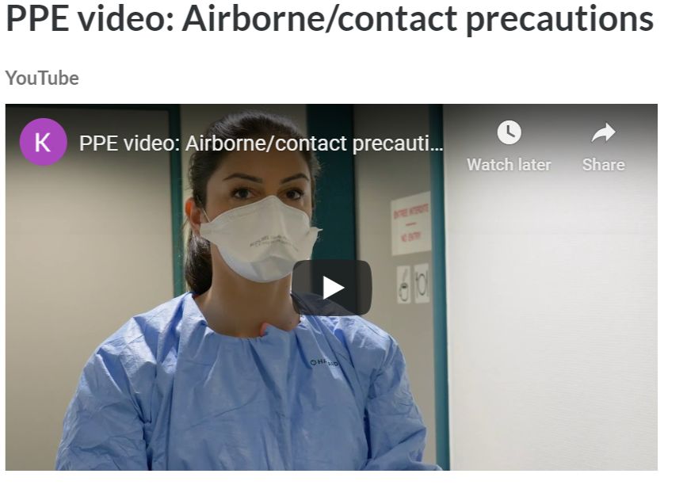
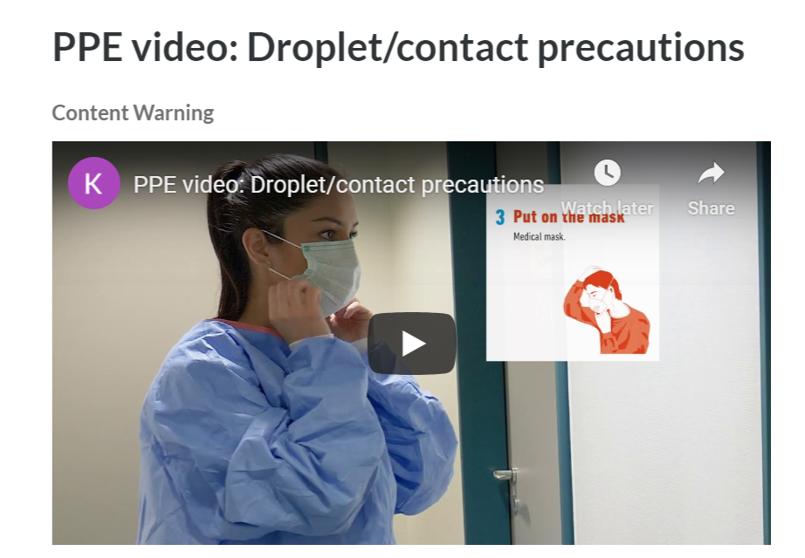
PPE videos
PPE videos
Play video
Play video

Slide 37
Types of face covers: Surgical mask and N95
Surgical masks (medical) are made of several layers of paper and protect against splashes and droplets. These are widely used in healthcare but should be reserved for HCW working in the clinical areas.
N95 Respirators (FFP2, FFP3) are specifically designed to filter out smaller particles and are recommended for use in airborne precautions such as when dealing with TB, measles or chickenpox. Non-valve N95 respirators are recommended to prevent droplet transmission from the wearer.

Slide 38
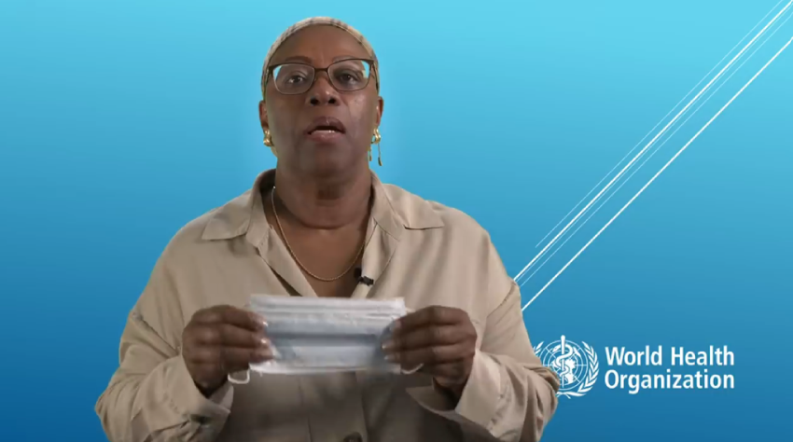
Face Masks: Video
Play video
Notes:
Usually in healthcare only two types of face covers offer adequate protection to the healthcare worker, i.e. face mask and N 95 respirators.
COVID-19 patients when inside a dedicated COVID-19 ward, where staff are wearing PPE, do not need to wear masks.
COVID-19 patients when outside a dedicated COVID-19 ward must always wear a surgical mask. The mask can be used for up to 8 hours.
https://www.youtube.com/watch?time_continue=2&v=Ded_AxFfJoQ&feature=emb_logo

Slide 40
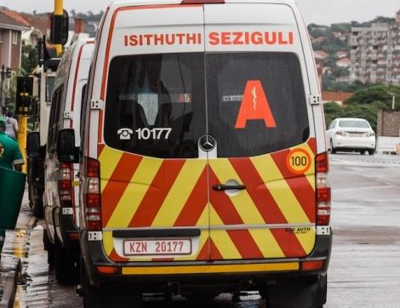
Patient Transport
Implement effective management of patients
Patient transportation
Patient to wear face mask during transfer
Advise EMS patient has COVID-19
Transfer as a single case
Guidance for EMS and others when transporting patient
Notes:
Effective hand hygiene (HH) is a critical component of SP and ensures patient and staff safety
Liquid soap for washing hands must be available at each basin.
• Clean running water should be available

Slide 41
Management of Visitors
Ideally no visitors are allowed however exceptions could be made in special circumstances and if absolute necessary.
Surgical mask should be used.
Hand hygiene before and after wearing and taking off PPE.
Mothers of hospitalized or isolated children allowed in with face mask and instructed on hand hygiene and social distancing.
Notes:
Effective hand hygiene (HH) is a critical component of SP and ensures patient and staff safety
Liquid soap for washing hands must be available at each basin.
• Clean running water should be available

Slide 42
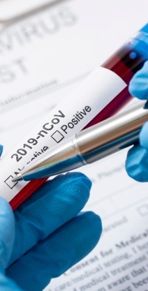
Environmental Controls
Patient placement or accommodation
Confirmed or suspected patients with COVID-19 not requiring ICU care should be accommodated either in a single room or in cohort isolation.
Single room:
Single occupancy room with en-suite toilet facilities
Natural ventilation of 60l/sec per patient or 6 air changes per hour (ACH)
Cohort (group) isolation:
Bed distance must be at least 2m from the foot of one bed to the foot so that the head of each bed is further than 2m.

Slide 44
Intensive Care Units (ICU)
Bed spacing: 3m or more to allow ease of movement of staff and equipment
Good ventilation: 160L/hour/patient or 12 air changes per hour (ACH)
Closed suctioning: use fresh sterile water each time to clean the suction catheter
Open suctioning: NOT RECOMMENDED
Dedicated ventilator equipment with single patient use circuit
Dedicated patient care equipment
Carry out hand hygiene and change gloves after each patient contact
Do not touch face, front of apron, mask, goggles or face shield during a clinical ward round
Keep patient charts far from the patient’s bed (outside the room, if possible)
Always carry out hand hygiene before and after touching the notes (persistence on cardboard and paper reported)

Slide 45
Ventilation
Provision of fresh air to a room/building
Where possible, natural ventilation is preferred giving air exchange of 60L/sec/patient
Mechanical ventilation must be checked by the engineers and records kept of airflow and air changes per hour (ACH) which should be a minimum of 6 ACH
IPC team to check airflow using a smoke test

Slide 46
Ventilation in Operating Theatre
Should a COVID-19 patient need surgery, the operating theatre ventilation must be checked for ACH and airflow. It is not necessary to convert the operating theatre into negative ventilation as long as there is sufficient air volume (160L/sec) changes (up to 24 ACH) to keep a high dilution factor particularly when carrying out AGP.

Slide 47
Maternity and Labour Ward
The delivery suites should have good bed spacing and ventilation.
Operating rooms should be similar to conventional operating theatre environment.
Mothers who are positive for SARS-CoV-2 are advised to wear face masks when feeding their baby for 14 days after their symptoms have resolved as mother to baby transmission via respiratory droplets can occur.
There is no evidence of viral presence in breastmilk and breastfeeding is strongly encouraged.

Slide 48
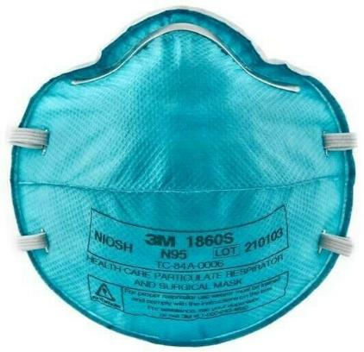
Standard Precautions
Standard precautions are critical for all HCW
Standard precautions are aimed at reducing the risk of transmission of microorganisms from recognised and unrecognised sources.
Patients and staff may serve as reservoirs for microorganisms, even if only colonised and not exhibiting any signs of infection.

Slide 49
Environmental cleaning
Human coronaviruses can remain infectious on surfaces for up to 9 days. The SARS-CoV-2 virus has been detected after up to 72 hours in experimental conditions. Therefore, cleaning the environment is paramount and is covered in detail in the National IPC Manual (2020).
1
To summarise, each area of the healthcare facility must be cleaned at least twice daily, with a proper schedule, checklist and programme. In high risk areas (COVID-19 triage, isolation ward and ICU settings), the environment must be cleaned and disinfected at least 3-4 times per day and checked by the supervisor each time.
2
The cleaning can be validated using visual inspection and fluorescent markers and a record of cleaning must be kept. Following thorough cleaning, surfaces are wiped (NOT SPRAYED) with disinfectants such as 1:1000 ppm chlorine or 70% alcohol, as recommended.
3
Environmental spraying of walls, floors, ceilings and passages in health care facilities with chlorine is not recommended. There is no evidence that transmission from these areas occurs.
4
Body spraying of humans with any chemical or product in any situation including entrances to healthcare facilities, is not warranted. The chemicals used may be toxic to the skin, eyes and respiratory tract and may aggravate the acquisition of SARS-CoV 2.
5

Slide 50
Healthcare Waste Management
SARS-CoV-2 is a fragile enveloped virus which is susceptible to heat, chemicals and UV light. There is no evidence of spread or infect humans from healthcare waste generated in the facilities if the existing healthcare waste management policies are followed where all HCRW will be handled as infectious waste.
HCRW includes all PPE used in triage, COVID-19 clinical areas for PUI and confirmed cases, and isolation facilities. It also includes disposable medical devices used for the care of such patients.
A single red bag placed inside a cardboard box marked “Infectious waste” is used to discard all HCRW. When ¾ full, the red bag is tied, HCRW container is labelled and transported to the point of collection for disposal.
SARS CoV2 is a fragile virus that does not remain viable in sewerage. HCF without municipal sewerage systems that have chemical toilets or similar are safe to clean provided the usual PPE worn by the municipality workers affords adequate protection.

Slide 51
2020: Guidelines for Management of Human Remains in the Context of COVID-19
Before attending to a body, ensure that the necessary hand hygiene and personal protective equipment (PPE) supplies are available for standard precautions including hand hygiene.
PPE for routine use will be gloves and apron, however if there is a risk of splashing, face protection, such a face mask, face shield or goggles may be worn.
After removing all medical devices, ensure that any leaking from orifices is contained.
Keep movement and handling of the body to a minimum.
The dignity of the dead, their cultural and religious traditions, and their families should be respected and protected throughout.

Slide 52
Cleaning of Mortuary
To date, there is no evidence of persons having become infected from exposure to the bodies of persons who died from COVID-19.
The mortuary must be kept clean and properly ventilated at all times.
Surfaces must first be cleaned with soap and water, or a commercially prepared detergent solution. After cleaning, a disinfectant with a minimum concentration of 0.1% (1000 ppm) sodium hypochlorite (bleach), or 70% ethanol should be used.

Slide 53
Handling of Human Remains in Mortuaries/Funeral Undertaker
The act of moving a recently deceased patient onto a hospital trolley for transportation to the mortuary might be sufficient to expel small amounts of air from the lungs and thereby present a minor risk.
A body bag should be used for transferring the body to the mortuary and those handling the body at this point should use full personal protective equipment (PPE).
The outer surface of the body bag should be decontaminated immediately before the body bag leaves the ward or anteroom area.
The trolley carrying the body must be disinfected prior to leaving the ward or anteroom.
Prior to leaving the ward or anteroom, the staff members must remove their PPE.
Once in the hospital or private mortuary, it would be acceptable to open the body bag for family viewing only (mortuary attendant to wear full PPE).
Family to be provided with mask and gloves fore viewing and should not kiss the body.

Slide 54
Preparing the Body in Mortuaries/Funeral Undertaker
Washing or preparing the body is acceptable if those carrying out the task wear PPE. Mortuary staff and funeral directors must be advised by the Environmental Health Practitioner of the biohazard risk.
Washing of the human remains can only be performed at the mortuary/ funeral undertaker's premises, no washing is allowed out of the mortuary/ funeral undertaker's premises.
If the family wishes to dress the human remains, they may do so at the funeral undertaker's premises prior to the body being placed in the body bag.
If a post mortem is required safe working techniques (for example manual rather than power tools) should be used and full PPE worn.
After use, empty body bags should be treated or disposed of as health care risk waste.

Slide 55
Measures When a Patient Passes on at Home
If a COVID-19 patient dies at home, family members may not at any stage handle the body, a funeral undertaker must be called immediately.
The belongings of the deceased person should be handled with gloves and cleaned with a detergent followed by disinfection with a solution of at least 70% ethanol or 0.1 % (1000 ppm) bleach.
Clothing and other fabric belonging to the deceased should be machine washed with warm water at 60-90°C (140-194° F) and laundry detergent.
If machine washing is not possible, linens can be soaked in hot water and soap in a large drum using a stick to stir and being careful to avoid splashing. The drum should then be emptied, and the linens soaked in 0.05% chlorine for approximately 30 minutes.
The laundry should be rinsed with clean water and the linens allowed to dry fully in sunlight.

Slide 56
Viewing of Human Remains
If the family wishes to view the body, they may do so without touching it, using standard precautions at all times including hand hygiene.
Family members should not touch or kiss the body and should wash their hands thoroughly with soap and water following the viewing; physical distancing measures should be strictly applied (at least 1 m between people).
People with respiratory symptoms should not participate in the viewing or at least wear a medical mask to prevent contamination of the place and further transmission of the disease to others.
Adults >60 years and immunosuppressed persons should not directly interact with the body.

Slide 57
Environmental Cleaning and Control
Human coronaviruses can remain infectious on surfaces for up to 9 days, therefore cleaning the environment is paramount.
The mortuary must be kept clean and properly ventilated and illuminated at all times.
Surfaces and instruments should be made of materials that can be easily disinfected as prescribed in Regulations Relating to the Management of Human Remains, Regulation No. R. 363 of 22 May 2013 as framed in terms of the National Health Act, 2003 (act No. 61 of 2003).
Environmental surfaces, where the body was prepared, should first be cleaned with soap and water, or a commercially prepared detergent solution; after cleaning, a disinfectant with a minimum concentration of 0.1% (1000 ppm) sodium hypochlorite (bleach), or 70% ethanol should be used to disinfect.

Slide 58
Conveyance of Infectious Human Remains
The human remains of a person who, at the time of his or her death suffered from disease or condition which is capable of transmitting an illness even after death and in the opinion of the health authority concerned, may pose a health hazard or endanger public health in one way or another, may not be conveyed in public in any way unless:
such human remains are placed in a polythene bag, sealed in an airtight container, placed in a sturdy non-transparent sealed coffin, embalmed and/or the total surface of the body covered with a 5 cm layer of wood sawdust or other absorbent material which is treated with a disinfectant; or
a medical practitioner declares in writing that in his or her opinion the conveyance of such human remains will not constitute a health hazard.

Slide 59
Conveyance of Infectious Human Remains
No person other than an attending medical practitioner or attending forensic pathologist or a medical practitioner who can prove that they have treated the deceased during illness may certify that the person did not die of an infectious disease:
such declaration must accompany the human remains at all times during the conveyance and up to the burial; and
the declaration shall be shown to an EHP on demand by the person responsible for the conveyance of the human remains;
no person shall damage a container, or open such container or remove the human remains from the container or come into direct contact with the human remains after it has been sealed without prior approval from an EHP.
Notes:
Burials and/or cremation of the human remain that died of an infectious disease is carried out as prescribed in the Regulations Relating to the Management of Human Remains, Regulation No. R. 363 of 22 May 2013 as framed in terms of the National Health Act, 2003 (act No. 61 of 2003).

Slide 60
Monitoring and Evaluation
There is little value in monitoring or auditing without timely feedback to managers and health workers at unit/ ward level
Regular feedback promotes best practices and over time results in behaviour or system change towards improved quality of care and patient safety

Slide 61
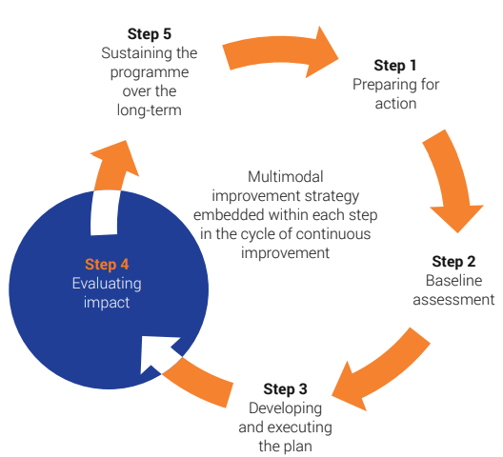
Monitoring and Evaluation

Slide 62
References
The National Infection Prevention and Control Strategic Framework, March 2020
Practical Manual for the Implementation of the National IPC Strategic Framework, March 2020
Provincial Personal Protective Equipment Plan, Western Cape Government, (Circular H34-2020) 25th March, 2020
WHO recommendations for COVID-19 2020. Deliberations of the COVID 19 Expert Committee will be used to update these guidelines

Slide 63
Questions?

