Slide 1
COVID-19 CLINICAL CASE MANAGEMENT
(Version 2 – 25 May 2020)
Notes:
This course will evolve as we get more information about COVID-19. There shall therefore be version 3 depending on the available evidence.

Slide 2
OOutlineLINE
Introduction
Objectives
Epidemiology
Clinical Presentation
Laboratory Diagnosis
Clinical Management and Palliative Care
Conclusion

Slide 3
What is New?
Updated case definition for a suspected COVID-19 (Section 3.1 of the guidelines)
New guidance on SARS-CoV-2 sampling and on repeat testing (Section 3.2)
Recommendation against the use of rapid antibody-based tests for the routine diagnosis of acute COVID-19 (Section 3.2)
Removal of the requirement that mild disease in high-risk individuals requires hospitalization (Section 4.1)

Slide 4
What is New?
Guidance on patients requiring nebulized medications or inhaled or systemic steroid use for management of their comorbidities (Section 4.2)
Updates to critical care section (Section 4.5)
Specific guidance on children, HIV patients, and pregnant/breastfeeding women (Section 5)
Updated guidance on the forms required when testing and managing COVID-19 patients (Section 7)

Slide 5
Introduction
The World Health Organization (WHO) was alerted on 31st December 2019 to a cluster of pneumonia cases of unknown etiology in patients in Wuhan City, China
A week later it was known to be the novel coronavirus
Also called Severe Acute Respiratory Syndrome coronavirus 2 (SARS-CoV-2)
That is why the illness is called COVID-19 as of 11st February 2020
This presentation describes clinical care in and outside health care facilities for patients who are suspected or confirmed to have contracted COVID-19

Slide 6
Updated case definition for a suspected COVID-19 case
A suspected COVID-19 case includes any person presenting with an acute (< or equal to 14 days) respiratory tract infection or other clinical illness compatible with COVID-19,
OR
An asymptomatic person who is a close contact to a confirmed case (this category should not be routinely tested)

Slide 7
Who is a close contact of a COVID-19 case?
A close contact is defined as a person having had face-to-face contact (< or equal 1 metre) or having been in a closed space with a confirmed COVID-19 case for at least 15 minutes.
This includes, amongst others:
COVID-19 cases households members
Individuals working with the confirmed case
Health care workers and people who are providing direct care for COVID-19 case while not wearing PPE
A contact in an aircraft sitting within 2 seats (in any direction) of the case, travel companions or care providers or crew members serving in the section where the case was seated in a aircraft

Slide 8
What constitutes key respiratory syndrome in the context of COVID-19?
Cough
Sore throat
Shortness of breath
Anosmia or dysgeusia
…with or without other symptoms (which may include fever, weakness, myalgia, or diarrhoea)

Slide 9
Objectives
At the end of this training, the attendees will:
Understand what COVID-19 is
Be able to suspect and screen individuals suspected to have COVID-19
Understand how COVID-19 is diagnosed in the laboratory
Familiarise themselves with the clinical management of COVID-19
Be able to prevent COVID-19 while assisting those in need of help

Slide 10
SARS-CoV-2 is a betacoronavirus closely related to SARS-Cov and MERS-Cov.
It is an enveloped, non-segmented, positive sense RNA virus.
It is believed to have originated in bats but the animal that mediated transmission to humans remains unknown.
The incubation period is estimated to be 4–5 days.
On average each infected person spreads the infection to 2 others.
Epidemiology
Notes:
Individuals of all age may be infected, older individuals are more likely to develop severe disease – particularly males

Slide 11
Clinical Presentation (1)
Truly asymptomatic COVID-19 patients (as distinguished from pre-symptomatic patients) have been described, but their proportion is not well characterized yet.
Among symptomatic patients in China:
81 % developed mild disease
14% developed severe disease with hypoxaemia, dyspnea and tachypnea and
5% become critically ill (with respiratory failure, septic shock and/or multiorgan dysfunction).
Notes:
Up to 40 %, possibly 70 % of those who are infected are asymptomatic.

Slide 12
Clinical Presentation (2)
Because of the strong effect of age on disease severity, the proportions of mild, severe, and critical cases seen in a country will partially depend on that country’s population age structure.
Persons with underlying co-morbid illness esp. cardiopulmonary disease
Atypical manifestations are increasingly being recognized, including large vessel strokes in young patients, unexplained abdominal pain, various dermatological manifestations, and a multisystem inflammatory syndrome in children

Slide 13
Clinical Presentation (2): Symptomatology
Fever is the most common
Cough is also very common
Fatigue
Sputum production
Shortness of breath
Myalgia or arthralgia
Sore throat
Headache
Chills
Gastrointestinal symptoms such as nausea, vomiting or diarrhea are uncommon
Anosmia (loss of sense of smell) and dysgeusia (alteration of the sense of taste) have also emerged as relatively common, early, and moderately specific symptoms.

Slide 14
Transmissibility
Main route of transmission is respiratory droplets
Airborne when performing aerosol-generating procedures (e.g. taking nasopharyngeal swabs, performing CPR or intubation)
Excreted in stool (possibly faeco-oral)
No evidence of sexual transmission

Slide 15
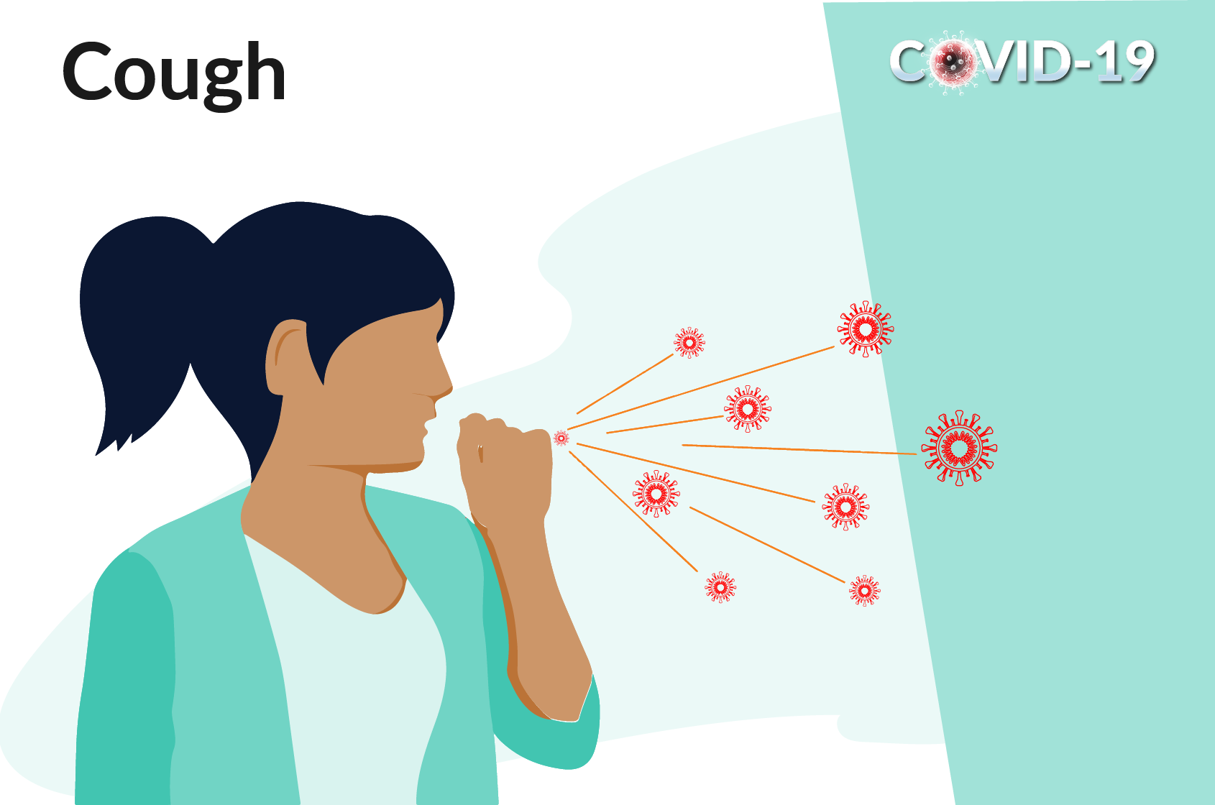
COVID-19: How does it spread?
Person infected with COVID coughs or sneezes, release droplets of infected fluid
Larger droplets fall on nearby surfaces and objects
People infected when touch contaminated surface then touch their eyes, nose or mouth
People infected by breathing in droplets if standing with 1m of infected person

Slide 16
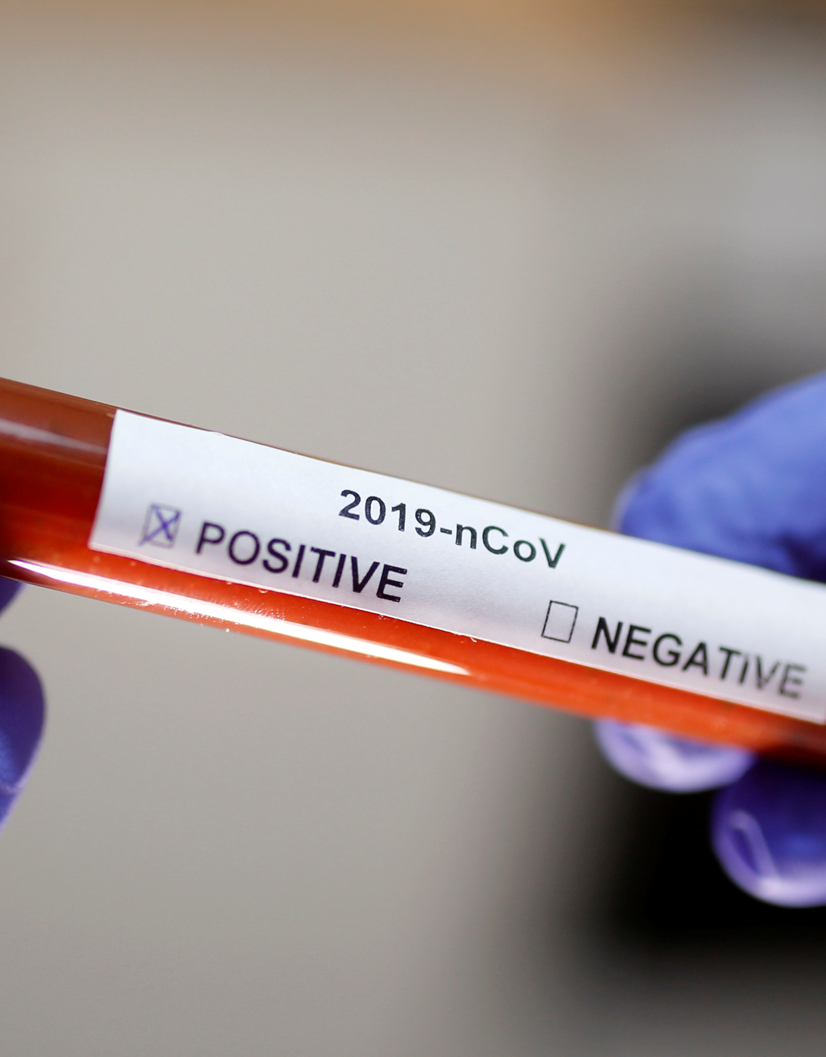
Management of suspected COVID-19
HCW to use N95 respirator and cover eyes – especially when taking a specimen or performing an aerosol generating procedure)
Use the screening questionnaire
If screening is positive, give the patient a medical/surgical mask
Direct the patient to a separate area, preferably isolation room if available
Educate the patient on how the cover the nose and mouth while coughing or sneezing (flexed elbow may be used)
Educate the patient on hand hygiene
Early initiation of supportive therapy may be required
Limit patient’s movements in the facility

Slide 17
Laboratory Diagnosis
Polymer Chain Reaction (PCR method)
GeneXpert will be used in near future
Antibody-based tests not recommended for COVID-19 diagnosis
Point of care antigen tests not recommended
Samples to be sent are: upper respiratory tract samples (nasopharyngeal and oropharyngeal swabs in universal transport medium) or lower respiratory tract samples if possible (sputum, tracheal aspirates, bronchoalveolar lavage fluid). Saliva may be used when directive is in place
Notes:
Antibody tests not yet defined and should not be used at this point in time.

Slide 18
Repeat testing
Repeat testing may produce false negative results due to factors such as poor sampling technique, suboptimal specimen storage (e.g. unavailability of viral/universal transport medium, or specimen not stored at cold temperatures), the site te sample is obtained from, and the time point at which the swab is taken (viral loads are usually highest early on in the disease course).
Test may be done if there is strong suspicion in consultation with ID specialist
Keep in mind differential diagnosis
No role for repeat confirmatory test- one single positive is enough

Slide 19
Differential diagnosis include
Influenza
Both conventional and atypical bacterial pneumonias
CD 4 count < 200 cells/mm3
Pneumocystis jiiroveci pneumonia (PJP)
Malaria (in patients with history of travel)
Non-infectious cases of dyspnoea and/or fever should be considered, such as pulmonary emboli, myocardial infarction, and heart failure

Slide 20
Appropriate tests for patients with severe disease who require admission
HIV test (if status unknown)
Full blood count + differential count
Blood culture
Nasopharyngeal and/or oropharyngeal swabs for detection of viral and atypical pathogens
Chest radiography
Sputum for MCS and Mycobacterium tuberculosis detection (GeneXpert MTB/RIF Ultra)
Urine for lipoarabinomannan (LAM) if HIV positive
Beta-D-glucan and expectorated sputum/tracheal aspirate for PJP if HIV+ and clinically suspicious of PJP (Do not induce sputum though)

Slide 21
For patients with mild disease who do not require admission
Limited workup depending on the specific presentation
HIV test
Sputum GeneXpert MTB/RIF Ultra if patient is HIV positive and is coughing
If HIV negative, TB test may be done if the individual is a close contact of a TB patient

Slide 22
Specimen collection for SARS-CoV-2 testing
Collect appropriate samples
Lower respiratory tract samples are preferred because the lower respiratory tract is the primary site of infection
Take combined nasopharyngeal and oropharyngeal swabs in ambulatory patients and sputum (if produced) and/or tracheal aspirate or bronchoalveolar lavage in patients with more severe respiratory disease
Use universal/viral transport medium for swabs, if available; sterile container for sputum and aspirates

Slide 23
How to collect nasopharyngeal and oropharyngeal swabs
Oropharyngeal swab
Nasopharyngeal swab

Slide 24
Step 1: Equipment and materials
Complete specimen submission form and person under investigation (PUI) form and contact line list found here
Nasopharyngeal (NP) and oropharyngeal (OP) flocked swabs
Tube containing universal transport medium (UTM), if UTM unavailable may use gel or send dry in sterile tube
Tongue depressor
Gloves, N95 respiratory (or surgical mask if unavailable) and eye protection
Tissue for the patient to use after sample collection
Biohazard bag for disposal of non-sharp materials
Cooler box and cooled ice packs
Ziploc plastic specimen bag

Slide 25
Step 2: Record keeping
Complete
Complete the specimen submission form and person under investigation (PUI) form and contact line list
Place
Place specimen submission and PUI form into a Ziploc bag
Label
Label the tube of universal transport media (UTM) with the patient’s name and date of birth and sample type

Slide 26
Step 3: Collection of nasopharyngeal swab (NPS)
Don gloves, respirator or mask, and eye protection.
Open a sterile flocked swab at the plastic shaft.
Ask the patient to tilt his/her head back. Estimate the distance from the patient’s nose to the ear.
Gently insert swab into the nostril and back (not upwards) to the nasopharynx until a slight resistance is met.
Rotate swab 2-3 times and hold in place for 2-3 seconds.
If resistance is met before fully inserted, remove and try the other nostril.
Slowly withdraw the swab and put it into the specimen container.
Break plastic shaft at the break point line and close the tube.

Slide 27
Step 4: Collection of oropharyngeal swab (OPS)
Wearing gloves, respirator or mask, and eye protection, and holding the UTM with the nasopharyngeal swab in, open a second flocked swab for OPS collection.
Ask the patient to tilt their head back and mouth open.
Hold the tongue down with a tongue depressor.
Have the patient say “aahh” to elevate the uvula.
Swab each tonsil first, then the posterior pharynx in a figure-8 movement.
Avoid swabbing the soft palate or the tongue with the swab tip as this can induce the gag reflex.
Place the swab into the same UTM tube with the NPS already in and break off the shaft at the break point.
Tightly close the tube.
Place the closed tube with two swabs in the Ziploc bag.
Remove gloves, respiratory or mask, and eye protection and wash hands thoroughly.

Slide 28
Step 5: Transport of specimens
Ensure the cooler box and ice packs stay at 2-8°C.
Transport to NHLS or private laboratory on the day of specimen collection.
Contact NHLS laboratories as below for shipping instructions or contact private laboratories directly.
If shipping to NICD (for reference testing), mark:
“Suspected COVID-19, NHLS/NICD, Centre for Respiratory Diseases and Meningitis (CRDM), Lower North Wing, SAVP building 1 Modderfontein Rd, Sandringham, Johannesburg, 2131”
NHLS laboratories use usual overnight regional courier service; private labs will ship via existing systems.

Slide 29
Step 6: NHLS laboratory contact details
Eastern Cape Province:
Dora Nginza Virology Lab Dr Howard Newman 0413956152
Free State Province:
Universitas Virology 051 405 3162 After hours ask for virologist on call 051 405 3033
Gauteng Province:
Charlotte Maxeke Laboratory 082 329 2914
Tshwane Virology Laboratory Prof Sim Mayaphi 012 319 2351
DGM Virology Laboratory Dr Temitayo Famoroti 012 521 4398
KwaZulu Natal Province:
Inkosi Albert Luthuli Academic Hospital Virology Dr Khanyisile Msomi 031 240 2791/4
Northern Cape Province:
Universitas Virology 051 405 3162 After hours ask for virologist on call 051 405 3033
Western Cape Province:
Tygerberg Virology 021 938 4330/4934
Groote Schuur Hospital Virology 021 404 4129/3091

Slide 30
Empiric treatment of other pathogens
Depending on the clinical syndrome that is appropriate
Conventional community-acquired pneumonia see SA community-acquired pneumonia guidelines
Atypical pneumonia (see above guidelines)
Notes:
Refer to NEMLC Standard Treatment Guidelines. These guidelines may be downloaded on your phones from Google Play.

Slide 31
Managing Patients at Home while Awaiting Lab Results
Suspected cases who are medically well, or who are assessed as having only mild disease, may be managed at home while awaiting test results.
Criteria for mild disease:
SpO2 equal or >95%
Respiratory rate <25
Heart rate <120
Temperature 36–39°C
Mental status normal

Slide 32
Advice for Patients Self-Isolating at Home
Sleep in own room and use own bathroom (if possible)
Use surgical mask, maintain at least 1m distance from other members
Wash hands with soap or alcohol-based solution
Practice cough etiquette (elbow crease)
Frequently clean hard surfaces and objects at patient’s disposal
Use own dishes, cups, spoons, forks etc.
Patient should know who to call if condition worsens

Slide 33
Management of confirmed COVID-19 cases
The goal is to reduce morbidity and mortality and minimise transmission
Triaging patients and early identification of severe cases that may need hospital or ICU admission is important in morbidity and mortality
Prevent transmission of coronavirus
Contact tracing
Patient’s education on cough hygiene and IPC at home

Slide 34
Symptomatic management of confirmed COVID-19 cases
Paracetamol is preferred for relief of pain or fever rather than nonsteroidal anti-inflammatory drug (NSAID)
Cough suppressants, such as codeine-containing cough mixtures are not indicated
Opioids such as morphine should not be used and may only be used with due caution and careful monitoring
ACEi (Angiotensin converting enzyme inhibitors) or ARBs (Angiotensin receptor blockers) might upregulate ACE2 receptors, the binding site for SARS-CoV-2, within tissues including the lung and heart, prompting theoretical concerns that this might place patients at risk of worse outcomes with COVID-19. But there is no evidence hence discontinuation of these agents not recommended.

Slide 35
Guidance on patients requiring nebulized medications or inhaled or systemic steroid use for management of their co-morbidities
Whether nebulisers increase the risk of transmission of SARS-CoV-2 is currently unknown
Patients who do require a nebulizer should use it in a room that is isolated from other household members and/or patients
Good ventilation is recommended.
Spacers need to be disinfected between patients with either soap and water followed by a wipe down with 70 % alcohol, or by using a chlorine-based disinfectant (soak for 30 minutes then rinse well with water to avoid chlorine being absorbed into the spacer)

Slide 36
Specific therapies
No evidence any drug is effective against SARS-CoV-2
Several drugs are under evaluation e.g. chloroquine, lopinavir/ritonavir, azithromycin but no sound evidence has emerged
Clinical trials should be conducted
If investigational therapeutics are given outside of a clinical trial, this should be done under the Monitored Emergency Use of Unregistered Interventions (MEURI) framework

Slide 37
Specific Therapies: Meuri Principles
Data providing preliminary support for the intervention’s efficacy and safety are available, at least from laboratory or animal studies
Ethics’ approval should be in place
The patient’s informed consent should be obtained before treatment administration
Adequate resources are required before implementation
The results of the intervention are documented and shared with the wider medical and scientific community
Therapies outside clinical trials should include hospitalized patients, not those on ambulatory care

Slide 38
Guidance on patients requiring nebulized medications or inhaled or systemic steroid use for management of their co-morbidities
Patients requiring inhaled corticosteroids for the chronic management of asthma or COPD, or a topical nasal corticosteroids for allergic rhinitis, should not discontinue these therapies due to COVID-19 related concerns
Similarly, patients who require a short course of oral corticosteroids for an asthma or COPD exacerbation should be given this therapy, notwithstanding concerns relating to corticosteroids and COVID-19.

Slide 39
Rapid Triaging of Cases
Assess severity of disease.
Mild disease may be treated at home (as long as patients can self-isolate and access health care if symptoms worsen).
Moderate to severe disease will require admission.
Criteria for management at home (age 12 or higher):
Mild disease: Oxygen saturation = or above 95%, respiratory rate less than 25/min, heart rate less than 120, body temperature 36–39°C and normal mental status
Able to safely self-isolate: separate room, able to contact and return to health care facility in case of deterioration

Slide 40
Early Supportive Therapy During Hospitalisation
Provide supplemental oxygen immediately in patients with poor saturation aiming at achieving at least oxygen saturation of 90% or higher
Use conservative fluid management because aggressive fluid resuscitation may worsen oxygenation, especially in settings where there is limited availability of mechanical ventilation
Empiric treatment as per NEMLC Standard Treatment Guidelines
Close clinical monitoring is very important

Slide 41
Oxygen Therapy
Provide supplemental oxygen immediately in patients with poor saturation using:
1. A nasal canula (Oxygen dose 1 – 5 L/min) or
2. A face mask (6 – 10 L/min) or
3. A face mask with reservoir bag (10 – 15 L/min)
This is the intervention that will save most lives.

Slide 42
Management of Hypoxemic Respiratory Failure (1)
Recognise severe hypoxemic respiratory failure when a patient with respiratory distress is failing standard oxygen therapy.
Patients may continue to have increased work of breathing or hypoxemia (spO2 <90 %, PaO2 < 60 mmHg [<8.0 kPa]) even when oxygen is delivered via a face mask with reservoir bag.
Hypoxemic respiratory failure in ARDS commonly results from intrapulmonary ventilation-perfusion mismatch or shunt and usually requires mechanical ventilation.

Slide 43
Management of Hypoxemic Respiratory Failure (2)
In the absence of an indication for endotracheal intubation, a trial of high-flow nasal oxygen (HFNO), continuous positive airway pressure (CPAP) or other non-invasive ventilation (NIV) technique may be considered for adults with COVID-19 and acute hypoxaemic respiratory failure failing standard oxygen therapy.
Patients receiving HFNO, CPAP or other NIV should be closely monitored by individuals who are capable of performing endotracheal intubation if need be
These procedures carry the risk of aerosolization of viral particles. These patients should be in single rooms using airborne precautions.
The use of prone position in non-intubated, conscious patients may be beneficial.

Slide 44
Endotracheal intubation and mechanical ventilatory support: considerations
Detailed guidelines on ventilation strategies are beyond the scope of this guideline.
Always consult an intensivist if possible, or alternatively a practitioner experienced with mechanical ventilation.

Slide 45
Endotracheal intubation and mechanical ventilatory support: principles (1)
Individualise ventilatory strategies based on respiratory mechanics and disease progression.
Use lung-protective ventilation strategies for patients with established ARDS who have low lung compliance.
Aim for an initial tidal volume of 4 – 6 ml/kg.
Strive to achieve the lowest plateau pressure possible. Plateau pressures above 30 cm H20 are associated with an increased risk of pulmonary injury.

Slide 46
Endotracheal intubation and mechanical ventilatory support: principles (2)
Hypercapnia is permitted if meeting the pH goal of > 7.15 – 7.2.
Application of prone ventilation 12 – 16 hours a day is strongly recommended for patients with severe ADRS.
The use of deep sedation may be required to control respiratory drive, achieve tidal volume targets, and assist with patient-ventilator dyssynchrony.

Slide 47
Endotracheal intubation and mechanical ventilatory support: principles (3)
In patients with moderate-severe ARDS (PaO2/FiO2 < 200), neuromuscular blockade by continuous infusion should not be routinely used.
Continuous neuromuscular blockade may still be considered in patients with ADRS in certain situations: ventilator dyssynchony despite sedation, such that tidal volume limitation cannot be reliably achieved; or refractory hypoxemia.
Avoid disconnecting the patient from ventilator, which results in loss of PEEP and atelectasis. Use in-line catheters for airway suctioning and clamp endotracheal tube when disconnection is required (e.g. transfer to a transport ventilator).
A high efficiency particulate filter on the expiratory limb of the ventilator circuit should be used.

Slide 48
De-isolation Criteria (1)
Asymptomatic patient
Mild case
Severe case
De-isolate 14 days after initial positive test
De-isolate 14 days after symptom onset
De-isolate 14 days after clinical stability achieved

Slide 49
De-isolation (2)
It is not necessary to repeat PCR testing in order to de-isolate a patient.
Patients can remain PCR positive even after they are no longer infectious.
A positive PCR test does not equate to an infectious, viable virus.
Patient’s clinical evaluation must be conducted at the end of isolation.
Patients who are still symptomatic at the end of their isolation period can be de-isolated provided that their fever has resolved (without the use of antipyretics) and their symptoms have improved.

Slide 50
Management of children with COVID-19 (1)
Childhood is a period of innate physical, social and psychological vulnerability which are likely to be aggravated by COVID-19.
In the early Chinese experience, children under the age of 10 accounted for fewer than 1 % of all cases.
Most of these children acquired their infection at home (82 – 90 %).
The asymptomatic represented 4 % while 51 % had mild disease or moderate disease in 39 %.
Very few children died.

Slide 51
Management of children with COVID-19 (2)
Clinical presentation is similar to that of adults.
The case definition is the same.
However, the entire spectrum of COVID-19 related symptoms continues to evolve.
The focus of the response include:
Protection and prevention of primary infection
Early detection, isolation and treatment if infected
Psychological support and child-caring arrangements for both infected and affected children
Preservation of and access to routine health services

Slide 52
Management of COVID-19 in newborns (1)
No evidence of vertical transmission to date.
The is a risk of horizontal transmission from COVID-19 positive mother to her newborn baby, although these infections appear to be mild.
Babies are currently considered potentially infectious for 14 days after birth and staff should use hand hygiene and standard PPE in caring for them (gloves, surgical mask, apron, eye protection if risk of mucosal splash).
As far as possible do NOT separate COVID-19 positive mother and baby.

Slide 53
Management of COVID-19 in newborns (2)
Well mothers should take care of the babies but take infection control precautions: washing hands, breast hygiene, face mask, respiratory hygiene.
Unwell mothers should not participate in the care of their babies and family should identify an alternative.
Promote breastfeeding by well mothers.
Unwell mothers should be encouraged to express their breastmilk if they can.
Case definition is same as children and adults.

Slide 54
Management of COVID-19 in newborns (3)
Well babies should:
Remain with mother in isolation
Not be admitted to the neonatal ward/nursery, unless absolutely necessary
Therapy required to be administered at the postnatal ward if possible (use of PPE by staff)
Receive the usual postnatal care
Not have a COVID-19 test
Be discharged as soon as possible with advice to the mother regarding danger signs (respiratory distress/fever etc.)
Be considered potentially infectious for 14 days and must self-isolate with the caregiver at home.

Slide 55
Newborn who is well but mother is unable to take care for them should
Be isolated in a closed incubator.
Be cohorted or isolated if possible, and receive no visitors.
Receive the usual postnatal care and expressed breastmilk if possible.
Be discharged as soon as possible with advice to the caregiver regarding feeding and danger signs.
Be considered potentially infectious for 14 days and must self-isolate with the caregiver at home.

Slide 56
Unwell / Symptomatic babies should
Be isolated in a closed incubator (cohorted or in an isolation room if available).
Have a COVID-19 test on day 3 of life if he/she meets the case definition.
Test done before 72 hours may give false negative result.
Receive no visitors, including their mother, for 14 days.
Receive expressed milk if possible. Mixed feeding to be avoided especially in HIV-exposed.

Slide 57
Management of COVID-19 in pregnant and breastfeeding women
No evidence that pregnant women are more at risk of contracting COVID-19 or of worse maternal outcomes.
No evidence of in utero transmission.
Antenatal care should continue. Visits may be delayed until they are non-infectious.
Outpatient and inpatient care of pregnant women with COVID-19 should be carried out in an appropriate isolation area.
Intrapartum care, delivery and immediate postnatal care to be conducted by a dedicated midwife who should not take care of other women in labour.
COVID-19 is not an indication for Caesarean section.
Breastfeeding is possible but precautions must be taken.

Slide 58
Management of people living with HIV
The risk of COVID-19 in people living with HIV is unknown, both in terms of risk of acquisition, as well as risk of complications.
It is anticipated that COVID-19 impact may be negative on this population.
The risk may be exacerbated with age and other comorbidities such as tuberculosis, post-TB bronchiectasis, diabetes and COPD.
ART should not be discontinued.
Influenza vaccination is indicated.

Slide 59
Recording and Reporting
This is very important.
The goal of clinical management is to reduce morbidity and mortality from COVID-19 .
We therefore need to record and report with accuracy and completeness in order to track the size and severity of the pandemic.
The use of ordinary laboratory request form from NHLS is recommended.
Please capture patient’s ID number or passport number.
Do not forget to capture the province as well as other data elements indicated on the lab request form.

Slide 60
Recording tools (1)
Tool | When to complete | Comments
Contact line list | To be completed for all individuals suspected of COVID 19 disease and having a specimen taken | This needs to be completed for all patients from whom COVID-19 samples are collected.
Laboratory specimen submission form | For all COVID-19 specimens | Always include patient’s ID/passport number and contact details
Clinical platform for hospitalised patients | To be completed for all confirmed inpatients daily (until discharge) | This form will document the presence of comorbidities, clinical progression, treatment and outcomes
Home assessment forms | To be completed at de-isolation, for all patients being cared for at home | This form will document patient progress and outcomes
Notifiable medical condition (NMC) case notification | To be completed for all confirmed COVID-19 cases | No longer required to notify suspected cases, only confirmed cases.

Slide 61
Recording tools (2)
A paper/modifiable PDF version of the home assessment form is available at the NICD’s website. Completed forms should be emailed to ncov@nicd.ac.za
The online version of the contact line list is available at https://cci.nicd.ac.za. It is also available as an app on Android mobile devices:
The clinical platform for hospitalized patients is available at:
Online versions of the NMC forms can be completed at /
An Android app for this is also available at the same link.

Slide 62
Palliative care for COVID-19 patients (1)
Patients who do not qualify for intubation and ventilation and are deteriorating despite best supportive care require good palliative care interventions and support to alleviate symptoms that cause distress and promote a dignified death.
Spiritual and psychological well-being are paramount as many of these patients will die alone in a room without their loved ones present.
Explain the prognosis to the patient and their family.
Please encourage them to talk to their family/friends, if possible, on their own phones.
Guide families as needed on how to communicate with the patient.
Refer patients and families to the palliative care team (if available) for further counselling as required.

Slide 63
Palliative care for COVID-19 patients (2)
The physical symptoms requiring palliation include breathlessness, anxiety, increased secretions, cough and fever, as well as constipation from opioid use.
Interventions include non-pharmacological and pharmacological strategies.
Do not withhold medications for fear of respiratory depression.
Doses in this guideline are a starting point and can be increased as necessary.
The side effects of the medicines should be explained to the patient. Some may cause increased confusion and should be explained to the family (telephonically).
Stop vitals monitoring and routine blood tests during this phase of illness as this is uncomfortable for the patient and causes unnecessary contact.
If the patient is unable to eat, do not use artificial (NGT/PEG etc.) nutrition. Offer oral fluids as tolerated.
Regular mouth care (cleaning and keeping moist) and skin care (regular turning) is essential.

Slide 64
Palliative care for COVID-19 patients (3)
A table of management options is provided on slides below.
If a patient is unable to swallow, MST tablets may be administered rectally.
Some oral medications (not slow/prolonged release formulations) may be crushed or capsules emptied into liquid and administered orally.
If IV access is not available, medications may be administered subcutaneously (SC) through a primed butterfly needle sited on the upper chest or back above the scapula and secured with a transparent dressing; or with a portable syringe driver, if available.

Slide 65
Palliative care for COVID-19 patients (4)
Symptom | Non-pharmacological | Pharmacological
Fever | Cool cloth | Paracetamol 500mg - 1g PO 6 hrly/prn
Nausea |  | Metoclopramide 10mg PO/IVI/SC 8 hrly/prn Alternatively, haloperidol 1 – 2.5mg PO nocte
Breathlessness | Open window – fresh air Sit upright | Start with Morphine syrup at 2.5 – 5mg PO prn, If > 2 doses needed /24 hours: MST 10mg 12hourly or Morphine syrup 2.5 – 5mg PO 6 hrly/prn If cannot swallow – Morphine sulphate 1mg IVI/SC – can repeat 6hrly if necessary If severe underlying respiratory disease (e.g. COPD): start with morphine syrup 1mg PO prn/6hourly) If swallowing tablets ok, can convert to MST (24 hour requirement/2 given 12 hourly) Give nausea prophylaxis and add laxatives Increase doses as required for symptom control

Slide 66
Palliative care for COVID-19 patients (5)
Symptom | Non-pharmacologica | Pharmacological
Cough |  | Morphine as above Or Codeine sulphate 30mg po 6 hourly
Anxiety (can contribute to breathlessness) | Deep breathing Talking to family may help Counselling | Clonazepam (rivotril) 0.5 – 1mg po/IMI/IVI 8hourly Lorazepam 1mg PO/SL/IVI/SC Midazolam 2mg IVI/sc stat, can repeat prn Valium 2 - 5mg PO nocte

Slide 67
Palliative care for COVID-19 patients (6)
Symptom | Non-pharmacological | Pharmacological
Respiratory secretions | Position semi-prone for postural drainage or sit upright/semi-recumbant if pulmonary oedema or reflux | Buscopan 20mg IVI/SC 6 hrly (not oral) Glycopyrolate 0.2 mg SC/IVI up to 6hrly prn (Medications need to be given as soon as secretions begin as they do not eliminate existing secretions) *atropine 1% ophthalmic solution may be used SL 2- 4 drops 6 hourly (off-licence)
Delirium | Orientation Treat other symptoms – pain, hypoxia, anxiety | Haloperidol 1-2 mg PO/IVI/SC stat – repeat if needed in 1hr or Chlorpromazine (largactil) 25mg PO/IMI as needed or Quetiapine (Seroquel) 12.5 - 25mg bd/tds
Constipation (side effect of opiods) |  | Senokot 1-2 tabs po nocte (may also add liquid paraffin as a stool softener) Lactulose 15 – 30mls nocte May need suppository if no stool after 3 days

Slide 68
Conclusion
This training course is based on NDoH clinical management guidelines version 3 of 27th March 2020.
Clinical guidelines for COVID-19 are changing rapidly.
Every time there is a new version, we shall send it to you seeing that we may not update these slides regularly.
Your contribution is essential in the fight against COVID-19.
Your most important contribution is adherence to NDoH guidelines.
“TOGETHER WE SHALL DEFEAT COVID-19”

