Slide 1
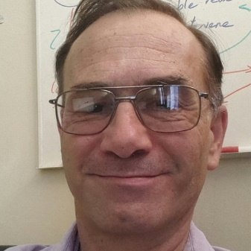
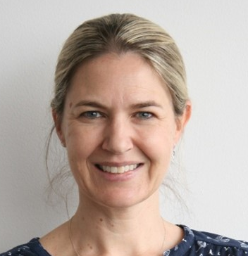
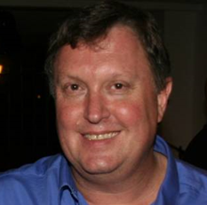
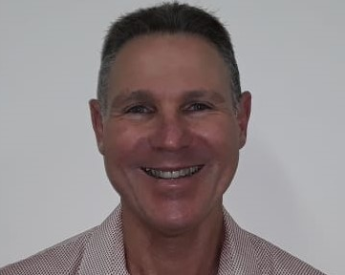
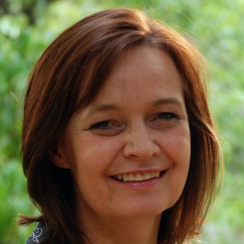
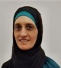
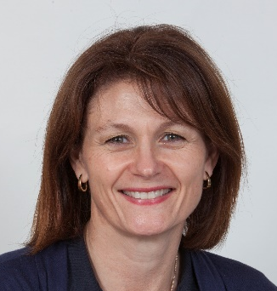
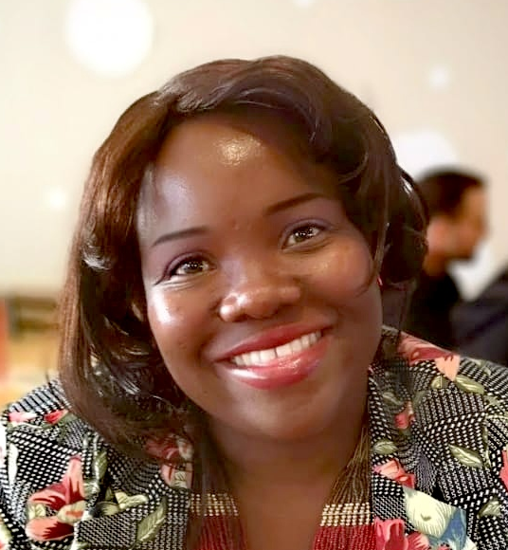
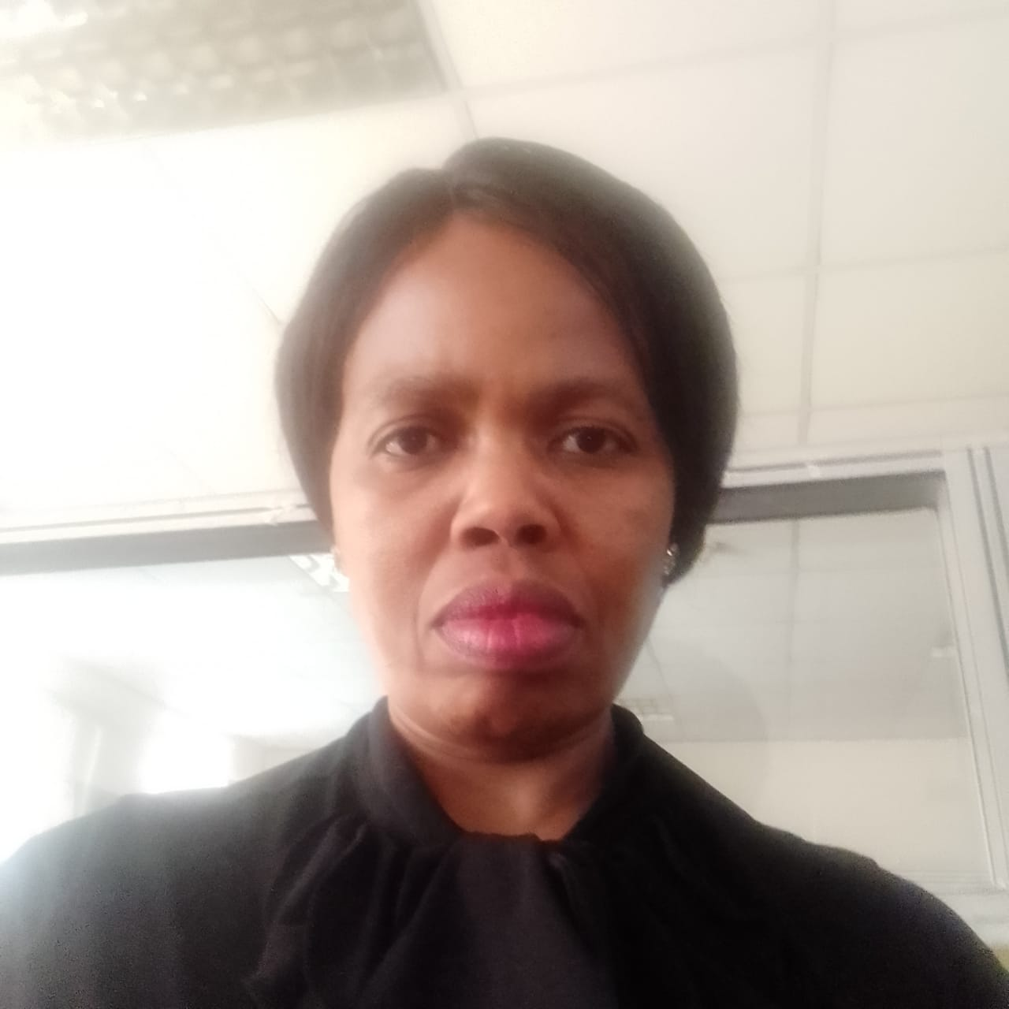
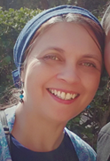
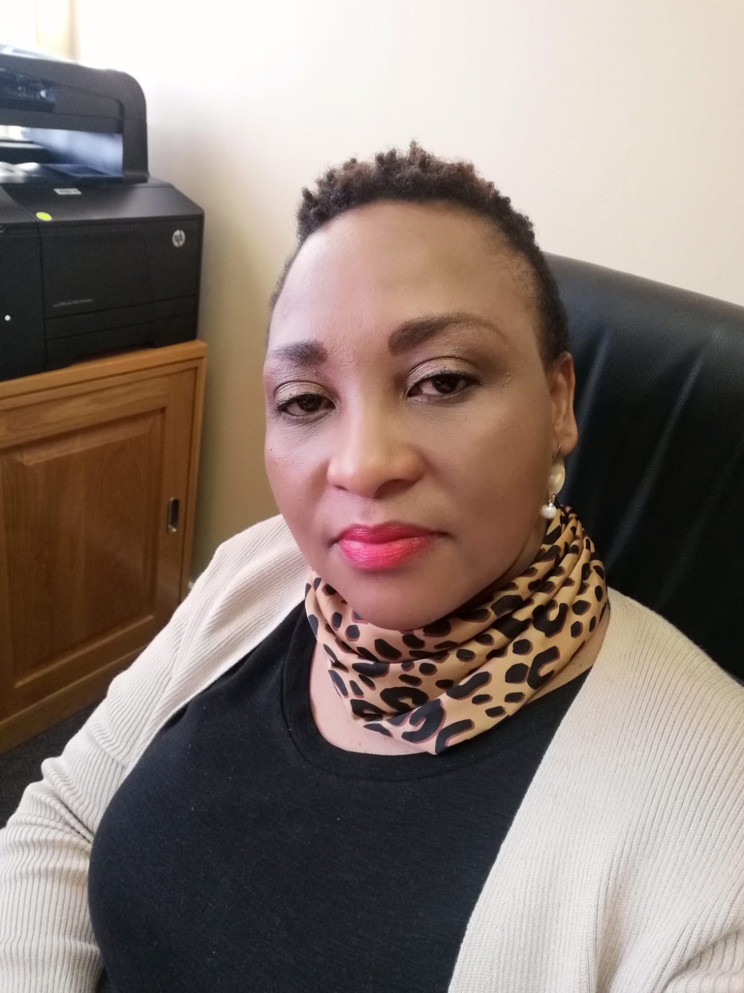
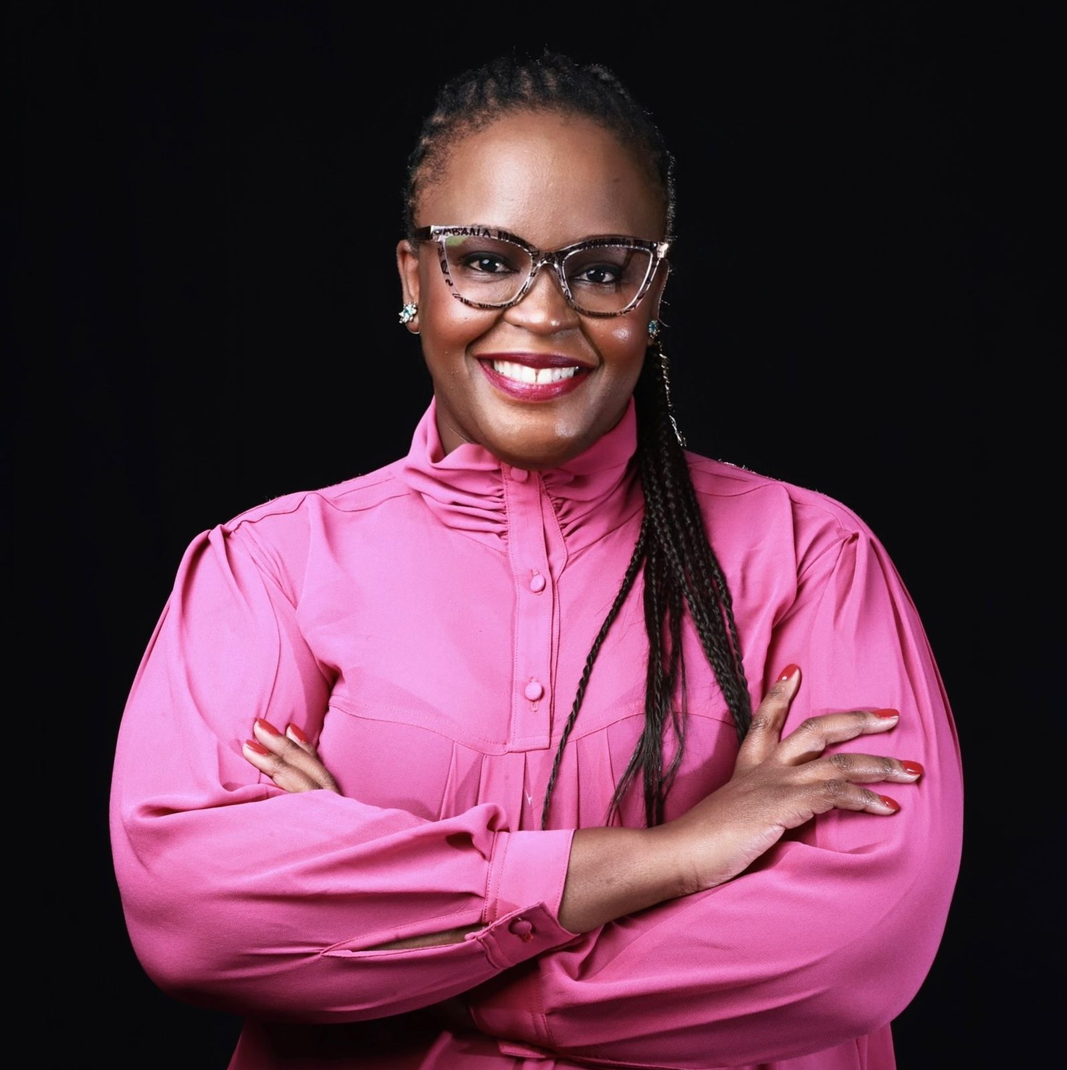
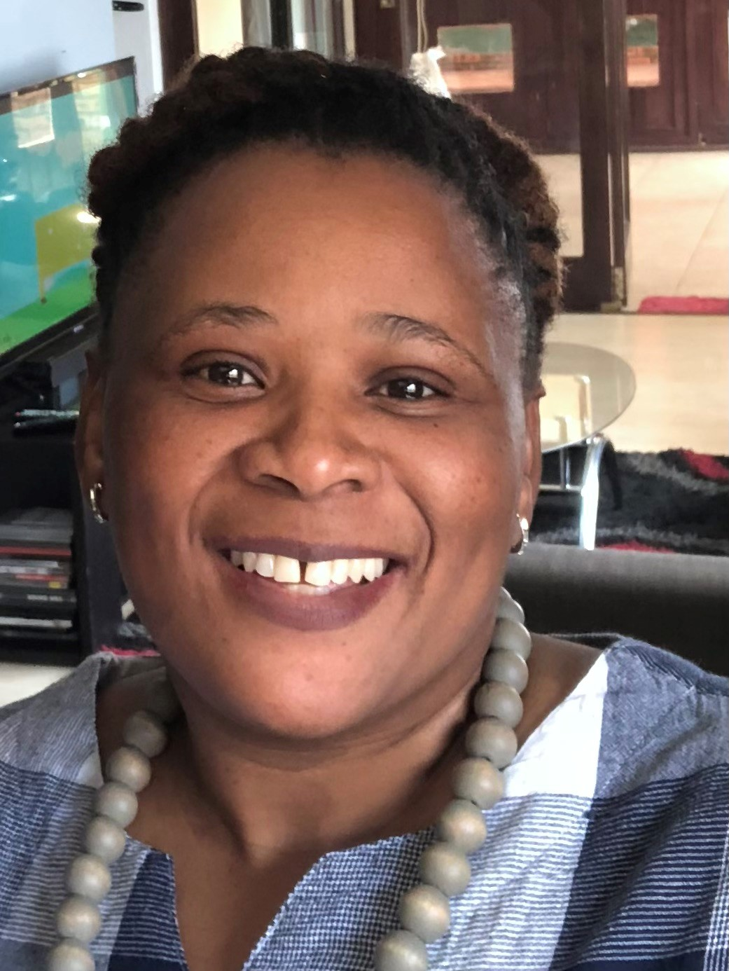
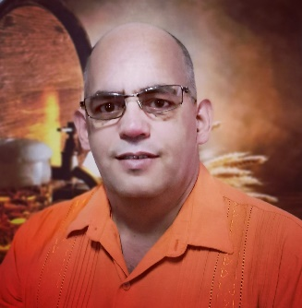
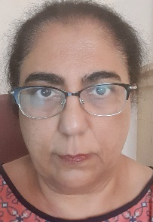
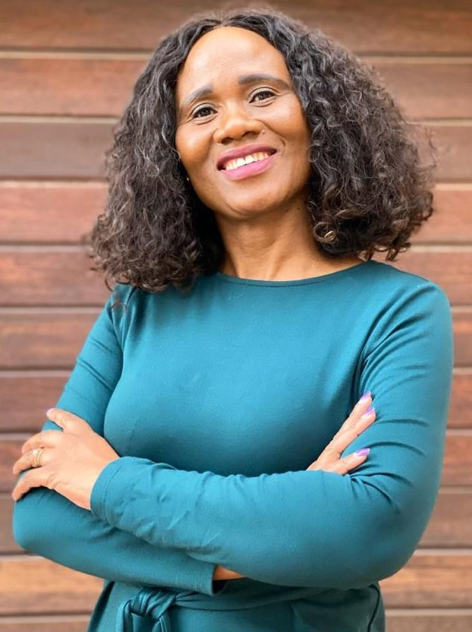
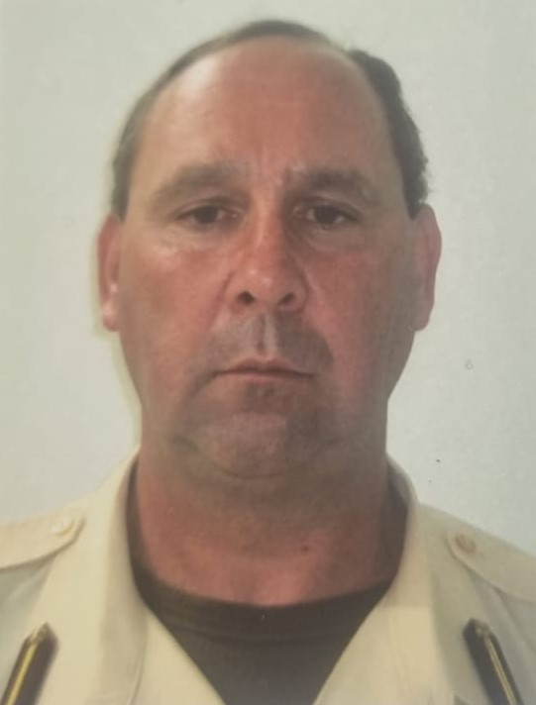

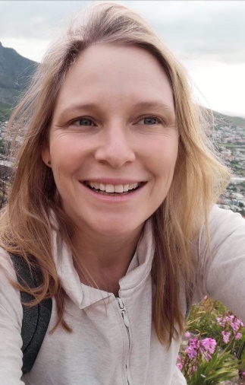
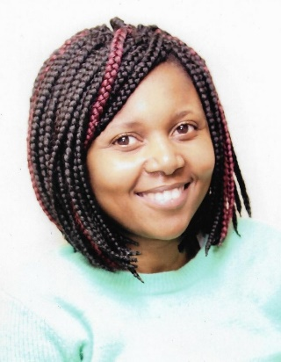
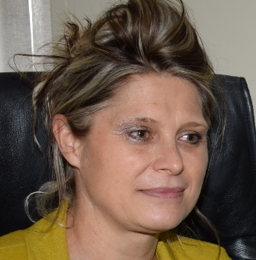
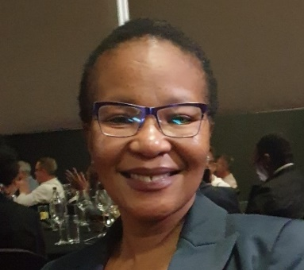
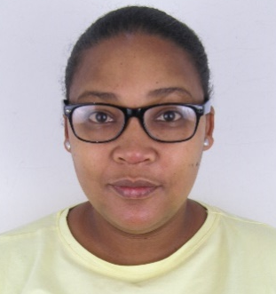
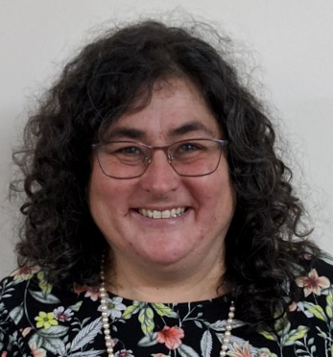
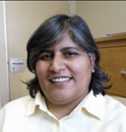
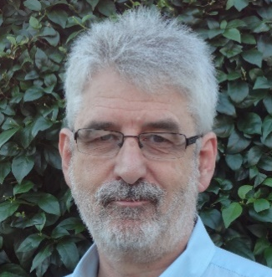
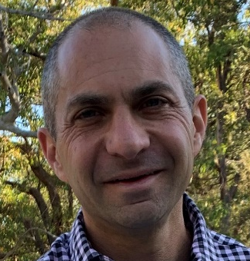
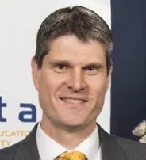
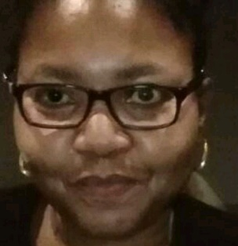
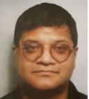
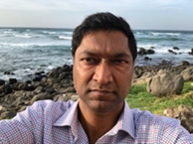
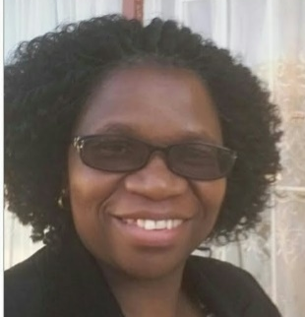
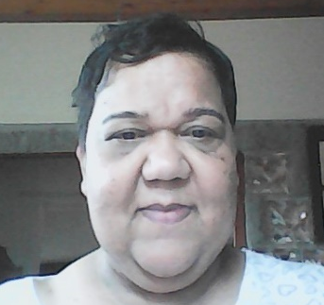
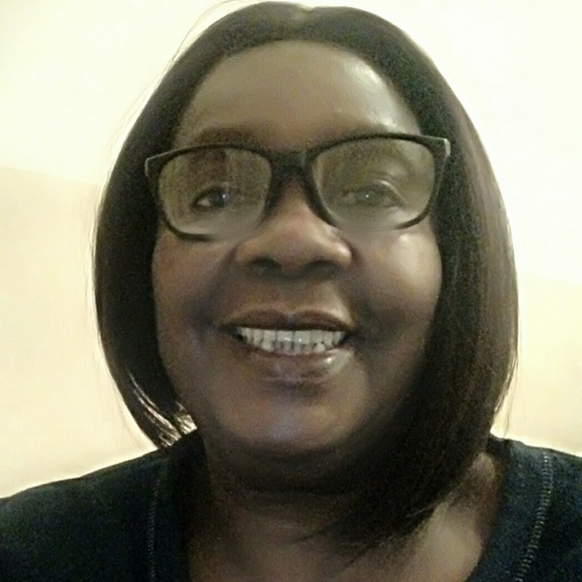
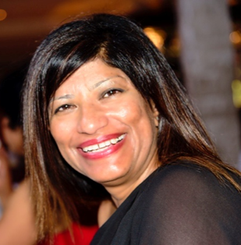
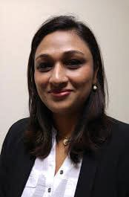
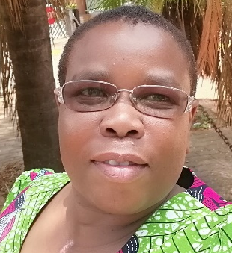
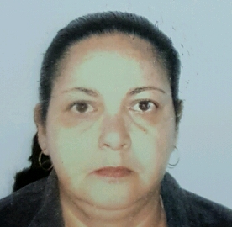
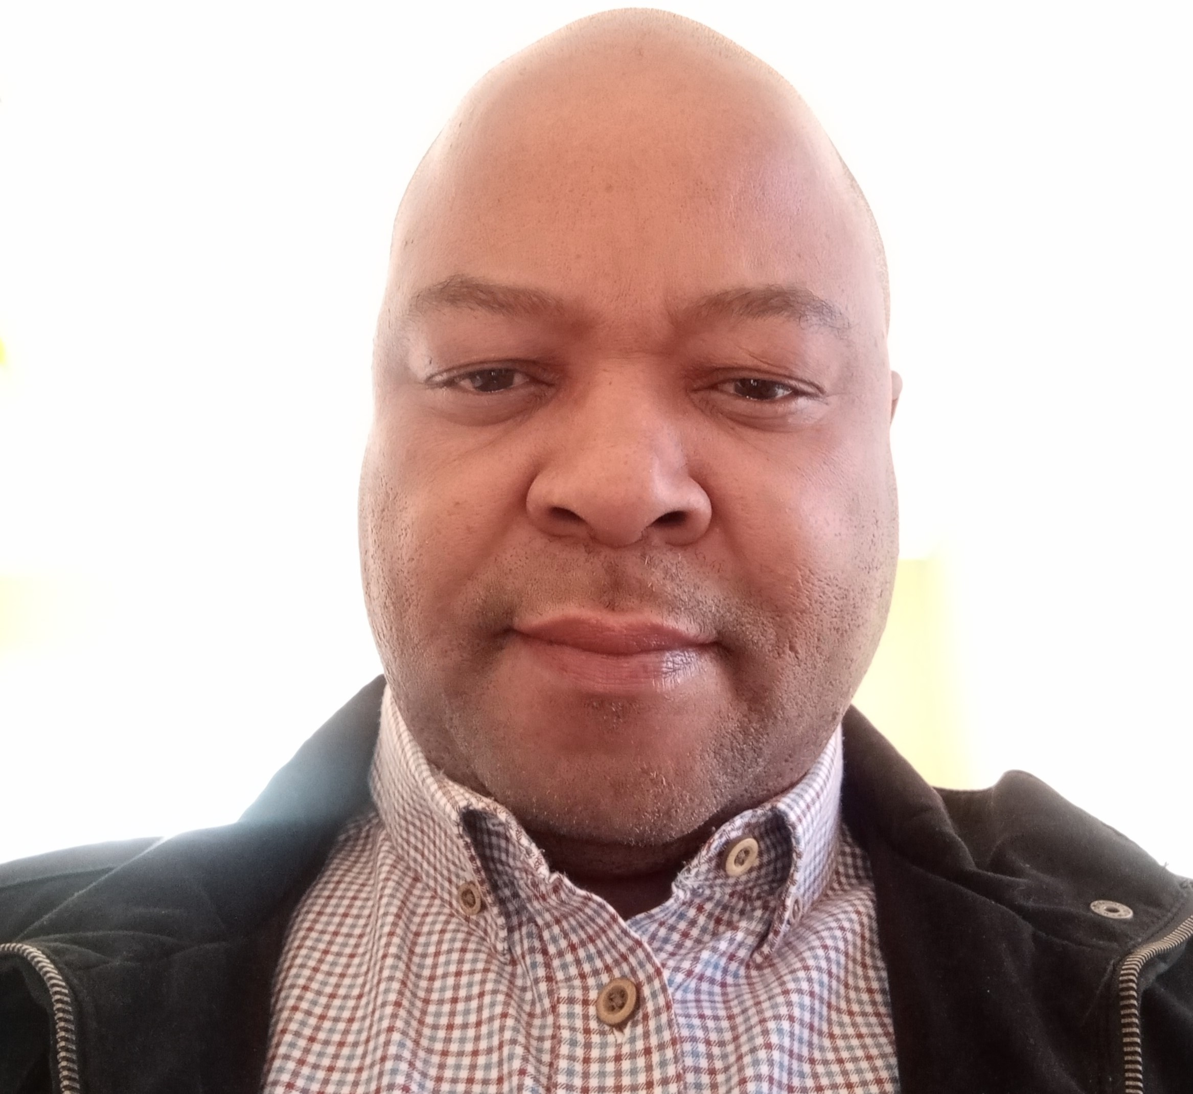
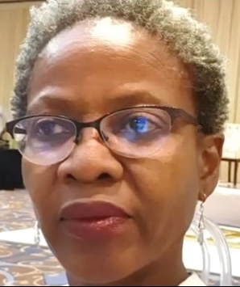
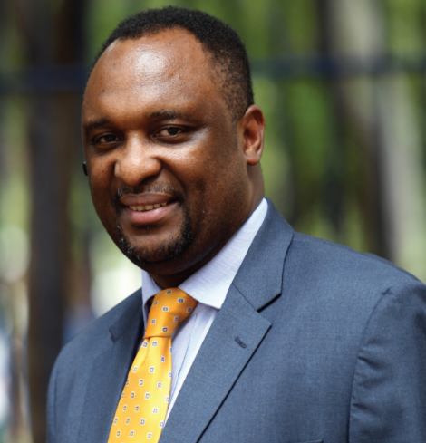
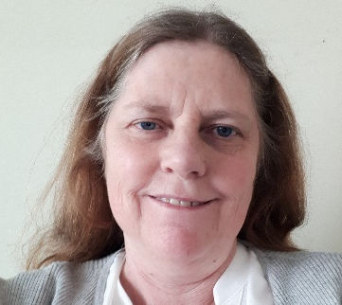
1 | 2 | 3 | 4 | 5 | 6 | 7 | 8
Mrs L Mahlangu | 10 | 11 | Mrs B Molongoana | 13 | Dr K Motse | N Makalima | 16
Dr G Seaketso | Col J Nortje | 19 | 20 | 21 | 22 | 23 | 24
25 | 26 | 27 |  |  | 28 | 29 | 30 Vacant CD: HIV/AIDS, STIs
31 | Dr M Dheda | Mr R Naidoo | 34 | 35 | 36 | 37 | 38
 |  | Mr K Mahlako
A Parrish
R de Waal
P Ruff
M Blockman
L Robertson
Z Adam
J Miot
H Mamorobela
L Mahlangu
Y Johnson
B Molongoana
K Motse
N Makalima
R Romero
T Njapha
Z Rhemtula
N Makalima
G Seaketso
J Nortje
B Semete
T Kredo
K Makgamathe
E Osuch
M Matlala
A Arries
NEMLC
2021 - 2024
K Cohen
H Dawood
A Gray
G Reubenson
R Wiseman
K Vilakazi-Nhlapo
M Dheda
R Naidoo
M Matandela
B Maclou
T Furumele
S Singh
N Naicker
NOTE: Decisions are made by consensus and not by any individual member of the NEMLC. Any queries should be directed to the Essential Drugs Programme on saedp@health.gov.za
M Makua
A Hargreaves
K. Mahlako
L Mvusi
N Ndjeka
L Bamford

Slide 2
NEMLC Members
NEMLC Members
Chair | Dr | Renee | de Waal | Researcher: Centre for Infectious Disease Epidemiology and Research, University of Cape Town. Medical doctor with a Master of Public Health (Heath Economics) degree, a co-editor of the South African Medicines Formulary since 2009 and a member of the NEML MAC on COVID-19 Therapeutics.
Chair | Prof | Andy | Parrish | Head of Department of Medicine: East London Hospital Complex, previous NEMLC chairperson, and previous member of Tertiary and Adult ERCs.
Member | Ms | Zahiera | Adam | Consultant: Right to Care (Leave of absence supporting EDP secretariat).
Member | Dr | Lesley | Bamford | Specialist and Acting Chief Director: Child, Youth and School Health, with a background in Paediatrics and public health.
Member | Prof | Marc | Blockman | Professor: Department of Internal Medicine and Senior Consultant in the Division of Clinical Pharmacology at Groote Schuur Hospital and the University of Cape Town. Chair of the Health Sciences Human Research and Ethics Committee and Chairperson of the Pharmacovigilance Expert Committee of SAHPRA.
Member | Prof | Karen | Cohen | Associate Professor: Division of Clinical Pharmacology in the Department on Medicine, Groote Schuur Hospital, University of Cape Town.
Member | Dr | Halima | Dawood | Head of the Clinical Infection Diseases Unit: Greys Hospital which is the referral center for all hospitals in the western region of KwaZulu-Natal.
Member | Dr | Mukesh | Dheda | Director: Pharmacovigilance Centre for Public Health Programmes based at the National Department of Health.
Member | Ms | Tsakani | Furumele | Director: Communicable Disease Control, the National International Health Regulation Focal Point and has coordinated communicable disease outbreak response in South Africa.
Member | Mr | Andy | Gray | Senior Lecturer: Division of Pharmacology, School of Health Sciences, University of Kwa-Zulu Natal. Honorary Senior Scientist: Consultant Pharmacist for CAPRISA, non-executive Director of JEMBI Health Systems and Chairperson of the Naming and Scheduling Committee of SAHPRA.
Member | Ms | Antoinette | Hargreaves | Regional Director: Port Health Services in the Coastal Region. Environmental Health Practitioner.
Member | Mrs | Yasmina | Johnson | Pharmaceutical Policy Specialist: Western Cape Department of Health. Portfolio: Rational Medicine Use & Policy. Secretariat of the Provincial Pharmacy and Therapeutics Committee & National Essential Medicines List Committee Provincial Representative.
Member | Dr | Tamara | Kredo | Specialist: Clinical Pharmacology and Senior Specialist Scientist: Cochrane South Africa, South African Medical Research Council.
Member | Ms | Anthea | Arries-Jacobs | Junior Lecturer: Nursing Department, CPUT, with Primary Health Care as a specialty and a PGDIP in Advanced Midwifery and Neonatology.

Slide 3
NEMLC Members
NEMLC Members
Member | Ms | Bridget | Maclou | Director: National Tertiary Services Grant (NTSG) at the National Department of Health.
Member | Mr | Kgwiti | Mahlako | Director: Primary Health Care, National Department of Health. Member of the Speech, Language and Hearing Board of the Health Professional Council of South Africa.
Member | Mrs | Letty | Mahlangu | Provincial EML Manager and Provincial PTC Deputy Chairperson, Mpumalanga Province.
Member | Ms | Ncomeka | Makalima | Assistant Manager: Pharmaceutical Services at Nelson Mandela Academic Hospital, Eastern Cape.
Member | Dr | Keolopile | Makgamathe | Medical Advisor: Council for Medical Schemes.
Member | Dr | Manala | Makua | Chief Director: Women, Maternal and Reproductive Health, National Department of Health.
Member | Dr | Hlayisani | Mamorobela | Family Physician: Mankweng Tertiary and Academic Hospital and Lecturer at the School of Medicine, University of Limpopo.
Member | Dr | Mirriam | Matandela | Director: Nursing Practice within Nursing Services Cluster; Trauma and Emergency Nurse Specialist, responsible for co-ordination of Nursing Practice programmes.
Member | Dr | Moliehi | Matlala | Senior Lecturer and Acting Head: Division of Pharmacy Management and Public Health in the School of Pharmacy at Sefako Makgtho Health Sciences University.
Member | Dr | Jacqui | Miot | Division Director: Health Economic and Epidemiology Research Office, Witwatersrand Health Consortium, School of Clinical Medicine, Faculty of Health Sciences, University of Witwatersrand.
Member | Mrs | Boitumelo “Tumi” | Molongoana | Head of Pharmaceutical Services and Chief Executive Officer of the Central Medicine Trading Account, Free State Provincial Department of Health. Vice President of the South African Pharmacy Council.
Member | Dr | Kagiso | Motse | Specialist Physician and Nephrologist. Head of Clinical Unit: Department of Internal Medicine, Job Shimankana Tabane Hospital, Rustenburg.
Member | Dr | Lindiwe | Mvusi | Director: TB Control and Management at the National Department of Health.
Member | Ms | Nolene | Naicker | Assistant Director: Nutrition, Directorate Nutrition.
Member | Mr | Raveen | Naidoo | Director: Emergency Medical Services and Disaster Medicine, National Department of Health.

Slide 4
NEMLC Members
NEMLC Members
Member | Dr | Norbert | Ndjeka | Chief Director: Tuberculosis (TB) Control and Management at the National Department of Health.
Member | Mrs | Thandeka | Njapha | Acting Depot Manager and Responsible Pharmacist: Kwazulu-Natal Provincial Pharmaceutical Supply Depot. Pharmacist who is a member of the Kwa-Zulu Natal PTC and NDoH Bid Specification Committee.
Member | Col | Jacobus | Nortjé | Director: Pharmacy, South African National Defence Force (SANDF).
Member | Prof | Elzbieta | Osuch | Professor, Specialist Clinical Pharmacologist and Head of Department of Clinical Pharmacology, Dr George Mukhari Academic Hospital/ Sefako Makgatho Health Sciences University.
Member |  | Vacant |  | Chief Director: HIV/AIDS, STIs at the National Department of Health.
Member | Dr | Gary | Reubenson | Paediatrician: Rahima Moosa Mother & Child Hospital. Vice-Chair of the NEMLC Paediatric Expert Committee.
Member | Ms | Zuleika | Rhemtula | Senior Manager: Pharmaceutical Services: Gauteng Department of Health. Acting Chief Director: Pharmaceutical and Clinical support services and Acting CEO of Medical supplies depot.
Member | Prof | Lesley | Robertson | Community Psychiatrist: Sedibeng District of Gauteng, South Africa. Adjunct Professor: Department of Psychiatry, University of the Witwatersrand.
Member | Dr | Rodolfo | Romero | Clinical Head, District Clinical Specialist Team (DCST), Namakwa District. Member of the National Advisory Committee for Drug Resistant Tuberculosis.
Member | Prof | Paul | Ruff | Emeritus Professor and Previous Head of Division of Medical Oncology, School of Clinical Medicine, University of Witwatersrand Faculty of Health Sciences, Head of WITS/SAMRC Common Epithelial Cancer Research Centre, Chair of SAHPRA Clinical Trials Committee and Ministerial Advisory Committee on Cancer Control and Prevention, previous Chair of Tertiary/Quaternary EML Committee, NEMLC Representative on Stakeholders Forum to Promote Transparency and Multi Stakeholder Engagement Regarding Medicine Availability and Member of American Society of Clinical Oncology (ASCO) Sub-Saharan Africa Regional Council.
Member | Dr | GoitseModimo | Seaketso | Medical Practitioner: Department of Correctional Services. Special interest in the Management of HIV & AIDS, Mental Health and Youth Development. Member of Palliative Care Practitioners of South Africa.
Member | Dr | Boitumelo (Tumi) | Semete | Chief Executive Officer (CEO): SAHPRA. PhD Biochemistry, with expertise in nanotechnology drug delivery systems for drugs with poor bioavailability profiles in HIV, TB and Malaria drug regimens. Currently member of the VMAC as well as a member of the regulatory working group of the AU Partnership for African Vaccine Manufacturing.
Member | Ms | Sandhya | Singh | Acting Chief Director: Non-Communicable Diseases Cluster at the National Department of Health.
Member | Dr | Kgomotso | Vilakazi-Nhlapo | The Viral Hepatitis Lead: National Department of Health, South Africa and responsible for the TB/HIV Integration program in the National office.
Member | Mr | Roger | Wiseman | Health Policy and Clinical Governance: Liberty Health. Chairperson: Tertiary and Quaternary Expert Review Committee.

