Slide 1
1
A COLLECTIVE CALL TO PREVENT GBV AMONG ADOLESCENTS.
From Evidence to Action: Strengthening South Africa's Response to Adolescent Girls through the Adolescent Investment Case and GAMA Findings
Ms Hlamalani Queen Nenzhelele
Assistant Director: Adolescent and Youth Health
26 August 2026
Notes:
Good morning, colleagues.
This presentation looks at how South Africa can strengthen its response to adolescent girls by translating two important pieces of work into action: the Adolescent Investment Case, which strengthens the case for investing in adolescent health and well-being, and the GAMA validation, which helps us examine whether we have the information and indicators needed to understand adolescent health and measure our progress.
The central message is simple: we need to invest in what matters, measure what matters, and act together.

Slide 2
2
CONTENTS
Why Invest in Adolescent Girls?
What the Adolescent Investment Case (AIC) Tells Us
What does the AIC mean for adolescent girl?
What Global Action for Measurement of Adolescent Health (GAMA) Tells Us
What remains invisible
From Evidence to Action
From AIC and GAMA to action
Our collective call to action
Slide 2

Slide 3
3
WHY INVEST IN ADOLESCENT GIRLS
Investing in Adolescents is an Investment in South Africa's Future.
The South African Adolescent Investment Case (AIC) provides an economic and social rationale for investing in adolescent health and well-being.
Key messages:
Investing in adolescents generates long-term social and economic returns.
Prevention can be more cost-effective than managing the consequences of poor adolescent health & wellbeing.
Adolescent pregnancy carries significant economic and social costs.
Investment must extend beyond the health sector.
High-impact interventions require multisectoral implementation and adequate resources.
The NDoH has described the AIC as demonstrating that adolescent health investment is an economic imperative, with benefits extending to HIV prevention, education and economic productivity.
WHO's 2025 South Africa annual report also reports the AIC's headline estimate of US$46 (R748.4) billion in investment generating US$762 billion (R12.38) trillion in lifetime returns, equivalent to about 7.2% of GDP annually.
Slide 3
Notes:
Adolescent girls do not experience health challenges in isolation.
Gender-Based Violence, adolescent pregnancy, HIV, mental health challenges, poverty, inequality and disrupted education are interconnected.
A girl experiencing violence may also experience trauma, poor mental health, interruption of her education, unintended pregnancy or difficulty accessing health services.
This means that our response cannot be fragmented.
We need evidence that helps us understand not only the outcomes we are seeing, but also the factors that are contributing to those outcomes.
We cannot improve what we do not understand, and we cannot sustain progress without measuring it.

Slide 4
4
WHAT THE ADOLESCENT INVESTMENT CASE TELLS US
The AIC calls for prioritizing interventions that can change the trajectory of adolescent girls' lives.
Investment in adolescents generates long-term social and economic returns.
Prevention is more cost-effective than dealing with consequences.
Adolescent health investment contributes to education, HIV prevention, productivity and broader development.
Investment requires multisectoral action
Slide 4
Notes:
The Adolescent Investment Case provides an important economic and social argument for investing in adolescents.
It demonstrates that investment in adolescent health is not simply an expenditure on health services. It is an investment in South Africa's human capital and future development.
The case highlights the potential long-term returns from investing in adolescents and the importance of prevention.
It also reminds us that the determinants of adolescent health extend beyond the health sector. Education, social protection, economic opportunities, gender equality and safe environments all influence adolescent outcomes.
For us, therefore, the question is not whether we can afford to invest in adolescent girls.
The question is whether we can afford not to.
When we invest in an adolescent girl today, we are investing in the woman, family, community and economy of tomorrow.

Slide 5
5
WHAT DOES THE AIC MEAN FOR ADOLESCENT GIRL?
The AIC calls for prioritizing interventions that can change the trajectory of adolescent girls' lives.
Our response must strengthen:
Prevention of adolescent pregnancy
SRHR and access to adolescent-responsive services
HIV prevention
Mental health and psychosocial support
Violence prevention and protection
Education retention
Empowerment and agency
Multisectoral collaboration
The AIC therefore provides the investment case for moving from fragmented interventions towards coordinated, high-impact action.
Slide 5
Notes:
The AIC is not only an economic argument. Ultimately, its value must be seen in whether investment changes the trajectory of an adolescent girl's life. What does this investment case mean in practical terms for adolescent girls?
It means that we need to prioritise interventions that can change the trajectory of a girl's life.
This includes preventing adolescent pregnancy, ensuring access to sexual and reproductive health services, preventing HIV, addressing mental health, preventing violence and ensuring that girls remain in education and have opportunities to develop their potential.
It also means strengthening adolescent girls' agency and ensuring that they can access services that are responsive to their needs.
Importantly, these interventions cannot be implemented by the health sector alone.
The investment case therefore strengthens the argument for coordinated, multisectoral action.

Slide 6
6
WHAT THE GLOBAL ACTION FOR MEASUREMENT OF ADOLESCENT HEALTH (GAMA) TELLS US
The GAMA Validation Asked a Critical Question.
Do we have the right information to understand adolescent health and well-being and guide action?
South Africa's GAMA assessment was among the early national assessments globally and was led by NDoH with WHO, UNICEF and multisectoral partners.
It included a desk review, data mapping, stakeholder consultation and national validation.
What we learned:
South Africa already has important adolescent health indicators. However, indicators only partially align with GAMA recommendations.
Data systems remain fragmented.
Age-disaggregated reporting is limited.
Indicator definitions are not always consistent.
Proxy indicators are sometimes used.
Cross-sectoral data integration remains weak.
Slide 6
Notes:
The second important body of work is the GAMA validation.
While the Investment Case helps us understand the importance of investment, GAMA asks a different but equally important question:
Do we have the right information to understand adolescent health and well-being and guide our action?
South Africa already collects a substantial amount of adolescent health information. However, the validation found that our indicators only partially align with the GAMA recommendations.
We identified challenges including fragmented data systems, limited age-disaggregated reporting, inconsistent definitions, the use of proxy indicators and weak integration of data across sectors.
This is important because good policy and good programming depend on good information.
If we cannot see the problem clearly, it becomes difficult to target interventions effectively and to know whether we are making progress.

Slide 7
7
FROM EVIDENCE TO ACTION
GAMA highlighted important measurement gaps in:
Mental health and psychosocial well-being
Depression and anxiety
Social connectedness
Family support
Agency and sexual health
Decision-making
Autonomy
Ability to make informed choices
Safety and protection
Severe violence
Sexual violence
Full burden of violence affecting adolescents
Key message:
We are often better at measuring outcomes than the factors that lead to those outcomes.
This is particularly important for prevention. If we only measure violence after it occurs, we miss opportunities to identify vulnerability and intervene earlier.
Slide 7
Notes:
One of the important lessons from the GAMA validation is that there are areas of adolescent well-being that remain insufficiently measured.
These include aspects of mental health and psychosocial well-being, agency and sexual health, and violence and safety.
This is particularly relevant to today's discussion on GBVF.
We need to know not only how many adolescents experience violence, but also understand the factors that place them at risk and the protective factors that can prevent violence.
We also need better information about adolescent girls' agency, decision-making and ability to seek support.
We are often better at measuring outcomes than the factors that lead to those outcomes.
Strengthening our measurement systems is therefore not simply a data exercise. It is part of prevention.

Slide 8
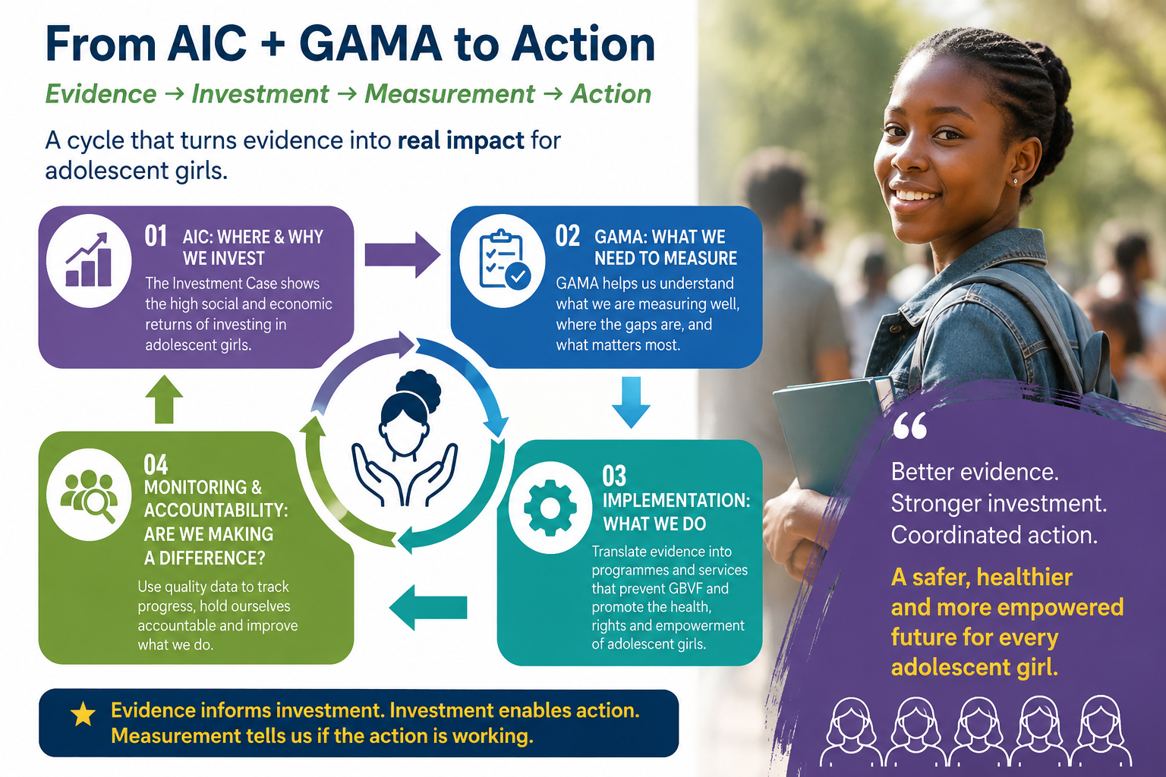
8
FROM ADOLESCENT INVESTMENT CASE AND GAMA TO ACTION
Slide 8
Notes:
When we bring the AIC and GAMA findings together, we have a powerful framework for action.
The AIC tells us where and why we need to invest.
GAMA helps us understand what we need to measure and where our information gaps are.
We then need to translate this evidence into implementation through our programmes and partnerships.
Finally, we need monitoring and accountability mechanisms that allow us to ask: Are our interventions making a difference?
This creates a cycle:
Evidence informs investment. Investment enables action. Measurement tells us whether the action is working. And the findings should then inform our next investment and our next action.
This is how we move from evidence to impact.

Slide 9
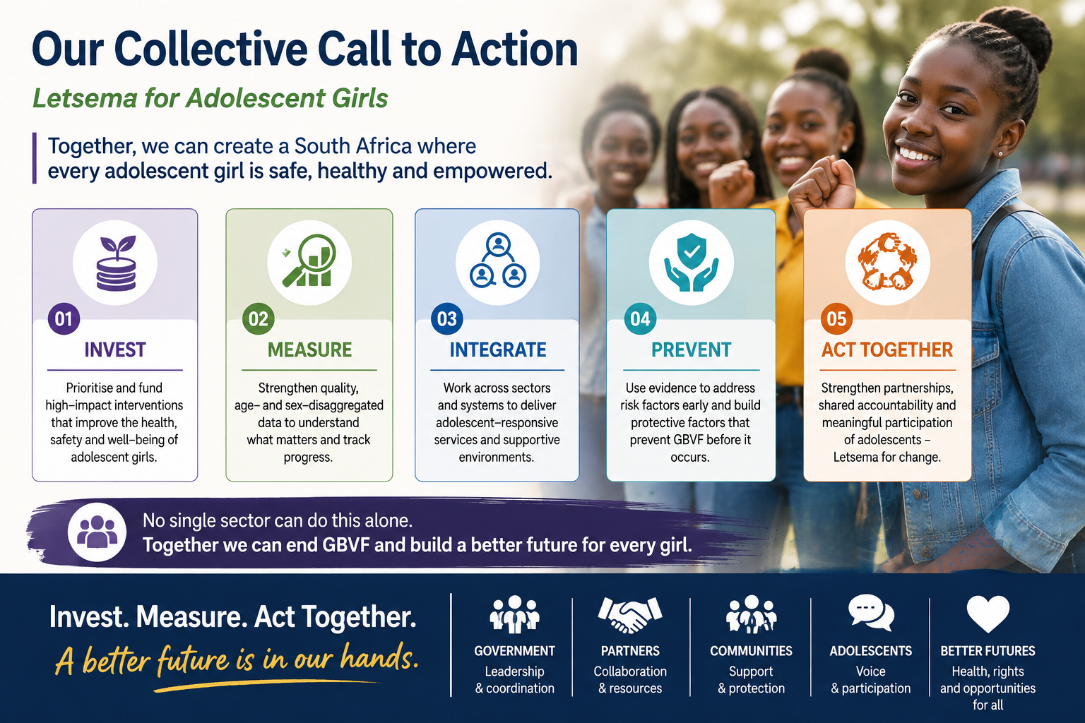
9
OUR COLLECTIVE CALL TO ACTION
Slide 9
Notes:
The evidence gives us a clear call to action.
First, we must invest in interventions that have the greatest potential to improve the lives of adolescent girls.
Second, we must measure—and strengthen the quality, availability and use of age- and sex-disaggregated data.
Third, we must integrate our efforts across health, education, social development, justice and other sectors.
Fourth, we must strengthen prevention, including identifying vulnerabilities earlier and addressing the factors that place girls at risk.
And finally, we must act together.
This is where the Letsema approach becomes important.
No department, institution or organisation can end GBVF on its own. We need collective responsibility, shared accountability and coordinated action.

Slide 10

10
CLOSING
Let us all:
Invest
Measure
Act Together
Ndo livhuwa,
Na khensa
Thank you
Baie dankie
Re a leboga
Ngiyabonga
Re a leboga
Enkosi
Re a leboha
Ngiyabonga
Ndiyabulela
Slide 10
Notes:
The evidence gives us a clear call to action.
First, we must invest in interventions that have the greatest potential to improve the lives of adolescent girls.
Second, we must measure—and strengthen the quality, availability and use of age- and sex-disaggregated data.
Third, we must integrate our efforts across health, education, social development, justice and other sectors.
Fourth, we must strengthen prevention, including identifying vulnerabilities earlier and addressing the factors that place girls at risk.
And finally, we must act together.
This is where the Letsema approach becomes important.
No department, institution or organisation can end GBVF on its own. We need collective responsibility, shared accountability and coordinated action.

