Slide 1


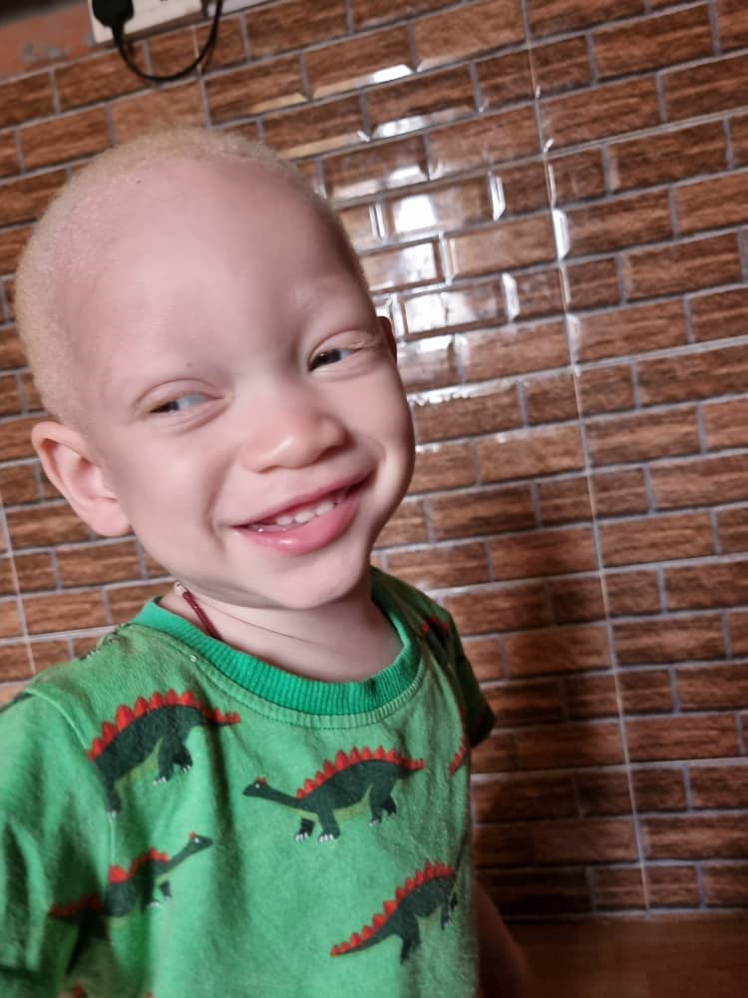

TOWARD AN INCLUSIVE WORLD FOR PEOPLE WITH ALBINISM
Why My Eyesight Matters
WORLD OPTOMETRY DAY WEBINAR
by Nontsikelelo Loteni 26 March 2026

Slide 2
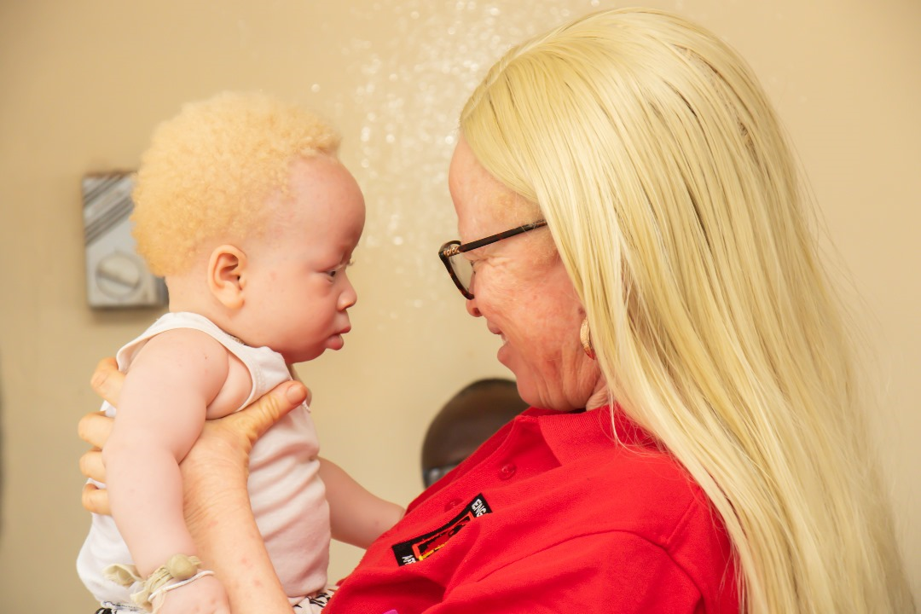
What is Albinism?
A genetic condition characterized by a lack or reduction of melanin.
Reduced Melanin
Visual Impairment
Sun Sensitivity
Light sensitivity and reduced vision due to lack of melanin in eyes.
Leads to pale skin, light hair, and eye color.
Increased risk of skin cancer
due to lack of melanin in skin.
Types of Albinism
Oculocutaneous Albinism – Hair, Skin and Eyes
Ocular Albinism
– Eyes only

Slide 3
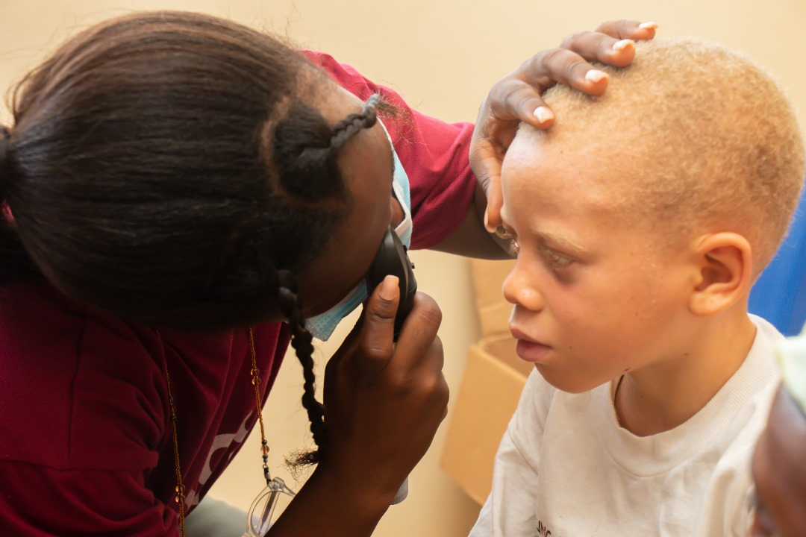
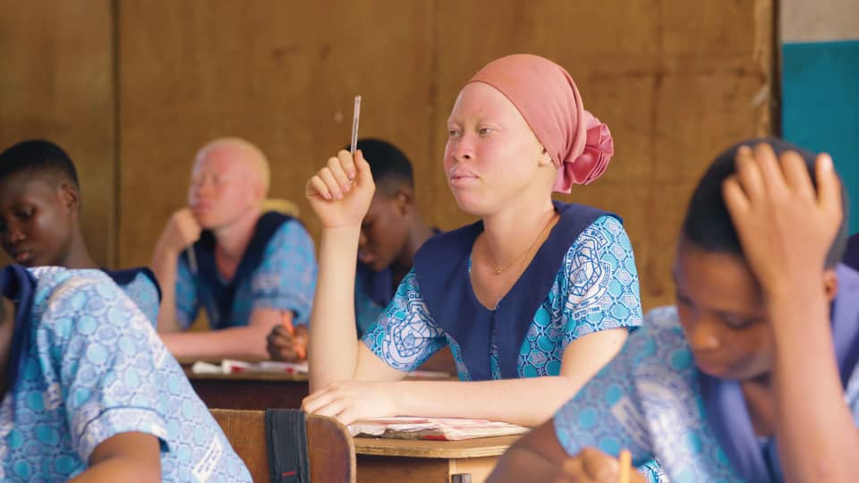
Eyesight Challenges and unintended impact to quality of Life for PWA
Limited access exacerbates existing inequalities for PWA.
Healthcare
Limited access to specialized care
Limited access to sunscreen and
protective gears, i.e., wide-brim hats, sunglasses, etc.
Limited access to low-vision assistive devices
Limited awareness among healthcare providers
Education
Insufficient resources for inclusive education
Low vision that results in limited participation in class
which ultimately affects academic performance
Limited reasonable accommodation
Exclusion from extracurricular activities
Increase in dropout rate of learners with albinism
Employment
Limited employment opportunities
Lack of support for reasonable accommodation

Slide 4
COLLABORATION FOR SOLUTIONS
Bilateral engagements with NDOH to discuss a plan of action on how we can respond to the needs of PWA.
Eye care assessments during awareness events, especially in Gauteng, are also useful.

Slide 5
Conclusion and Call to Action
Accessible healthcare services for all PWA, especially in rural areas.
Increase the capacity of trained specialists, especially for rural areas.
Improve accessibility and provision of assistive devices for PWA.
We request more campaigns and raising awareness around eye care in communities, especially for persons with albinism in rural areas.
1
2
3
4

Slide 6


