Slide 1
INTRODUCTION TO THE NHI CHANGE CHAMPION INITIATIVE
NATIONAL DEPARTMENT OF HEALTH
MR FOSTER MOHALE
TUESDAY, 3 MARCH 2026

Slide 2
OUTLINE
Background
Overview of the Initiative
Goal & Objectives
Target audience
Recruitment & Training
Potential Activities
Support Opportunities

Slide 3

BACKGROUND
Access to quality health care remains unaffordable for millions globally and for approximately 85% of South Africans.
Deep health inequities persist: most health funding benefits a small private sector, while the public sector serves the majority with limited resources.
The signing of the NHI Act in May 2024 marked a major milestone in health system reform because it establishes a unified financing system aimed at correcting these inequities
NHI advances Universal Health Coverage (UHC) by ensuring access to quality healthcare without financial hardship, based on need rather than the ability to pay.

Slide 4



BACKGROUND
Service delivery: Concerns about operational efficiency, especially in rural and under-resourced areas with workforce shortages
Financing & governance: Fears around affordability, corruption risks, and unclear benefit packages
System readiness: Anxiety about infrastructure gaps and potential health-worker migration
Misinformation & trust: Negative narratives amplified online risk eroding public confidence and reform support
SYSTEMS
READINESS
&
FEARS
&
MISINFORMATION
&
CONCERNS
&

Slide 5

NHI CHANGE CHAMPIONS INITIATIVE
Establishes a national network of 10,000 trained, trusted NHI Change Champions
Based on the global UHC Champions Programme model
Responds to public mistrust, unequal access to information, and widespread misinformation
Uses a networked, peer-driven approach, leveraging existing structures and phased implementation
CHANGE
CHAMPIONS

Slide 6
CHANGE CHAMPIONS
To address existing gaps in access to information and knowledge about the NHI through face-to-face communication, strengthening public trust, countering misinformation, and ensuring access to accurate, trusted information in local languages.
GOAL

Slide 7
OBJECTIVES
Strengthen Trusted NHI Communication by building a national network of 10,000 competent NHI Change Champions
Objective 1
Empower Communities & Health Workers enabling meaningful participation in health decision-making and service access
Objective 2
Objective 3
Counter Misinformation & Build Confidence improving understanding and trust in NHI implementation
Objective 4
Mobilise Stakeholders for UHC Reforms promoting collaboration and alignment across sectors
Amplify Trusted Community Narratives building social solidarity through authentic, community-led NHI stories
Objective 5

Slide 8

WHO IS AN NHI CHANGE CHAMPION?
Individuals or groups committed to equitable access to health services
Voluntary advocates promoting accurate NHI information
Healthcare workers (clinical and non-clinical)
Facility-based change agents and role models
Champions for equity and quality healthcare

Slide 9
CHANGE CHAMPIONS
TARGET
GROUPS
Primary: Any healthcare worker, communication leads, CHWs, ACSM officials, health promoters, public relations officers, organisational development teams
Secondary: Facility managers, civil society leaders, community leaders, key partners
End beneficiaries: Communities, healthcare service users, healthcare workers

Slide 10
HEALTH FACILITY RECRUITMENT
PHC clinics: 1-2 champions per facility or more
District hospitals: 2 or more champions per facility
Regional hospitals: 4 or more champions per facility
Tertiary and central hospitals: 5 or more champions per facility

Slide 11












RECRUITMENT
Nominated/ volunteered
Document Submission
Online registration
Onboarding & Orientation
Training
Registered Champions will receive an introductory toolkit to orientate them to their role and the NHI
A self paced e-learning module on Knowledge Hub complemented by webinars
A potential NHI Change Champion will be nominated
Sign the NHI Change Champion pledge and submit a signed screening checklist to their coordinator
Quick & simple online registration
Step 01
Step 02
Step 03
Step 04
Step 05

Slide 12
NHI CHANGE CHAMPIONS PLEDGE
Prior to registration, the NHI Change Champion must sign the pledge (physical or electronic) aligning themselves with the goals of NHI and the values of open and respectful dialogue

Slide 13
SELECTION CRITERIA
Champions must be willing to:
Undergo NHI training
Support accurate NHI messaging
Uphold UHC principles of equity and non-discrimination
Advocate for health reforms
Address misinformation, disinformation and misconceptions around the NHI

Slide 14
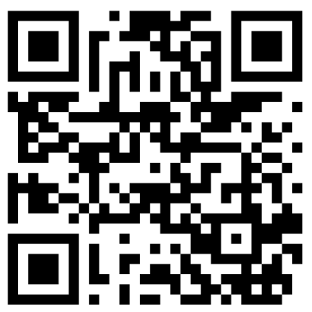
TRAINING
Resource Repository
NHI Intro Toolkit
Training Platforms
Knowledge Hub modules
NHI Webpage
Onboarding and capacity building toolkit
Webinars
Notes:
Pre and post-module assessment
Certificate of competence
CPD accredited

Slide 15
SUPPORT SYSTEMS & NETWORK
Peer networks
WhatsApp chatbot for FAQs
Email platform
Feedback forms & Quarterly reviews
Key Partners
Subdistrict, District & Provincial coordinators

Slide 16












POTENTIAL ACTIVITIES
DIALOGUES
IEC MATERIALS
AUTHENTIC STORYTELLING
Coordinate facility dialogues
Collate all FAQs, queries, concerns for communication materials and posters
Support video collections of authentic stories of health care service experiences
OPPORTUNISTIC
COLLABORATION
FEEDBACK
Ongoing & opportunistic information sharing with colleagues and users (corridors, queues, meetings etc.)
Collaborate with health promoters, CHWs, ACSM officials to conduct myth-busting sessions and advocacy activities
Share NHI knowledge surveys for monitoring, provide feedback, document and submit quarterly reports per facility

Slide 17












PHASED IMPLEMENTATION
01
03
02
04
PHASE 1: HCW
PHASE 3: WHOLE OF GOVERNMENT
Nomination of HCWs in public health facilities
PHASE 2: COMMUNITIES
Volunteer and nomination extended to non-health government departments (e.g. DSD, DBE, DHA)
PHASE 4: PRIVATE SECTOR
Community-based champions in collaboration with community health care workers & key partners
Private health care providers call using digital platforms and professional associations

Slide 18









SUPPORT OPPORTUNITIES
Recruitment
Training & Capacity Building
Message testing & refinement
Activities
Monitoring
Identifying trusted individuals
Identifying coordinators
Reaching underserved communities
Module development
Training capacity
Delivery support
Simplifying language
Translations
Ensuring clarity & cultural relevance
Collaboration in:
Facility & community dialogues
Myth-busting sessions
Adressing misinformation
Research
Emerging narratives
Social listening
Reviews
Feedback loops
Continuous improvement

Slide 19
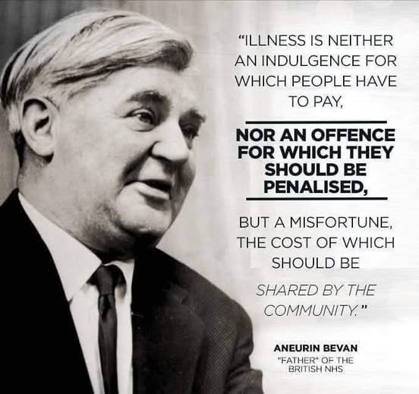

Slide 20

For additional information and questions, please email NHIChangeChamp@health.gov.za

