Slide 1
Haemophilia STGs and EML
National Department of Health
Affordable Medicines Directorate
Essential Drugs Programme
Paediatric and Adult Hospital Level
Tertiary and Quaternary Hospital Level

Slide 2
Evidence
Please access the National Essential Medicines List Committee (NEMLC) reports and related documents for detailed evidence (including rationale, references and costings) informing decision-making on medicine addition, amendments and deletions:
NHI Website: https://www.health.gov.za/nhi-edp-stgs-eml
Knowledge Hub: www.knowledgehub.health.gov.za/e-library
Disclaimer
This presentation is an implementation tool and should be used alongside the most recently published STGs available on the Knowledge Hub. This information does not supersede or replace the STGs.

Slide 3
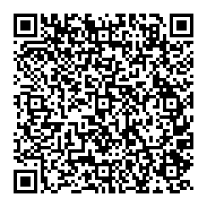
SCAN ME
AHL Chapter 2: Blood and Blood Forming Organs
SCAN ME
Paediatric Hospital Level Chapter 3: Blood and Blood Forming Organs

Slide 4
Presentation Outline
Haemophilia Subcommittee
Haemophilia A – Factor VIII Deficiency (no inhibitors)
Haemophilia B – Factor IX Deficiency (no inhibitors)
Therapeutic Interchange
Emicizumab Prophylaxis for severe haemophilia A with inhibitors

Slide 5
Haemophilia Subcommittee
Establishment
1
2
Composition
NEMLC approved the formation of the Haemophillia Subcommittee in November 2022
The committee included members of NEMLC and ERCs
Rationale
Objectives
3
4
To understand the current haemophilia space to help inform decision making
Emicizumab consideration
Factor VII Prophylaxis in haemophila A
Factor IX Prophylaxis in haemophila B
The formation of the committee was prompted by:
Paediatric review of Factor VIII for haemophilia A without inhibiotors
Emicizumab as part of the project plan for Tertiary ERC
Need for holistic consideration of care across levels of care and ages

Slide 6
Haemophilia A – Factor VIII Deficiency (no inhibitors)
Prophylactic Factor VIII compared to on-demand treatment for patients (adults and children) with haemophilia A without inhibitors
There is very low certainty evidence to suggest that low dose and intermediate dose factor VIII prophylaxis therapies are more effective than treatment on-demand for patients with haemophilia A
Basic cost-effectiveness analysis shows low and intermediate dose prophylaxis are potentially more cost-saving than treatment on demand if only considering acquisition costs of factor VIII. Sensitivity scenarios which accounted only for treatment of minor bleeds (and not major or life-threatening bleeds) showed that low and intermediate dose prophylaxis were more effective but more costly than treatment on demand.
NEMLC Recommendation
NEMLC recommends using intermediate factor VIII prophylaxis for severe haemophilia A patients without inhibitors.

Slide 7
Haemophilia A (no inhibitors)
STG recommendations
Acute management of a bleed: Manage pain, FFP or FDP while awaiting transfer (if no factor available); adjunctive measures e.g. ice packs; tranexamic acid for mucous membrane bleeds.
ADULT recommendations
PROPHYLAXIS
(for severe haemohilia A – no inhibitors)
Factor VIII, IV 25 units/kg, twice weekly
(dose rounding to avoid wastage)
TREATMENT
Minor bleeds
Factor VIII, IV 20 – 40 units/kg
Major bleeds
Factor VIII, IV 40 – 50 units/kg
Hospitalisation
Intracranial bleeds
Factor VIII, IV 40 – 50 units/kg 6 hourly
Paediatric recommendations
PROPHYLAXIS
(for severe haemohilia A – no inhibitors)
Factor VIII, IV 25 units/kg, twice weekly
(dose rounding – dosing table provided)
TREATMENT
Minor bleeds
Factor VIII, IV 20 – 40 units/kg
Major bleeds
Factor VIII, IV 40 – 50 units/kg
Hospitalisation
Intracranial bleeds
Factor VIII, IV 40 – 50 units/kg 6 hourly
Efforts made to align recommendations and ensure seamless transition

Slide 8
Haemophilia B – Factor IX Deficiency
(no inhibitors)
Prophylactic Factor IX compared to on-demand/episodic treatment for patients with severe haemophilia B without inhibitors
There was very limited, low-quality evidence available for prophylaxis in the management of haemophilia B. However, the benefit of factor IX prophylaxis compared to on-demand/episodic treatment for haemophilia B patients has been shown in non-randomised controlled trials and recommended in guidelines. The majority of guidelines follow the recommendations for haemophilia A.
A cost analysis revealed potential cost-savings for all prophylaxis regimens, with intermediate dose prophylaxis found to be the most cost-saving. Low dose prophylaxis was shown to be less cost saving, but more cost-saving than high dose prophylaxis. The costing model relied on many assumptions including uncertain estimates of the number of patients requiring prophylaxis. Despite these limitations, the potential benefit of prophylaxis is acknowledged and alignment with haemophilia A is considered to be beneficial.
NEMLC Recommendation
NEMLC recommends the use of factor IX prophylaxis for patients with severe haemophilia B.

Slide 9
Haemophilia B (no inhibitors)
STG recommendations
Acute management of a bleed: Manage pain, FFP or FDP while awaiting transfer (if no factor available); adjunctive measures e.g. ice packs; tranexamic acid for mucous membrane bleeds.
ADULT recommendations
PROPHYLAXIS
(for severe haemohilia B – no inhibitors)
Factor IX/factor IX complex, IV 25 units/kg, twice weekly
(dose rounding to avoid wastage)
TREATMENT
Minor bleeds
Factor IX/factor complex, IV 40 units/kg as a single dose
For ongoing bleeding – consult local haemophilia centre
Major bleeds
Factor IX/factor complex, IV 60units/kg
Hospitalisation
Paediatric recommendations
PROPHYLAXIS
(for severe haemohilia B – no inhibitors)
Factor IX/factor IX complex, IV 25 units/kg, twice weekly
(dose rounding – dosing table provided)
TREATMENT
Minor bleeds
Factor IX/factor IX complex, IV 50 units/kg immediately as single dose
For ongoing bleeding – consult local haemophilia centre
Major bleeds
Factor IX/factor IX complex, IV 50 – 80 units/kg and Hospitalisation
Efforts made to align recommendations and ensure seamless transition

Slide 10
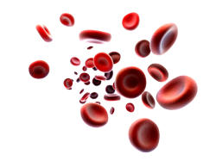
Therapeutic Class and Interchange
Therapeutic Class
In most cases, these medicines have close similarity in efficacy and safety profiles, when administered in equipotent doses for a specific indication.
ADVANTAGES
Procurement: Economies of scale; Competitive prices; Cost savings. | Medicine supply constraints: Alternatives already identified, in comparable effective doses.
Von Willebrand factor VIII complex for treatment of bleeds in Von Willebrands Disease
Human derived plasma and recombinant factor VIII options for treatment of bleeds for Haemophilia A
Human derived plasma factor IX, complex and purified formulations options for treatment of bleeds for Haemophilia B
Haemosolvate®
Includes: Haemosolvate® Octanate®
Kogenate®
Includes:
Haemosolvex® Octanine®

Slide 11
Emicizumab prophylaxis for severe haemophilia A with inhibitors
Previous standard of care in South Africa for severe haemophilia A patients with inhibitors was to treat bleeds as they occur with bypassing agents: activated factor VIIa (Novo7®) or activated prothrombin complex concentrate (FEIBA®)
These agents are expensive and patients not receiving prophylaxis are at potential increased risk of morbidity associated with bleeds if not treated timeously
Thus: The review aimed to assess the safety and efficacy of emicizumab compared to standard of care in the management of patients with severe haemophilia A with inhibitors

Slide 12
Emicizumab Review – Efficacy and Safety
Adults, adolescents and children with Haemophilia A with inhibitors
Population
Intervention
Subcutaneous emicizumab prophylaxis
Study Design:
Randomised controlled trials and systematic reviews.
P
I
HAVEN 1 ^{1,2}
Annualised bleeding rate: 2.9 events (95% CI 1.7-5.0) with emicizumab prophylaxis (35 participants) vs 23.3 events (95% CI 12.3-43.9) with no prophylaxis (18 participants). The observed difference of 87% in favour of emicizumab prophylaxis was significantly significant (p<0.001). Moderate certainty of evidence
Quality of Life (QoL) – Emicizumab may improve QoL. Low certainty of evidence
Note: Limitations in bias, small samples, lack of head-to-head comparison on prophylaxis
O
C
Annualised bleeding rate, target joint damage, adverse events, health related quality of life
Outcomes
Comparators
Treatment of bleeds with on-demand bypassing agents
Oldenburg J, et al. Emicizumab Prophylaxis in Hemophilia A with Inhibitors. N Engl J Med. 2017;377(9):809-18.
Oldenburg J, et al. The effect of emicizumab prophylaxis on health-related outcomes in persons with haemophilia A with inhibitors: HAVEN 1 Study. Haemophilia. 2019;25(1):33-44.

Slide 13
Emicizumab Review – Cost/Affordability
Due to the relatively large beneficial effect size for annualised bleeding rate with use of emicizumab; but high cost – recommendation was made to conduct a more in-depth costing analysis
Initial investigations:
Cost comparison/cost per patient
Difficult to compare directly (prophylaxis vs treatment; weight-based dosing)
Benefit in ABR with use of emicizumab compared to standard of care
Evaluation of published cost analyses
Insufficient literature available to help account for differences that would likely be observed if an economic evaluation were to conducted specifically for the South African setting.
THUS
NEMLC recommended the commissioning of a cost-effectiveness analysis
HE²RO developed model

Slide 14
Emicizumab Costing analysis

Slide 15
Scenarios
Challenges around patient level data (patient demographics.
4 Scenarios based on:
Case numbers
Due to various unknowns, 4 scenarios were developed using varying assumptions
Uncertainty around patients presenting for bleeds.
Bleeds treated
Scenario 3 was closest to replicating the current procurement costs of bypassing agents
This scenario was used to develop the initial willingness to pay cost neutral price
Uncertainty around bleed frequency and bleed severity.
ABR
No data on number of hospitalisations and durations of stay
Hospitalisations
Variations in dosing practices
Dosing

Slide 16
Cost-effectiveness Analysis Results
Cost Neutral Price (reference price) calculated based in scenario 3
Credit: HE²RO
 | Scenario 1 | Scenario 2 | Scenario 3 | Scenario 4
 | N=35 | N=35 | N=55 | N=160
Costs (ZAR)
Emicizumab prophylaxis | R54,211,136 | R54,211,136 | R89,195,303 | R272,344,816
Emicizumab treatment of bleeds | R19,327,746 | R19,797,128 | R9,940,568 | R90,017,551
Emicizumab prophylaxis + treatment of bleeds | R73,538,882 | R74,008,264 | R99,135,871 | R362,362,367
Comparator treatment of bleeds | R246,886,169 | R168,405,976 | R84,179,262 | R714,508,227
Incremental cost of emicizumab arm | -R173,347,287 | -R94,397,712 | R14,956,610 | -R352,145,860
Number of bleeds treated
Emicizumab arm | 60 | 60 | 28 | 138
Comparator arm | 437 | 437 | 205 | 1,111
Bleeds averted | 377 | 377 | 177 | 973
Incremental cost per bleed averted | -R459,792 (cost-saving) | -R250,383 (cost-saving) | R84,594 | -R361,981 (cost-saving)

Slide 17
Decision Making
Initial Decision:
14 March 2024
To not approve emicizumab for prophylaxis of patients with haemophilia A with Factor VIII inhibitors
Review indicators: Price, affordability, availability of higher quality evidence with larger effect sizes
Rationale: Uncertainties around patient cohort, health seeking, ABR, treatment practices; and the initial cost-neutral price estimate being higher than the emicuzumab state offer price
Background: Discussions with Pharmaceutical Company on pricing and communication of proposed reference pricing

Slide 18
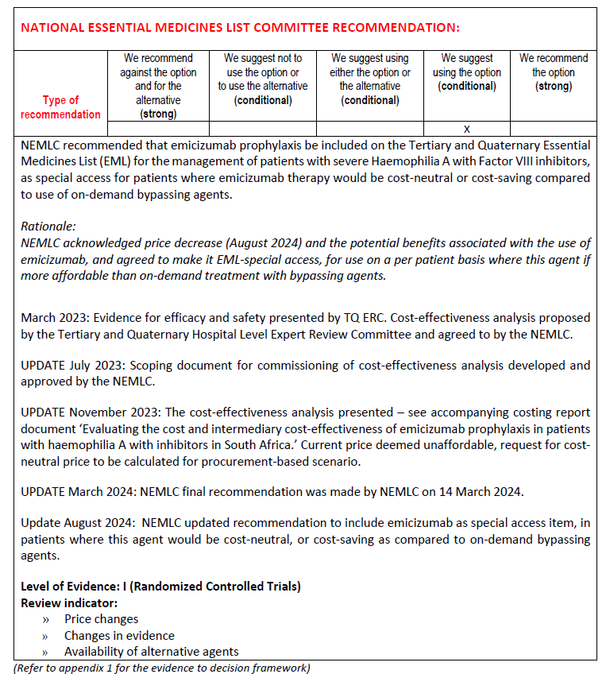
Decision August 2024
Reference price met
Recommendation for inclusion on the Essential Medicine List:
August 2024
Special Access

Slide 19
Criteria for Use
Essential Medicines List
Approved: Special Access (refer to Criteria for Use)
Ensure access to those who need it
Criteria to help guide on use
Definite benefit in terms of efficacy and cost for specific patients who are bleeding frequently or those who experience/at risk of severe bleeds

Slide 20
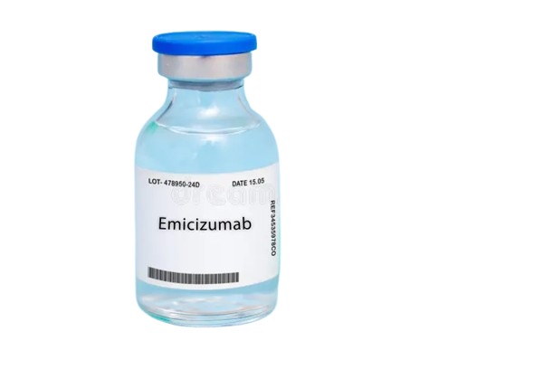
Implementation
Emicizumab has been awarded on National Contract: HP10-2025 supply and deliver of small biological preparations tender: taking effect from 1 January 2025
As an EML item, this product can be accessed for patients meeting the criteria (through hospital or provincial PTCs) on a buy-out basis in the interim until tender takes effect

Slide 21
Monitoring
Monitoring
Utilisation (of both emicizumab and bypassing agents to treat bleeds) and outcomes should be monitored by responsible Pharmaceutical and Therapeutic Committees (PTCs)
Currently the development of a tool is underway to help this process
Gaining data on use can help to support decision making, and indication expansions in the future.
Utilisation dashboards on the National Surveillance Centre are currently in place
Ultimately a comprehensive registry in the haemophilia space should be developed/maintained

Slide 22
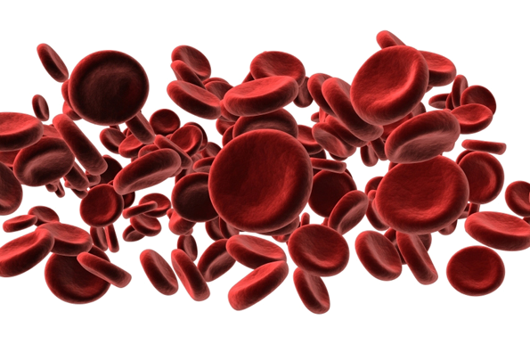
THANK YOU

