Slide 1
Advanced HIV disease & the Liver
Lauren Richards

Slide 2
Outline
Who should get an LFT?
Patterns of liver dysfunction
Hepatocellular
Cholestatic
Isolated hyperbilirubinaemia
Investigations
Management
A quick word on treating hepatitis B

Slide 3
Who should get an LFT?
Anyone with signs & symptoms
Boyles T et al. S Afr J HIV Med. 2024

Slide 4
Who should get an LFT?
Anyone with signs & symptoms
-/+ Prior to TPT or TB
-/+ Hospitalised patients with AHD
Boyles T et al. S Afr J HIV Med. 2024

Slide 5
Patterns of Liver Dysfunction

Slide 6
Clinical Case
46yr male
Works as a driver
HIV +, on TLD*, CD4 130, VL LDL
No other medication/allergies/sober habits
P/w nausea, vomiting, abdominal pain & jaundice x 1/52

Slide 7
POLL 1
Which of these differential diagnoses is not compatible with these symptoms and blood results?
Acute hepatitis A
Non-alcoholic fatty liver disease
Acute hepatitis B
Drug induced liver injury
‘herbal medication’ ingestion

Slide 8
POLL 1
Which of these differential diagnoses is not compatible with these symptoms and blood results?
Acute hepatitis A
Non-alcoholic fatty liver disease
Acute hepatitis B
Drug induced liver injury
‘herbal medication’ ingestion

Slide 9
Hepatocellular dysfunction: ALT/AST > ALP/GGT

Slide 10
Hepatocellular dysfunction: Infectious
VIRUSES
Hepatitis A, B, E
Herpes Viruses: CMV HSV VZV EBV
CD4 <50
May be no rash
RARE
Friedman L. UpToDate. 2022
Friel T. UpToDate. 2022
Johnston C & Wald A. UpToDate. 2021
Nel J. SAHCS. 2016
Schechter S & Lamps L. Arch Pathol Lab Med .2018
Ahmed M et al. J Microsc Ultrastruct. 2021

Slide 11
Hepatocellular dysfunction: Infectious
BACTERIA
“Sepsis syndrome”
TB/NTM
Syphilis
VIRUSES
Hepatitis A, B, E
Herpes Viruses: CMV HSV VZV EBV
Mild $↑$ in enzymes -
Usually in 100’s &
Often as a ‘mixed picture’
Anglaret & Eholie SP. Lancet HIV .2017
Ahuja V. UpToDate. 2022
Crum-Cianflone N et al. Int J STD AIDS. 2009

Slide 12
Hepatocellular dysfunction: Infectious
BACTERIA
“Sepsis syndrome”
TB/NTM
Syphilis
VIRUSES
Hepatitis A, B, E
Herpes Viruses: CMV HSV VZV EBV
Histoplasmosis
Emergomycosis
Cryptococcosis
FUNGI
CD4 < 150
Usually disseminated
Mild $↑$
Mixed picture
Rare manifestation
In the 100’s
Adamian CMC Int. J. STD AIDS. 2022
Baddley JW. UpToDate. 2022
Estifan E et al. Cureus. 2019
Piratvisuth T. J. Gastroenterol. Hepatol. 1999

Slide 13
Hepatocellular dysfunction: Infectious
BACTERIA
“Sepsis syndrome”
TB/NTM
Syphilis
VIRUSES
Hepatitis A, B, E
Herpes Viruses: CMV HSV VZV EBV
Histoplasmosis
Emergomycosis
Cryptococcosis
PROTAZOA
Malaria
FUNGI
SA Malaria Guidelines. 2019

Slide 14
Clinical Case
43yr male
HIV +, on TLD, CD4 180 VL LDL (started 7/12 ago)
PTB and rifafour has been started
Presented with symptoms of a hepatitis after 3 weeks:

Slide 15
POLL 2
Which of these differential diagnoses is not compatible with these symptoms and blood results?
Acute hepatitis A
‘Hepatic adaptation’ to the TB drugs
Acute hepatitis B
Drug induced liver injury
‘herbal medication’ ingestion

Slide 16
POLL 2
Which of these differential diagnoses is not compatible with these symptoms and blood results?
Acute hepatitis A
‘Hepatic adaptation’ to the TB drugs
Acute hepatitis B
Drug induced liver injury
‘herbal medication’ ingestion

Slide 17
Clinical Case
43yr male
HIV +, on TLD, CD4 180 VL LDL (started 7/12 ago)
PTB and rifafour started
Presented with symptoms of a hepatitis after 3 weeks:

Slide 18
Hepatocellular dysfunction : Non-infectious
Drug induced liver injury
ART- NVP, EFV
TB therapy - RIF, INH, PZA
- ETO, BDQ, CFZ, PAS
Fluconazole
Co-trimoxazole
Herbal/traditional
*Hepatic adaptation
Nel J et al. South. Afr. J. HIV Med. 2020
Sonderupa MW et al. Aids. 2016
Jong E et al. S Afr J HIV Med. 2013
Saukkonen. Am J Respir Crit Care Med. 2006

Slide 19
Clinical Case
46yr female
HIV +, on TLD, CD4 130, VL LDL
PTB, started rifafour 3 weeks ago
An LFT was done for an unknown reason, pt asymptomatic:
 | Baseline | Now | Normal
T. Bili | 15 | 35 $↑$ | 5- 21
ALT | 45 | 180 $↑$ | 10- 40
AST | 41 | 60 $↑$ | 15- 40
ALP | 100 | 98 | 52- 128
GGT | 80 | 91 | <68

Slide 20
POLL 3
What is the most likely cause for the elevated liver enzymes in this patient?
Drug induced liver injury (DILI)
Acute hepatitis B
Primary HSV infection
‘Hepatic adaptation’ to the TB drugs
I don’t know

Slide 21
POLL 3
What is the most likely cause for the elevated liver enzymes in this patient?
Drug induced liver injury (DILI)
Acute hepatitis B
Primary HSV infection
‘Hepatic adaptation’ to the TB drugs
I don’t know

Slide 22
Clinical Case
30yr female
HIV +, CD4 5 CrAg neg
P/w 2 week history of diarrhoea, abdominal pain and jaundice
On abdo U/S there are dilated intra-hepatic ducts
 | Value | Normal
T. Bili | 80$↑$ | 5- 21
ALT | 124 $↑$ | 10- 40
AST | 168 $↑$ | 15- 40
ALP | 954 $↑$ | 52- 128
GGT | 898 $↑$ | <68

Slide 23
POLL 4
What is the most likely diagnosis?
Cholangiopathy secondary to cryptosporidiosis
Acute hepatitis B
Paracetamol toxicity
Acute hepatitis E
I don’t know

Slide 24
POLL 4
What is the most likely diagnosis?
Cholangiopathy secondary to cryptosporidiosis
Acute hepatitis B
Paracetamol toxicity
Acute hepatitis E
I don’t know

Slide 25
Cholestatic dysfunction: ALP/GGT > ALT/AST
 | Value | Normal
T. Bili | 80$↑$ | 5- 21
ALT | 124 $↑$ | 10- 40
AST | 168 $↑$ | 15- 40
ALP | 954 $↑$ | 52- 128
GGT | 898 $↑$ | <68

Slide 26
Cholestatic dysfunction: Infectious
BACTERIA
TB/NTM
Ahuja V. UpToDate. 2022

Slide 27
Cholestatic dysfunction: Infectious
BACTERIA
TB/NTM
Histoplasmosis
Emergomycosis
Cryptococcosis
FUNGI
Adamian CMC . International Journal of STD & AIDS. 2022
Baddley JW. UpToDate. 2022
Estifan E et al. Cureus. 2019

Slide 28
Cholestatic dysfunction: Infectious
BACTERIA
TB/NTM
Histoplasmosis
Emergomycosis
Cryptococcosis
PROTAZOA
Cryptosporidiosis
FUNGI
CD4 <100
Afdhal NH & Ghandi RT. UpToDate. 2021
Chen XM & LaRusso NF. Semin. Liver Dis. 2002

Slide 29
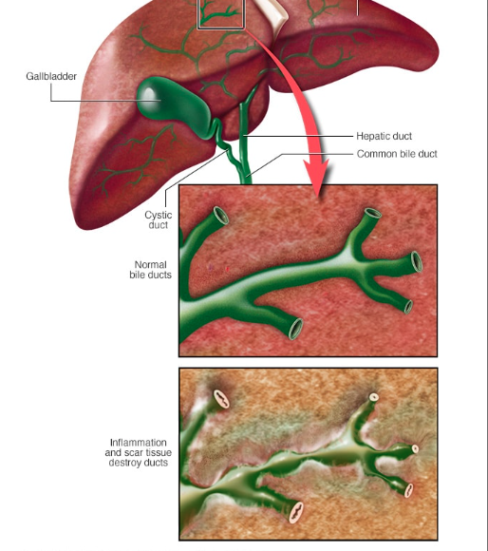
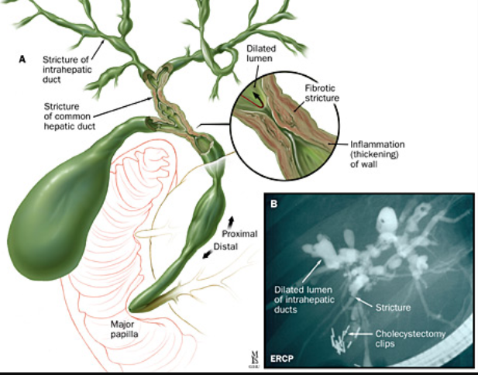
Cholestatic dysfunction: Infectious
BACTERIA
TB/NTM
Histoplasmosis
Emergomycosis
Cryptococcosis
PROTAZOA
Cryptosporidiosis
FUNGI
Johns Hopkins Medicine. Primary sclerosing cholangitis
Mayo clinic. Primary sclerosing cholangitis

Slide 30
Clinical Case
55yr female
HIV +, CD4 194 on TLD
Obese, T2DM and hypertension
COPD on azithromycin prescribed by pulmonologist
LFT done as she had hepatomegaly on examination
 | Value | Normal
T. Bili | 18 | 5- 21
ALT | 55 $↑$ | 10- 40
AST | 30 $↑$ | 15- 40
ALP | 555 $↑$ | 52- 128
GGT | 438 $↑$ | <68

Slide 31
POLL 5
Which diagnosis is not compatible with the patient?
Cholangiopathy secondary to cryptosporidiosis
Cholestatic LFT secondary to azithromycin
Non-alcoholic fatty liver disease
I don’t know

Slide 32
POLL 5
Which diagnosis is not compatible with the patient?
Cholangiopathy secondary to cryptosporidiosis
Cholestatic LFT secondary to azithromycin
Non-alcoholic fatty liver disease
I don’t know

Slide 33
Cholestatic dysfunction: Non-Infectious
Metabolic dysfunction-associated steatotic liver disease or MASLD (previously NAFLD)
Sherman KE et al. Hepatology. 2015
Nel J et al. South. Afr. J. HIV Med. 2020
Cainelli F & Vento S. Lancet. 2015
CM Wilcox. UpToDate. 2022

Slide 34
Cholestatic dysfunction: Non-Infectious
MASLD
Malignancy
-Non-hodgkins lymphoma
-Kaposi sarcoma
Drugs
-Cotrimoxazole
-Amoxil/clavulanate
-Macrolides
Kaplan, LD & Ai W. UpToDate. 2022
Poles MJ. Acquir Immune Defic Syndr. 1996
Bonacini M. Am. J. Med. 1992
NDOH. Hospital level STG and EML. 2019

Slide 35
Liver dysfunction: IRIS
“An exaggerated inflammatory reaction to a disease-causing microorganism that sometimes occurs when the immune system begins to recover following treatment with ARV drugs.”
TB: Typically a ‘Mixed picture’ LFT
Features more suggestive of TB-IRIS
Temporal relationship with ART
TB-IRIS features in other organs
Cholestatic enzymes > with preserved synthetic fxn
https://clinicalinfo.hiv.gov/en/glossary/immune-reconstitution-inflammatory-syndrome-iris
Jong et al. S Afr J HIV Med 2013
M. Lanzafame et al. J. Clin. Tuberc. Other Mycobact. Dis. 2016
Boyles, T et al. SAHCS guidelines for hospitalized adults with advanced HIV disease. 2022

Slide 36
Isolated hyperbilirubinaemia
Atazanavir
Malaria
Nel J et al. South. Afr. J. HIV Med. 2020

Slide 37
Investigations
Thorough history & examination
NDOH. Hospital level STG and EML. 2019
Govender NP. S Afr J HIV Med. 2019

Slide 38
Investigations
Thorough history & examination
Full LFT
Pregnancy test for ♀︎
INR
CD4 count
CXR
Abdominal U/S
NDOH. Hospital level STG and EML. 2019
Govender NP. S Afr J HIV Med. 2019

Slide 39
Management
Stop/hold all hepatotoxic drugs
Supportive care:
Monitor HGTs and other vitals
If encephalopathy: low protein diet
If liver failure: Lactulose 10-30ml tds
Vitamin K or FFPs if bleeding
Cholestyramine
Consult GIT/ID/surgery
NDOH. Hospital level STG and EML. 2019

Slide 40
Who to refer?
Anyone with clinical jaundice (urgent)
Suspected or proven DILI
Suspected liver failure
ALT > 2.5 x ULN (> 100 IU/L)
NDOH. Hospital level STG and EML. 2019
NDOH. Primary healthcare STG and EML. 2020

Slide 41
What to do prior to referral?
Stop hepatotoxic drugs
Check vitals especially serum glucose

Slide 42
Clinical Case
27yr male
HIV +, CD4 20 not on ART
Chronic hepatitis B infection
Creat 120, eGFR 44
ALT 32

Slide 43
POLL 6
Choose the correct answer:
This patient should be started on ALD
Treatment for the chronic hep B only needs to be started when the ALT becomes abnormal
This patient should be started on TAF, FTC, DTG
This patient should be started on TLD
I don’t know

Slide 44
POLL 6
Choose the correct answer:
This patient should be started on ALD
Treatment for the chronic hep B only needs to be started when the ALT becomes abnormal
This patient should be started on TAF, FTC, DTG
This patient should be started on TLD
I don’t know

Slide 45
Hepatitis B
Chronic Hep B always needs to be treated in PLWHIV
ART drugs with anti-HBV activity are TDF/TAF + 3TC/ FTC
- TDF eGFR >50
- TAF e GFR 15-30 + on HD
Nel J et al. South. Afr. J. HIV Med. 2020
Nel J et al. SAHCS ART guidelines 2023

Slide 46
POLL 6
Choose the correct answer:
This patient should be started on ALD
Treatment for the chronic hep B only needs to be started when the ALT becomes abnormal
This patient should be started on TAF, FTC, DTG
This patient should be started on TLD
I don’t know

Slide 47
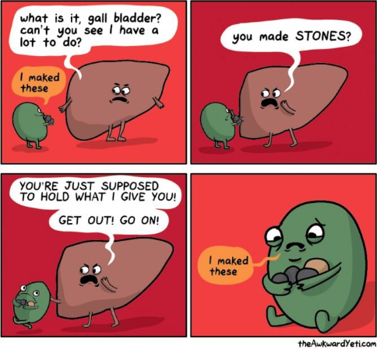
Cholestatic dysfunction: Infectious
BACTERIA
TB/NTM
Histoplasmosis
Emergomycosis
Cryptococcosis
PROTAZOA
Cryptosporidiosis
FUNGI

